Slide 1
“Deep Genomics”
Interpreting non-coding regions
(05/17/21)
Today’s schedule:
Interpreting non-coding variants (machine learning)
Break
Other deep learning applications in genomics
Announcements:
JC4 Wednesday
Group directories on datahub
PS4 due Friday

Slide 2
Outline
Why look at the non-coding genome?
Lay-person intro to deep learning
Application to interpreting non-coding variants
Other deep learning applications in genomics

Slide 3

Going from genotype to phenotype
AACGGCTACTACTGGTACAGCACTACGGTGCATAGGCTTATATAA
AACGGCTACTACTGGTACAGCAGTACGGTGCATAGGCTTATATAA
????
Notes:
TODO: show genetic variant
How figure out what it does?

Slide 4
For the exome, we have a “code”
DNA -> RNA -> Protein
I
I
F
G
V
rs113993960
GAAAATATCATCTTTGGTGTTTCC
GAAAATATCAT---TGGTGTTTCC
But… only <2% of the genome is protein-coding!
Vast majority of the genome is intergenic or intronic, where these rules don’t apply.
Notes:
TODO: show code
But… this is only 2% of the genome. Rest is intergenic or intronic

Slide 5
Moving from exomes to genomes
In rare disease: whole exome studies have success rates of ~10-50%
In common, complex disease: 95% of GWAS hits point to non-coding regions
Obvious next step: let’s look at the non-coding regions!

Slide 6
What are non-coding regions doing?

Slide 7
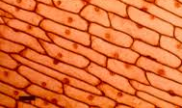
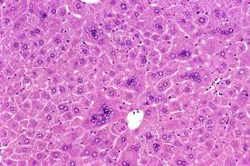
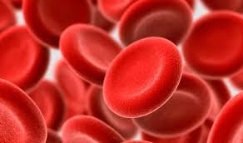
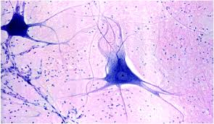
DNA is just the beginning of the story!
DNA ~identical!
Real difference in the proteins, but hard to measure
DNA
RNA
Protein
RNA is a useful intermediate!
~Informative of protein level/sequence
Made from nucleic acids = we can sequence that!
Mutations with phenotypic consequences in many cases are ultimately disrupting protein function or abundance
Notes:
Not just function, but amounts

Slide 8
Non-coding (“regulatory”) regions control expression
Transcription Factors and other proteins bind to the promoter/enhancer DNA and regulate expression of the gene
TF
TF
TF
Exon 1
Exon 2
Exon 3
Exon 4
Promoter: ~+/- 1-3kb from Transcription Start Site (TSS)
TFs often recognize specific sequence motifs
In many cases gene regulation is cell-type specific

Slide 9
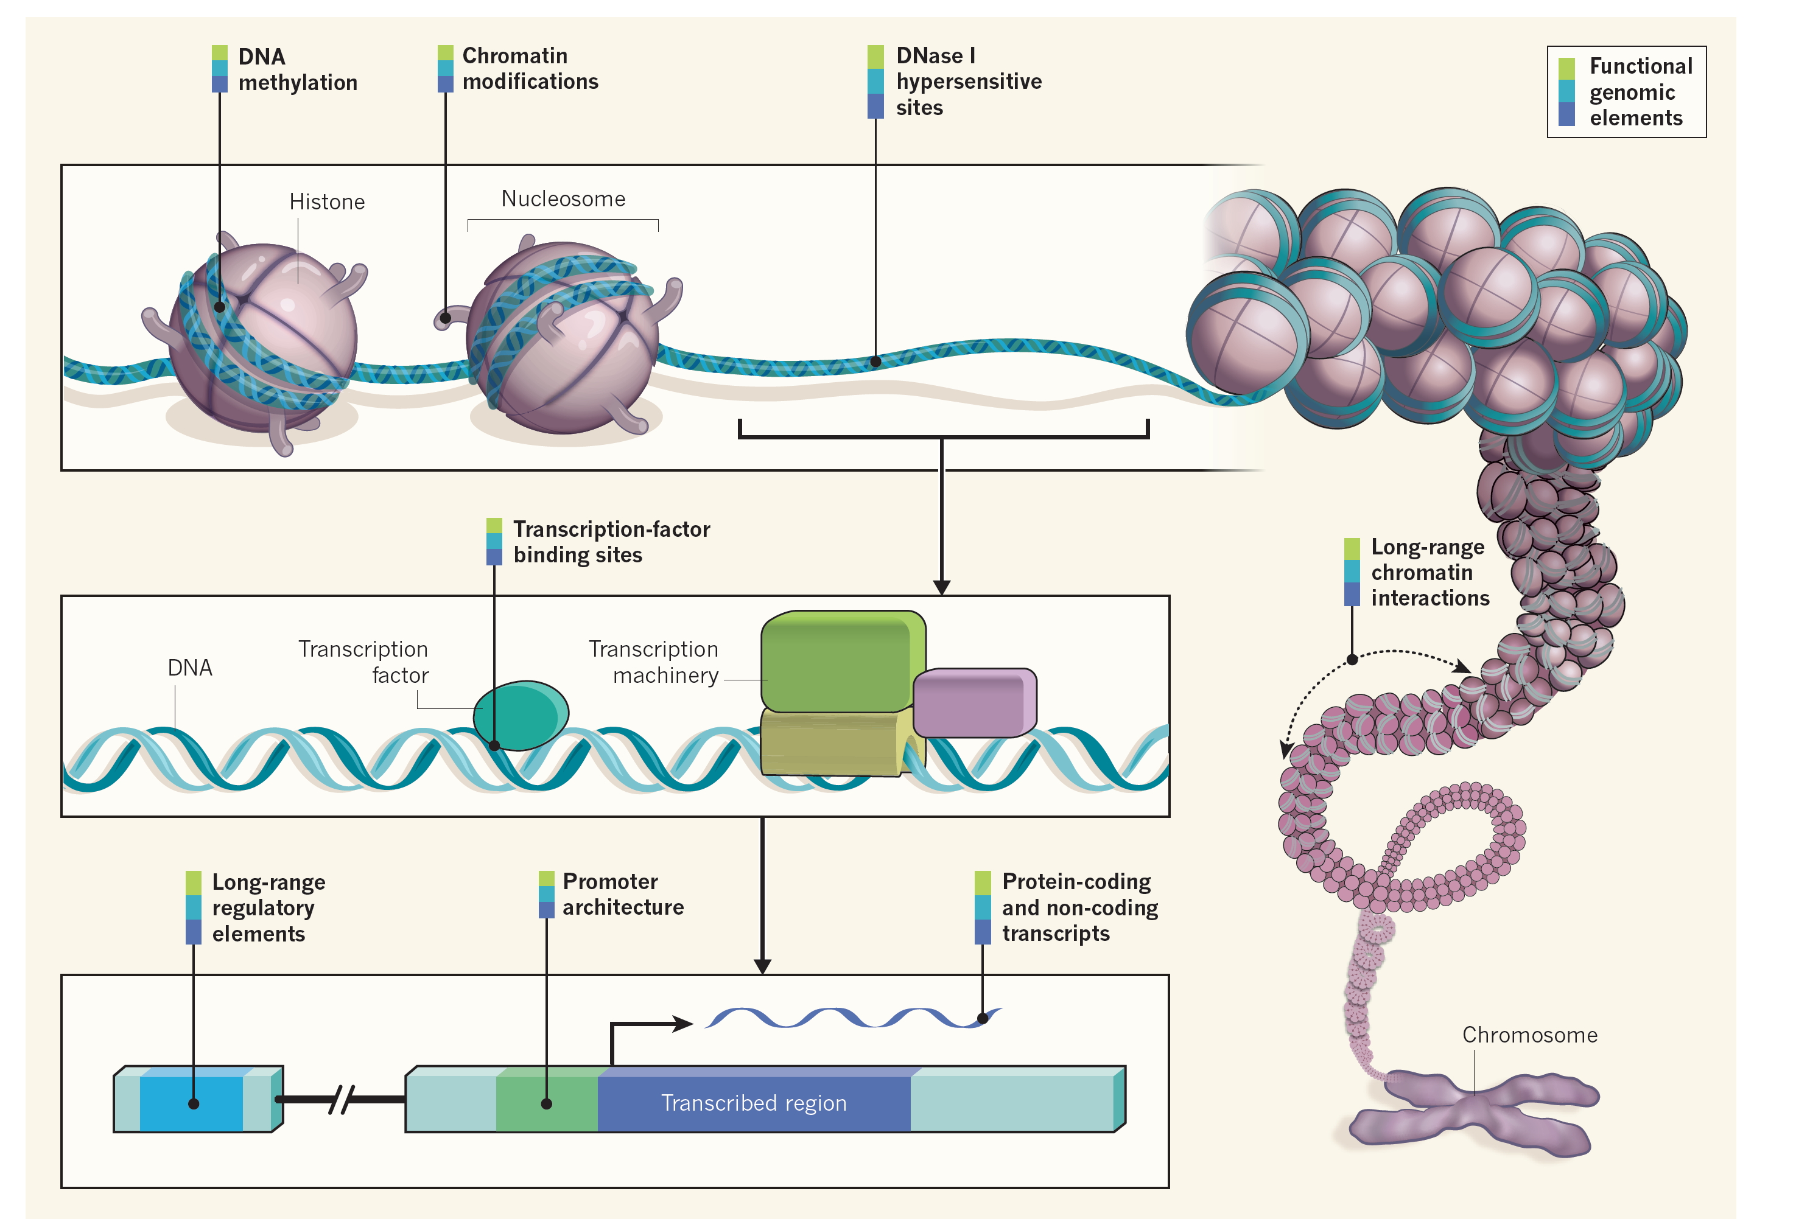
It gets complicated – gene regulation
Promoters: directly upstream of a gene. Typically TSS +/- 3kb (flexible)
Enhancers: may be dozens of kb away. Long-range interaction with TSS to regulate gene expression
Ecker et al., Nature 2012

Slide 10
It gets complicated – alternative splicing
Gene 1
DNA
Exon 1
Exon 2
Exon 3
Exon 4
Isoform 1
mRNA
Isoform 2
Isoform 3
Genes/isoforms can be highly tissue specific
Non-coding signals in introns help regulate splicing

Slide 11
Non-coding mutations can disrupt gene regulation
TF
TF
TF
Exon 1
Exon 2
Exon 3
Exon 4
Alter splicing
Change chromatin accessibility and/or TF binding
Change expression level of nearby gene
Alter 3d genome structure
A growing number of known high impact/pathogenic non-coding mutations
Notes:
TODO: change expression level
Change splicing
Change accessibility
Know many examples of high impact/pathogenic non-coding mutations

Slide 12
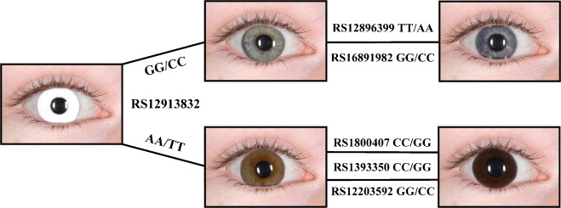
The top SNP for eye color is non-coding
Rs12913832 is in intron of HERC2
OCA2 is probably the causal gene
This SNP is probably regulatory, reduces OCA2 expression
Walsh et al. 2011

Slide 13
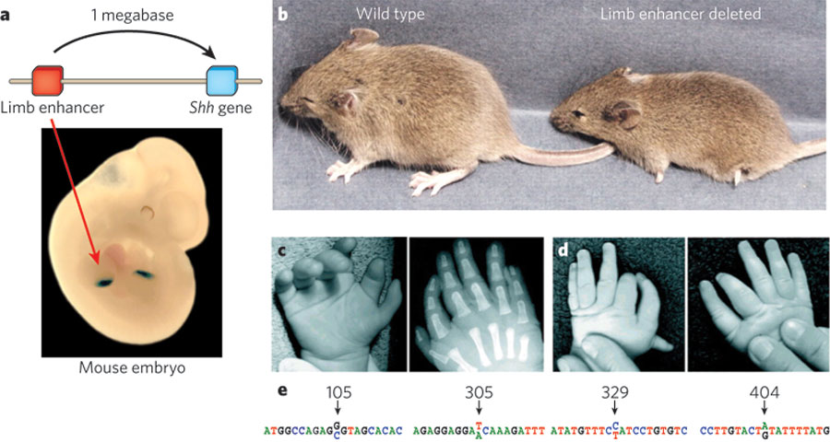
Handful of known non-coding pathogenic variants
Mutations in distal enhancer for SHH cause Preaxial Polydactyly (1Mb away!) [autosomal dominant]
Visel et al. Nature 2009

Slide 14
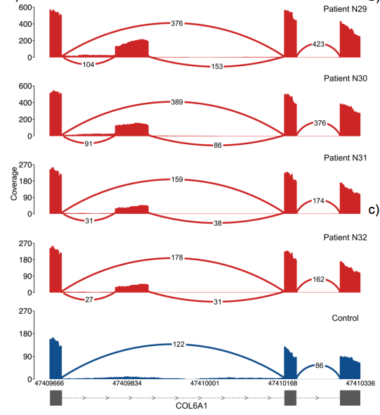
Handful of known non-coding pathogenic variants
A deep intronic mutation in COL6A1 causes external collagen-VI-like dystrophy
Cummings et al. 2016

Slide 15
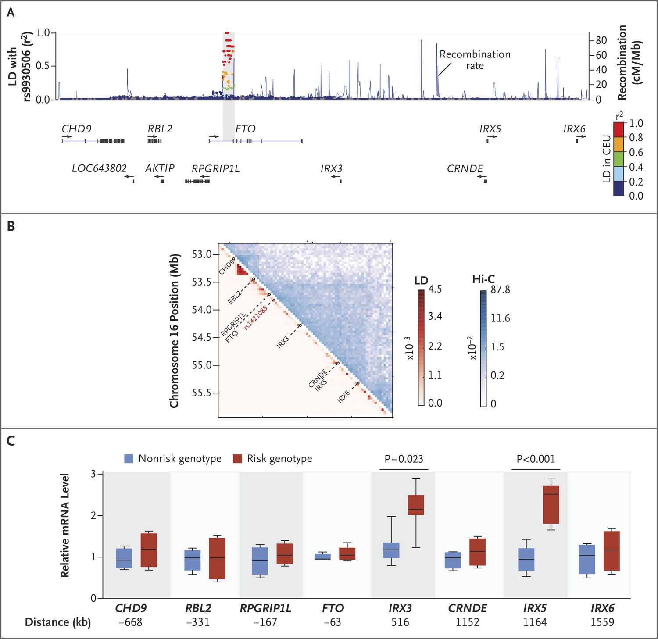
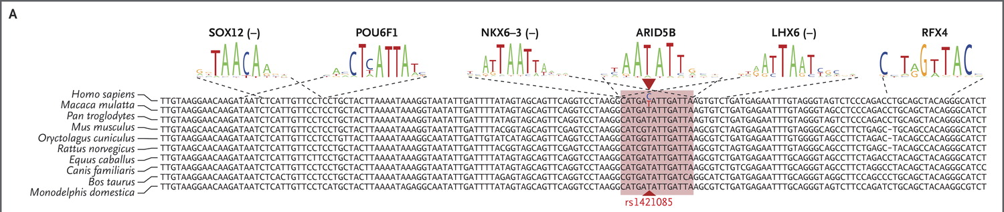
Handful of known non-coding pathogenic variants
A GWAS hit for obesity in FTO actually regulates IRX3, 1.2 megabases away!
Claussnitzer et al. 2015

Slide 16
Using NGS to study gene regulation
Hi-C:
3D genome organization
RNA-seq:
Expression
Splicing
TF
TF
TF
Exon 1
Exon 2
Exon 3
Exon 4
ChIP-seq:
TF binding
Histone modifications
ATAC-seq:
“Open chromatin”
Nucleosome positioning
We can measure these molecular phenotypes in hundreds of people and check for genetic associations
Notes:
TODO:
Rna-seq
Chip-seq
Atac-seq
DNaseI-seq
Hi-c

Slide 17
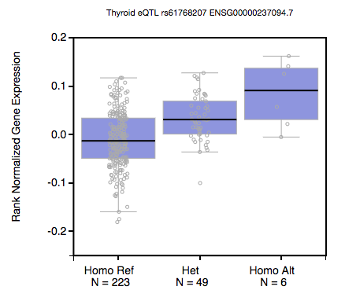
Quantitative trait loci
Quantitative trait locus = a locus whose genotype is associated with a quantitative trait
A/G
GENE

Slide 18
Many flavors of QTLs
TF
TF
TF
eQTL (expression)
spliceQTL
dsQTL (open chromatin)
Expression level
Expression level
Expression level
AA
AG
GG
AA
AG
GG
AA
AG
GG

Slide 19
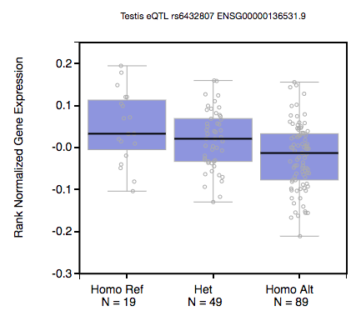
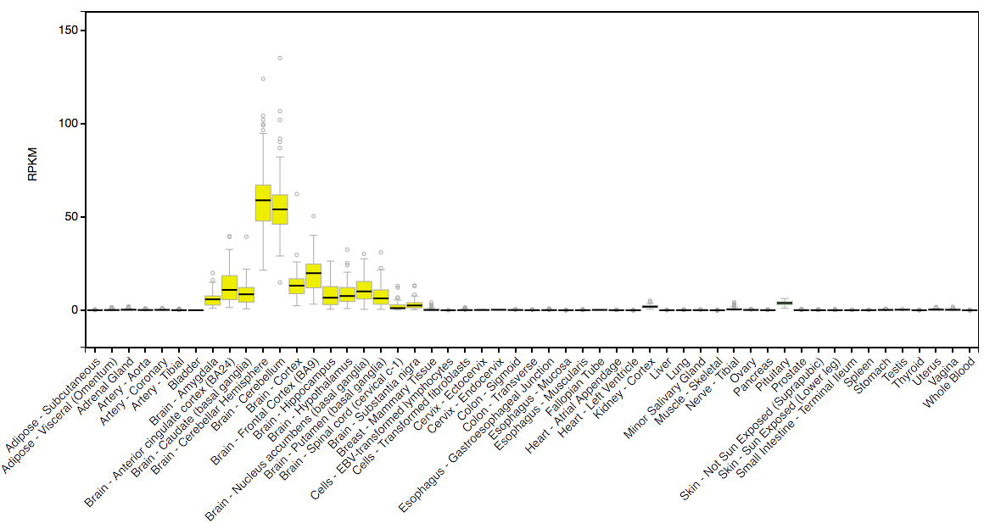
Thousands of tissue-specific QTLs in GTEx
The Genotype-Tissue Expression Project (GTEx)
http://www.gtexportal.org/home/
QTLs come in many flavors!
See also: dsQTLs, crQTLs, splice QTLs, eSTRs, and more
Same idea: is my variant associated with a molecular phenotype?
+ “Test your own”
Notes:
Show gtex for example tissue
Qtl plots
See also: epigenomie roadmap, 4d nucleome
Catalogs of epigenetic etc. data

Slide 20
Going from genotype to phenotype
AACGGCTACTACTGGTACAGCACTACGGTGCATAGGCTTATATAA
AACGGCTACTACTGGTACAGCAGTACGGTGCATAGGCTTATATAA
eQTL (expression)
????
Expression level
QTLs are helpful. But these are just associations
Can we more directly predict the impact of a specific variant?
AA
AG
GG

Slide 21
A lay person’s intro to deep learning for genomics

Slide 22
Goal: can we predict the function of a particular sequence?
?
C A G G C A T T T
Functional (+)
Not functional (-)
C A G G C A T T T
P(Func|C)
-
C A G G A A T T T
P(Func|A)
Δ_{AC}
Notes:
If we had method to predict dnase/chip from seq, can use to compare different variants

Slide 23
Predicting DNAseI HS using machine learning
1
2
3
4
5
Seq1 -> features1 (+)
Seq2 -> features2 (+)
Seq3 -> features3 (-)
Seq4 -> features4 (-)
Seq5 -> features5 (+)
Train
Classifier
Learn features from a single experiment on a given cell type
Classifier acts as an in silico genome editing assay
Notes:
how would this work?

Slide 24
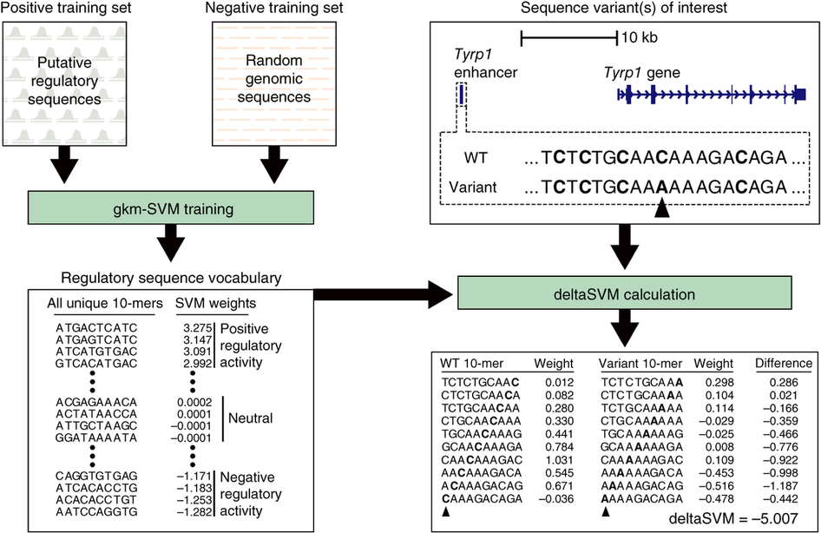
Take 1: kmers+SVM (Example: DeltaSVM)
Lee et al. Nature Genetics 2015

Slide 25
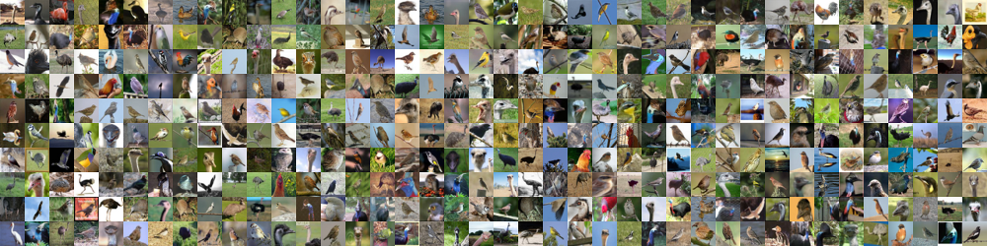
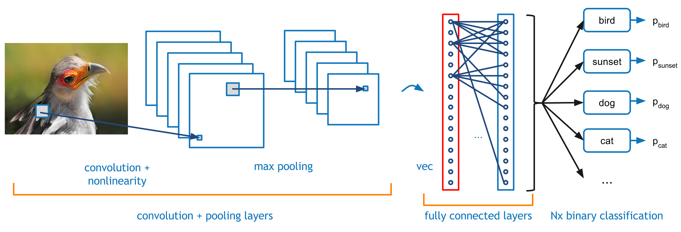
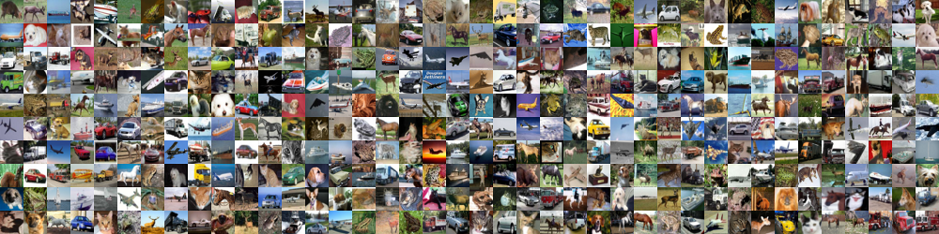
Deep learning outperforms traditional classification methods
Birds:
Not birds:
Notes:
Recently, lots of advances in so called "deep learning" techniques used in the image classification world
overcomes challenge of enumerating the correct features, by learning what those features are
my impression is the advance is that these methods only work when we have tons of data, which we have now

Slide 26
Learning hierarchical sets of features
Low level features learned by initial filters
Features used as input to fully connected layers

Slide 27
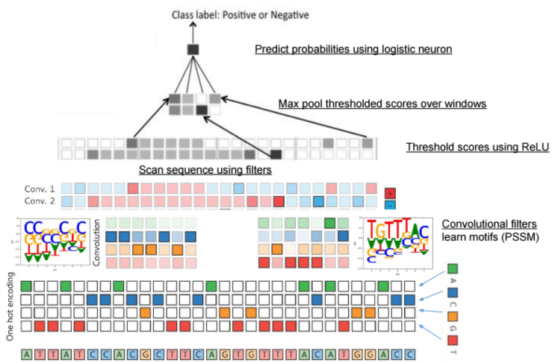
“Deep learning” in the non-coding genome
https://drive.google.com/file/d/0B4Yo77Kh_QeeaXZKQUtZWjNrWkE/view

Slide 28
Turning DNA into an “image”: one hot encoding
A | 0 | 0 | 1 | 0 | 0 | 1 | 0 | 0 | 0 | 1 | 0 | 1 | 1
C | 0 | 1 | 0 | 0 | 0 | 0 | 1 | 1 | 0 | 0 | 0 | 0 | 0
G | 1 | 0 | 0 | 0 | 0 | 0 | 0 | 0 | 1 | 0 | 0 | 0 | 0
T | 0 | 0 | 0 | 1 | 1 | 0 | 0 | 0 | 0 | 0 | 1 | 0 | 0
Input Sequence
G | C | A | T | T | A | C | C | G | A | T | A | A

Slide 29
“Convolutional” neural network: neurons=motifs!
Neuron = “motif” (PWM)! [filter]
A | -5.7 | -3.2 | 3.7 | -3.2 | 3.7 | 0.6
C | 0.5 | -3.2 | -3.2 | -3.2 | -3.2 | -5.7
G | 0.5 | 3.7 | -3.2 | -3.2 | -3.2 | -5.7
T | -5.7 | -3.2 | -3.2 | 3.7 | -3.2 | 0.5
Motif score
Weights=parameters=PWM values
G | C | A | T | T | A | C | C | G | A | T | A | A
A | 0 | 0 | 1 | 0 | 0 | 1 | 0 | 0 | 0 | 1 | 0 | 1 | 1
C | 0 | 1 | 0 | 0 | 0 | 0 | 1 | 1 | 0 | 0 | 0 | 0 | 0
G | 1 | 0 | 0 | 0 | 0 | 0 | 0 | 0 | 1 | 0 | 0 | 0 | 0
T | 0 | 0 | 0 | 1 | 1 | 0 | 0 | 0 | 0 | 0 | 1 | 0 | 0
Input Sequence
(X)

Slide 30
“Convolutions” scan DNA for a match to a motif
Motif match scores
2.1
A | -5.7 | -3.2 | 3.7 | -3.2 | 3.7 | 0.6
C | 0.5 | -3.2 | -3.2 | -3.2 | -3.2 | -5.7
G | 0.5 | 3.7 | -3.2 | -3.2 | -3.2 | -5.7
T | -5.7 | -3.2 | -3.2 | 3.7 | -3.2 | 0.5
Filter
(W)
Score: sum(W*X)
(matrix multiplication)
A | 0 | 0 | 1 | 0 | 0 | 1 | 0 | 0 | 0 | 1 | 0 | 1 | 1
C | 0 | 1 | 0 | 0 | 0 | 0 | 1 | 1 | 0 | 0 | 0 | 0 | 0
G | 1 | 0 | 0 | 0 | 0 | 0 | 0 | 0 | 1 | 0 | 0 | 0 | 0
T | 0 | 0 | 0 | 1 | 1 | 0 | 0 | 0 | 0 | 0 | 1 | 0 | 0
Input Sequence
(X)
G | C | A | T | T | A | C | C | G | A | T | A | A

Slide 31
“Convolutions” scan DNA for a match to a motif
Motif match scores
2.1 | -4.2 |  |  |  |  | …
PWM
(W)
A | -5.7 | -3.2 | 3.7 | -3.2 | 3.7 | 0.6
C | 0.5 | -3.2 | -3.2 | -3.2 | -3.2 | -5.7
G | 0.5 | 3.7 | -3.2 | -3.2 | -3.2 | -5.7
T | -5.7 | -3.2 | -3.2 | 3.7 | -3.2 | 0.5
A | 0 | 0 | 1 | 0 | 0 | 1 | 0 | 0 | 0 | 1 | 0 | 1 | 1
C | 0 | 1 | 0 | 0 | 0 | 0 | 1 | 1 | 0 | 0 | 0 | 0 | 0
G | 1 | 0 | 0 | 0 | 0 | 0 | 0 | 0 | 1 | 0 | 0 | 0 | 0
T | 0 | 0 | 0 | 1 | 1 | 0 | 0 | 0 | 0 | 0 | 1 | 0 | 0
Input Sequence
(X)
G | C | A | T | T | A | C | C | G | A | T | A | A

Slide 32
“Convolutions” scan DNA for a match to a motif
Motif match scores
2.1 | -4.2 | -24 | -17 | -18 | -11 | …
A | -5.7 | -3.2 | 3.7 | -3.2 | 3.7 | 0.6
C | 0.5 | -3.2 | -3.2 | -3.2 | -3.2 | -5.7
G | 0.5 | 3.7 | -3.2 | -3.2 | -3.2 | -5.7
T | -5.7 | -3.2 | -3.2 | 3.7 | -3.2 | 0.5
PWM
(W)
Scan entire sequence to score each position
A | 0 | 0 | 1 | 0 | 0 | 1 | 0 | 0 | 0 | 1 | 0 | 1 | 1
C | 0 | 1 | 0 | 0 | 0 | 0 | 1 | 1 | 0 | 0 | 0 | 0 | 0
G | 1 | 0 | 0 | 0 | 0 | 0 | 0 | 0 | 1 | 0 | 0 | 0 | 0
T | 0 | 0 | 0 | 1 | 1 | 0 | 0 | 0 | 0 | 0 | 1 | 0 | 0
Input Sequence
(X)
G | C | A | T | T | A | C | C | G | A | T | A | A

Slide 33
A neuron is a pattern detector
Motif score, Y=F(X)
Parameters (weights)
Z = w₁x₁+w₂x₂+…+b
w₁
w_{n}
Y = h(Z)
Non-linear transformation (e.g. logistic or ReLu)
G | C | A | T | T | A
X₁
X₂
…
X_{n}
Logistic (sigmoid)

Slide 34
Deep convolutional neural network architecture
Is TF bound?
Motif score
G | C | A | T | T | A | C | C | G | A | T | A | A

Slide 35
Deep convolutional neural network architecture
Is TF bound?
Score many different motifs (filters)
G | C | A | T | T | A | C | C | G | A | T | A | A

Slide 36
Deep convolutional neural network architecture
Output prediction
Is TF bound?
Learn “grammars”
(combinations of motifs)
Score many different motifs (filters)
G | C | A | T | T | A | C | C | G | A | T | A | A

Slide 37
Simplify with “ReLu” and “max pool” layers
https://drive.google.com/file/d/0B4Yo77Kh_QeeaXZKQUtZWjNrWkE/view

Slide 38
ReLu (Rectified Linear Unit) sets low scores to 0
Motif score, Y=F(X)
Parameters (weights)
Z = w₁x₁+w₂x₂+…+b
w₁
w_{n}
Y = h(Z)
Non-linear transformation (e.g. logistic or ReLu)
G | C | A | T | T | A
X₁
X₂
…
X_{n}
Logistic (sigmoid)
ReLu (threshold)

Slide 39
Simplify with”ReLu” and “max pool” layers
https://drive.google.com/file/d/0B4Yo77Kh_QeeaXZKQUtZWjNrWkE/view

Slide 40
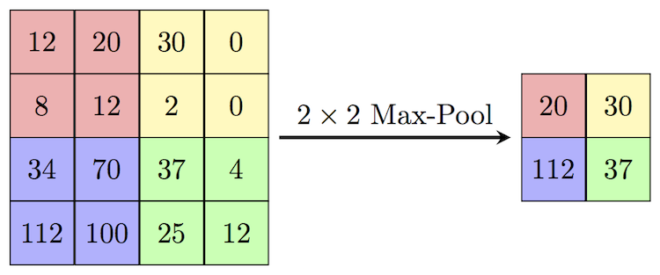
“max pool” combines windows
https://computersciencewiki.org/index.php/File:MaxpoolSample2.png

Slide 41
Multi-class networks borrow info across outputs
Anshul Kundaje

Slide 42
Training CNNs on real data
Goal: Learn parameters (w) via optimization algorithm stochastic gradient descent to minimize loss (difference between true Y and predicted output F(x)
Present samples (x, y) one at a time
Modify weights (w) slightly to increase the log probability of observed y
“Learning rate”
Gradient w.r.t w
Train until loss starts to plateau
Can take a looong time (days or weeks)
Often, pretrained models made available
Anshul Kundaje

Slide 43
Example model - DeepSEA
Web application
Also see:
Basset
DeepBIND
DanQ
DragonNN
AgentBind

Slide 44
DeepSEA model architecture
Model Architecture:
Convolution layer ( 320 kernels. Window size: 8. Step size: 1. )
Pooling layer ( Window size: 4. Step size: 4. )
Convolution layer ( 480 kernels. Window size: 8. Step size: 1. )
Pooling layer ( Window size: 4. Step size: 4. )
Convolution layer ( 960 kernels. Window size: 8. Step size: 1. )
Fully connected layer ( 925 neurons )
Sigmoid output layer
DeepSEA performs multiclass classification to predict 919 features (125 DNaseI features, 690 TF features, 104 histone features) simultaneously
https://blog.bayeslabs.co/2019/07/26/DeepSEA.html

Slide 45
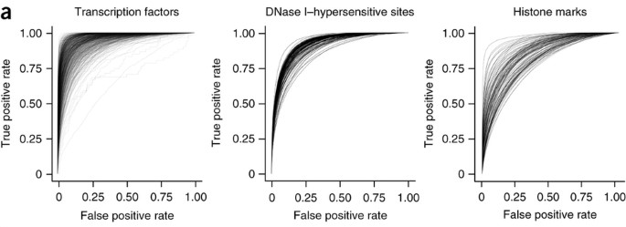
CNNs accurately predict regulatory annotations
Median AUC=0.958
Median AUC=0.923
Median AUC=0.856
gkSVM median AUC=0.896
Zhou and Troyanskaya 2015

Slide 46
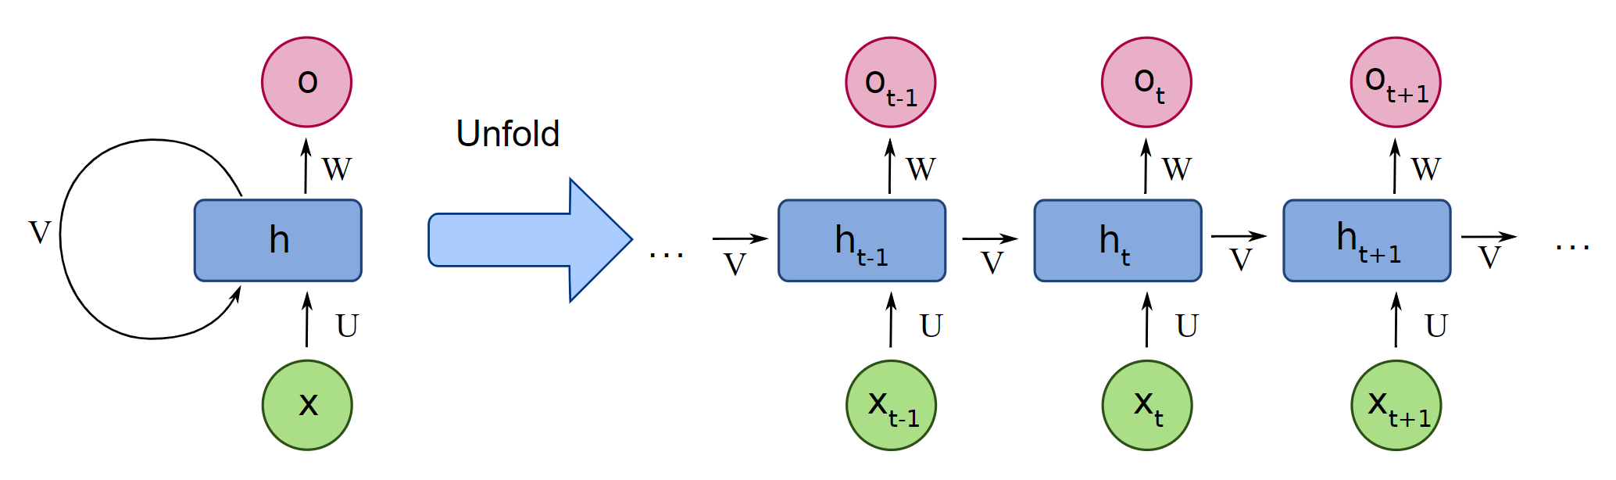
Recurrent neural networks (RNNs)
X: input data
O: output data
H: main block (e.g. LSTM or GRU)
Used to model sequence data (e.g. language translation)
For genomics applications:
  Can capture spatial relationships better than CNNs
  a potential advantage is they don’t require fixed width input
https://medium.com/deeplearningbrasilia/deep-learning-recurrent-neural-networks-f9482a24d010
Notes:
Todo show danq improvement
Rnn/lstm example

Slide 47
LSTM Example - DanQ

Slide 48
Applying CNNs over longer ranges (“Basenji”)

Slide 49
Break
Example applications

Slide 50
Sequence determinants of TF binding

Slide 51
Example application: “to bind of not to bind”
TF
???
TF
TF
TF
DNA
TAGAACATATGTTCGA
AAAAACATATGTTCGA
GAACATTTGTTCGA
A TF motif may exist tens of thousands of time in the genome by chance.
Only a small subset will actually be bound!
Many other factors are important.

Slide 52
Example application: “to bind of not to bind”
Is the motif in “open” vs. “closed” chromatin?
TF
Motif
Motif
TF
Is a “cofactor” required for binding?
TF
TF
Motif
Motif
Is the site blocked by other proteins?
TF
Motif
Motif
Sequence context around the TF motif also important!

Slide 53
Example application: “to bind of not to bind”
Applied to 38 TFs in GM12878.
Huge range in sample size:
>100K training data points for CTCF
<100 training data points for FOS
Zheng, et al 2021

Slide 54
Transfer learning leverages info from other datasets
“Pre-train” on very large DeepSEA dataset
Transfer convolutional layers learned to our network
“Fine-tune” with remaining training samples
Zheng, et al 2021

Slide 55
We can predict binding for most TFs very well
Zheng, et al 2021

Slide 56
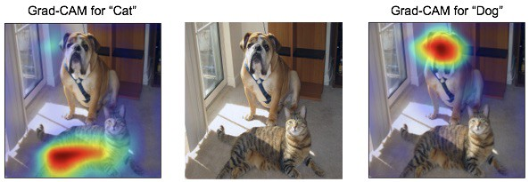
Interpreting the models (Grad-CAM)
We got the answer right, but can we determine which specific features most influenced our prediction?
https://medium.com/@mohamedchetoui/grad-cam-gradient-weighted-class-activation-mapping-ffd72742243a

Slide 57
Scoring the “importance” of each nucleotide
Real sequence:
Zheng, et al 2021

Slide 58
Learning the “rules” of TF binding
These rules are highly cell-type specific!
Zheng, et al 2021

Slide 59
SNPs with high Grad-CAM scores under selection
% singletons based on 1000Genomes
Zheng, et al 2021

Slide 60
Challenge: how you choose the training data matters!
“Baseline” model: choose negative sequences randomly
Largely learns GC content differences. Not very interesting
“GC-controlled” model: match positive and negative sequences on % GC
Largely learns features of “open” vs. “closed” chromatin regions
“DNaseI-controlled” model: only choose positive and negative sequences from “open chromatin” regions
Learns TF-specific binding determinants
Zheng, et al 2021

Slide 61
Challenge: how to deal with indels?
Our network required fixed-length (1kb) sequences as input
Great for modeling effects of SNPs
What about indels? Repeats?

Slide 62
Challenge: how to infer spatial rules?
Grad-CAM told us which bases/motifs are important
It doesn’t tell us about any spatial constraints between different motifs

Slide 63
Using Grad-CAM scores to interpret GWAS variants
Challenge: how to systematically incorporate these scores into GWAS fine-mapping?
Zheng, et al 2021

Slide 64
More applications of deep learning in genomics
Interpreting coding variants (PrimateAI)
Intrepreting splicing variants (spliceAI)
Variant calling (DeepVariant)
And more (e.g. base calling, protein sequencing, splicing efficiency)

Slide 65
Interpreting missense variants - PrimateAI

Slide 66
SpliceAI

Slide 67
DeepVariant
True SNP
True indel (het)
True indel (hom)
Error
https://ai.googleblog.com/2017/12/deepvariant-highly-accurate-genomes.html

Slide 68
More applications of deep learning in genomics
Interpreting coding variants (PrimateAI)
Intrepreting splicing variants (spliceAI)
Variant calling (DeepVariant)
And more (e.g. base calling, protein sequencing, splicing efficiency)

