Slide 1
Long Reads
(05/12/21)
Today’s schedule:
Nanopore
Break
PacBio + Other long read technologies
Personal genomics applications of long reads
Announcements:
JC4 next Weds (5/19)
PS4 due next Friday (5/21)

Slide 2
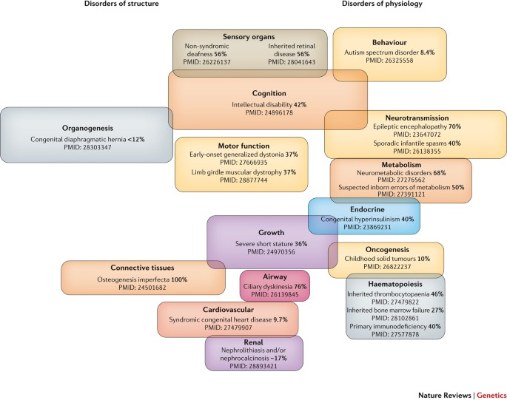
Recall from JC3: NGS left a lot unsolved
Wright, et al. Nature Reviews Genetics

Slide 3
The next frontier: long reads
Illumina (“next generation”)
Genome
Amplify genome
Fragment into ~300bp chunks
Fragments
“Sequencing by synthesis”
~100bp reads
Reads
Long reads (e.g. ONT) (“3rd generation”)
Amplification not required
Takes long (“high molecular weight”) DNA strands as input
Sequences those long strands directly

Slide 4

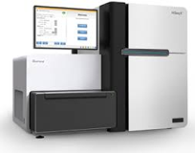

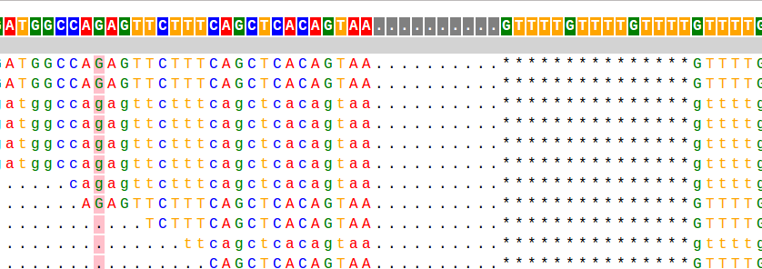
Recall our NGS workflow
1. SEQUENCING
2. ALIGNMENT
Reference
ACGTACGGATATGCGATACGACAT
Reads
All of these things will look a little bit different with long reads!
3. GENOTYPING
4. VISUALIZATION
CCA-CTCTACTCACAC----TAGC
SNPs/Indels
STRs
CCAACGCTACTCACACACACTAGC

Slide 5
Outline
Limitations of short reads
Nanopore sequencing
PacBio
Personal genomics/clinical applications

Slide 6
Short reads can’t resolve complex and repetitive regions
Reference genome
Hard to tell!
Need a read to span all the way across
How many copies of the purple repeat do we have?
(But: see ”GangSTR” and “ExpansionHunter” tools for tricks to deal with this)
Example diseases largely intractable to NGS:
Fragile X Syndrome, ALS, MCKD

Slide 7
Short reads can’t resolve complex and repetitive regions
Duplications/repeat elements/pseudogenes
Copy 1 (1KB)
Copy 2 (1KB)
Genome
Example: SMA (SMN1)
Long repeats
1 unit = 1kb
Genome
Large insertions
Example: Mobile elements
500bp insertion

Slide 8
GC-rich regions still poorly sequenced (even w/ PCR-free data)
Example: FMR1 (CCG) severely underestimated by all existing tools
Also: C9orf72 (CCCCGG)
Fragile X
CCG repeat
GangSTR
ExpansionHunter
TredParse
NA09237
940xCCG
Estimated # CCG
NA04025
645xCCG
True # CCG
Refseq

Slide 9
Long reads allow long-range phasing
Genome
AACAAACCATGACGGATCGGTATGATTCGG
A
G
C
T
Short reads:
CCATGA
TATCATT
CATGGC
ATTATT
ATGACG
TTATTC
TGGCGG
CATTCG
Long reads:
ACCATGACGGATCGGTATTATTC
CATGGCGGATCGGTATCATTCGG

Slide 10
Compound heterozygotes
Cystic Fibrosis (autosomal recessive) E.g. if both copies of the CFTR gene are damaged, cystic fibrosis results
G85E
Compound heterozygote
(affected)
M copy
F copy
Δ508
Short reads
TCTCCTGGAGAGAAACAAA
GAAAATATCATCTTTGGTGTTTCC
TCTCCTGGAAAGAAACAAA
GAAAATATCAT---TGGTGTTTCC
Long reads
TCTCCTGGAGAGAAACAAAACATCACTGAAAATATCATCTTTGGTGTTTCC
TCTCCTGGAAAGAAACAAAACATCACTGAAAATATCAT---TGGTGTTTCC
G85E
Δ508
One complete copy of CFTR
(not affected)
M copy
F copy
Short reads
TCTCCTGGAGAGAAACAAA
GAAAATATCATCTTTGGTGTTTCC
TCTCCTGGAAAGAAACAAA
GAAAATATCAT---TGGTGTTTCC
Long reads
TCTCCTGGAGAGAAACAAAACATCACTGAAAATATCAT---TGGTGTTTCC
TCTCCTGGAAAGAAACAAAACATCACTGAAAATATCATCTTTGGTGTTTCC

Slide 11
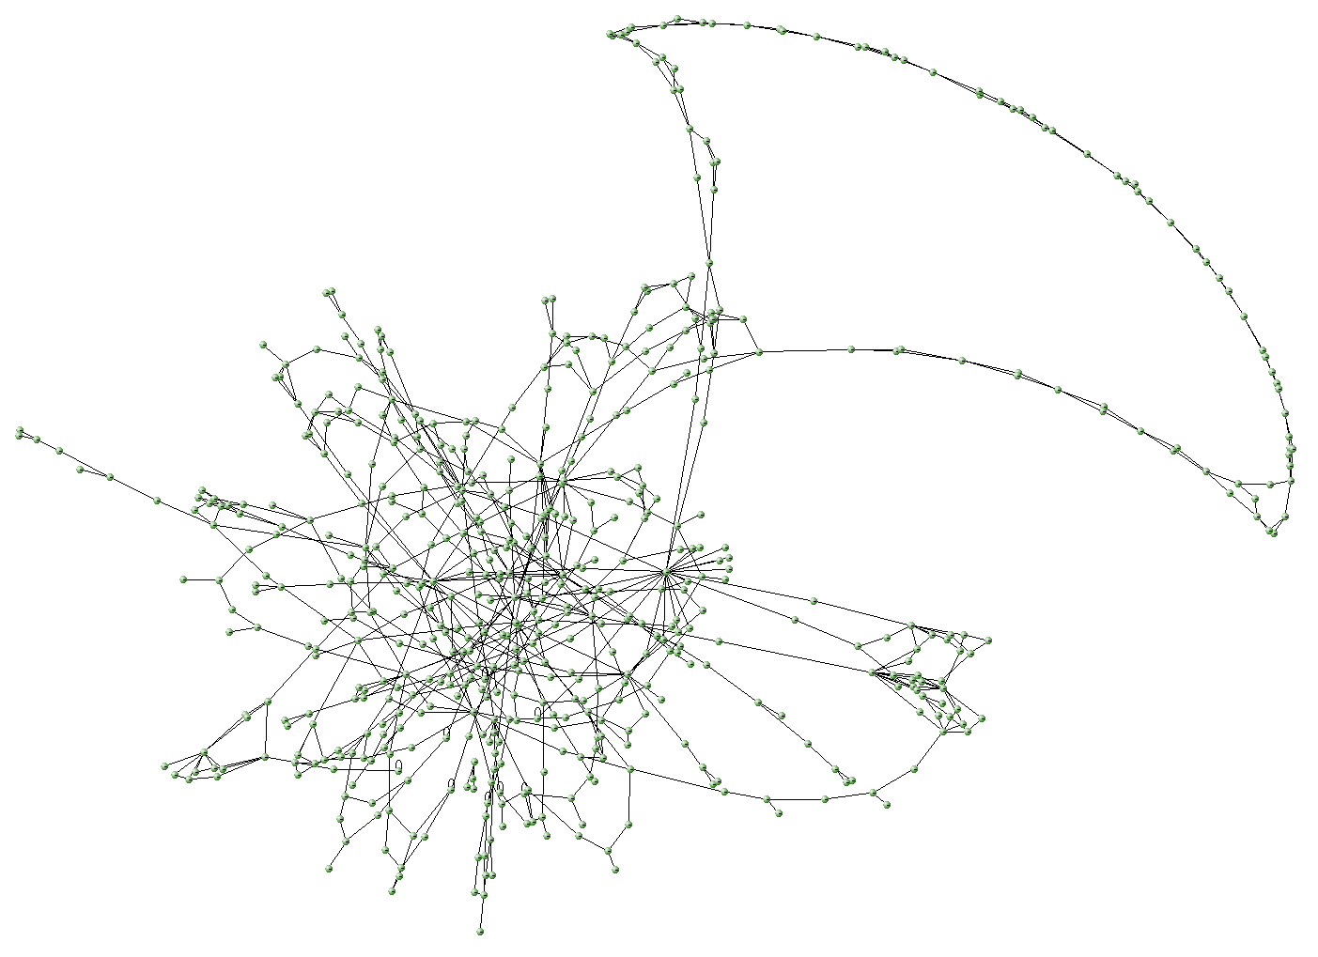
Long reads allow more complete genomes
Vs.
Short read assembly
Long read assembly

Slide 12
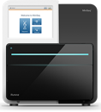
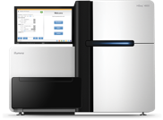
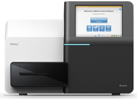
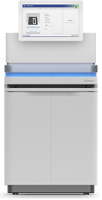
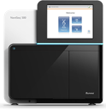
Illumina read length has grown over time
Initial read lengths of 2x36, 2x50, 2x76 from Genome Analyzer or GAII (e.g. 2010)
Currently, most common read lengths 100-150bp
Modern-day Illumina read lengths:
MiniSeq: 2 x 150bp
HiSeq: 2 x 150bp
MiSeq: 2 x 300bp
Novaseq: 2 x 300bp
NextSeq: 2 x 150bp

Slide 13
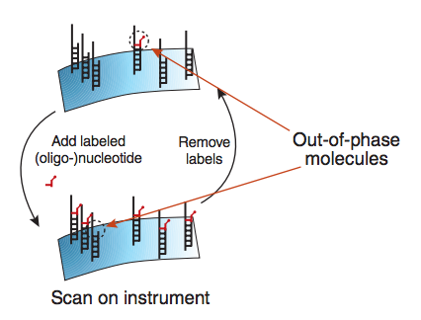
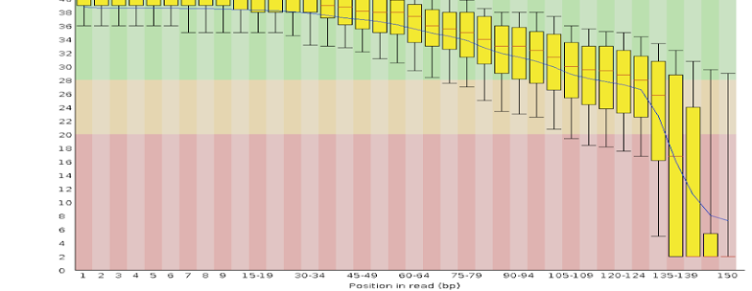
What limits Illumina read lengths?
Recall: Illumina using “sequencing by synthesis”, imaging each base pair as it’s added
Sequencing is done on “clusters” of ~1000 copies of a molecule at once
Eventually some molecules will start to get out of phase, increasing noise and limiting ability to read further
Base quality
Position in read
Fuller et al. 2009

Slide 14
Sequencing – then and now
2000s
Other systems: ABI SOLID, Ion Torrent
Long reads!
1977
Sanger Sequencing
1990
Human Genome Project
started
2003
HGP
completed
~2017
$1,000 Genome
2007
Illumina/Solexa
~1980
Shotgun sequencing
~2020
PacBio Hifi
ONT
2005
First NGS system
(454, Roche)
36bp
75bp
101bp
150bp
100KBp
Read lengths
Notes:
let's revisit our timeline about the history of sequencing technology and see where we are now
long read technologies have been around for 10 years or more. but only recently in the last several years have they become good enough in terms of throughput and accuracy to be widely useaable.
so we'll add long reads to our timeline here spanning the last several years where they have really taken off
also added down here the change in read lengths over time
10 years ago we were dealing with 36bp reads
we'll see today technologies that can give us 100Kbp reads!

Slide 15
Long read approaches
Actually sequencing long reads…
  Nanopore
  PacBio
“Synthetic” long reads: Use some tricks to get long read information out of traditional short reads
  Illumina Moleculo
  10X Genomics
http://www.slideshare.net/mkim8/a-comparison-of-ngs-platforms/7

Slide 16
The next frontier: long reads
Illumina (“next generation”)
Genome
Amplify genome
Fragment into ~300bp chunks
Fragments
“Sequencing by synthesis”
~100bp reads
Reads
Long reads (“3rd generation”)
“Single molecule sequencing” (SMS)
Amplification not required
Takes long (“high molecular weight”) DNA strands as input
Sequences those long strands directly

Slide 17
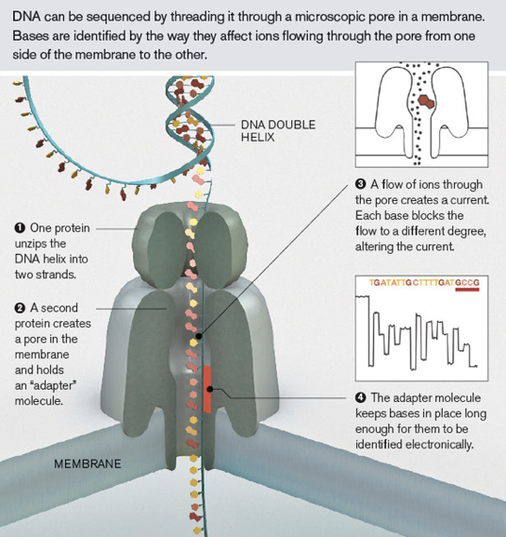
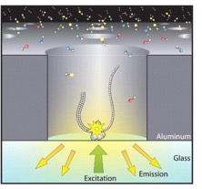
Two major long read technologies
ONT (Oxford Nanopore Technologies)
Pacific Biosciences (PacBio)
Notes:
two major players in the long read game
both have different advantages and disadvantages
we'll give an overview of how each of these work
first is Nanopore, or ONT
second is PacBio

Slide 18
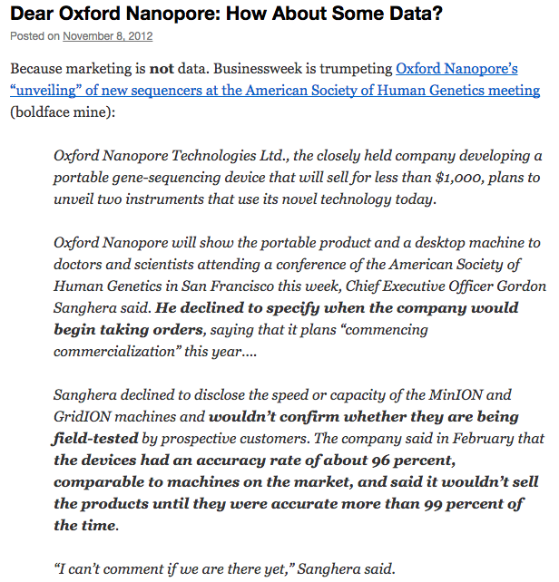
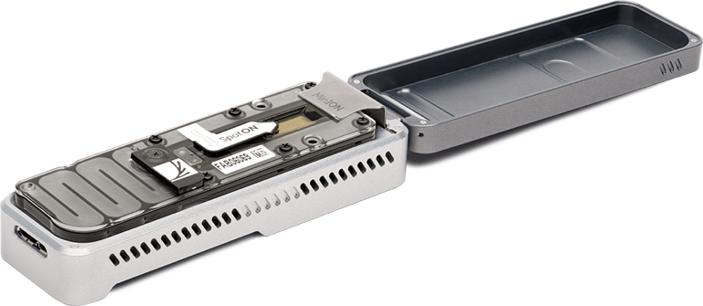
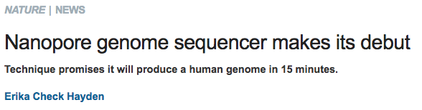
First came the hype…
In 2012 we were promised a system:
Sequencer the size of a USB stick
Long reads (over 100kb)
Produce a human genome in 15 minutes for <$1000!

Slide 19
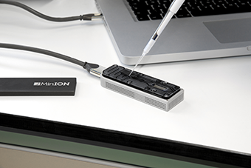

Eventually, Nanopore is delivering
2013… 2014… (some data) … 2015… (better chemistry) … 2016… more improvements … 2020!
Literally pocket-sized
10 minute sample prep
Real-time analysis as DNA read through nanopores
Reads are dozens of kb long
http://www.21stcentech.com/gizmos-gadgets-dna-testing-field/

Slide 20
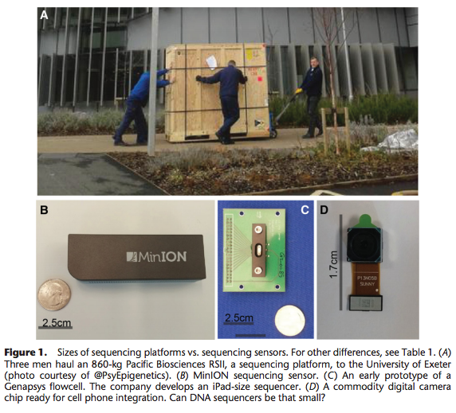
The MinION is literally a USB stick
Erlich 2016 Genome Research

Slide 21

Nanopore sequencing
http://www2.technologyreview.com/news/427677/nanopore-sequencing/

Slide 22
Nanopore sequencing – the flowcell
Tether
Flow of ions through the pore
Nanopore
membrane
https://www.youtube.com/watch?v=RcP85JHLmnI
Notes:
TODO draw nanopore on the membrane. Show tether
Animate DNA coming with an adapter molecule that allows it to attach to the pore

Slide 23
Nanopore sequencing
Motor protein
DNA to sequence
Adapter sequence
Each base disrupts the ion flow in a characteristic way
A
G
T
T
G
C
G
“Trace” – contains ionic current signal of a sequence of nucleotides as it’s threaded through the pore
A
Notes:
TODO draw nanopore on the membrane. Show tether
Animate DNA coming with an adapter molecule that allows it to attach to the pore

Slide 24
Nanopore sequencing
https://www.youtube.com/watch?v=GUb1TZvMWsw
Notes:
https://www.youtube.com/watch?v=GUb1TZvMWsw

Slide 25
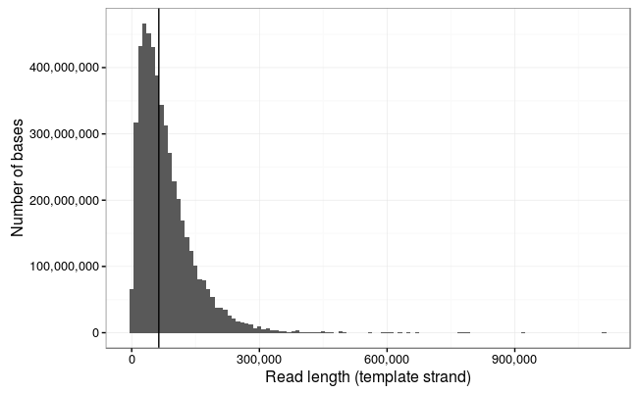
You can get *really* long reads
Note: variable read lengths.
Not like Illumina, where we have a fixed number of “cycles”
!!!
https://lab.loman.net/2017/03/09/ultrareads-for-nanopore/

Slide 26
But… they are really messy
Notes:
https://www.youtube.com/watch?v=GUb1TZvMWsw

Slide 27
ONT – example SAM line
Notes:
https://www.youtube.com/watch?v=GUb1TZvMWsw

Slide 28
Basecalling
ONT error rate is high (10-15% per base error rate)
Unlike for Illumina, base calling for ONT is still very actively improving
Why is it so hard?
  The size of the nanopore is bigger than 1 base. Each signal is an aggregate of multiple adjacent nucleotides
  The DNA doesn’t move at a constant rate (avg. 450bp/sec). Might skip bases by accident, leading to indel errors.
Notes:
https://www.youtube.com/watch?v=GUb1TZvMWsw

Slide 29
Basecalling – has gotten better
Improvements coming from:
Chemistry improvements
Basecalling algorithm improvements
Notes:
https://www.youtube.com/watch?v=GUb1TZvMWsw

Slide 30
Basecalling – chemistry improvements
R9 pore:
3bp in the pore at a time
64 possible k-mers we need to learn squiggles for
R7 pore:
~6bp in the pore at a time
4,096 possible k-mers we need to learn squiggles for
Notes:
https://www.youtube.com/watch?v=GUb1TZvMWsw

Slide 31
Basecalling – algorithm improvements
Transducer deal with homopolymer issue
Early algorithms based on HMMs
Later based on RNNs (deep learning)
Notes:
https://www.youtube.com/watch?v=GUb1TZvMWsw

Slide 32
Basecalling – HMMs (again!)
States: all possible k-mers
Emission probabilities: based on pore models
Transition probabilities: determined from training data
Viterbi decoding to determine most probable sequence
Notes:
https://www.youtube.com/watch?v=GUb1TZvMWsw

Slide 33
RNN based methods outperform HMMs
RNNs: “recurrent neural networks” can perform ”sequence to sequence” translation (e.g. language translation)
Here, convert “squiggles” to “sequence”
Doesn’t rely on fixed kmer length
Multiple variations. But most recent basecallers use some kind of RNN (MinKNOW is the one distributed with ONT).
Notes:
https://www.youtube.com/watch?v=GUb1TZvMWsw

Slide 34
Remaining challenge - homopolymers
Homopolymer sequences (e.g. AAAAAAAAA) are challenging
  Consecutive k-mers are identical
  DNA not moving through the nanopore at a constant rate, hard to tell how many times the consecutive kmer is repeated
A new “transducer” neural network method is supposed to greatly reduce homopolymer errors
Current error rates around 5-10% (vs. <1% for Illumina)
Notes:
https://www.youtube.com/watch?v=GUb1TZvMWsw

Slide 35
Assembling whole genomes with ONT
Large chunks of healthy genomes missing from reference assemblies based on shorter reads!
Notes:
https://www.youtube.com/watch?v=GUb1TZvMWsw

Slide 36
Calling SVs from ONT
https://www.ncbi.nlm.nih.gov/pmc/articles/PMC5990442/
Notes:
https://www.youtube.com/watch?v=GUb1TZvMWsw

Slide 37
Calling SVs from ONT – example pipeline
Alignment
SV calling
https://www.ncbi.nlm.nih.gov/pmc/articles/PMC5990442/
Notes:
https://www.youtube.com/watch?v=GUb1TZvMWsw

Slide 38
Calling SNPs from ONT
Notes:
https://www.youtube.com/watch?v=GUb1TZvMWsw

Slide 39
Other ONT applications
Key = different molecules passing through the pore make different squiggle patterns!
We saw DNA sequencing as an example
Can also sequence:
  Base modifications (e.g. DNA methylation)
  Native RNA
  Maybe even proteins (seems possible. Would be a *huge* deal)
A
G
T
T
G
C
G
A
Notes:
https://www.youtube.com/watch?v=GUb1TZvMWsw

Slide 40
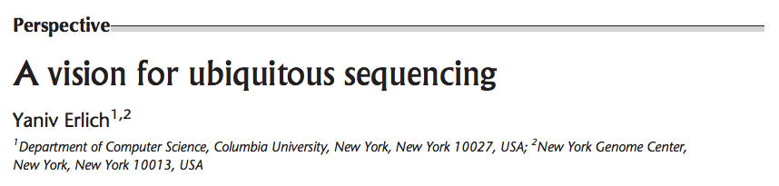
“Ubiquitous sequencing”
Sequencing “sensors”: miniaturized sequencers with automated sample-prep, enabling sequencing in the field
Sequencing at home (e.g., monitor water supply for pathogens, in toilets to monitor microbiome)
Diagnosing infectious disease (e.g. at-home diagnosis)
Testing for pathogens in food
Forensics and security applications (e.g. at airports, or sequencing on the spot at crime scenes)

Slide 41
Short vs. long reads
Accuracy
Illumina
99.9%
Very long reads
Give big picture
But low per-base accuracy
Short but very accurate reads
ONT
~80%
0
Read length (kb)
50kb
* Note the numbers on this graph are very rough approximations. The numbers are changing all the time…
Notes:
TODO: short vs. long reads
X-axis: length
Y-axis: accuracy
Show ILMN vs. ONT
https://www.pacb.com/smrt-science/smrt-sequencing/hifi-reads-for-highly-accurate-long-read-sequencing/

Slide 42
Break

Slide 43
Two major long read technologies
ONT (Oxford Nanopore Technologies)
Pacific Biosciences (PacBio)

Slide 44
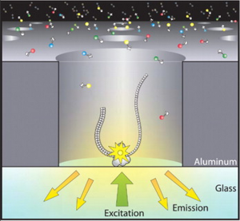
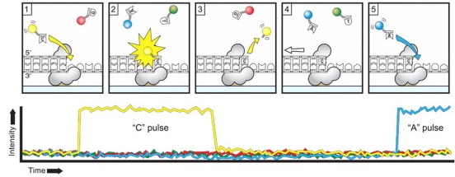
PacBio technology
DNA polymerase bound to bottom of wells
Feed in single-stranded DNA and fluorescently labeled nucleotides
Record bases being incorporated in real time
“SMRT”: single-molecule real-time sequencing
First released ~2011
http://chrisamiller.com/science/tag/sequencing/

Slide 45
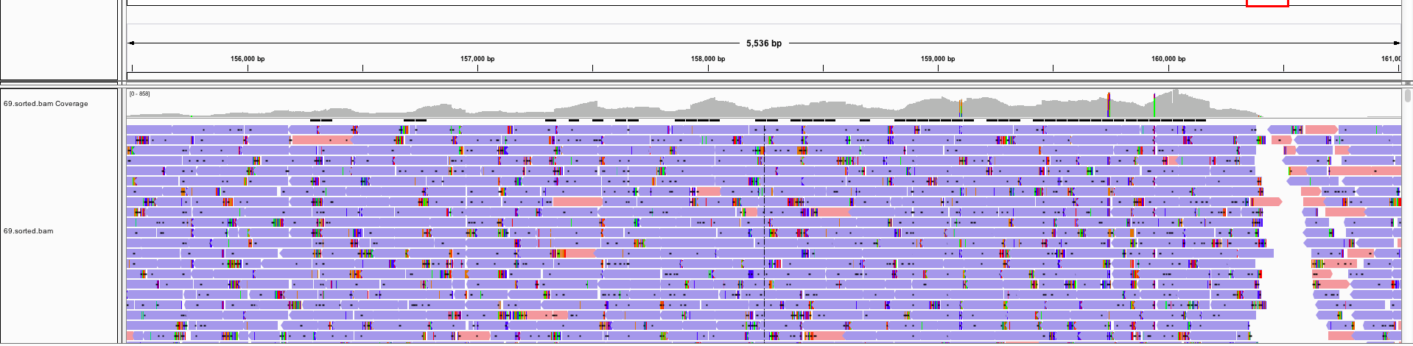
PacBio – Error rate (early data)
Example IGV screenshot of PacBio reads:
In earlier data, really high error rate (~17%), frequent random errors
http://biostar40.rssing.com/chan-9396846/all_p18.html

Slide 46
PacBio generates “circular” reads
Adapter
Adapter
Fragment of interest (many kb)
Sequence around the circle
Notes:
99.9% accuracy
Two modes of pacbio sequencing
https://www.slideshare.net/GenomeInABottle/giab-grc-workshop-ashg-2019-billy-rowell-evaluation-of-v4-with-ccs-gatk
https://www.pacb.com/smrt-science/smrt-sequencing/
CCS (hifi) vs. CLR
Tradeoff of accuracy vs. read length

Slide 47
PacBio can be run in two modes
“Continuous Long Read Sequencing”
(CLR)
“Circular Consensus Sequencing”
(CCS, or “Hifi”)
Subread 1
Long read 1
Long read 2
Subread n
Long read 3
Hifi Read
Consensus sequence
Long reads >20kb. Up to 175KB
~90% accuracy
Long reads <20kb
>99% accuracy

Slide 48
Short vs. long reads
Short vs. long reads
Accuracy
Pacbio “hifi”
Illumina
99.9%
Best of both worlds?
Very long reads
Give big picture
But low per-base accuracy
Short but accurate reads
PacBio CLR
ONT
~80%
0
50kb
Read length (kb)

Slide 50
Which is better? ONT vs. PacBio?
Depends…
Read length: ONT>PacBio (probably? On average)
Accuracy: PacBio (Hifi) >ONT
Cost: ONT (startup cost $1000) < Pacbio
Accessibility: ONT (USB size) > PacBio (huge machine)
(all of these are constantly changing though!)

Slide 51
Synthetic long reads (e.g. 10X)

Slide 52
Synthetic long reads
Basic idea:
Fragment the genome into long segments (e.g. 10-50kb)
Dilute DNA (e.g. into wells (Moleculo) or droplets (10X) such that each dilution likely contains at most 1 copy of a given genomic region
Amplify fragments in each dilution, cut into shorter fragments and barcode each one
Pool sequences and sequence as usual

Slide 53
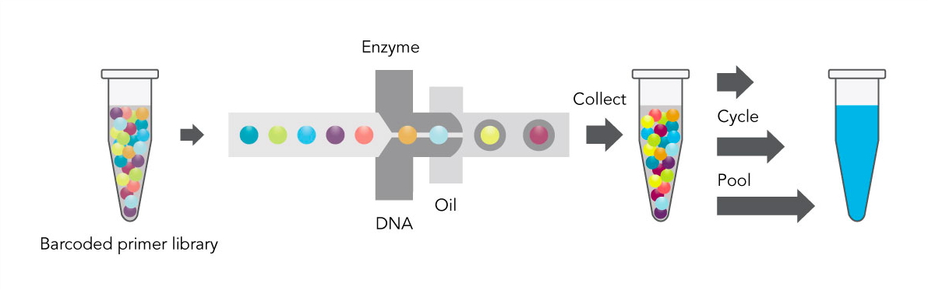
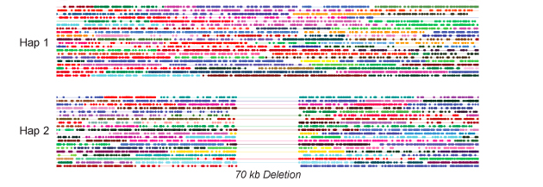
10X Sequencing pipeline
http://core-genomics.blogspot.com/2015/03/10x-genomics-whats-fuss-over-phasing.html
https://www.10xgenomics.com/applications/

Slide 54
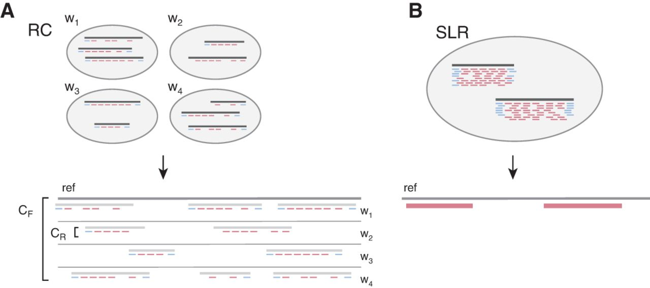
Synthetic long reads and “read clouds”
Bishara et al. Genome Research 2015

Slide 55
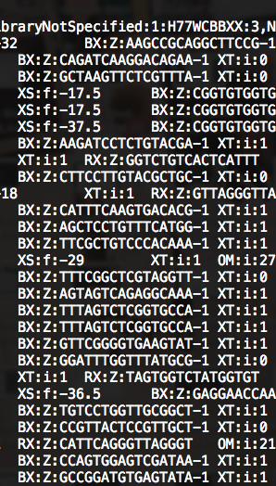
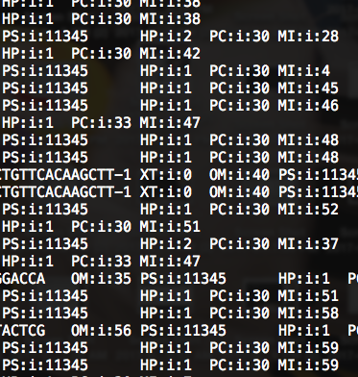
10X Data (BAM format)
Reads as usual:
Barcode tags (BX)
Phase tags (PC, PS, HP, MI))

Slide 56
10X Applications
Resolving complex heterozygosity
Long-range phasing
Single cell
Detecting structural variants
Resolving gaps in genome assemblies
Low error rate long reads may overcome advantages of linked reads

Slide 57
Long read applications

Slide 58
Application: Mutation hunting (repeats)

Slide 59
Application: Targeted PCR-free sequencing

Slide 60
Application: Infectious disease + metagenomics
Can use to directly sequence SARS-CoV-2 RNA virus, and other pathogens

Slide 61
2021: complete sequence of a human chromosome!
Sample: CHM13 (hydatidiform mole. Haploid-like genome)
Notes:
These gaps have been unresolved despite knowing about them for ~20 years of using the human reference genome
Btw the sample they did for this special cell type derived from

Slide 62
Hybrid assembly approach
Hifi reads give highly accurate contigs (32.4x)
Ultra-long ONT reads provide scaffolding info (20x)

