Slide 1
Clinical applications of NGS
(05/10/21)
Today’s schedule:
Clinical NGS applications
Break
Journal club #3
Announcements:
Project meetings during office hours today and Wednesday. Some slots during Tuesday
Switching lectures on deep learning (now 5/17) and Ancient Genomes (now 5/24)

Slide 2
Precision genomics: going from genotype to phenotype
Predict:
Cancer risk?
Heart disease?
Diabetes?
Cystic fibrosis?
AACGGCTACTACTGGTACAGCACTACGGTGCATAGGCTTATATAA
AACGCCTACTATTGGTACAGCACTACGATGCATAAGCTTATCTAA
Inform treatment
Mendelian(ish) traits
Trait controlled by a single gene
Relatively straightforward to predict
e.g. Cystic Fibrosis
Eye color (kind of)
Tay-Sachs
Marfan Syndrome
Complex traits
Trait controlled by a combination of many genes and/or environment factors
More difficult to predict
e.g. Heart disease
Height
Schizophrenia
Diabetes
What if we don’t know the relevant gene/mutation to begin with?

Slide 3
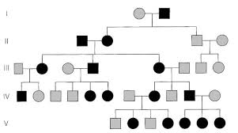
A family comes into the clinic…
How can we get to the causal mutation?
AACGGCTACTACTGGTACAGCACTACGGTGCATAGGCTTATATAA
AACGCCTACTATTGGTACAGCACTACGATGCATAAGCTTATCTAA
Notes:
here focus mostly on the how
in JC we'll mention the why, and talk about how doing this in clinical setting is and is not feasible

Slide 4
We can apply our NGS pipeline
Reads
*.fq
Ref. genome (+ index files)
hg19.fa.*
Intepretation
Alignment
Genotyping
?????
Alignments
(*.sam, *.bam, *.cram)
Variants
(*.vcf)
Notes:
here focus mostly on the how
in JC we'll mention the why, and talk about how doing this in clinical setting is and is not feasible

Slide 5
The challenge: sifting through piles of variants
…
From the exome alone, THOUSANDS of candidate variants
For whole gnomes, there are many more

Slide 6
The challenge: sifting through piles of variants
1. Is this variant in affected family members?
3. Have I seen this variant before?
2. Does this mutation affect gene function?
GAAAATATCATGTGGTGTTTCC
6. Is the gene likely relevant to this disease?
GAAAATATCATATGGTGTTTCC
4. Is this position conserved across species?
5. Gene expression pattern of this gene makes sense?
Common approach: progressively apply filters from highest to least confidence
Caveat: some truly pathogenic variants will fail these filters!
Notes:
more aggressive we filter, more things we could lose
less aggressive, end up with too many candidates

Slide 7
Pedigrees help narrow down the disease location
Thousands of candidate variants
Dozens of candidate variants

Slide 8
Pedigrees help narrow down the disease location
Causal variant homozygous in affecteds, missing or heterozygous in unaffecteds
Affected siblings almost always share the region IBD=2
Autosomal recessive
Autosomal dominant
Causal variant het (or hom) in affecteds, missing in unaffecteds
Affected siblings likely share the region IBD=1 (or 2), both inherited from affected parent
Bigger pedigree=better. Why?
More families=better. Why?
De novo
Mutation not present in parents or affected siblings
Notes:
Example of different types
Dominant
Heterozygous
De novo

Slide 9
T.H. Morgan: Chromosomal theory of inheritance
Chromosomal theory of inheritance: genes are located on chromosomes like beads on a string. Some genes are physically linked (on the same chromosome), and thus are (almost) always inherited together
(early description of linkage disequilibrium)

Slide 10
Sturtevant: the first genetic map
(as a 19 year old undergrad)
Key Idea: Farther apart two genes are on a chromosome, the more likely they are to be separated by recombination
Defined the “map unit” (now centimorgan): if two positions are 1cM away, it means they have a recombination frequency of 1%
http://www.nature.com/scitable/topicpage/Thomas-Hunt-Morgan-GeneHc-RecombinaHon-and-Gene-496

Slide 11
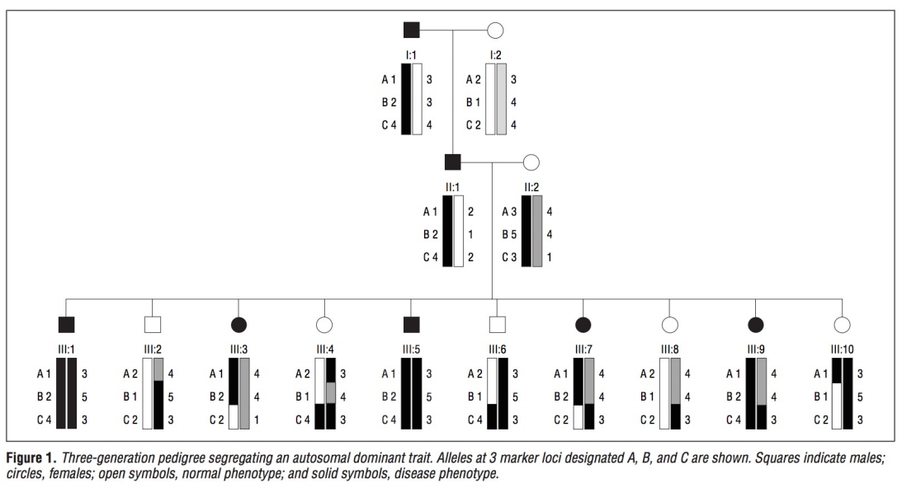
Linkage mapping: tracking genes in families
Marker B perfectly segregates (linked) with disease
Recombination frequency:
Fraction of progeny where the marker and causal allele broken up by recombination
A: 1 recomb/10 progeny: 10cM
B: perfectly linked
C: 4 recomb/10 progeny: 40cM
Marker A partially linked (1 recomb.)
Marker C unlinked (many recombinations)
X
X
X
X
X
LOD score: log₁₀(prob of observed data|linkage)/(prob of observed data | no linkage)
Arch Neurol. 1999;56(6):667-672. doi:10.1001/archneur.56.6.667.

Slide 12
Linkage mapping successes

Slide 13
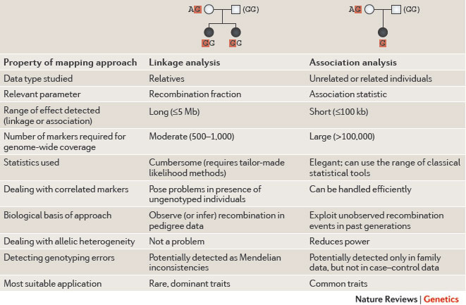
Linkage vs. association
http://www.nature.com/nrg/journal/v12/n7/box/nrg2989_BX1.html

Slide 14
The challenge: sifting through piles of variants
1. Is this variant in affected family members?
3. Have I seen this variant before?
2. Does this mutation affect gene function?
GAAAATATCATGTGGTGTTTCC
6. Is the gene likely relevant to this disease?
GAAAATATCATATGGTGTTTCC
4. Is this position conserved across species?
5. Gene expression pattern of this gene makes sense?
Today: focus mostly on variants in coding regions (more likely to cause severe disease)
Next week: interpreting variants in non-coding regions

Slide 15
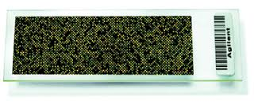
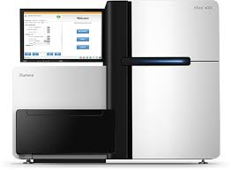
Exomes – only sequencing the coding regions
Exome sequencing – ~2% of the genome
Whole genome sequencing
Exon 1
Exon 2
Exon 3
Fragmented Genomic DNA
Hybridize to array with sequences of “target regions” (exons)
Amplification and sequencing
Note: WGS closing in on price of WES, WGS becoming more common

Slide 16
Exome sequencing succeses

Slide 17
Which variants likely to be causing disease?
“Loss of function” (LoF) mutations
likely to obliterate gene function
Usually the first thing we’d look for
Functional gene
AG
GT
AG
GT
AG
GT
TTC…CGA…
Nonsense SNP (“stop gained”)
AG
GT
AG
GT
AG
GT
TTC…TGA…
Frame-shift indel
AG
GT
AG
GT
AG
GT
T-C
Splice-site
AG
GT
CG
GT
AG
GT
T-C

Slide 18
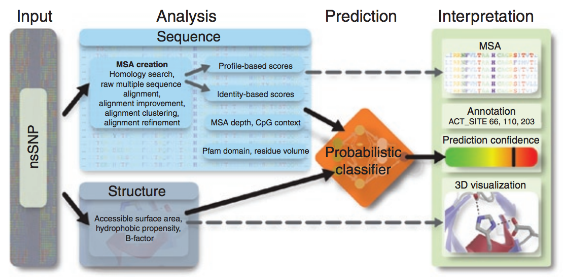
Which variants likely to be causing disease?
Missense mutations (change amino acid sequence)
Some benign, some severe
If we don’t find LoF, look here next
Polyphen2: predict impact of an amino acid substitution on gene structure and function
See also: SIFT, MutationTaster, SNAP, and more. Most people use multiple methods and e.g. require more than one method to call the mutation damaging
Adzhubei et al. Nature Methods 2010

Slide 19
Which variants likely to be causing disease?
Other (less likely, but totally possible) possibilities:
In-frame indel
E.g. Cystic Fibrosis (delta F508 in CFTR)
UTRs
E.g. 5’UTR variant in IFITM5 in osteogenesis imperfecta (creates alternate start codon)
Synonymous variant
E.g. synonymous variants in UBE1 in spinal muscular atrophy (affect methylation)
Non-coding mutations
E.g. mutations in promoter of HBB (hemoglobin) in beta-thalassemia
Lesson: anything can happen. But look at the most obvious places first.

Slide 20
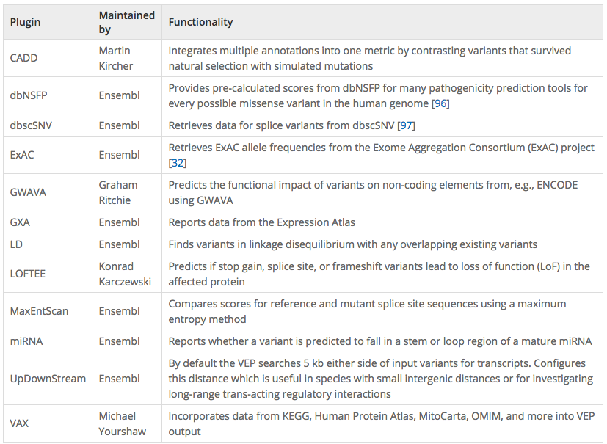
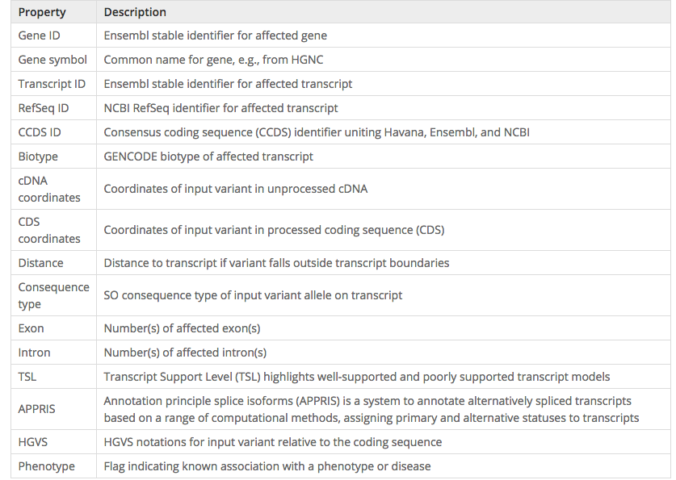
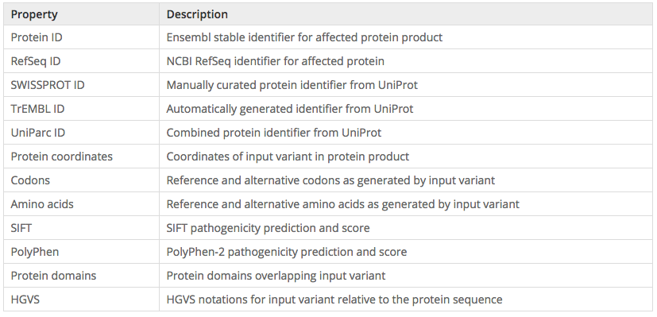
Annotating impact of mutations on genes

Slide 21
Ensemble annotations
Ensemble: combination of different methods
Idea: there’s lots of annotations out there. Some combination of which are probably important. Let’s combine them into a single classifier
CADD: Combined Annotation-Dependent Depletion
Kircher, et al. Nature Genetics 2014 (Shendure Lab)
Features (63 annotations total):
VEP annotations (e.g. nonsense, missense)
SIFT, PolyPhen2
Mappability
Conservation (PhastCons, PhyloP, GERP)
Segmental duplications
Expression
Histone modifications
SVM Classifier
Train on simulated data to determine:
Observed (likely benign) vs.
Simulated de novos (likely pathogenic)

Slide 22
Example of annotation complexity
Insertion of an “A” at the last bp of this gene. What is the impact?
Frameshift?
Stopgain?
Synonymous?
All of the above?

Slide 23
The challenge: sifting through piles of variants
1. Is this variant in affected family members?
3. Have I seen this variant before?
2. Does this mutation affect gene function?
GAAAATATCATGTGGTGTTTCC
6. Is the gene likely relevant to this disease?
GAAAATATCATATGGTGTTTCC
4. Is this position conserved across species?
5. Gene expression pattern of this gene makes sense?

Slide 24
Selection says disease-causing mutations are rare
severe
e.g. Tay-Sachs
Severe Mendelian disorders
Nonexistent
(removed by selection)
(well actually… AD APO e4. why?)
Effect size
Likely many examples, but low power to detect these
e.g. high cholesterol, Crohn’s Disease, Type II Diabetes
(many common alleles with small effect sizes)
mild
rare
common
Allele Frequency

Slide 25
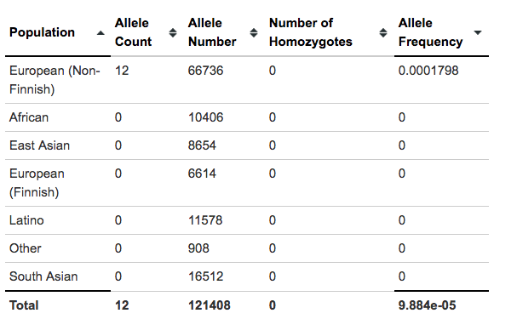
Disease causing mutations likely to be rare
If a mutation causes a severe phenotype, it MUST be rare or nonexistent in the general population
How does this differ for dominant vs. recessive diseases?
Filtering by allele frequency is an important first step in analyzing candidate variant set
E.g. dbSNP, Gnomad, 1000Genomes
Variant should be rare in EVERY population
Example: Tay Sach’s Disease (recessive)
Rs121907954, highest MAF is 0.0002 in Europeans
https://gnomad.broadinstitute.org/

Slide 26
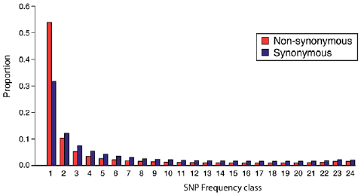
Metrics of purifying selection
Site frequency spectrum: the distribution of allele frequencies of a given set of SNPs in a population or sample
Summarizing the SFS:
% Singletons (seen 1 time in the population). Higher=rarer=stronger selection
Mean MAF (higher=more common=weaker selection)
% variable sites (how many positions were never variable. Higher=weaker selection)
Notes:
Site frequency spectrum define it
Use the three different metrics:
% variable sites (e.g. for de novos we’ll talk about thurs)
% singleton
Mean MAF

Slide 27
Purifying selection for variant classes
MAPS: mutability adjusted % singletons
(ExAC)
Generally, the more variants that are singletons, the more deleterious that mutation class is
Caveat: these metrics describe categories of variants, and may or may not be useful for predicting impact of a specific mutation
Lek et al. 2016
Notes:
Missense, nonsense, syn, splice
Show intron exon plot from daly
Help us prioritize variation, but can only be applied to classes of vars, not single
http://www.nature.com/nature/journal/v536/n7616/images_article/nature19057-f2.jpg

Slide 28
The challenge: sifting through piles of variants
1. Is this variant in affected family members?
3. Have I seen this variant before?
2. Does this mutation affect gene function?
GAAAATATCATGTGGTGTTTCC
6. Is the gene likely relevant to this disease?
GAAAATATCATATGGTGTTTCC
4. Is this position conserved across species?
5. Gene expression pattern of this gene makes sense?

Slide 29
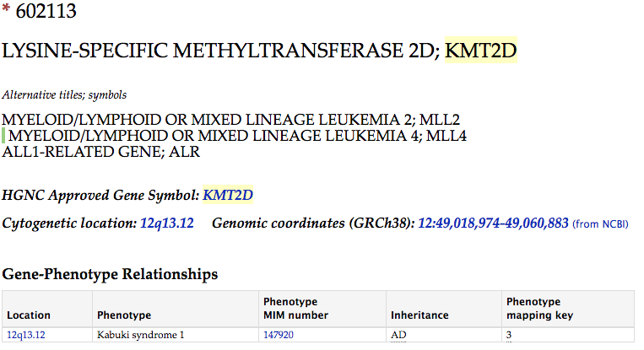
Databases of clinical consequences of variants
Has my candidate gene been previously implicated in a human disease?
If yes, is it related to the current disease I’m trying to solve?

Slide 30
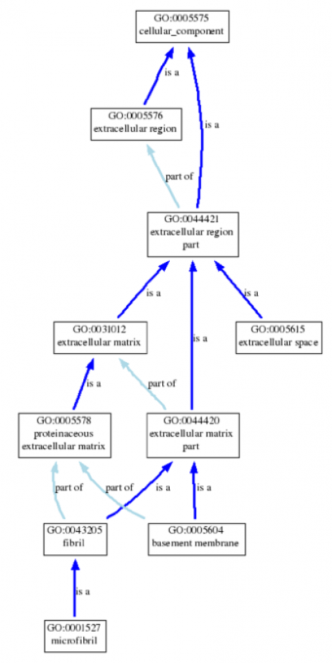
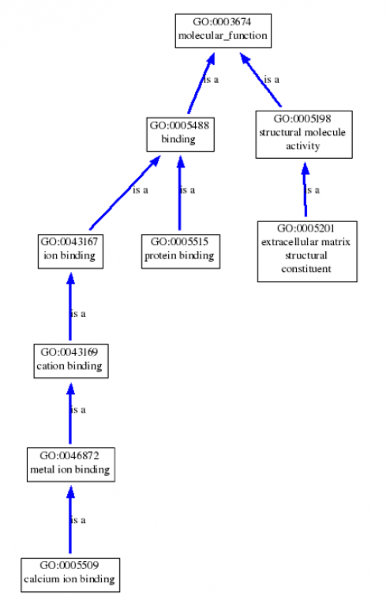
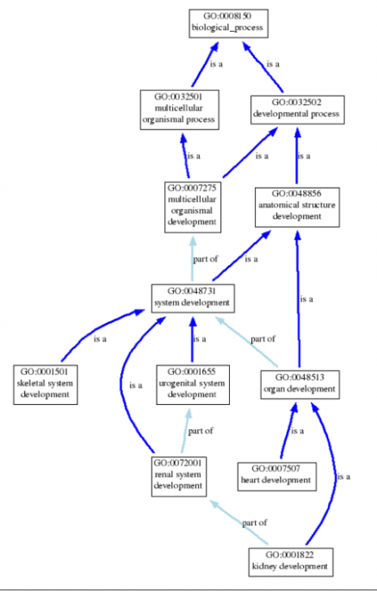
Gene ontologies
Does the annotated function of my gene make sense?
Caveat: you can almost always make up a story! Should always have a healthy amount of skepticism until proven otherwise…
e.g. for Marfan Syndrome, FBN1
Biological process: skeletal/heart/kidney development
Cellular component: basement membrane, extracellular, microfibril
Molecular function: Calcium ion binding, structural, protein binding
http://waclawikgen677s10.weebly.com/gene-ontology.html

Slide 31
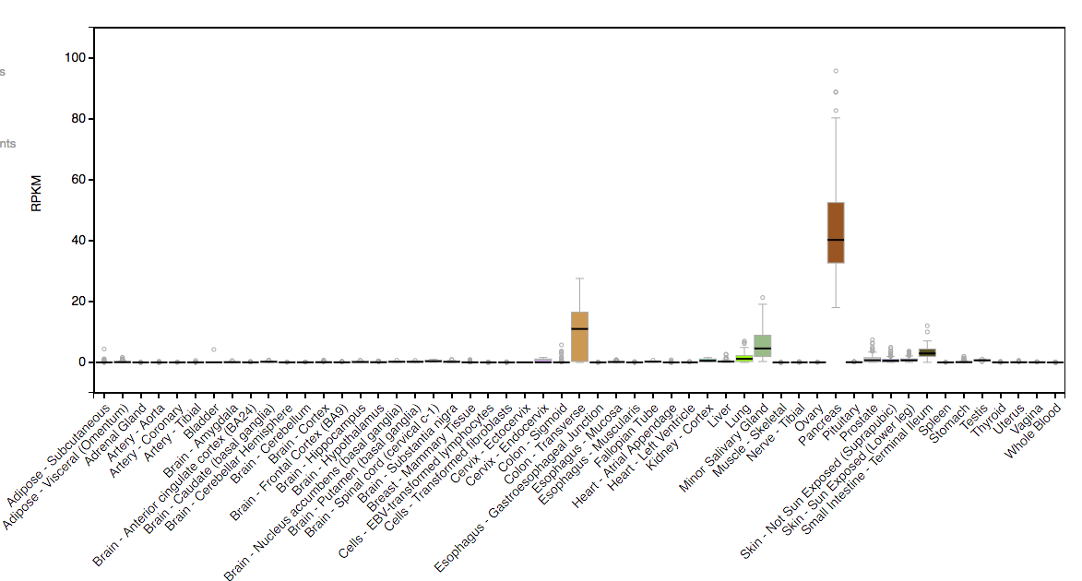
Incorporating gene expression data - tissue
Is this gene expressed in tissues that make sense for this disease?
e.g. if disease is primarily liver related, the causal gene is probably expressed in liver
We now have resources (e.g. GTeX) reporting expression across tissues
CFTR Expression by tissue
http://www.gtexportal.org/home/gene/CFTR

Slide 32
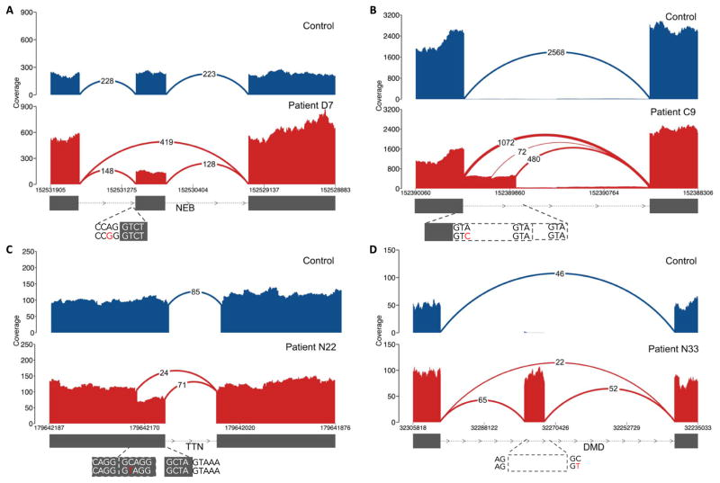
Incorporating gene expression data

Slide 33
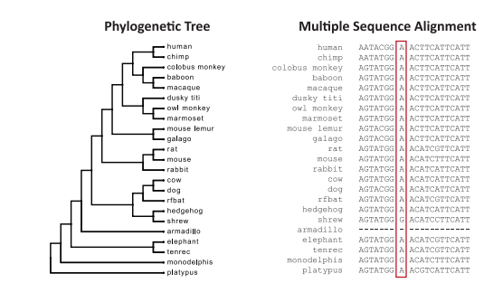
Conservation across species informative
Phastcons: compute conservation based on phylogenetic tree + HMM
phyloP: compute conservation using sequence alignment and model of neutral evolution
GERP: identify constrained elements in multiple sequence alignment by quantifying “substitution deficits”
Davydov et al. 2010

Slide 34
To summarize: filter, filter, filter
Follow expected inheritance
LoF/missense
Rare
Relevant genes
AACGGCTACTACTGGTACAGCACTACGGTGCATAGGCTTATATAA
AACGCCTACTATTGGTACAGCACTACGATGCATAAGCTTATCTAA

Slide 35
Clinical NGS – cancer genomics
We’re neglecting cancer genomics. Could have had a whole module on this…

Slide 36
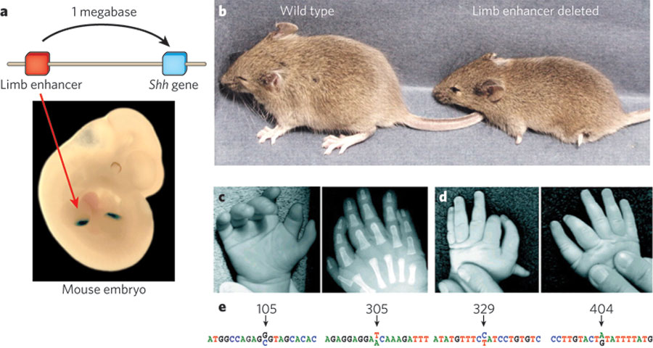
Our standard pipeline will miss a lot…
Non-coding variants (next week)
Repeat expansions
Visel et al. Nature 2009
Gene duplication

Slide 37
Break
Journal club #3 – Clinical NGS

