Slide 1
Alignment and variant calling
(05/05/21)
Today’s schedule:
Sequence alignment (BWT + local realignment)
Break
Variant calling (SNPs) + error sources
Calling other types of variants
Announcements:
Proposals due tonight. Will set up times to discuss shortly.

Slide 2

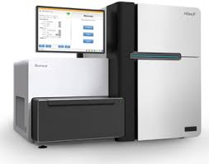

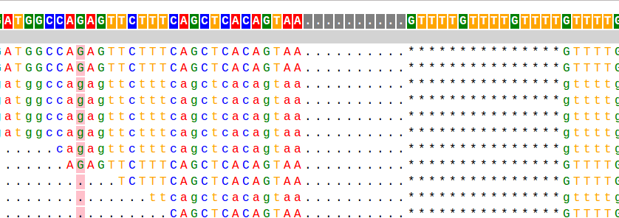
Our typical NGS analysis pipeline
1. SEQUENCING
2. ALIGNMENT
Reference
ACGTACGGATATGCGATACGACAT
Reads
3. GENOTYPING
4. VISUALIZATION/INTERPRETATION
CCA-CTCTACTCACAC----TAGC
SNPs/Indels
STRs
CCAACGCTACTCACACACACTAGC
Notes:
Talked on Monday about NGS
Typically steps would be to first align the reads to the reference genome
Then do genotyping, to find variants from the ref genome
Today we’ll go in some more detail about these steps
Talk about canonical ways these things are done
Then talk about some alternative ways to consider both alignment and genotyping
Start first with sequence alignment

Slide 3
Recall – reads in FASTQ format
ERR194146_1.fastq
(first end of each pair)
@ERR194146.1 HSQ1008:141:D0CC8ACXX:3:1308:20201:36071/1
ACATCTGGTTCCTACTTCAGGGCCATAAAGCCTAAATAGCCCACACGTTCCCCTTAAATAAGACATCACGATGGATCACAGGTCTATCACCCTATTAACCA
+
?@@FFBFFDDHHBCEAFGEGIIDHGH@GDHHHGEHID@C?GGDG@FHIGGH@FHBEG:GGIEEHH;@CHH=EDFFBBE>;@?3;;;>;;;AA?<C>C@@C:
@ERR194146.2 HSQ1008:141:D0CC8ACXX:4:1208:5231:93701/1
CCAGCGTCTCGCAATGCTATCGCGTGCATACCCCCCAGACGAAAATACCAAATGCATGGAGAGCTCCCGTGAGTGGTTAATAGGGTGATAGACCTGTGATC
+
?88ADA?BDF8F:@@DB49C>B7C806B<?DEF=@FFC=AABEA<;@D>AC265;ADA;@@?<@B@A<;?5(8+:0>(4:@AAA832?@@BBBB:<4(:>>
@ERR194146.3 HSQ1008:141:D0CC8ACXX:2:1305:18078:8420/1
GATCACAGGTCTATCACCCTATTAACCACTCACGGGAGCTCTCCATGCATTTGGTATTTTCGTCTGGGGGGTATGCACGCGATAGCATTGCGAGACGCTGG
+
@CCFFFFFHHFGHJIGJJJJJJJJJJJIJIIJJJIJJJIGJJJJIIJIGIHIJI=FFIJJJJHHJHGHHDD;@CDDEDDDDDBDDDCECDDDDDBDDDDDD
ERR194146_2.fastq
(second end of each pair)
@ERR194146.1 HSQ1008:141:D0CC8ACXX:3:1308:20201:36071/2
CCAGCGTCTCGCAATGCTATCGCGTGCATACCCCCCAGACGAAAATACCAAATGCATGGAGAGCTCCCGTGAGTGGTTAATAGGGTGATAGACCTGTGATC
+
<?@DDDBDHHHAAH@CG@FBBGGIEG@D@GCHFG@F/5=C4=B'=7?CA9@?ACDCDCA@<?BDCCCB=BB0<4>?4?>@:CCD???A:@C3>A>AC:++:
@ERR194146.2 HSQ1008:141:D0CC8ACXX:4:1208:5231:93701/2
CCCACACGTTCCCCTTAAATAAGACATCACGATGGATCACAGGTCTATCACCCTATTAACCACTCACGGGAGCTCTCCATGCATTTGGTATTTTCGTCTGG
+
@??BD1:AFHBDDGGHIJIF@EEE>GFHGHEAG?DEG<FD>B;?BB<*/9??C8BB@FHC7=CCGAE;=,5,,.;@@>(5(;>ACCC(,,5;>CCB88<??
@ERR194146.3 HSQ1008:141:D0CC8ACXX:2:1305:18078:8420/2
GATCACAGGTCTATCACCCTATTAACCACTCACGGGAGCTCTCCATGCATTTGGTATTTTCGTCTGGGGGGTATGCACGCGATAGCATTGCGAGACGCTGG
+
@CCFFFFFHHFGHJIGJJJJJJJJJJJIJIIJJJIJJJIGJJJJIIJIGIHIJI=FFIJJJJHHJHGHHDD;@CDDEDDDDDBDDDCECDDDDDBDDDDDD
Notes:
Recall we had all these reads

Slide 4

Challenge: Rapidly align short reads to a reference
Goal: Where in the genome does each read originate?
Reference genome: ~3×10⁹ bp
?
Reads: ~100bp
Solution: Index genome in quickly searchable data structure
Chr1:3899292
ACGATAG
ATCGACGATAGCCG
ACGATAG
Genome
Index
(Burrows Wheeler Transform)
Notes:
Now want to know where they come from

Slide 5
In practice, store extra “index” files for the reference
bwa index hg19.fa
Reference genome
Index files

Slide 6
Burrows-Wheeler Transform
String T: AACATCGAGCTACGTACGTACGTACGTACGTACGTACGTACGACGAGGGGAGAGAAT
T
BWT(T)
(Burrows Wheeler Transform)
Size O(|T|), searching in time O(|query string|)
(Naïve solution would mean searching in O(|T|) )
Burrows Wheeler Transform (and related auxiliary data structures) allows:
Compression
Indexing/searching (our main application)
Notes:
Follow here:
http://www.cs.jhu.edu/~langmea/resources/bwt_fm.pdf
Overall idea is to make a transform of T
Applications:
Compression
indexing

Slide 7
Burrows-Wheeler Transform
String T: BANANA$
m=|T| (length of T)
T ends with a terminator character ($), lexicographically prior to all other characters
Creating BWT(T)
Write down rotations of T
Sort the rows lexicographically to make BWM(T) (Burrows Wheeler Matrix)
The final column of BWM(T) gives BWT(T)
Step 1:
Step 2:
B A N A N A $
$ B A N A N A
A $ B A N A N
N A $ B A N A
A N A $ B A N
N A N A $ B A
A N A N A $ B
$ B A N A N A
A $ B A N A N
A N A $ B A N
A N A N A $ B
B A N A N A $
N A $ B A N A
N A N A $ B A
BWT(T) = ANNB$AA
Notes:
Follow here:
http://www.cs.jhu.edu/~langmea/resources/bwt_fm.pdf
Convert banana to matrix

Slide 8
Relationship to suffix arrays
String T: BANANA$
Creating SuffixArray(T)
Write T’s suffixes, note the starting index of each suffix
Sort lexicographically
BWM(T)
SuffixArray(T)
Suffix given by SA
$ B A N A N A
A $ B A N A N
A N A $ B A N
A N A N A $ B
B A N A N A $
N A $ B A N A
N A N A $ B A
6
5
3
1
0
4
2
$
A $
A N A $
A N A N A $
B A N A N A $
N A $
N A N A $
T[SA[i]-1] if SA[i]>0
BWT(T)[i] =
$ if SA[i]==0
Notes:
Follow here:
http://www.cs.jhu.edu/~langmea/resources/bwt_fm.pdf
Convert banana to matrix
BWT giving us the letter that comes right before that suffix

Slide 9
BWT for compression
BWT is reversible, necessary for compression (we can reconstruct T from BWT(T) )
BWT(T) has same length as T, so not immediately clear where compression comes in.
BUT BWT often brings similar characters together, easier to shrink with run length encoding methods, e.g. bzip2
BWT(BANANA$) = ANNB$AA
BWT(tomorrow and tomorrow and tomorrow) = wwwdd nnoooaatttmmmrrrrrrooo $ooo

Slide 10
Reversing the BWT with LF mapping
Create the BWM, but this time include order of each character
e.g.:
B₀ A₀ N₀ A₁ N₁ A₂ $
Step 1:
Step 2:
B₀ A₀ N₀ A₁ N₁ A₂ $₀
$₀ B₀ A₀ N₀ A₁ N₁ A₂
A₂ $₀ B₀ A₀ N₀ A₁ N₁
N₁ A₂ $₀ B₀ A₀ N₀ A₁
A₁ N₁ A₂ $₀ B₀ A₀ N₀
N₀ A₁ N₁ A₂ $₀ B₀ A₀
A₀ N₀ A₁ N₁ A₂ $₀ B₀
$₀ B₀ A₀ N₀ A₁ N₁ A₂
A₂ $₀ B₀ A₀ N₀ A₁ N₁
A₁ N₁ A₂ $₀ B₀ A₀ N₀
A₀ N₀ A₁ N₁ A₂ $₀ B₀
B₀ A₀ N₀ A₁ N₁ A₂ $₀
N₁ A₂ $₀ B₀ A₀ N₀ A₁
N₀ A₁ N₁ A₂ $₀ B₀ A₀
LF Property: the ith occurrence of a character c in the last column (L) has the same rank as the ith occurrence of c in the first column (F)
e.g. for A, has order 2, 1, 0 in both L and F
e.g. for N, has order 1, 0 in both L and F

Slide 11
Reversing the BWT with LF mapping
T = B₀ A₀ N₀ A₁ N₁ A₂ $
First col (F)
Last col (L)
Rank in last col.
$₀ B₀ A₀ N₀ A₁ N₁ A₂
A₂ $₀ B₀ A₀ N₀ A₁ N₁
A₁ N₁ A₂ $₀ B₀ A₀ N₀
A₀ N₀ A₁ N₁ A₂ $₀ B₀
B₀ A₀ N₀ A₁ N₁ A₂ $₀
N₁ A₂ $₀ B₀ A₀ N₀ A₁
N₀ A₁ N₁ A₂ $₀ B₀ A₀
$
A
A
A
B₀
N
N
A
N
N
B
$
A
A
0
0
1
0
0
1
2
BWM(T)=
Start with the first row, with $ in first column
Last column of first row must have character to the left in T, so A$.
Rank of A is 0, so must correspond to 1st “A” in F. So we get NA$.
Rank of N is 0, so must correspond to 1st “N” in F. So we get ANA$.
Repeat steps to get BANANA$

Slide 12
Searching using LF mapping
T = B₀ A₀ N₀ A₁ N₁ A₂ $
Searching for P = N A N
F
L
Rank in last col.
$₀ B₀ A₀ N₀ A₁ N₁ A₂
A₂ $₀ B₀ A₀ N₀ A₁ N₁
A₁ N₁ A₂ $₀ B₀ A₀ N₀
A₀ N₀ A₁ N₁ A₂ $₀ B₀
B₀ A₀ N₀ A₁ N₁ A₂ $₀
N₁ A₂ $₀ B₀ A₀ N₀ A₁
N₀ A₁ N₁ A₂ $₀ B₀ A₀
0
0
1
0
0
1
2
BWT(T)=
Backwards matching: repeatedly apply LF mapping to range of rows prefixed by successively longer suffixes of P.
First find rows beginning with shortest suffix of P, “N”
From “L”, see both are preceeded by “A”, corresponding to “A1” and “A2”
Now find all rows beginning with next-longest suffix of P, “AN”
See only one is preceeded by “N”, corresponding to “N1”
Number of rows remaining = number of occurrences of P in T.
Notes:
Follow here:
http://www.cs.jhu.edu/~langmea/resources/bwt_fm.pdf
Convert banana to matrix

Slide 13
String search with FM-index
Searching with LF-mapping requires O(m) time, where m=|T| ☹. We’d like O(|P|)
Augment rank array with m x |Σ| matrix. Each row gives how many times that character has been observed up to and including that position in BWT(T)
Occ
F
L
$ A B N
$ B A N A N A
A $ B A N A N
A N A $ B A N
A N A N A $ B
B A N A N A $
N A $ B A N A
N A N A $ B A
0
0
0
0
1
1
1
1
1
1
1
1
2
3
0
0
0
1
1
1
1
0
1
2
2
2
2
2
Now, searching for P=N A N
Look for row beginning with first suffix, “N”. Look up range of next character using corresponding row of Occ(A). Only need to look at the first and last.
Now, only need to lookup next character “A” with the ranks of those occurrences
Still only gives us how many times P occurs in T, not where!

Slide 14
Looking up offsets
T = B₀ A₀ N₀ A₁ N₁ A₂ $
Searching for P = N A N
BWM(T)
F
L
SuffixArray(T)
$ B A N A N A
A $ B A N A N
A N A $ B A N
A N A N A $ B
B A N A N A $
N A $ B A N A
N A N A $ B A
6
5
3
1
0
4
2
Suffix array tells us that the match occurs at offset 2 in the original string T!
Allows string searching in O(length of query string). Independent of reference (T) size!

Slide 15
In practice, store extra “index” files for the reference
bwa index hg19.fa
Index files
BWT
Suffix Array
Occ matrix
And other helper files

Slide 16
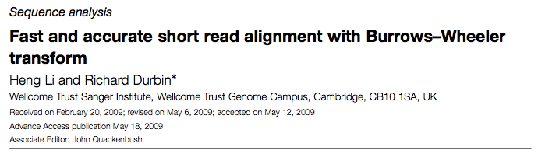
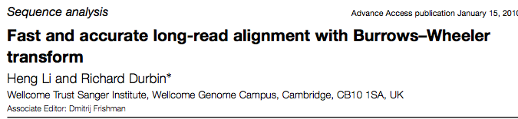
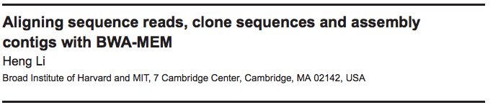
BWA Aligner
Notes:
Go through tricks in bwa
https://academic.oup.com/bioinformatics/article-lookup/doi/10.1093/bioinformatics/btp324

Slide 17
BWA
Exact matching: backward search as described above
Inexact matching: find intervals of the reference that match the query string with no more than z differences (mismatches or gaps)
  Use bounded traversal/backtracking.
  In practice, use a “seed” sequence from beginning of read, which must have minimal match to the genome
  The more errors in the reads, the slower the inexact mapping process is

Slide 18
BWA - continued
BWA-MEM
  “Seed-and-extend” paradigm: for each position, find longest exact match
  Chain together co-linear seeds
  Extend the longest seeds
  Allows for larger gaps, variable length reads

Slide 19
Alignment vs. mapping
Mapping: where in the genome did a given read come from?
BWT
Alignment: more precise specification for how two or more sequences align, e.g. including gaps and mismatches
Needleman-Wunsch
(Dynamic programming)
Notes:
Show pedigree with CF
Show height
Or case control

Slide 20
CIGAR Scores describe alignments
M: match
D: deletion
I: insertion
Reference
31M
ACGATCATCAAAAAAAAAACTGATGTTCATA
Read
ACGATCATCAAAAAAAAAACTGATGTTCATA
Reference
19M2I12M
ACGATCATCAAAAAAAAAA--CTGATGTTCATA
Read
ACGATCATCAAAAAAAAAAAACTGATGTTCATA
Reference
9M2D20M
ACGATCATCAAAAAAAAAACTGATGTTCATA
Read
ACGATCATC--AAAAAAAACTGATGTTCATA

Slide 21
Needleman-Wunsch pairwise alignment
Goal: align two sequences to each other in order to maximize some score function
Score: (Example)
Match: +1
Mismatch: -1
Indel: -1
E.g.: GCATGCA and GATTACA
GCATG-CA
G-ATTACA
Score = 2.
# Possible alignments between two length N sequences is 2^{2N}/sqrt(pi*N). Need a smart way to narrow this down!

Slide 22
Needleman-Wunsch pairwise alignment (DP algorithm)
 |  | G | C | A | T | G | C | A
 | 0 | -1 | -2 | -3 | -4 | -5 | -6 | -7
G | -1 | 1 | 0 | -1 | -2 | -3 | -4 | -5
A | -2 | 0 | 0 | 1 | 0 | -1 | -2 | -3
T | -3 | -1 | -1 | 0 | 2 | 1 | 0 | -1
T | -4 | -2 | -2 | -1 | 1 | 1 | 0 | -1
A | -5 | -3 | -3 | -1 | 0 | 0 | 0 | -1
C | -6 | -4 | -2 | -2 | -1 | -1 | 1 | 0
A | -7 | -5 | -3 | -1 | -2 | -2 | 0 | 2
D[i-1, j-1] + match(A[i], B[j])
D[i-1,j] + G
D[i,j-1] + G
Match(A, B) = +1 if A=B, else -1
G = gap penalty
D[i,j] = max{
Trace back the process to create the alignment!
See: “Biological sequence analysis” textbook for more info on these methods

Slide 23
Affine gap penalties
Motivation:
Scoring scheme above treats all gaps the same
More plausible to have one long gap vs. multiple short gaps
ACGATCATCAAAAAAAAAAAACTGATGTTCATA
ACGATCATC-A-AA--A--A-CTGATGTTCATA
ACGATCATCAAAAA-------CTGATGTTCATA
Affine gap penalty:
Gap open penalty (expensive) (O)
Gap extension penalty (cheaper) (E)
Score = O + E*L, where L is length of gap
But you need to keep track of 3 DP matrices…
Setting scores is somewhat of an art form…

Slide 24
Alternative ways to think about alignment
We’ve been thinking about alignment to a somewhat mythical “reference” genome.
What might be some limitations of this “reference-based” way of doing things?
  Biases from aligning to a single reference?
  Other problems?
What might be some alternative solutions?
Notes:
We’ve been thinking about alignment to a somewhat mythical “reference” genome.
Aligning to the reference inherently can introduce biases. E.g. reads with major variants compared to the reference will be difficult to align.
Should we use a population-specific reference?
Potential solution: aligning to a “pan-genome”
Build a “graph” containing info from a population
Align reads to the graph

Slide 25
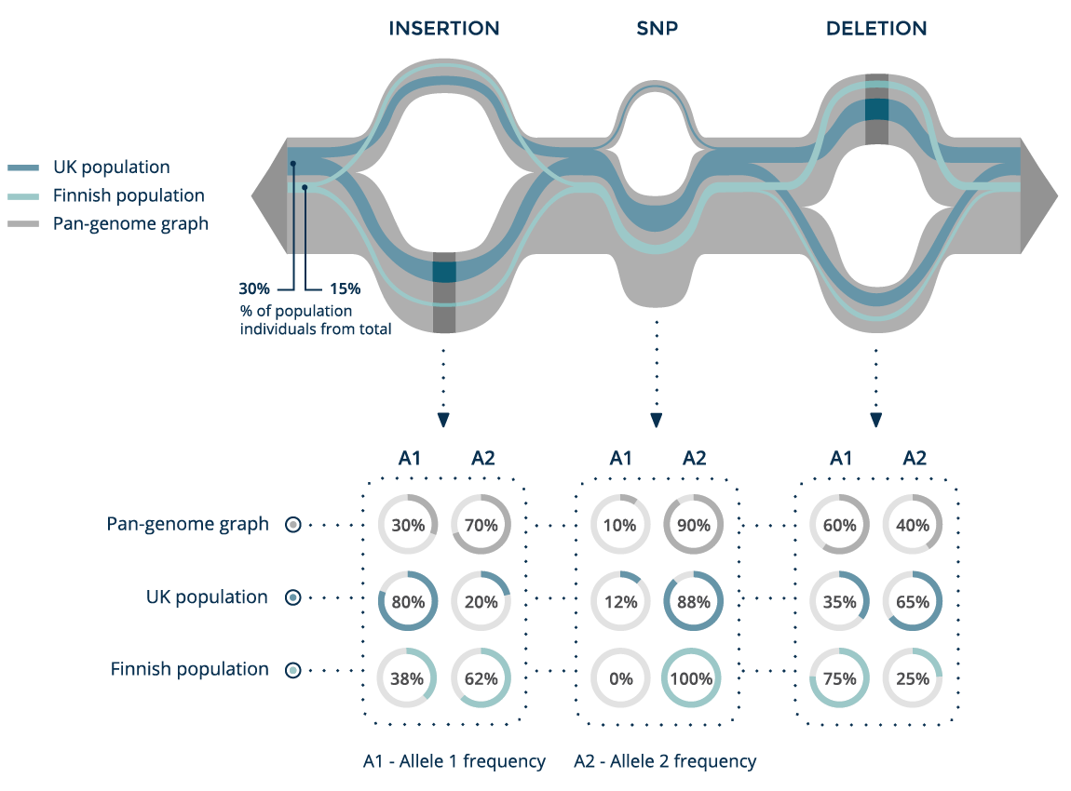
The “pan-genome”
https://www.sevenbridges.com/graf/better-reference/

Slide 26
Alternative ways to think about alignment
Genetic variation -> different paths through the graph!
https://ekg.github.io/

Slide 27
Alternative ways to think about alignment
Erik Garrison
Heng Li
This is still really hard…
But has huge potential for changing how we do things

Slide 28
Break
SNP calling

Slide 29
Our typical NGS analysis pipeline
1. SEQUENCING
2. ALIGNMENT
Reference
ACGTACGGATATGCGATACGACAT
Reads
3. GENOTYPING
4. VISUALIZATION/INTERPRETATION
CCA-CTCTACTCACAC----TAGC
SNPs/Indels
STRs
CCAACGCTACTCACACACACTAGC

Slide 30
SNP calling overview
SNP caller
VCF file (list of locations that vary from the reference genome)
BAM file (read alignments)

Slide 31
Side note: SNP vs. SNV
SNP = single nucleotide polymorphism
Usually applied to variants that are variable in the population
SNV = single nucleotide variant
More frequently used when looking at a specific individual. Variants could be private to that individual, and not polymorphic in the population
(I tend to use these interchangeably)

Slide 32
Side note: SNP vs. SNV

Slide 33
SNP calling – take 1 (naïve)
Reference genome
Homozygous reference (AA)
Homozygous non-reference (BB)
100% ref, 0% non-ref
0% ref, 100% non-ref
Heterozygous (AB)
50% ref, 50% non-ref
Method 1:
If N==K: return BB
Else if K==0: return AA
Else: return AB
At a given position we see:
N total reads
K match the non-reference allele (B)
N-K match ref (A)

Slide 34
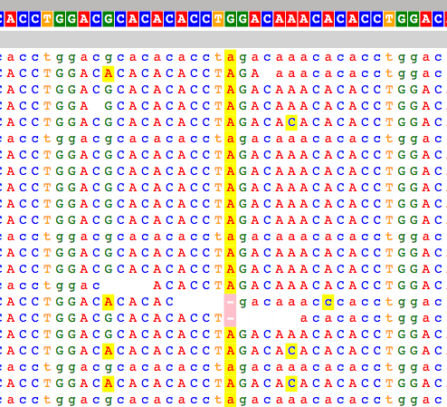
SNP calling – take 1
What could go wrong?
Sequencing errors: If we see just one wrong base, our method will call the position a SNV!
If error rate is ~1%, and we have coverage 100X, expect to see ~1 error per base. We’d call everything a SNP!
Statistical variation: For a heterozygous position, we expect 50/50 A vs. B reads. But we’ll see fluctuation, especially for sites with low coverage!

Slide 35
SNP calling – take 2 (allele frequencies)
Reference genome
Homozygous reference (AA)
Homozygous non-reference (BB)
100% ref, 0% non-ref
0% ref, 100% non-ref
Heterozygous (AB)
50% ref, 50% non-ref
At a given position we see:
N total reads
K match the non-reference allele (B)
N-K match ref (A)
Method 2:
If K/N in [0, 0.2) -> AA
Else if K/N in [0.2, 0.8] -> AB
Else if K/N in (0.8, 1] -> BB

Slide 36
SNP calling – take 2
What are limitations of just using allele frequencies?
Hard to quantify uncertainty
  We should treat K/N differently for N=2000 reads vs. N=2 reads
We’d like to model sequencing error rates
In practice this method won’t do too bad. But you’ll want to filter things with really low N as unreliable

Slide 37
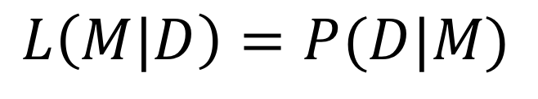
SNP calling – take 3 (maximum likelihood)
Likelihood = probability to see the data (D) we see given some true underlying model (M)
$$L\left(M|D\right)=P(D|M)$$
For SNP calling:
Data (D) = observed set of bases at the position
Model (M) = true genotype (AA, AB, or BB)

Slide 38
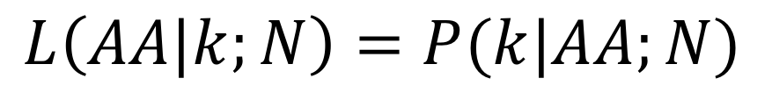
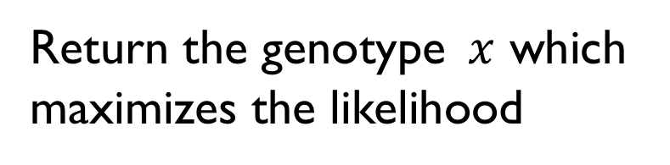
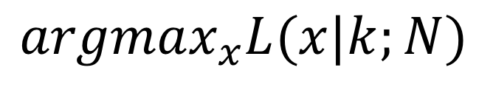
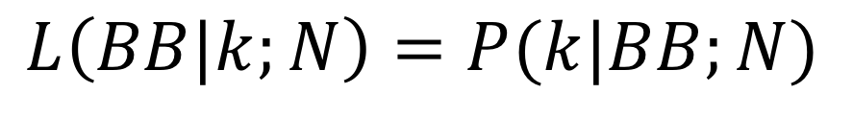
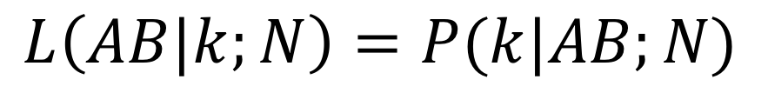
SNP calling – take 3 (maximum likelihood)
Compute likelihood for each genotype:
$$L\left(AA|k;N\right)=P(k|AA;N)$$
$$L\left(AB|k;N\right)=P(k|AB;N)$$
$$L\left(BB|k;N\right)=P(k|BB;N)$$
Return the genotype $x$ which maximizes the likelihood
$$argmax_{x}L(x|k;N)$$

Slide 39
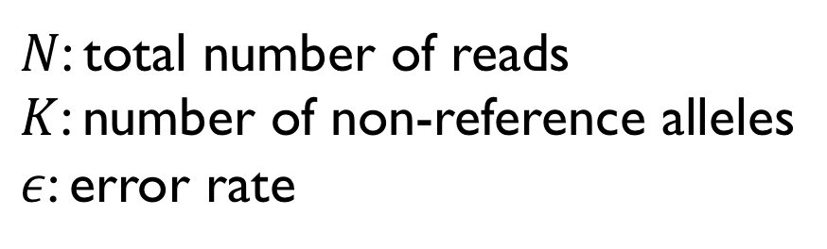
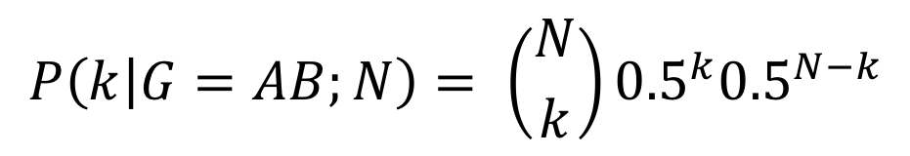
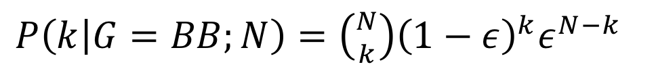
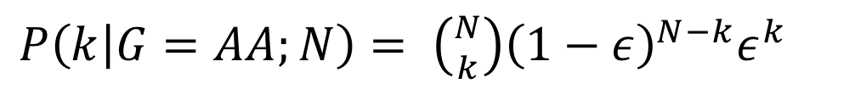
SNP calling – take 3 (maximum likelihood)
$N$: total number of reads
$K$: number of non-reference alleles
$ε$: error rate
Can model using a binomial distribution:
$P\left(k | G=AA;N\right)= \left({N \atop k}\right){\left(1−ε\right)}^{N−k}ε^{k}$
$P\left(k | G=BB;N\right)=\left({N \atop k}\right){\left(1−ε\right)}^{k}ε^{N−k}$
$$P\left(k | G=AB;N\right)= \left({N \atop k}\right){0.5}^{k}{0.5}^{N−k}$$
Notes:
=

Slide 40
SNP calling – take 3 (maximum likelihood)
$N$: total number of reads
$K$: number of non-reference alleles
$ε$: error rate
Intuitively, expect:
Notes:
=

Slide 41
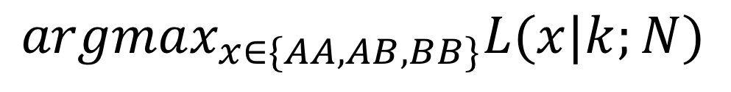
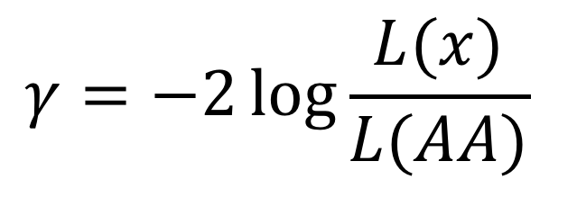
SNP calling – take 3 (maximum likelihood)
Return:
Most likely genotype
$$argmax_{x∈\{AA,AB,BB\}}L(x|k;N)$$
Score (one possibility=likelihood ratio statistic to compare to null hypothesis of no SNP [AA])
$$γ=−2\log{\frac{L(x)}{L(AA)} }$$
Probably also want to keep track of N

Slide 42
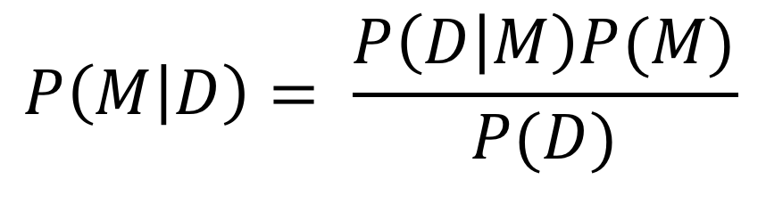
Likelihood vs. posteriors
Recall Bayes Theorem:
Likelihood (purely driven by the data)
$$P\left(M | D\right)= \frac{P\left(D | M\right)P(M)}{P(D)}$$
Prior (what we think before seeing any data)
P(D) helps normalize so that posteriors sum to 1
Posterior (takes into account our prior belief, but modify based on the data we see)
Notes:
N: total number of reads
K: number of non-reference alleles
E: error rate

Slide 43
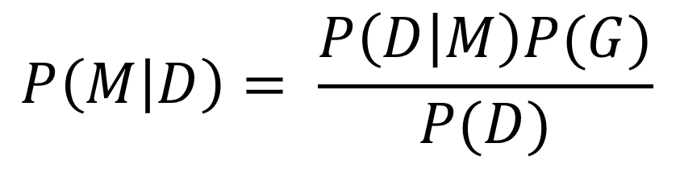
Likelihood vs. posteriors
$$P\left(M | D\right)= \frac{P\left(D | M\right)P(G)}{P(D)}$$
Maximum likelihood approach: find model M (AA,AB,BB) that maximizes the likelihood P(D|M)
Maximum a posteriori (MAP) approach: find model M that maximizes the posterior P(M|D)
Notes:
N: total number of reads
K: number of non-reference alleles
E: error rate

Slide 44
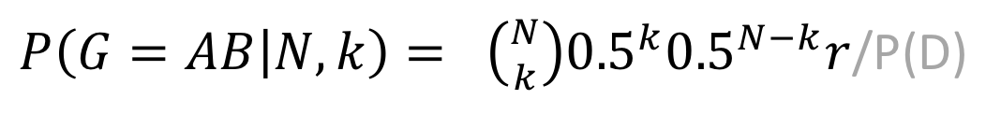
SNP calling – MAP (example model)
N: total number of reads
K: number of non-reference alleles
e: error rate
r: prior probability of a heterozygous genotype (not very realistic way to set prior)
Can model using a binomial distribution:
$P(G=AA|N,k)= \left({N \atop k}\right){\left(1−ε\right)}^{N−k}ε^{k}(1−r)/2$ /P(D)
$P\left(G=BB | N, k\right)=\left({N \atop k}\right){\left(1−ε\right)}^{k}ε^{N−k}(1−r)/2$ /P(D)
$P\left(G=AB | N,k\right)= \left({N \atop k}\right){0.5}^{k}{0.5}^{N−k}r$/P(D)
Notes:
=

Slide 45
SNP calling – alternative approaches
Heuristic:
E.g. Varscan, samtools
Maximum a posteriori (see hidden slides):
E.g. MAQ
Expectation maximization:
E.g. SNVMix
Maximum likelihood:
E.g. GATK returns genotype likelihood scores
Machine learning (e.g. use SVM to determine if a position is a SNP)
Try out your own!
PS4 Part 2
Notes:
N: total number of reads
K: number of non-reference alleles
E: error rate

Slide 46
Genotype calls in VCF format
VCF header describes fields
##fileformat=VCFv4.2
##FILTER=<ID=PASS,Description="All filters passed">
##samtoolsVersion=1.2+htslib-1.2.1
##samtoolsCommand=samtools mpileup -g –o test.bcf –f Homo_sapiens_assembly19.fasta /b
##reference=file:Homo_sapiens_assembly19.fasta
##ALT=<ID=X,Description="Represents allele(s) other than observed.">
##INFO=<ID=AC,Number=A,Type=Integer,Description="Allele count in genotypes for each ALT allele, in the same order as listed">
##INFO=<ID=AN,Number=1,Type=Integer,Description="Total number of alleles in called genotypes">
##INFO=<ID=DP4,Number=4,Type=Integer,Description="Number of high-quality ref-forward , ref-reverse, alt-forward and alt-reverse bases">
##FORMAT=<ID=PL,Number=G,Type=Integer,Description="List of Phred-scaled genotype likelihoods">
##FORMAT=<ID=GT,Number=1,Type=String,Description="Genotype">
##INFO=<ID=MQ,Number=1,Type=Integer,Description="Average mapping quality">
. . .
##bcftools_callVersion=1.2+htslib-1.2.1
##bcftools_callCommand=call -vmO z -o test.vcf.gz test.bcf
#CHROM POS ID REF ALT QUAL FILTER INFO FORMAT example
INFO fields describe each locus (e.g. AC)
FORMAT fields describe each individual call (e.g. GT)
Example entries
SNP (A/C)
1 20321 . A C 12.5244 . DP=96;AC=1;AN=2 MQ=8 GT:PL 0/1:45,0,62
1 66377 . A ATTT 13.5315 . INDEL;DP=2;AC=2;AN=2;MQ=30 GT:PL 1/1:41,6,0
Indel (A/ATTT)

Slide 47
A note on VCF fields for likelihood methods
GL=log₁₀(L_{AA}), log₁₀(L_{AB}),log₁₀(L_{BB}),
PL=-10log₁₀(L_{AA}), -10log₁₀(L_{AB}),-10log₁₀(L_{BB}),
Notes:
N: total number of reads
K: number of non-reference alleles
E: error rate

Slide 48
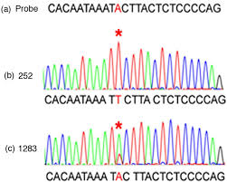
Evaluating short variant calls
1. Comparison to “ground truth” (e.g. SNP array) via a “confusion table”
“Ground truth”
 | AA | AB | BB
AA | 100 | 20 | 0
AB | 10 | 150 | 5
BB | 2 | 10 | 90
False negatives
NGS
False positives
2. Experimentally validate (e.g. Sanger sequencing)
3. “Sanity checks” (next slides)
Notes:
Confusion matrix
Accuracy
Compare to snp genotype
Sanger seq

Slide 49
How many SNPs should we find?
(2010)
~3-4 million SNPs (compared to reference) for a single human genome
Transition to transversion ratio (Ti/Tv) should be around 2.1

Slide 50
A “typical” genome varies by ancestry
AFR
AMR
# SNPs
SAS
EUR
EAS
A global reference for human genetic variation

Slide 51
Sources of error in variant calling

Slide 52
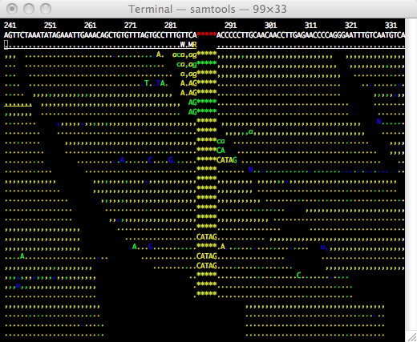
Is this really a variant?
Reference genome
T
A
A
A
T
T
T
All the variant bases are at the ends of reads – bad sign!

Slide 53
Is this really a variant?
Duplicated sequence
Reference genome
T
A
T
A
T
A
T
A
T
A
MAPQ=0
MAPQ=60

Slide 54
Is this really a variant?
This one looks more promising…
Unreliable SNP call!
All supporting reads are PCR duplicates

Slide 55
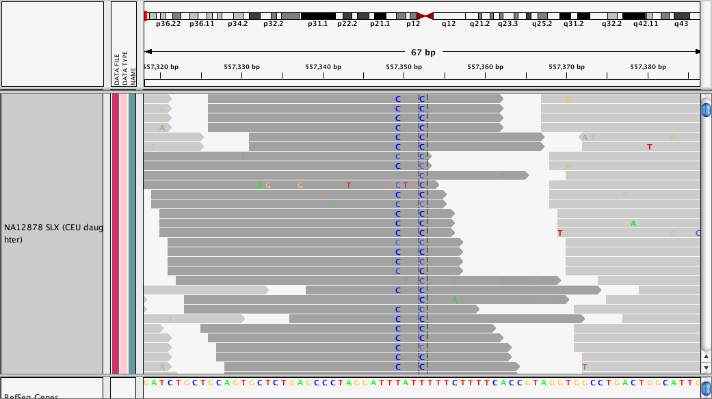
Is this really a variant?

Slide 56
SNP calling – complications and artifacts
MANY potential sources/signs of error, including:
Variant only seen at read ends
Variant only seen on one strand
Multiple nearby variants, complicate alignment
Indels get messy!
PCR duplicates
Poorly mappable regions, e.g. repeats, are source of false positive SNPs
Regions with very low or very high coverage are error prone

Slide 57
State of the art variant calling

Slide 58
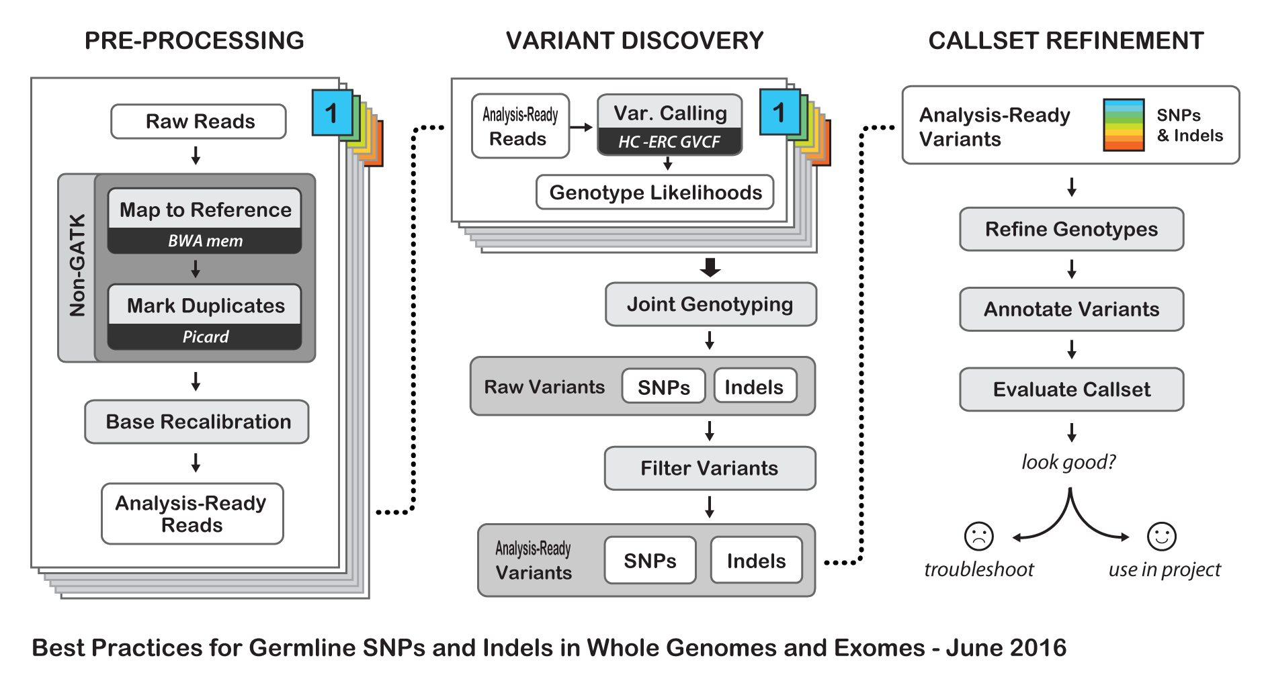
The Genome Analysis Toolkit
http://www.broadinstitute.org/gatk/guide/best-practices

Slide 59
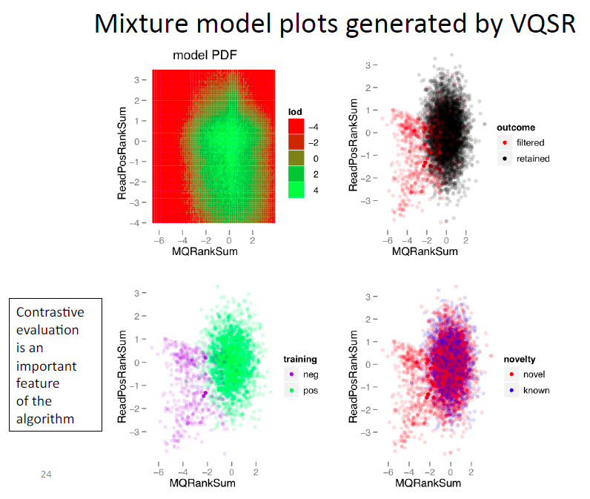
Variant score recalibration
http://weallseqtoseq.blogspot.com/2013/10/gatk-best-practices-workshop-variant.html

Slide 60
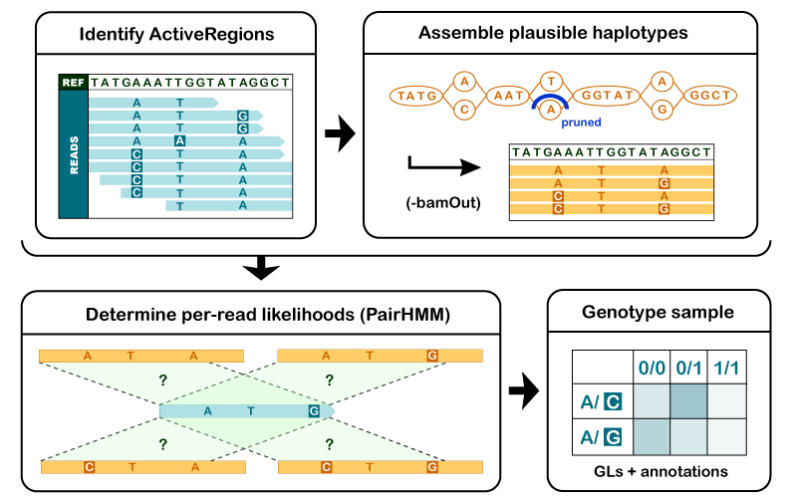
GATK HaplotypeCaller
http://gatkforums.broadinstitute.org/

Slide 61
DeepVariant
Poplin et al Nature Biotechnology 2018

Slide 62
DeepVariant
True SNP
True indel (het)
True indel (hom)
Error
https://ai.googleblog.com/2017/12/deepvariant-highly-accurate-genomes.html

Slide 63
What about other variant types?

Slide 64
Genetic variation comes in many forms!
SNP
Short indel (1-20bp)
Struct. Var /CNV (>20bp)
ACGACTCGAGCG
ACGACTCGAGCG
ACGACACGAGCG
ACGAC-CGAGCG
μ_{SNP}: 1.20 × 10⁻⁸ /loc/gen
μ_{INDEL}: 0.68 × 10⁻⁹ /loc/gen
Alu retrotransposition
Short tandem repeat
We can genotype a lot of these more complex things from NGS too!
We just need some creative tools.
Also: long reads will help. More next week!
CAGCAG---CAGCAGCA
CAGCAGCAGCAGCAGCA
Alu
μ_{STR}: 10⁻²-10⁻⁵ /loc/gen

Slide 65
Genotyping STRs from short reads (GangSTR)
Key idea: leverage multiple sources of info from paired-end reads
Output: maximum likelihood diploid copy number at each TR in the genome
(~1 million TRs in hg19)
Mousavi et al. NAR 2019
https://github.com/gymreklab/GangSTR

Slide 66
Genotyping variable number tandem repeats from NGS
“AdVNTR”

Slide 67
Genotyping structural variants

Slide 68
Identifying variants in duplicated regions

