Slide 1
Intro to NGS
(05/03/21)
Today’s schedule:
Intro to NGS
Overview of NGS analysis pipeline
Announcements:
Journal club #3 released
Problem set #4 released
Proposals due Wednesday night
Notes:
Assignments released
Please remember proposals due weds night.
We will then start going through them and setting up times to briefly meet with each team

Slide 2
Module | Date | Lecture | Homework
Intro to personal genomics | 03-29 (M) | Introduction to your genome
Ancestry | 03-31 (W) | Basic Population genetics/JC1 | JC1 questions
 | 04-05 (M) | Phasing and Imputation/HMMs | PS1 (due 4/5)
 | 04-07 (W) | Relative finding
 | 04-12 (M) | Determining ancestry
 | 04-14 (W) | Genetic genealogy/Ethics | PS2 (due 4/16)
Trait Prediction | 04-19 (M) | Mendelian(ish) Traits
 | 04-21 (W) | Risk prediction | JC2 questions
 | 04-26 (M) | Controlling for confounding
 | 04-28 (W) | Missing heritability | PS3 (due 4/30)
Next-generation sequencing | 05-03 (M) | Intro to NGS
 | 05-05 (W) | Alignment+variant calling | Project proposal
 | 05-10 (M) | Clinical genome sequencing | JC3 questions
 | 05-12 (W) | Long reads
 | 05-17 (M) | Ancient genomes | PS4
 | 05-19 (W) | Ethics part 2 | JC4 questions
Special Topics/Final Projects | 05-23 (M) | Deep learning in genomics
 | 05-57 (W) | Project presentations
 | 05-31 (M) | Memorial Day – no lecture
 | 06-02 (W) | Project presentations | Project Due (06/04)
Notes:
starting 4th module move to focusing on NGS and its applications
however, as before we're not going to forget about what we’ve covered so far
will still focus on applications of this technology to personal genomics, primarily in related to disease diagnosis
as usual, for any genetics application we'll always have to be aware of effects ancestry can have on our analyses

Slide 3
Next-generation sequencing
Monday, May 3
  Intro to NGS
Wednesday, May 5 (Proposal due)
  Sequence alignment + intro to variant calling / interpretation
Monday, May 10
  Clinical WGS +variant interpretation / JC3
Wednesday, May 12
  Long read sequencing technologies (ONT, PacBio)
Monday, May 17: Ancient genomics
Wednesday, May 19: Ethics part 2
Monday, May 24: Machine learning in personal genomics
Notes:
today: lot of background on technology and the data, which is going to be important to have in order to talk about analysis techniques and application
If you’ve seen NGS before this is likely to be a review. I still hope you find it helpful
If you haven’t, today should get you up to speed on the types of data we get from NGS
Then, on Wednesday we’ll go into more details of the computational methods used to analyze NGS
Next week will focus on clinical applications and long reads
Finally, last couple weeks we’ll cover a variety of special topics

Slide 4
Intro to NGS

Slide 5

NGS vs. “SNP chips”
A C G T T G C A T A C C C T T
A A G T A G C A C A C C C T T
“SNP chips” (Genotyping): interrogate a targeted set (usually around ~1.5 million) of known polymorphic sites
A C G T T G C A T A C C C T T
A A G T A G C A C A C C C T T
Sequencing: sequence the “entire” genome (or region of the genome)
Advantages? Disadvantages?
Notes:
Consider this person’s genome
Until now we’ve considered only SNP genotype data
Considered SNP chips like you get from 23andme
Only get ~1.5 million sites we know are polymorphic
Now, we will consider instead *sequencing* data, where we sequence the entire genome, not just a prespecified set of sites
What are advantages/disadvanatages?
Misconception: that 23andme could find rare disease causing mutations. Those aren’t really considered

Slide 6
NGS vs. “SNP chips”
Advantages:
Sequence “all” of the genome
Can get at rare or private variants
Can get at more “complex” variants
Disadvantages:
$$$. Sequencing ~$1,000. Array ~$100. (although prices going down)
Analysis challenges. More artifacts we’ll have to deal with
Bigger datasets, creates more logistical challenges

Slide 7
NGS in personal genomics - diagnosis
We won’t find rare pathogenic variants using genotyping arrays!
NGS much better suited for “mutation hunting” (JC3)
Notes:
premise of the class is personal genomics
always like to keep in mind what are the applications
one of main applications of NGS, especially over arrays, is power to diagnose rare diseases
a lot of focus has been on rare pediatrics conditions
Will talk more about this in JC3 next week

Slide 8
NGS in personal genomics – cancer genomics
2012!
Notes:
of course another huge application is cancer genomics
many companies offering targeted NGS of cancer genes to identify specific mutations
highlighted some here including from Illumina
we won’t really be covering cancer genomics here. It’s a whole field and there are many experts at UCSD I can point you to if you’re interested

Slide 9
NGS in personal genomics – complex variants
Genotype arrays don’t capture (directly):
Structural variants
STRs
CNVs
And more
Struct. Var /CNV (>20bp)
Short tandem repeat
Alu retrotransposition
CAGCAG---CAGCAGCA
CAGCAGCAGCAGCAGCA
Alu
μ_{STR}: 10⁻²-10⁻⁵ /loc/gen
Notes:
SNP arrays only gave us what we were looking for

Slide 10
Where can you get your genome sequenced?
(Not an exhaustive list. Some numbers are old)
  Veritas (whole genome $1,000, went down to $200 in 2018?)
  23andMe had pilot exome sequencing for $1,000, seems no longer available?
  Nebula $299 https://www.businessinsider.com/nebula-launches-direct-to-consumer-whole-genome-sequencing-test-2020-2
Notes:
maybe somebody knows where you can get this done?
Not sure how nebula gets away with this.

Slide 11
NGS technology
Notes:
important to understand the technology

Slide 12
Sequencing – then and now
2000s
Other systems: ABI SOLID, Ion Torrent, PacBio
1977
Sanger Sequencing
1990
Human Genome Project
started
2003
HGP
completed
~2017
$1,000 Genome
2007
Illumina/Solexa
~1980
Shotgun sequencing
2005
First NGS system
(454, Roche)
~2015+
ONT
1980 Nobel Prize for dideoxy (“Sanger”) sequencing
Notes:
to understand the technology, I think it's also useful to understand a bit of the history leading up to where we are now
here is roughly a timeline leading from first DNA sequencing method up to where we are now

Slide 13
Dideoxy (“Sanger”) sequencing
ACGCATCGATCGGGACTACGACTAGCTACGTACACG
Polymerase + mix of dNTPs, fluorescent ddNTPs
ACGCATCGATCGGGACTACGACTAGCTACGTACACG
ACGCATCGATC
ACGCATCGATCG
Separate by size
ACGCATCGATCGGGACTAC
ACGCATCGATCGGGA
ACGCATCGATCGGGA
ACGCATCGATCGGG
ACGCATCGATCGG
ACGCATCGATCG
ACGCATCGATC
Read colors with a laser
Detect
Notes:
Show pedigree with CF
Show height
Or case control

Slide 14
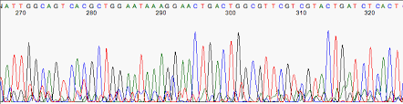
Dideoxy (“Sanger”) sequencing
Read off the gel!
ACGCATCGATCGGGACTACGACTAGCTACGTACACG
ACGCATCGATCGGGA
ATCGATCGGGA
ACGCATCGATCGGG
ACGCATCGATCGG
ACGCATCGATCG
“A”
“C”
“G”
“T”
ACGCATCGATC
Still used as a gold standard method to validate sequences today
Hard to sequence very long molecules. Why?
Smaller <- Size -> Larger
Gel
Notes:
Show pedigree with CF
Show height
Or case control

Slide 15
Shotgun sequencing
A genome
…
Shotgun sequencing
Parallelize on 384 well plates
Capillary tubing for size selection
Sanger sequencing
Notes:
Show pedigree with CF
Show height
Or case control

Slide 16
Sequencing – then and now
2000s
Other systems: ABI SOLID, Ion Torrent, PacBio
1977
Sanger Sequencing
1990
Human Genome Project
started
2003
HGP
completed
~2017
$1,000 Genome
2007
Illumina/Solexa
~1980
Shotgun sequencing
2005
First NGS system
(454, Roche)
~2015+
ONT
HGP based on shotgun sequencing
>10 years for 1 genome!
Notes:
Show pedigree with CF
Show height
Or case control

Slide 17

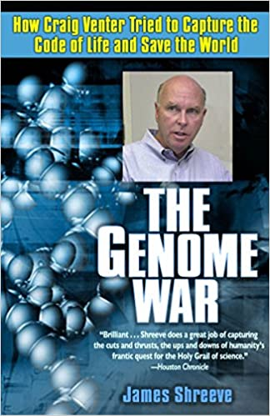
The human genome is sequenced (2001)
$3 Billion public project beginning in 1990
In 1998, Craig Venter started competing private project at Celera
“Draft” published in 2000. We still do not have a complete genome sequence!
>70% of this “reference genome” from a single male donor from Buffalo, NY (RP11). At least 4 individuals included.

Slide 18
Sequencing – then and now
2000s
Other systems: ABI SOLID, Ion Torrent, PacBio
1977
Sanger Sequencing
1990
Human Genome Project
started
2003
HGP
completed
~2017
$1,000 Genome
2007
Illumina/Solexa
~1980
Shotgun sequencing
2005
First NGS system
(454, Roche)
~2015+
ONT
HGP based on shotgun sequencing
>10 years for 1 genome!
Enter: the next generation!
1 genome = ~$600
Notes:
Show pedigree with CF
Show height
Or case control

Slide 19
Illumina sequencing overview
Extract DNA from cells of target sample
(we’ll sequence DNA from *many* cells at once=many genome copies)
Fragment
Adapters
PCR
Sequencing
Analysis
Most of what we’ll talk about in Module 4!
Today
Notes:
Show pedigree with CF
Show height
Or case control

Slide 20
Illumina sequencing overview – library prep
Fragment
Adapters
PCR
Sequencing
Analysis
A genome
…
Genome is fragmented to ~several hundred bp segments
Fragments usually ~normally distributed
Notes:
Show pedigree with CF
Show height
Or case control

Slide 21
Illumina sequencing overview – library prep
Fragment
Adapters
PCR
Sequencing
Analysis
…
A genome
Fragment
Attach adapters
P5
P7

Slide 22
Illumina sequencing overview – library prep
Fragment
Adapters
PCR
Sequencing
Analysis
Amplification cycles
PCR may introduce errors/biases! Why?
Also, variations on this theme:
PCR free
Whole exome/targeted
Notes:
Top: show outline of steps
Here: PCR amplification
Mention variations on this (exome/PCR-free)

Slide 23
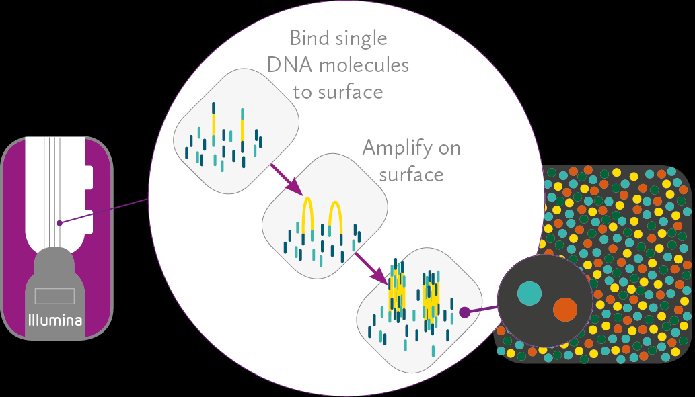


Illumina sequencing overview – sequencing
Fragment
Adapters
PCR
Sequencing
Bind single DNA molecules to surface (using adapter sequence)
Amplify on the surface “Bridge amplification”
Result: “clusters” of clonal DNA copies

Slide 24

Illumina sequencing overview – sequencing
“sequencing by synthesis”
Polymerase, reversible terminator dNTPs (similar trick to Sanger seq!)
G
Take picture
A
G
C
T
A
T
C
G
A
A
T
A

Slide 25
Illumina sequencing overview – sequencing
“sequencing by synthesis”
Polymerase, reversible terminator dNTPs (similar trick to Sanger seq!)
G
Take picture
A
Remove terminator
T
C
Repeat
G
T
A
A
T
A
T

Slide 26
Illumina sequencing overview – sequencing
“sequencing by synthesis”
Polymerase, reversible terminator dNTPs
C
G
Take picture
T
A
Remove terminator
A
T
G
C
Repeat
C
G
T
A
A
T
…
A
T
C
G
A
T
C

Slide 27

Illumina sequencing – sequencing by synthesis
Millions of images at once!
Each cluster=clonally related DNA copies
“Massively parallel”
http://data-science-sequencing.github.io/Win2018/lectures/lecture2/
Notes:
Show pedigree with CF
Show height
Or case control

Slide 28
Illumina sequencing – paired-end sequencing
Sequence fragment from one end
Wash away strand that is already read
Sequence again, in the opposite direction
~400bp
~100bp
Notes:
Show pedigree with CF
Show height
Or case control

Slide 29
Paired-end sequencing
Read 1 (~100bp)
(from forward strand)
This part usually not sequenced!
5’
3’
3’
5’
Read 2 (~100bp)
(from reverse strand)
Insert size/template length (~several hundred bp)
Sizes are ~normally distributed
(Sometimes this can happen though, resulting in some overlap of reads1+2.)
5’
3’
3’
5’
Notes:
Helpful video: http://www.youtube.com/watch?v=HMyCqWhwB8E&t=1m30s

Slide 30
Sequencing – then and now
2000s
Other systems: ABI SOLID, Ion Torrent, PacBio
1977
Sanger Sequencing
1990
Human Genome Project
started
2003
HGP
completed
~2017
$1,000 Genome
2007
Illumina/Solexa
~1980
Shotgun sequencing
2005
First NGS system
(454, Roche)
~2015+
ONT
(Now, the price is more like ~$600. $100 genome is not that far away though.)
Notes:
Show pedigree with CF
Show height
Or case control

Slide 31
To see more about Illumina sequencing…
https://www.youtube.com/watch?annotation_id=annotation_1533942809&feature=iv&src_vid=HMyCqWhwB8E&v=fCd6B5HRaZ8
Notes:
Helpful video: http://www.youtube.com/watch?v=HMyCqWhwB8E&t=1m30s

Slide 32
NGS – the data
Notes:
important to understand the technology

Slide 33
The data! – “FASTQ”
ERR194146_1.fastq
(first end of each pair)
@ERR194146.1 HSQ1008:141:D0CC8ACXX:3:1308:20201:36071/1
ACATCTGGTTCCTACTTCAGGGCCATAAAGCCTAAATAGCCCACACGTTCCCCTTAAATAAGACATCACGATGGATCACAGGTCTATCACCCTATTAACCA
+
?@@FFBFFDDHHBCEAFGEGIIDHGH@GDHHHGEHID@C?GGDG@FHIGGH@FHBEG:GGIEEHH;@CHH=EDFFBBE>;@?3;;;>;;;AA?<C>C@@C:
@ERR194146.2 HSQ1008:141:D0CC8ACXX:4:1208:5231:93701/1
CCAGCGTCTCGCAATGCTATCGCGTGCATACCCCCCAGACGAAAATACCAAATGCATGGAGAGCTCCCGTGAGTGGTTAATAGGGTGATAGACCTGTGATC
+
?88ADA?BDF8F:@@DB49C>B7C806B<?DEF=@FFC=AABEA<;@D>AC265;ADA;@@?<@B@A<;?5(8+:0>(4:@AAA832?@@BBBB:<4(:>>
@ERR194146.3 HSQ1008:141:D0CC8ACXX:2:1305:18078:8420/1
GATCACAGGTCTATCACCCTATTAACCACTCACGGGAGCTCTCCATGCATTTGGTATTTTCGTCTGGGGGGTATGCACGCGATAGCATTGCGAGACGCTGG
+
@CCFFFFFHHFGHJIGJJJJJJJJJJJIJIIJJJIJJJIGJJJJIIJIGIHIJI=FFIJJJJHHJHGHHDD;@CDDEDDDDDBDDDCECDDDDDBDDDDDD
Each read described by 4 lines
Line 1: “@” + Read ID
Line 2: Nucleotides
Line 3: “+”
Line 4: Base quality scores
ERR194146_2.fastq
(second end of each pair)
@ERR194146.1 HSQ1008:141:D0CC8ACXX:3:1308:20201:36071/2
CCAGCGTCTCGCAATGCTATCGCGTGCATACCCCCCAGACGAAAATACCAAATGCATGGAGAGCTCCCGTGAGTGGTTAATAGGGTGATAGACCTGTGATC
+
<?@DDDBDHHHAAH@CG@FBBGGIEG@D@GCHFG@F/5=C4=B'=7?CA9@?ACDCDCA@<?BDCCCB=BB0<4>?4?>@:CCD???A:@C3>A>AC:++:
@ERR194146.2 HSQ1008:141:D0CC8ACXX:4:1208:5231:93701/2
CCCACACGTTCCCCTTAAATAAGACATCACGATGGATCACAGGTCTATCACCCTATTAACCACTCACGGGAGCTCTCCATGCATTTGGTATTTTCGTCTGG
+
@??BD1:AFHBDDGGHIJIF@EEE>GFHGHEAG?DEG<FD>B;?BB<*/9??C8BB@FHC7=CCGAE;=,5,,.;@@>(5(;>ACCC(,,5;>CCB88<??
@ERR194146.3 HSQ1008:141:D0CC8ACXX:2:1305:18078:8420/2
GATCACAGGTCTATCACCCTATTAACCACTCACGGGAGCTCTCCATGCATTTGGTATTTTCGTCTGGGGGGTATGCACGCGATAGCATTGCGAGACGCTGG
+
@CCFFFFFHHFGHJIGJJJJJJJJJJJIJIIJJJIJJJIGJJJJIIJIGIHIJI=FFIJJJJHHJHGHHDD;@CDDEDDDDDBDDDCECDDDDDBDDDDDD

Slide 34
Base quality scores quantify uncertainty
Fluorescence intensity
A
C
G
T
Pretty sure it’s an A. Could be a T.
Notes:
Show pedigree with CF
Show height
Or case control

Slide 35
Base quality scores quantify uncertainty
Probability that the most intense color is the correct base
Fluorescence intensity
A
C
G
T
Notes:
Show pedigree with CF
Show height
Or case control

Slide 36
Base quality scores (Phred scores)
@ERR194146.1 HSQ1008:141:D0CC8ACXX:3:1308:20201:36071/1
ACATCTGGTTCCTACTTCAGGGCCATAAAGCCTAAATAGCCCACACGTTCCCCTTAAATAAGACATCACGATGGATCACAGGTCTATCACCCTATTAACCA
+
?@@FFBFFDDHHBCEAFGEGIIDHGH@GDHHHGEHID@C?GGDG@FHIGGH@FHBEG:GGIEEHH;@CHH=EDFFBBE>;@?3;;;>;;;AA?<C>C@@C:
Q = -10 log₁₀(Prob. Of error)
Phred Score | Prob. Of incorrect call | Base call accuracy
10 | 1 in 10 | 90%
20 | 1 in 100 | 99%
30 | 1 in 1,000 | 99.9%
40 | 1 in 10,000 | 99.99%
50 | 1 in 100,000 | 99.999%
Base quality score symbol = ASCII(Q+33)
e.g. 10=+, 20=5, 30=?

Slide 37
Quality scores and read length
Base quality
Read position (cycle number)
Why do quality scores degrade across the read?
Notes:
Show pedigree with CF
Show height
Or case control

Slide 38
Base quality scores quantify uncertainty
Errors accumulate each cycle
Eventually we have a hard time distinguishing the true base!
Fluorescence intensity
Fluorescence intensity
Fluorescence intensity
Fluorescence intensity
Fluorescence intensity
A
A
A
A
A
C
C
C
C
C
G
G
G
G
G
T
T
T
T
T
Notes:
Show pedigree with CF
Show height
Or case control

Slide 39
Quality scores and read length
Base quality
Read position (cycle number)
Notes:
Show pedigree with CF
Show height
Or case control

Slide 40
Sources of error and bias in NGS
“Upstream” errors:
Contamination of sample
Too many “primer dimers”
Errors introduced during PCR
  Mutations (e.g. SNPs or indels)
  GC bias (could get dropout of very rich GC regions)
“Sequencing” errors:
Illumina per-base error rate usually <1%
Errors still common at complex rations (e.g. TTTTTTT, GGGGGGG)
“Analysis” errors:
Lots of stuff can go wrong ☺ We’ll see some examples later.
Notes:
Show pedigree with CF
Show height
Or case control

Slide 41
Types of NGS experiments
Whole genome sequencing (WGS) - unbiased sequencing of all genomic DNA
Targeted sequencing - sequence after enriching for a certain target area
Exome sequencing (WES) - targeted sequencing of only protein coding regions. Advantages? Disadvantages?
“OMICS” experiments – e.g. RNAseq, ChIP-seq, DNAseI-seq
Notes:
Whole genome
Whole exome
Targeted
RNAseq, ChIPseq, etc.

Slide 42
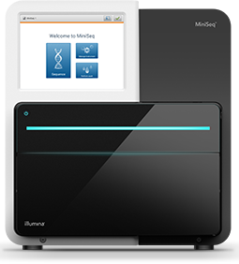
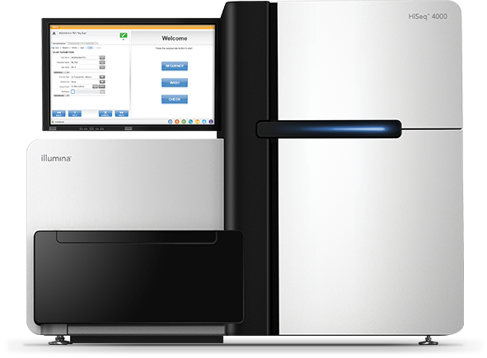
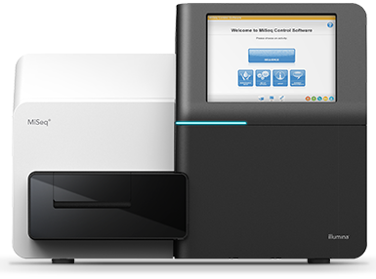
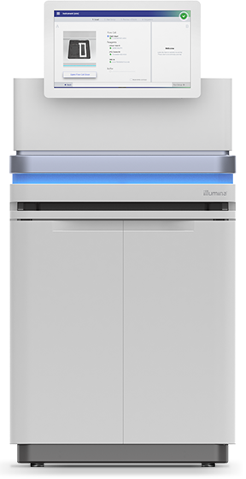
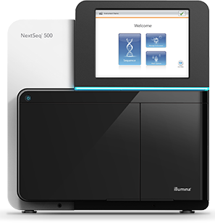
Typical NGS datasets
Initial read lengths of 2x36, 2x50, 2x76 from Genome Analyzer or GAII (e.g. 2010)
Currently, most common read lengths 100-150bp
Modern-day Illumina read lengths:
MiniSeq: 2 x 150bp
HiSeq: 2 x 150bp
MiSeq: 2 x 300bp
Novaseq: 2 x 300bp
NextSeq: 2 x 150bp
Notes:
Show pedigree with CF
Show height
Or case control

Slide 43
(Break)
NGS analysis workflow

Slide 44

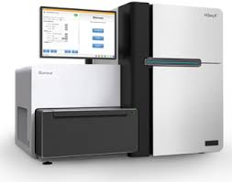

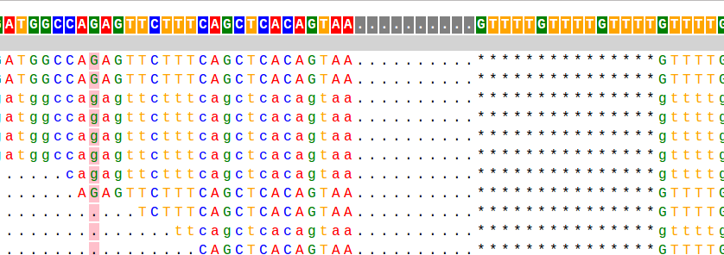
Outline
1. SEQUENCING
2. ALIGNMENT
Reference
ACGTACGGATATGCGATACGACAT
Reads
3. GENOTYPING
4. VISUALIZATION
CCA-CTCTACTCACAC----TAGC
SNPs/Indels
STRs
CCAACGCTACTCACACACACTAGC

Slide 45
The data! – “FASTQ”
ERR194146_1.fastq
(first end of each pair)
@ERR194146.1 HSQ1008:141:D0CC8ACXX:3:1308:20201:36071/1
ACATCTGGTTCCTACTTCAGGGCCATAAAGCCTAAATAGCCCACACGTTCCCCTTAAATAAGACATCACGATGGATCACAGGTCTATCACCCTATTAACCA
+
?@@FFBFFDDHHBCEAFGEGIIDHGH@GDHHHGEHID@C?GGDG@FHIGGH@FHBEG:GGIEEHH;@CHH=EDFFBBE>;@?3;;;>;;;AA?<C>C@@C:
@ERR194146.2 HSQ1008:141:D0CC8ACXX:4:1208:5231:93701/1
CCAGCGTCTCGCAATGCTATCGCGTGCATACCCCCCAGACGAAAATACCAAATGCATGGAGAGCTCCCGTGAGTGGTTAATAGGGTGATAGACCTGTGATC
+
?88ADA?BDF8F:@@DB49C>B7C806B<?DEF=@FFC=AABEA<;@D>AC265;ADA;@@?<@B@A<;?5(8+:0>(4:@AAA832?@@BBBB:<4(:>>
@ERR194146.3 HSQ1008:141:D0CC8ACXX:2:1305:18078:8420/1
GATCACAGGTCTATCACCCTATTAACCACTCACGGGAGCTCTCCATGCATTTGGTATTTTCGTCTGGGGGGTATGCACGCGATAGCATTGCGAGACGCTGG
+
@CCFFFFFHHFGHJIGJJJJJJJJJJJIJIIJJJIJJJIGJJJJIIJIGIHIJI=FFIJJJJHHJHGHHDD;@CDDEDDDDDBDDDCECDDDDDBDDDDDD
ERR194146_2.fastq
(second end of each pair)
@ERR194146.1 HSQ1008:141:D0CC8ACXX:3:1308:20201:36071/2
CCAGCGTCTCGCAATGCTATCGCGTGCATACCCCCCAGACGAAAATACCAAATGCATGGAGAGCTCCCGTGAGTGGTTAATAGGGTGATAGACCTGTGATC
+
<?@DDDBDHHHAAH@CG@FBBGGIEG@D@GCHFG@F/5=C4=B'=7?CA9@?ACDCDCA@<?BDCCCB=BB0<4>?4?>@:CCD???A:@C3>A>AC:++:
@ERR194146.2 HSQ1008:141:D0CC8ACXX:4:1208:5231:93701/2
CCCACACGTTCCCCTTAAATAAGACATCACGATGGATCACAGGTCTATCACCCTATTAACCACTCACGGGAGCTCTCCATGCATTTGGTATTTTCGTCTGG
+
@??BD1:AFHBDDGGHIJIF@EEE>GFHGHEAG?DEG<FD>B;?BB<*/9??C8BB@FHC7=CCGAE;=,5,,.;@@>(5(;>ACCC(,,5;>CCB88<??
@ERR194146.3 HSQ1008:141:D0CC8ACXX:2:1305:18078:8420/2
GATCACAGGTCTATCACCCTATTAACCACTCACGGGAGCTCTCCATGCATTTGGTATTTTCGTCTGGGGGGTATGCACGCGATAGCATTGCGAGACGCTGG
+
@CCFFFFFHHFGHJIGJJJJJJJJJJJIJIIJJJIJJJIGJJJJIIJIGIHIJI=FFIJJJJHHJHGHHDD;@CDDEDDDDDBDDDCECDDDDDBDDDDDD

Slide 46
Fast alignment to the reference genome
Goal: Where in the genome does each read originate?
Reference genome: ~3×10⁹ bp
?
Reads: ~100bp

Slide 47
The raw data! (reference genome, fasta)
hg19.fasta
>chr5
AGCTTTTCATTCTGACTGCAACGGGCAATATGTCTCTGTGTGGATTAAAAAAAGAGTGTCTGATAGCAGC
TTCTGAACTGGTTACCTGCCGTGAGTAAATTAAAATTTTATTGACTTAGGTCACTAAATACTTTAACCAA
TATAGGCATAGCGCACAGACAGATAAAAATTACAGAGTACACAACATCCATGAAACGCATTAGCACCACC
ATTACCACCACCATCACCATTACCACAGGTAACGGTGCGGGCTGACGCGTACAGGAAACACAGAAAAAAG
CCCGCACCTGACAGTGCGGGCTTTTTTTTTCGACCAAAGGTAACGAGGTAACAACCATGCGAGTGTTGAA
GTTCGGCGGTACATCAGTGGCAAATGCAGAACGTTTTCTGCGTGTTGCCGATATTCTGGAAAGCAATGCC
AGGCAGGGGCAGGTGGCCACCGTCCTCTCTGCCCCCGCCAAAATCACCAACCACCTGGTGGCGATGATTG
AAAAAACCATTAGCGGCCAGGATGCTTTACCCAATATCAGCGATGCCGAACGTATTTTTGCCGAACTTTT
GACGGGACTCGCCGCCGCCCAGCCGGGGTTCCCGCTGGCGCAATTGAAAACTTTCGTCGATCAGGAATTT
Chromosome (everything after “>” until the first space)
For humans: chr1, chr2, …. chr22, chrX, chrY
Pay attention to the reference build!
For humans: reference assembly gets updated every couple of years!
GRCh38 (most recent), hg19 (lab 1), hg18
Notes:
Talk about updates to human ref genome

Slide 48

Fast alignment to the reference genome
Goal: Where in the genome does each read originate?
Reference genome: ~3×10⁹ bp
?
Reads: ~100bp
Solution: Index genome in quickly searchable data structure
Chr1:3899292
ACGATAG
ATCGACGATAGCCG
ACGATAG
Genome
Index
BWT details Wednesday!
(Burrows Wheeler Transform)

Slide 49
Sequence alignment example
bwa index hg19.fa
Create the BWT index first!
…
bwa mem hg19.fa reads.fq
…
Single-end reads
…
…
Paired-end reads
bwa mem hg19.fa reads_1.fq reads_2.fq

Slide 50
SAM/BAM format stores alignment info
bwa mem hg19.fa reads_1.fq reads_2.fq > aligned_reads.sam
samtools view aligned_reads.sam
Tab-delimited text file
One line per read (usually)
3rd column =
chromosome
(lines are cut off on the right so they fit on the slide)
4th column =
position
SAM: Sequence Alignment/Map format
BAM: binary SAM format
CRAM: compressed BAM format
Notes:
Todo show command outputting to sam
Show example SAM line
Chrom, pos, other fields

Slide 51
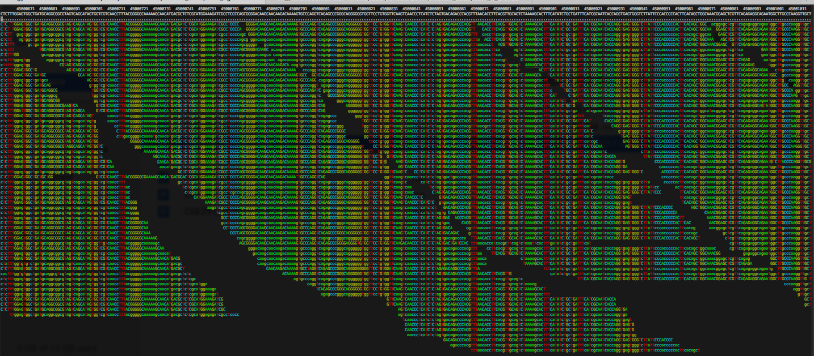
Example alignment view
Reference genome
Aligned reads

Slide 52
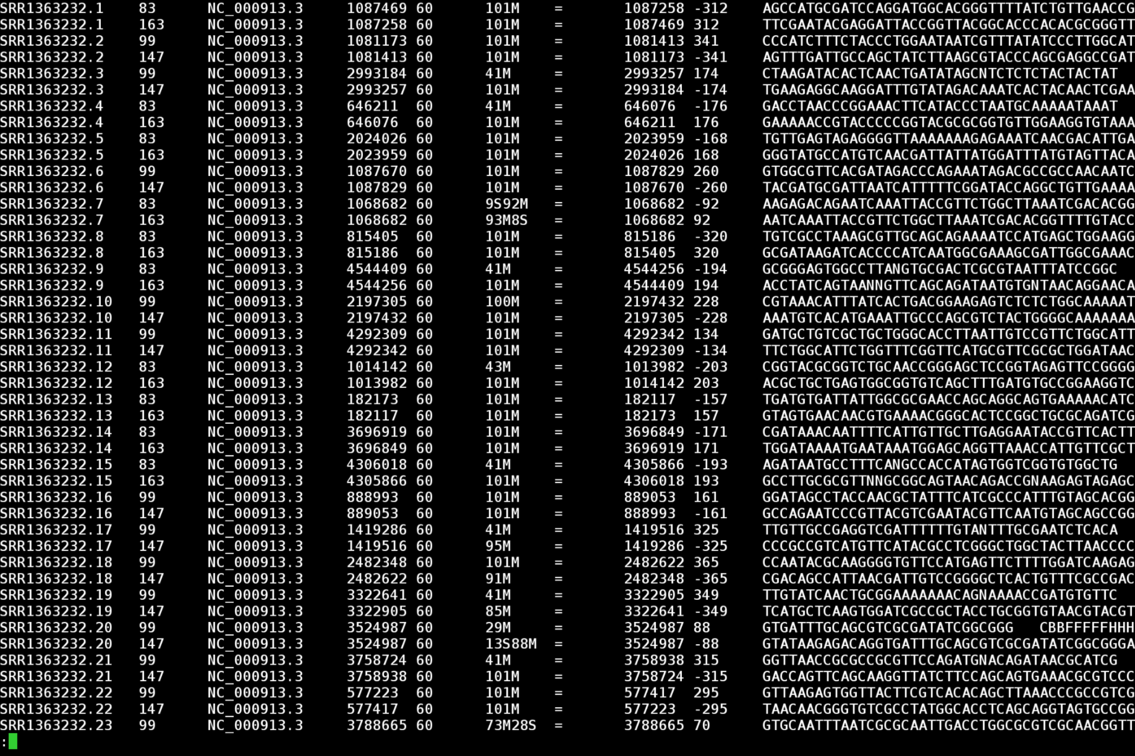
SAM/BAM files store alignment information
CIGAR
Column 1: read ID
Column 2: flag
Column 3: chromosome
Column 4: start position
…

Slide 53
CIGAR scores give detailed alignment info
M: match
D: deletion
I: insertion
Reference
31M
ACGATCATCAAAAAAAAAACTGATGTTCATA
Read
ACGATCATCAAAAAAAAAACTGATGTTCATA
Reference
19M2I12M
ACGATCATCAAAAAAAAAA--CTGATGTTCATA
Read
ACGATCATCAAAAAAAAAAAACTGATGTTCATA
Reference
9M2D20M
ACGATCATCAAAAAAAAAACTGATGTTCATA
Read
ACGATCATC--AAAAAAAACTGATGTTCATA
Notes:
Show pedigree with CF
Show height
Or case control

Slide 54
SAM flag gives additional info
Flag
Notes:
Show pedigree with CF
Show height
Or case control

Slide 55
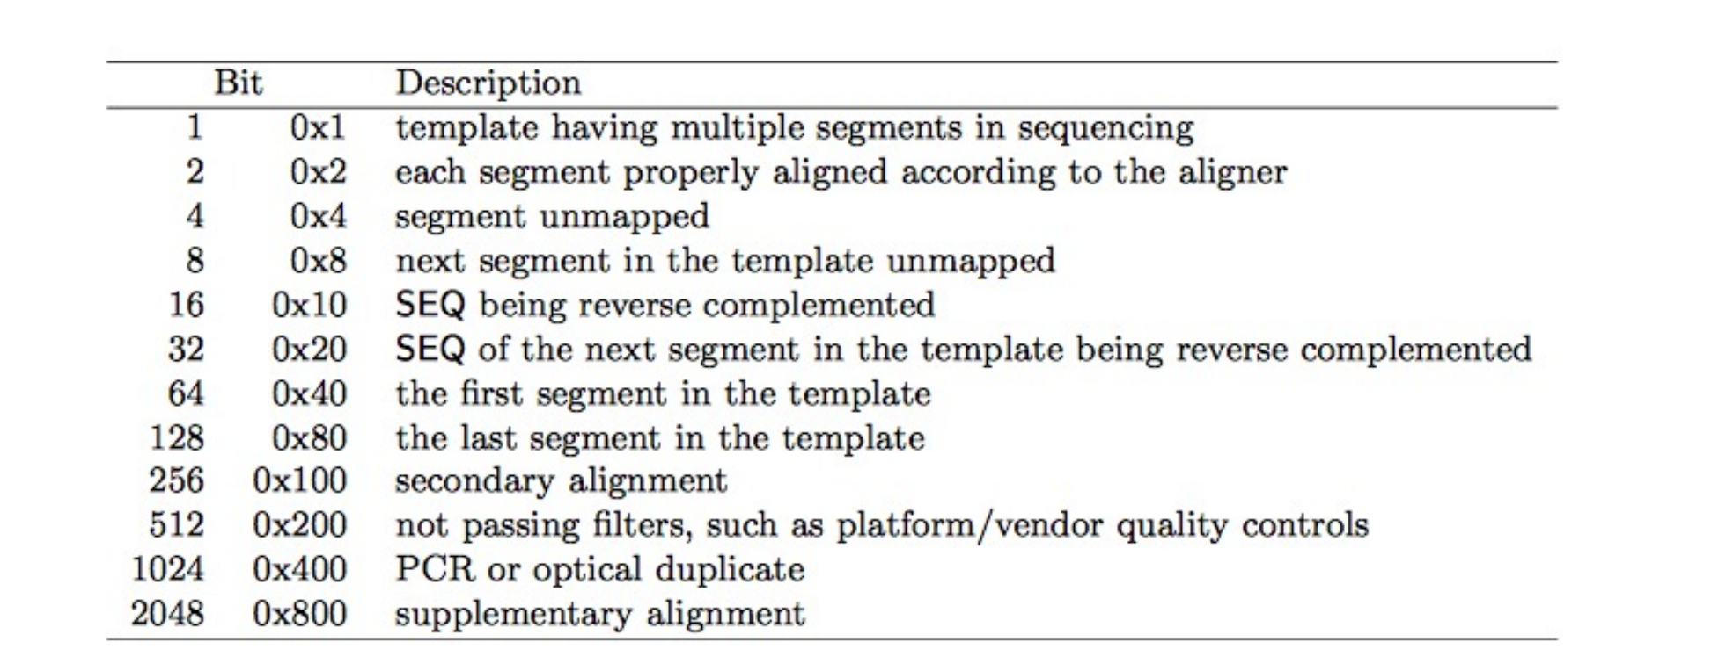
SAM flag gives additional info
# in SAM file flag column = sum of each true bit (in decimal)
Example: paired, unmapped read would get:
0b000000000001 + 0b000000000100 = 0b000000000101 (or 5 in decimal)
See https://broadinstitute.github.io/picard/explain-flags.html
Notes:
Show pedigree with CF
Show height
Or case control

Slide 56
Samtools for manipulating BAMs
View SAM/BAM file
> samtools view $DATADIR/example_bwamem.sam | less -S
Convert SAM to BAM
> samtools view –bS $DATADIR/example_bwamem.sam > \
example_bwamem.bam
Sort BAM
> samtools sort example_bwamem.bam example_bwamem.sorted
Index BAM for fast querying
> samtools index example_bwamem.sorted.bam
Pull out region from indexed BAMs
> samtools view example_bwamem.sorted.bam 1:15189-16189
Notes:
http://broadinstitute.github.io/picard/explain-flags.html
http://broadinstitute.github.io/picard/explain-qualities.html

Slide 57
Sequencing coverage
Usually sequence many copies of a genome in one run
(e.g. by taking millions of cells as input)
…
…
Reference genome
Coverage/depth: number of reads covering a given base
Typically for WGS: aim for ~50X
Notes:
Show pedigree with CF
Show height
Or case control

Slide 58
Sequencing coverage
Coverage: how many times do we sequence a certain position in the genome
Read length * Number of reads
# Sequenced bases
Average coverage =
Length of the genome
e.g. To sequence a human genome (3 billion bp) to 30X coverage with 100bp reads, we need:
(3 billion * 30)/100 = 900 million reads (or 450M read pairs)
Notes:
Show pedigree with CF
Show height
Or case control

Slide 59
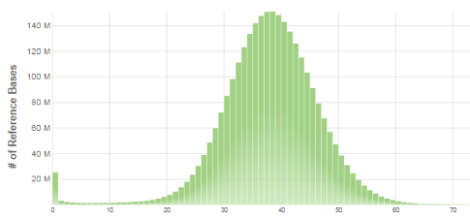
Sequencing coverage– it’s actually a distribution
…
…
Reference genome
Coverage:
0 0 0 1 2 3 3 3 4 4 4 4 3 2 1 1 1 0 0 0 0 1 1 2 3 3 3 3 3 3 2 1 1 0 0 0 0 2 2 2 2 2 2 2 2 2 0 0 0 0 0
16
13
Real data!
~40X WGS
Poisson-like distribution
10
# Bases
8
4
Why is there a spike at 0?
0
1
2
3
4
Coverage
Notes:
Show that it’s a distribution
Kind of Poisson like (although asterisk, neg binomial better)
Where does mean fall
Show real distribution
Some places with no coverage
Some places with lots of coverage

Slide 60
A closer look at coverage+alignment
Duplicated sequence
Reference genome
unique
Non-unique
A read may map equally well to more than one place!
Paired end reads can improve mapping specificity (not always)
Column 5: Mapping quality. MAPQ = -1*log10(Prob. Mapping position is wrong)
0=non-unique
SAM file:

Slide 61
A closer look at coverage+alignment
Reference genome
Reads
No reads mapped to this region!
Why?
Possible explanations:
The region is not uniquely mappable (e.g. repetitive)
The reference genome is not complete or correct in this region
The region has extremely high or low GC content
Other ideas?

Slide 62
A closer look at coverage+alignment
Reference genome
Reads
Possible explanations:
The region is repeated many times in the genome but only present once in the reference sequence
Others?
Way more reads than expected mapped to this region!
Why?
Question: how can you use coverage info to distinguish male vs. female samples?

Slide 63
Outline
1. SEQUENCING
2. ALIGNMENT
Reference
ACGTACGGATATGCGATACGACAT
Reads
3. GENOTYPING
4. VISUALIZATION
CCA-CTCTACTCACAC----TAGC
SNPs/Indels
STRs
CCAACGCTACTCACACACACTAGC

Slide 64
Genotyping variants from short reads
Diploid organism (e.g. homo sapiens)
Two copies of the genome (one from mom, one from dad)
(22 autosomes, + X, Y, mitochondria)
Reference genome
Homozygous reference
Homozygous non-reference
100% ref, 0% non-ref
0% ref, 100% non-ref
Heterozygous
50% ref, 50% non-ref
Homozygous: both genome copies have the same allele
Heterozygous: each genome copy has a different allele
In each case, what % of reads do you expect to show evidence of the ref vs. alternate allele?
What if we have sequencing errors?

Slide 65
Example variants in real reads (IGV)
Homozygous
mutation
Heterozygous
mutation

Slide 66
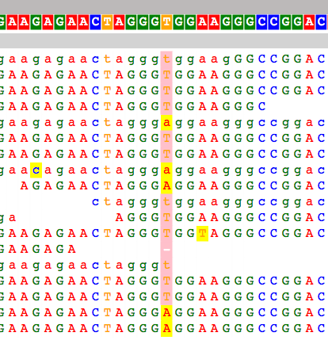
Genotyping variants from short reads
Genotyper
VCF file (list of locations that vary from the reference genome)
BAM file (read alignments)
SNPs/Indels
Short Tandem Repeats
CNVs
Structural variants
You’ll get a chance to write a SNP caller in PS4!

Slide 67
Genotype calls in VCF format (same as before)
VCF header describes fields
##fileformat=VCFv4.2
##FILTER=<ID=PASS,Description="All filters passed">
##samtoolsVersion=1.2+htslib-1.2.1
##samtoolsCommand=samtools mpileup -g –o test.bcf –f Homo_sapiens_assembly19.fasta /b
##reference=file:Homo_sapiens_assembly19.fasta
##ALT=<ID=X,Description="Represents allele(s) other than observed.">
##INFO=<ID=AC,Number=A,Type=Integer,Description="Allele count in genotypes for each ALT allele, in the same order as listed">
##INFO=<ID=AN,Number=1,Type=Integer,Description="Total number of alleles in called genotypes">
##INFO=<ID=DP4,Number=4,Type=Integer,Description="Number of high-quality ref-forward , ref-reverse, alt-forward and alt-reverse bases">
##FORMAT=<ID=PL,Number=G,Type=Integer,Description="List of Phred-scaled genotype likelihoods">
##FORMAT=<ID=GT,Number=1,Type=String,Description="Genotype">
##INFO=<ID=MQ,Number=1,Type=Integer,Description="Average mapping quality">
. . .
##bcftools_callVersion=1.2+htslib-1.2.1
##bcftools_callCommand=call -vmO z -o test.vcf.gz test.bcf
#CHROM POS ID REF ALT QUAL FILTER INFO FORMAT example
INFO fields describe each locus (e.g. AC)
FORMAT fields describe each individual call (e.g. GT)
GT 0/0 = homozygous for ref (“A”)
GT 0/1 = heterozygous (“A”/”C”)
GT 1/1 = homozygous for “C”
Example entries
SNP (A/C)
1 20321 . A C 12.5244 . DP=96;AC=1;AN=2 MQ=8 GT:PL 0/1:45,0,62
1 66377 . A ATTT 13.5315 . INDEL;DP=2;AC=2;AN=2;MQ=30 GT:PL 1/1:41,6,0
Indel (A/ATTT)

Slide 68
Putting it all together
Reads
(*.fq, *.fastq)
Ref. genome (+ index files)
(*.fa, *.fasta)
Alignment
Genotyping
Alignments
(*.sam, *.bam)
Variants
(*.vcf)

Slide 69
More on alignment + genotyping - Wednesday
BWT data structure and complications
SNP/indel calling
Filtering problematic variant calls
Next week: annotation and downstream analysis for clinical genomics applications

Slide 70
Outline
1. SEQUENCING
2. ALIGNMENT
Reference
ACGTACGGATATGCGATACGACAT
Reads
3. GENOTYPING
4. VISUALIZATION
CCA-CTCTACTCACAC----TAGC
SNPs/Indels
STRs
CCAACGCTACTCACACACACTAGC

Slide 71
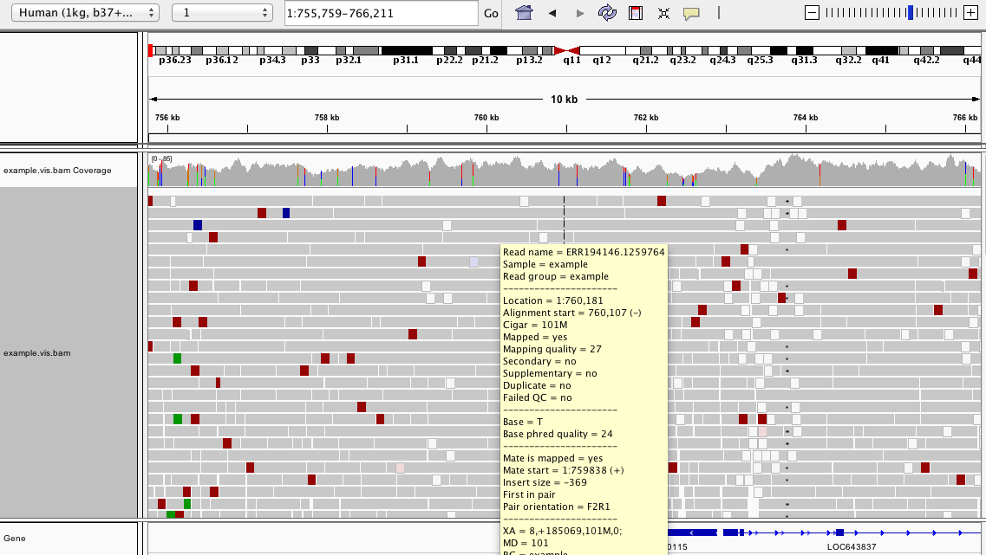
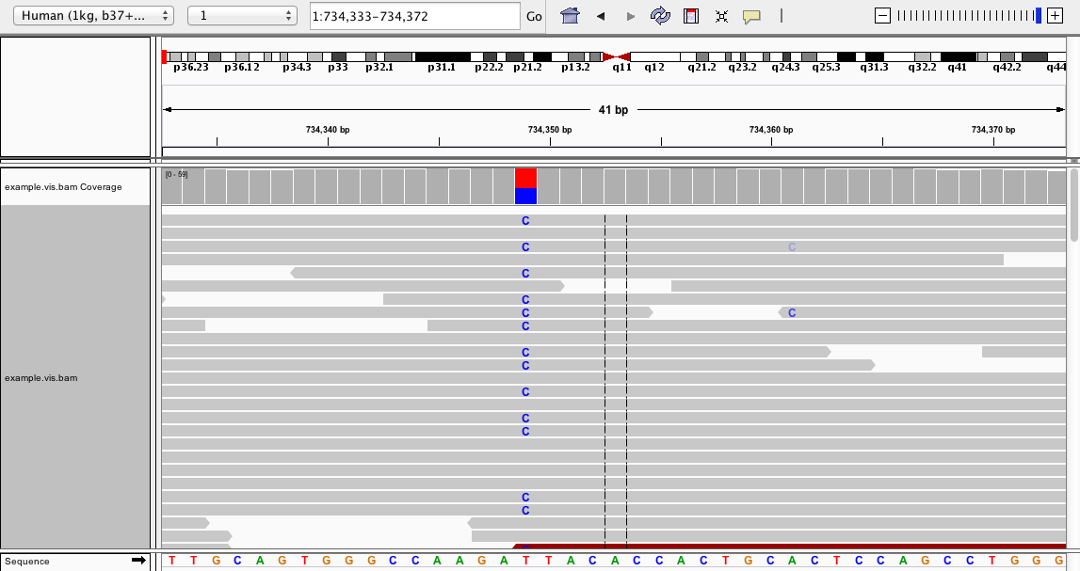
IGV: Integrative Genomics Viewer
Available from https://www.broadinstitute.org/igv/
Desktop (my favorite) or web-based version

Slide 72
Samtools tview
Runs on the command line! (but not on datahub…)

Slide 73
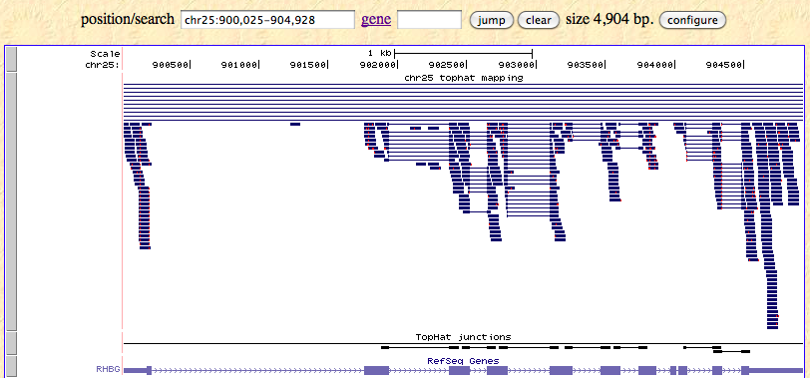
UCSC Genome Browser
Can load lots of tracks with info on gene annotations and more

Slide 74
PS4 Overview

Slide 75
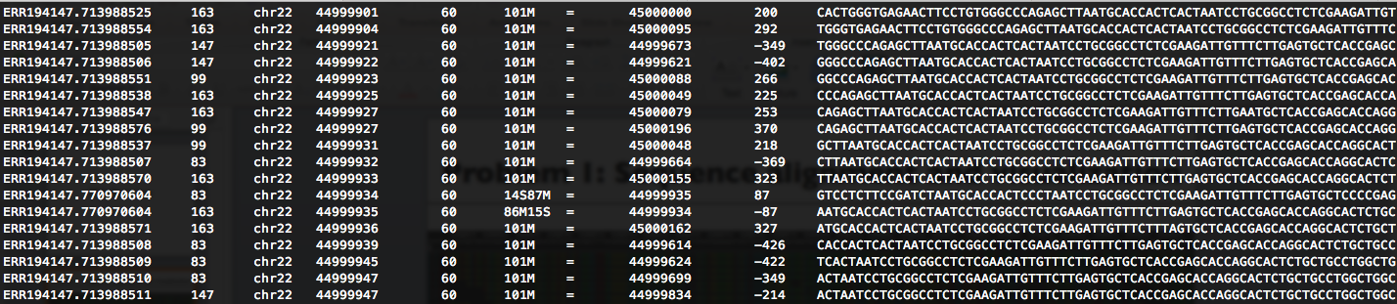
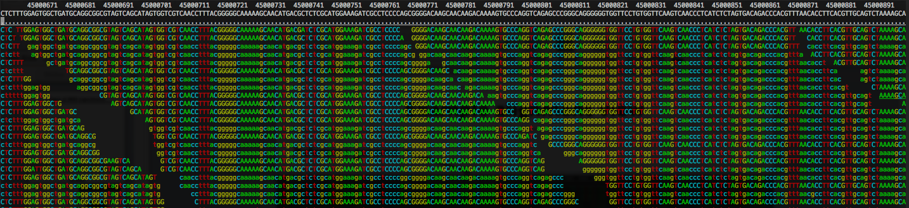
Problem 1: Sequence alignment and visualization

Slide 76
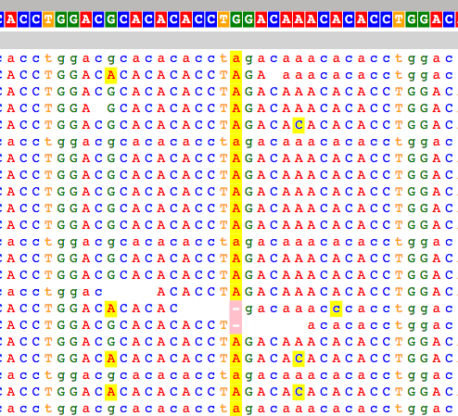
Problem 2: Writing a simple SNP caller
Homozygous SNP
Heterozygous SNP
BAM file -> pileup format -> SNP calls

Slide 77
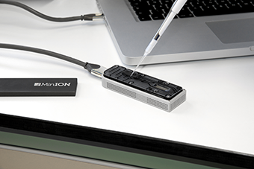
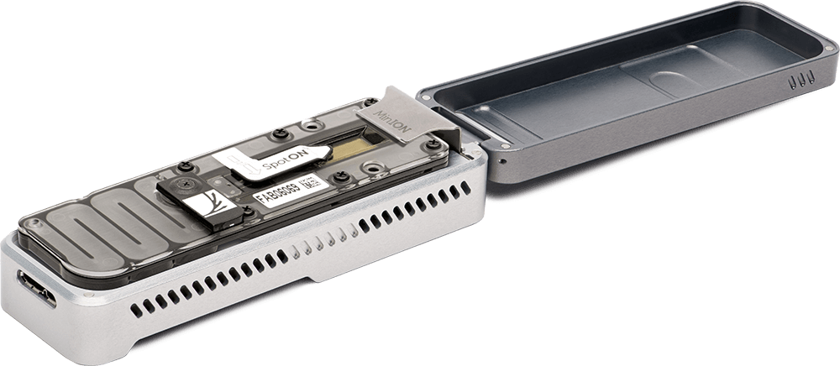
Problem 3: SNP calling with Nanopore
http://www.21stcentech.com/gizmos-gadgets-dna-testing-field/

Slide 78
Problem 4: Mutation hunting Kabuki Syndrome
…
Strategies for “mutation hunting” for a de novo disorder
Filtering/prioritizing
Comparison against population controls

