Slide 1
Missing heritability
(04/28/21)
Today’s schedule:
Heritability
Sources of the missing heritability
Overview of GWAS topics not covered
Announcements:
PS3 due Friday
Issue with plink hanging?
JC3+PS4 will be released Monday
Proposals due next Weds.
Notes:
Announcements: ps3.
couple ppl having issues with plink taking forever
let me know in chat if that's happening to you
I will see if we can make precomputed files avail so you can finish
proposals due next week. can still change mind. I'll set up meetings with you.
Will post remaining assignments soon.
today we’ll talk mostly about this concept of heritability and how to measure it
Finally will talk about some GWAS topics that are important but we didn’t get a chance to cover in detail

Slide 2
Precision genomics: going from genotype to phenotype
Predict:
Cancer risk?
Heart disease?
Diabetes?
Cystic fibrosis?
AACGGCTACTACTGGTACAGCACTACGGTGCATAGGCTTATATAA
AACGCCTACTATTGGTACAGCACTACGATGCATAAGCTTATCTAA
Inform treatment
Mendelian traits
Trait controlled by a single gene
Relatively straightforward to predict
e.g. Cystic Fibrosis
Eye color (kind of)
Tay-Sachs
Marfan Syndrome
Complex traits
Trait controlled by a combination of many genes and/or environment factors
More difficult to predict
e.g. Heart disease
Height
Schizophrenia
Diabetes
We were assuming all these traits have to do with genetics in the first place!
Notes:
Been talking about going from genotype to phenotype
We’ve been assuming that there was a contribution from genetics to all of these traits in the first place

Slide 3
Genetics isn’t everything
Environment (everything else)
Genetics
+
=
“Nature”
“Nurture”
But can we use our genetics tools to quantify the genetic contribution?
Notes:
But we know genetics isn’t everything
This is the classic problem of nature vs. nurture
We know many traits, including many diseases, can result from a combination of genetics, but also from everything else
We lump everything else into environment. This could many mean things: diet, where you live, who you interact with socially, exercise, and more
The question we’ll ask today is can we use our genetics knowledge as tools to quantify the genetic contribution to each of these traits?

Slide 4
What does it mean for a trait to be “heritable”?
Notes:
Before we do that, first back up and talk more precisely about what it means for a trait to be heritable

Slide 5
Defining heritability (h²) - intuition
Heritability roughly describes how much variation in a trait is inherited (i.e. due to genetics)
Offspring tend to look like the parents!
We’ve known this for 1000s of years. Here is Aristotle’s view:
https://en.wikipedia.org/wiki/Heredity
Notes:
H2 is a very ancient concept
Describes this idea that offspring tend to look like their parents
In fact, people were thinking about this concept 1000s of years ago. Here is Aristotle’s view

Slide 6
Defining heritability (h²)
Your phenotype (P) is the sum of effects of your genetics (G) and your environment (E):
P = G + E
e.g. height
Notes:
So let’s see how we can define h2
think of phenotype as the sum of effects of genetics and environment
When we’re talking about h2, primarily interested in variance in a population
If we were studying height, and everyone had exactly the same height, not very interesting
Generally, we’re not as interested in predicting the absolute value of someone’s height as we are in explaining variability in the population

Slide 7
Defining heritability (h²)
We care less about the actual height of each person
And more about variation in height in the population
e.g. height
If a trait is heritable, we can explain this variation by genetic factors
Notes:
So let’s see how we can define h2
think of phenotype as the sum of effects of genetics and environment
When we’re talking about h2, primarily interested in variance in a population
If we were studying height, and everyone had exactly the same height, not very interesting
Generally, we’re not as interested in predicting the absolute value of someone’s height as we are in explaining variability in the population

Slide 8
Defining heritability (h²)
Your phenotype (P) is the sum of effects of your genetics (G) and your environment (E):
P = G + E
We’re primarily interested in phenotypic variance:
V_{P} = V_{G} + V_{E} + V_{GE}
Heritability describes how much variation in the phenotype is described by genetics:
h² = V_{G}/V_{P}
Notes:
So let’s see how we can define h2
think of phenotype as the sum of effects of genetics and environment
When we’re talking about h2, primarily interested in variance in a population
If we were studying height, and everyone had exactly the same height, not very interesting
Generally, we’re not as interested in predicting the absolute value of someone’s height as we are in explaining variability in the population

Slide 9
Technical note - Broad sense vs. narrow sense h2
Broad-sense heritability (H²) describes how much variation in the phenotype is described overall by genetics:
h²_{broad} = V_{G}/V_{P}
We can further break genetic contributions into additive (A), dominant (D), and interactive contributions (I):
V_{G} = V_{A}+V_{D}+V_{I}
Narrow-sense heritability (h²): only considers *additive* genetic variance. (We’ll usually be talking about narrow-sense)
h²_{narrow} = V_{A}/V_{P}

Slide 10
Heritability of example traits
https://www.snpedia.com/index.php/Heritability
Notes:
H2 for some example traits
Some traits, like hair color, 100% h2
Others like t2d h2 but also contribution from other facts
Note some big error bars on some of these. We’ll talk next about different ways to measure h2. different ways will give you different answers

Slide 11
Quantifying heritability – Part I
Notes:
Ok we now have a better definition of h2
Let’s look at ways we can quantify that

Slide 12
There are many ways to estimate h²!
(and they won’t always give the same results!)
Midparent method
Twin studies
Haseman-Elston regression
Linear mixed models
LD-score regression
Close relatives
Part I
Unrelated samples
Note: we won’t actually need any genetic data for this first two techniques!
Notes:
Have been *many* ways to measure h2
Arranged these on a spectrum, ranging from methods involving close relatives, to more modern methods look at unrelated samples
Talk first about these classical metrics which we tend to use as gold standards for measuring h2
Note for these, we’re not actually going to need to use any genetics data!

Slide 13
Measuring h² – midparent regression
$$Y_{m}$$
$$Y_{f}$$
“midparent”
$$Y_{child}=β\frac{Y_{m}+Y_{f}}{2}+ε$$
$$Y_{child}$$
If $β$=0, child phenotype not explained by parents
If $β$=1, child phenotype completely explained by parents
Notes:
Most classical way is by comparing children to their parents
If a trait is controlled by additive genetic factors, expect a child to be midway between parent phenotypes

Slide 14
Measuring h² - midparent
$$Y_{child}=βY_{mid}+ε$$
One estimate of heritability!
A lot of environmental factors shared between parents and child. Likely overestimates h².
Limitations?
Notes:
Slope of this line is one way to measure h2
What are limitations?
Shared environment. E.g. diet similar to your parents

Slide 15
Measuring h² – twin studies
Monozygotic (identical) twins
Dizygotic (fraternal) twins
Idea: MZ and DZ twins share similar levels of environment
But: MZ twins share more of their genome

Slide 16
Measuring h² – twin studies
Monozygotic (identical) twins
Dizygotic (fraternal) twins
P(IBD=2)=100%
P(IBD=1)=0%
P(IBD=0)=0%
P(IBD=2)=25%
P(IBD=1)=50%
P(IBD=0)=25%
Share 100% of the genome (IBD2+0.5*IBD1)
Share 50% of the genome (IBD2+0.5*IBD1)

Slide 17
Measuring h² – twin studies
Identical (monozygotic) twins share:
100% of their genomes
A lot of environmental factors
$$r_{MZ}=V_{G}+V_{E}$$
Fraternal (dizygotic) twins share:
50% of their genomes
A similar amount of environmental factors
$$r_{DZ}=\frac{1}{2}V_{G}+V_{E}$$

Slide 18
Measuring h² – twin studies
$$r_{MZ}^{}=V_{G}+V_{E}$$
$$r_{DZ}^{}={\frac{1}{2}V}_{G}+V_{E}$$
$${2(r_{MZ}^{}−r}_{DZ}^{})=2V_{G}+2V_{E}−V_{g}−2V_{E}=V_{G}$$
Falconer’s formula:
$$H^{2}=2(r_{MZ}^{}−r_{DZ}^{})$$
Notes:
If all genetic and no environment, all correlation between MZ twins due to genetics. MZ twins should be twice as correlated as DZ twins

Slide 19
Measuring heritability – twin studies
Twin correlations for top 20 most investigated traits
Polderman et al. Nature Genetics 2015
Notes:
This technique has been used for more than 50 years to measure heritability of many different traits
Pointer to a study that performed a meta-analysis of past studies

Slide 20
Limitations of measuring h2 with twin studies?
Limitations:
What factors could cause us to overestimate h2 using the Falconer method?
What about underestimate?
What types of traits might this not work for?
$$H^{2}=2(r_{MZ}^{}−r_{DZ}^{})$$
Notes:
Overstimate: MZ twins share more environment. E.g. in utero. Treated differently. Overest their corr. Cause to overestimate h2
Not sure how to underestimate?
In all these cases assuming additive contribution. and polygenic contribution. Won’t work for traits controlled by e.g. recessive vs. dominant pattern

Slide 21
Measuring h² – twin studies
Limitations:
MZ twins may actually share more environment than DZ twins. E.g. they may be treated more similarly
You can end up with h2 estimates > 1!
$$H^{2}=2(r_{MZ}^{}−r_{DZ}^{})$$

Slide 22
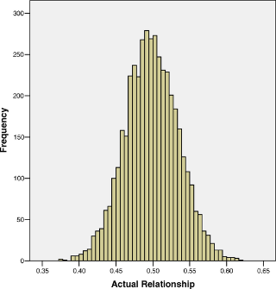
Measuring h² – Haseman-Elston (sibling pairs)
Dizygotic (fraternal) twins
Range ~40-60%
P(IBD=2)=25%
P(IBD=1)=50%
P(IBD=0)=25%
Twin method assumed DZ twins share 50%
But this is an average!
Visscher et al. 2006
Share 50% of the genome (IBD2+0.5*IBD1)
Notes:
https://en.wikipedia.org/wiki/Simple_linear_regression
https://www.ncbi.nlm.nih.gov/pmc/articles/PMC4012219/#__sec1title

Slide 23
Measuring h² – Haseman-Elston (sibling pairs)
Sib pair #1
Sib pair #2
Sib pair #3
Sib pair #4
Share 40%
Share 45%
Share 50%
Share 55%
Intuition: Expect sib pairs that share more of the genome to also have more correlated phenotypes
Notes:
https://en.wikipedia.org/wiki/Simple_linear_regression
https://www.ncbi.nlm.nih.gov/pmc/articles/PMC4012219/#__sec1title

Slide 24
Measuring h² – Haseman-Elston (sibling pairs)
Sib pair #i
$$Y_{i1}$$
$$Y_{i2}$$
$−β/2$ gives another heritability estimate!
Regress IBD sharing vs. phenotype correlation
$${\left(Y_{i1}−Y_{i2}\right)}^{2}=α+ βπ_{i}+ε$$
$π_{i}$=IBD2_{i}+0.5*IBD1_{i}
Squared trait diff
IBD (% genome sharing)
Notes:
https://en.wikipedia.org/wiki/Simple_linear_regression
https://www.ncbi.nlm.nih.gov/pmc/articles/PMC4012219/#__sec1title

Slide 25
Another way to do HE regression
Since we set:
mean(Y1)=mean(Y2) = 0
Var(Y1)=Var(Y2) = 1
$$E\left[\left(Y_{1}−Y_{2}\right)\right]=E[Y_{1}^{2}−2Y_{1}Y_{2}−Y_{2}^{2}]$$
$$=E\left[Y_{1}^{2}\right]−2E\left[Y_{1}Y_{2}\right]−E[Y_{2}^{2}]$$
$$=Var\left(Y_{1}^{2}\right)−Var\left(Y_{2}^{2}\right)−2E\left[Y_{1}Y_{2}\right]$$
$$=−2E\left[Y_{1}Y_{2}\right]$$
$$Cov\left(Y_{1},Y_{2}\right)=E[\left(Y_{1}−mean\left(Y_{1}\right)\right)\left(Y_{2}−mean\left(Y_{2}\right)\right)]=E[Y_{1}Y_{2}]$$
$E\left[\left(Y_{1}−Y_{2}\right)\right]=−2Cov\left(Y_{1},Y_{2}\right)$
Notes:
https://en.wikipedia.org/wiki/Simple_linear_regression
https://www.ncbi.nlm.nih.gov/pmc/articles/PMC4012219/#__sec1title

Slide 26
Another way to do HE regression
$${\left(Y_{i1}−Y_{i2}\right)}^{2}=α+ βπ_{i}+ε$$
$$Y_{i1}Y_{i2}=α+ βπ_{i}+ε$$
$−β/2$ gives h2
$β$ gives h2
$${\left(Y_{i1}−Y_{i2}\right)}^{2}$$
$$Cov(Y_{1},Y_{2})$$
IBD (% genome sharing)
IBD (% genome sharing)
(see derivation on previous hidden slide)
Notes:
https://en.wikipedia.org/wiki/Simple_linear_regression
https://www.ncbi.nlm.nih.gov/pmc/articles/PMC4012219/#__sec1title

Slide 27
Extending HE-Regression to more distant relatives
Example trait: longevity

Slide 28
Summary of h2 methods so far
Midparent method
Twin studies
Haseman-Elston regression
Linear mixed models
LD-score regression
Regress child on midparent phenotype
Part I
Compare MZ and DZ twins
Regress relatives covariance on IBD
Notes:
TODO: twin studies, midparent, Haseman-elston regression

Slide 29
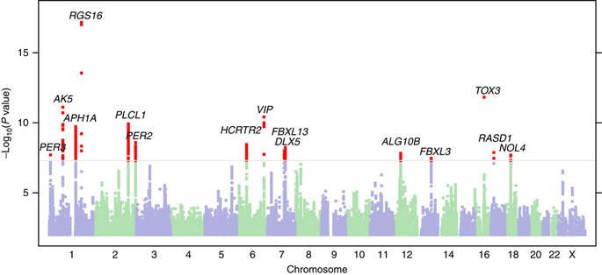
Missing heritability
Before we measured *how much* h2 there is.
Can GWAS help us find *where* that h2 is coming from?
Notes:
Before we go on to the next ones, let’s take a detour to relate this back to gwas

Slide 30
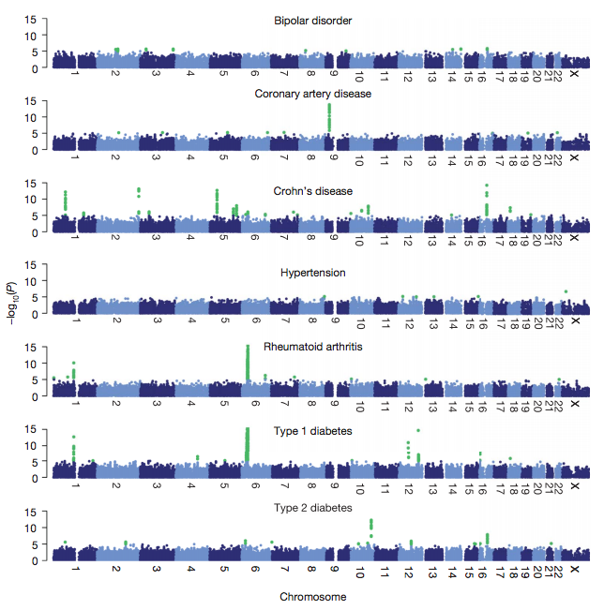
GWAS has found many convincing genome-wide hits
The Wellcome Trust Case Control Consortium

Slide 31
GWAS has found many convincing genome-wide hits
https://www.ebi.ac.uk/gwas/

Slide 32
How much trait variation is explained by these hits?
Are you a morning or a night person?
Notes:
TODO
Don’t get causal variant itself
Find possible genes
More on interpretation later

Slide 33
How much variance is explained by a GWAS SNP?
Recall our simple single SNP model:
$$Var\left(X\right)=1$$
$$ε_{i}\sim N(0, σ_{e}^{2})$$
$$Y_{i}=βX_{i}+ε_{i}$$
$$Var\left(Y\right)=1$$
Taking the variance of both sides:
$$Var\left(Y\right)=β^{2}Var\left(X_{i}\right)+σ_{e}^{2}$$
Then:
$$\frac{β^{2}Var(X)}{Var(Y)}=β^{2}$$
% Variance (h²) explained by the SNP
Turns out to be same as r²(X,Y)
$$\frac{σ_{e}^{2}}{Var(Y)}=σ_{e}^{2}=1−β^{2}$$
% Variance unexplained

Slide 34
How much variance is explained by all GWAS hits?
$$β_{j}^{2}$$
h² explained by SNP j
$${{h_{gwas}^{2}= Σ}_{j∈S}β}_{j}^{2}$$
h² explained by all SNPs in S
S is the set of genome-wide significant SNPs
(pruned to contain only independent SNPs)

Slide 35
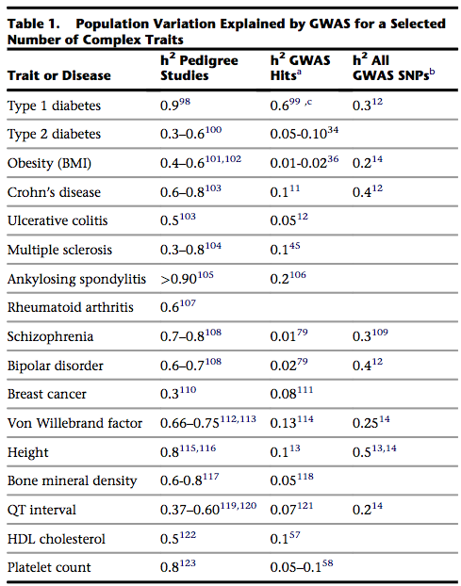
GWAS hits explains a small fraction of heritability
(These were early days. Numbers have improved for some traits since 2012.)
Visscher et al. 2012

Slide 36
GWAS has found many convincing genome-wide hits
Bipolar
70% heritable from twin studies
But no GWAS hits in first studies!
☹
The Wellcome Trust Case Control Consortium

Slide 37
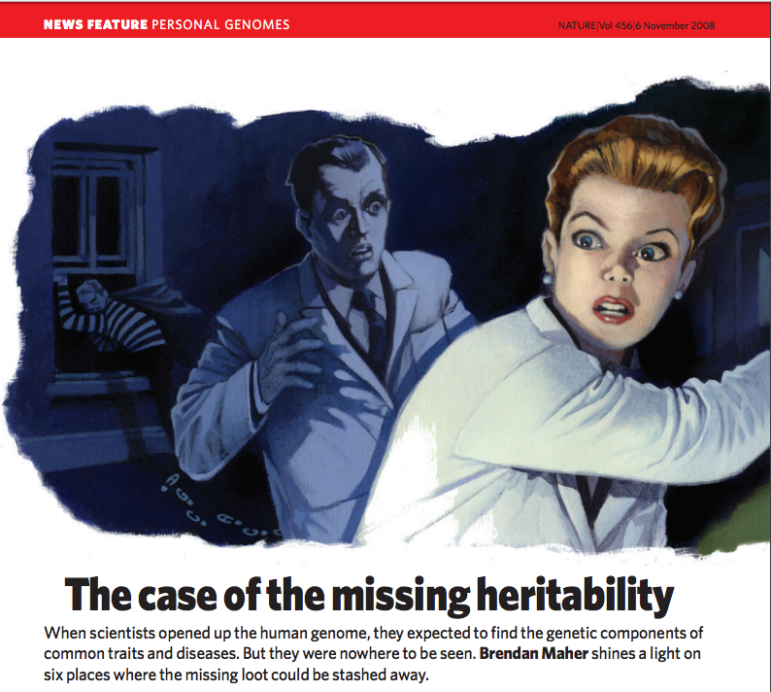
The case of the missing heritability

Slide 38
Quantifying heritability – Part 2

Slide 39
How much trait variation is explained by these hits?
Remember: we are usually underpowered.
Many true associations don’t reach our significance threshold

Slide 40
There are many ways to estimate h²!
(and they won’t always give the same results!)
Close relatives
Midparent method
Twin studies
Haseman-Elston regression
Linear mixed models
LD-score regression
Part 2
Unrelated samples
Measuring h2 explained by considering *all* of the SNPs we measured
(not just the ”GWAS hits” passing our significance threshold)
Notes:
TODO: twin studies, midparent, Haseman-elston regression

Slide 41
Preview: using all SNPs explains much more variance
Visscher et al. 2012

Slide 42
Recall from Monday - LMMs
$$Y=βX+Cγ+u+ ε$$
“Random effects”
Related samples will tend to have more correlated phenotypes
$$u$$
: Vector of random effects ($u=\{u_{1},…u_{n}\}$)
$$u\sim MVN(0, σ_{g}^{2}K)$$
$$K$$
: Genetic relatedness matrix
$$σ_{g}^{2}$$
: captures how much trait variance is due to genome-wide genotype sharing

Slide 43
Variance partitioning with LMMs
$$Y=u+ ε$$
(Fixed effects ignored. Treated as constants. Or can be regressed out)
$$Var\left(Y\right)=Var\left(u\right)+Var\left(ε\right)$$
Phenotypic variance-covariance matrix
Variance due to genome-wide relatedness
Variance due to non-genetic factors
$$Var\left(Y\right)=$$
$$σ_{g}^{2}K$$
$$+$$
$$σ_{e}^{2}I$$

Slide 44
Variance partitioning with LMMs
$$Var\left(Y\right)=$$
$$σ_{g}^{2}K$$
$$+$$
$$σ_{e}^{2}I$$
“unexplained variance”
How much variance explained by genetics?
“chip heritability” (h²_{SNP})
Measures % variance explained by *all* SNPs
(Not just the “GWAS hits”)
σ²_{g}
(Use REML to estimate these parameters. Not covering the method here)

Slide 45
All measured common SNPs explain a lot more h2
Visscher et al. 2012

Slide 46
More applications of variance portioning with LMMs
We can split our variants across multiple random effects terms:
$$Y=u+ ε$$
e.g. Split SNPs by:
chromosome
Functional annotation
Rare vs. common
$u_{1}+u_{2}+u_{3}+…$
$$Var\left(Y\right)=σ_{g1}^{2}K_{1}+σ_{g2}^{2}K_{2}+σ_{g3}^{2}K_{3}+…+σ_{e}^{2}$$
Percent of variance due to SNPs in category 1
Pairwise relatedness matrix computed using only SNPs from category 1

Slide 47
Partitioning variance by functional annotation
Protein coding
Promoters
Enhancers
Introns
UTRs
?
Trait
Causal SNPs

Slide 48
Heritability enriched in putative regulatory regions
Found ~80% of SNP h2 falling in “DHS” sites (gene regulatory regions. More on this in a couple weeks)

Slide 49
Partitioning variance by chromosome shows polygenicity
Yang et al. 2011

Slide 50
Partitioning variance by MAF shows rare variant signal
Yang et al. 2015

Slide 51
There are many ways to estimate h²!
Midparent method
Twin studies
Haseman-Elston regression
Linear mixed models
LD-score regression
Requires individual-level genotypes (not always available)
Also takes a long time to fit
Uses only summary statistics
Can:
Measure + partition h2
Plus more cool applications
Notes:
TODO: twin studies, midparent, Haseman-elston regression

Slide 52
What are summary statistics
Individual level data
0 1 0 0 1 0 0 0 1 0 0 0 1 0 2
1 0 0 0 1 0 0 0 1 0 0 0 1 0 2
2 2 0 0 0 0 0 0 0 0 0 0 0 0 0
0 1 0 0 1 0 0 0 1 0 0 0 1 0 1
Summary statistics
Greatly reduce data size
Alleviate privacy concerns
Effect size (β)
Std. error SE(β)
P-value (p)
Z-score=β/SE(β)

Slide 53
LD Score Regression
Recall: SNP genotypes are often correlated with other nearby SNPs
(“linkage disequilibrium” or LD)
LD score: for variant j gives the sum of its LD (r²) with all other variants
$$l\left(j\right)=Σ_{i}r_{ij}^{2}$$
Notes:
TODO: twin studies, midparent, Haseman-elston regression

Slide 54
LD score intuition
$$l\left(j\right)=Σ_{i}r_{ij}^{2}$$
SNPs in this block will tend to have high LD scores
This SNP will have a low LD score
Causal variant
If causal variants are distributed randomly, they are more likely to fall in a larger vs. smaller LD block.
SNPs with higher LD scores more likely to tag a causal variant!

Slide 55
LD Score Regression
Regress LD scores on $χ^{2}$statistics for each SNP $j$
$$E\left[χ_{j}^{2}\right]=\frac{Nh_{SNP}^{2}}{M}l\left(j\right)+Na+1$$
$${E[χ}_{j}^{2}]$$
Similar to the –log10 Pvalue for SNP j from GWAS
$$N$$
Sample size
$$M$$
Number of SNPs analyzed
$$a$$
Measures contribution of confounding
Notes:
TODO: twin studies, midparent, Haseman-elston regression

Slide 56
LD Score Regression
Intercept measures confounding
$$E\left[χ_{j}^{2}\right]=\frac{Nh_{SNP}^{2}}{M}l\left(j\right)+Na+1$$
Slope gives a measure of the h2 explained by all genotyped SNPs!
Bulik-Sullivan et al. Nature Genetics 2015
Notes:
TODO: twin studies, midparent, Haseman-elston regression

Slide 57
LDSC – distinguish polygenicity vs. confounding
Recall from Monday:
Need to adjust for confounding factors?
Or, maybe just really polygenic?

Slide 58
LDSC – distinguish polygenicity vs. confounding
Simulation 1 – population stratification
Simulation 2 – polygenicity
Bulik-Sullivan et al. Nature Genetics 2015

Slide 59
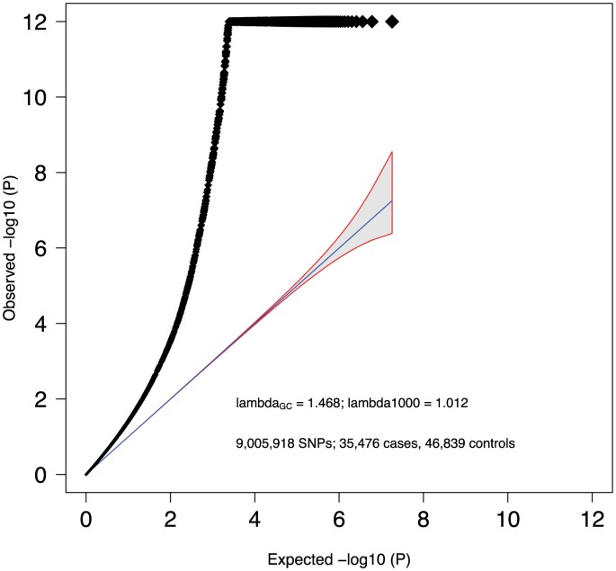
Example - Schizophrenia
Conclusion: schizophrenia is *extremely* polygenic!
LD score regression suggests this signal is real

Slide 60
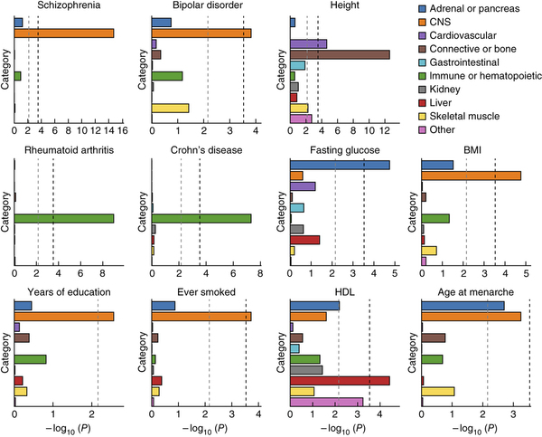
Partitioning heritability using LD-score regression
See Bulik-Sullivan et al. Nature Genetics 2015 for more on LD-score regression
Much faster than LMM-based variance partitioning, doesn’t require individual-level data!
Finucane et al. 2015

Slide 61
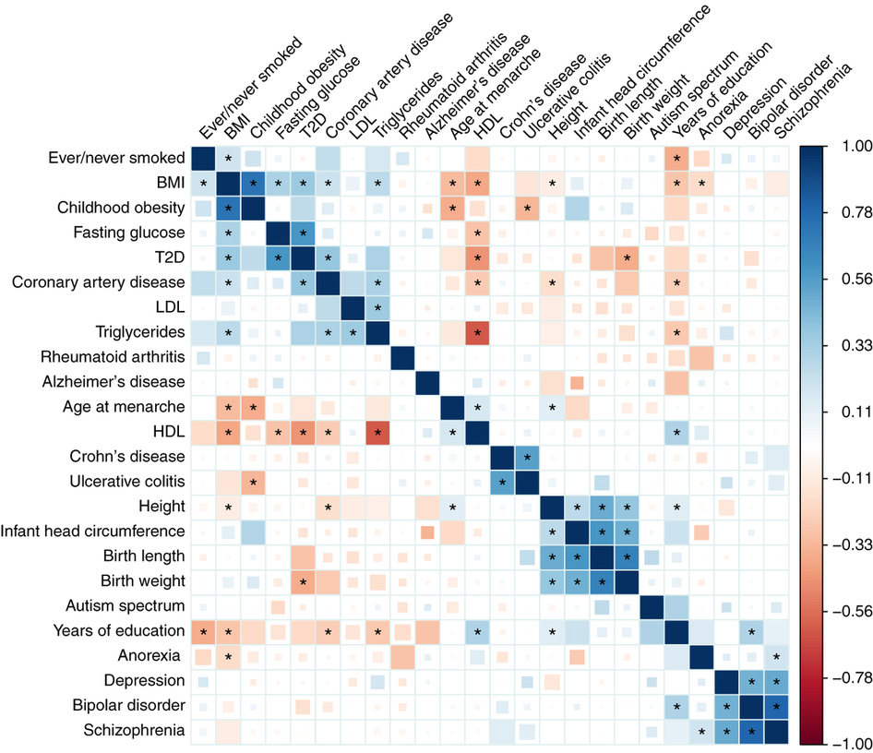
Cross-trait analyses
See Bulik-Sullivan et al. Nature Genetics 2015 for more on LD-score regression
Bulik-Sullivan et al. 2015

Slide 62
Measuring polygenicity

Slide 63
To summarize: we explain more but still a lot missing!
Visscher et al. 2012

Slide 64
Break
Sources of the missing h2

Slide 65
Where is the missing h2?
GWAS gap
h²_{pedigree} >> h²_{SNP} >> h²_{GWAS}
Genotyping gap
Some Hypotheses?
Hypothesis 1: Low power to detect small effects
Hypothesis 2: Rare variants
Hypothesis 3: Other variant types not tagged by common SNPs
Hypothesis 4: Epistasis (interactive terms)
Hypothesis 5: Complex regions with multiple causal variants
Hypothesis 6: Complicated modes of inheritance
Hypothesis 7: Maybe we got the denominator wrong
Others??

Slide 66
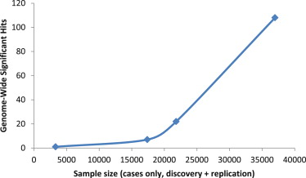
Where is the heritability hiding?
Possibility #1: Low power to detect variants of small effect
Solution: More samples
“Schizophrenia genetics comes of age” Need and Golstein 2014
Notes:
Show sample size vs. schizophrenia
Effect size power plot

Slide 67
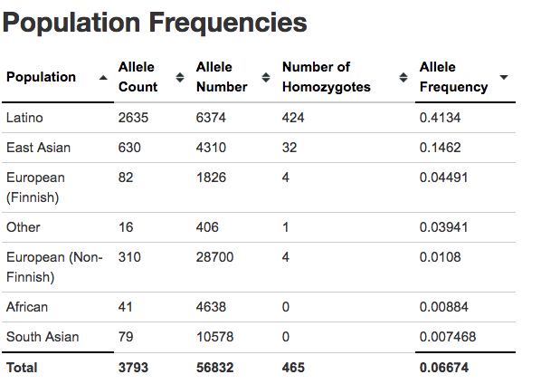
Where is the heritability hiding?
Possibility #2: Missing rare variants
Low power to detect rare variant associations
May not be tagged by common SNPs that we are imputing
Solution:
More samples
“Burden tests” to aggregate loci e.g. by gene
Haplotype-based tests
Do GWAS in more diverse population groups
Notes:
Show sample size vs. schizophrenia
Effect size power plot

Slide 68
Where is the heritability hiding?
Possibility #3: Complex variants not well-tagged by common SNPs!
e.g. copy number variants, short tandem repeats
Solution: analyze those variants directly, through imputation, or using haplotype-based tests
Sekar et al. 2016
Notes:
Variants not well tagged by snps! C4 schizophrenia paper

Slide 69
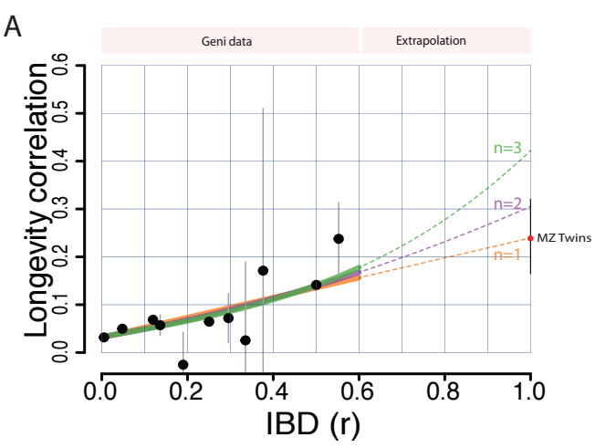
Where is the heritability hiding?
Possibility #4: Gene by gene interactions (epistasis)
Solution: Test different models? Likely this doesn’t contribute much to additional additive heritability
Recall H-E regression:
$${\left(Y_{i1}−Y_{i2}\right)}^{2}=α+ βπ_{i}+ε$$
If pairwise interaction matter:
$${\left(Y_{i1}−Y_{i2}\right)}^{2}=α+ βπ_{i}+γπ_{i}^{2}+ε$$
If n-wise interaction matter, get nth order polynomial
Kaplanis et al. Science 2019

Slide 70
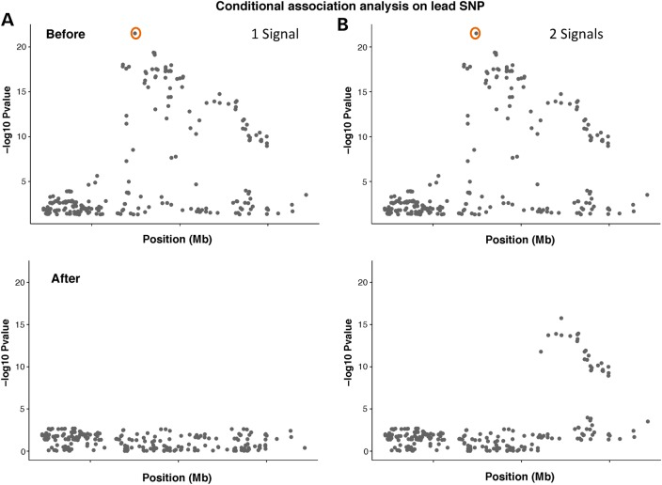
Where is the heritability hiding?
Possibility #5: Complex regions with multiple causal loci
Solution: Tedious fine-mapping of individual GWAS loci, e.g. conditional analyses
Spain and Barrett 2015

Slide 71
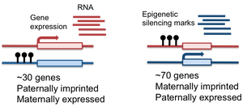
Where is the heritability hiding?
Possibility #6: Complicated modes of inheritance
e.g. a trait “skips” a generation or depends on genotypes of parents
Solution: Test alternative models
https://tllab.org/category/imprinting/

Slide 72
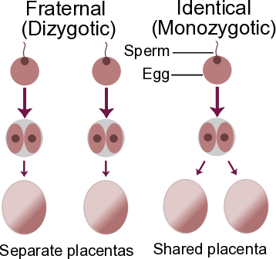
Where is the heritability hiding?
Possibility #7: Maybe we got the denominator wrong? E.g. we are over-estimating true heritability
Solution: Alternative ways of measuring heritability?
Do pedigree studies overestimate h2?
http://genomesunzipped.org/2010/12/estimating-heritability-using-twins.php
Possibility #8: Something we haven’t even thought of??

Slide 73
Where is the missing h2?
GWAS gap
h²_{pedigree} >> h²_{SNP} >> h²_{GWAS}
Genotyping gap
Some Hypotheses:
Hypothesis 1: Low power to detect small effects
Hypothesis 2: Rare variants
Hypothesis 3: Other variant types not tagged by common SNPs
Hypothesis 4: Epistasis (interactive terms)
Hypothesis 5: Complex regions with multiple causal variants
Hypothesis 6: Complicated modes of inheritance
Hypothesis 7: Maybe we got the denominator wrong
Others??
Probably a combination of these! And different for different traits

Slide 74
Other GWAS topics

Slide 75
There’s a lot more to say about GWAS
How to scale to millions of samples
Compute considerations
Data access barriers
Privacy considerations
GWAS Interpretation
Fine-mapping to identify causal *variants*
Identifying causal *genes*
Pathway/network analysis to identify relevant tissues/biological pathways
Methods to extend GWAS to more diverse groups
Integrating other variant types besides SNPs

Slide 76
Now: how can we go from associations to biology?
Major new NIH Initiative:

Slide 77
Meta-analysis: combining GWAS studies
Diabetes GWAS #1
UCSD
Diabetes GWAS #2
Broad Institute
Diabetes GWAS #3
Sanger
5,000 cases
7,000 controls
20,000 cases
40,000 controls
2,000 cases
4,000 controls
Mega-analysis
Re-analyze individual level data
Meta-analysis
Jointly analyze summary statistics
β_{1,UCSD}, SE(β_{1,UCSD}), p_{1,UCSD}
0 1 0 0 1 0 0 0 1 0 0 0 1 0 2
β_{1,Broad}, SE(β_{1,Broad}), p_{1,Broad}
0 2 0 1 1 0 2 0 1 0 1 0 1 0 2
β_{1,Sanger}, SE(β_{1,Sanger}), p_{1,Sanger}
1 1 0 1 1 1 2 0 0 0 0 0 1 1 1
β_{2,UCSD}, SE(β_{2,UCSD}), p_{2,UCSD}
β_{2,Broad}, SE(β_{2,Broad}), p_{2,Broad}
27,000 cases
51,000 controls
β_{2,Sanger}, SE(β_{2,Sanger}), p_{2,Sanger}

Slide 78
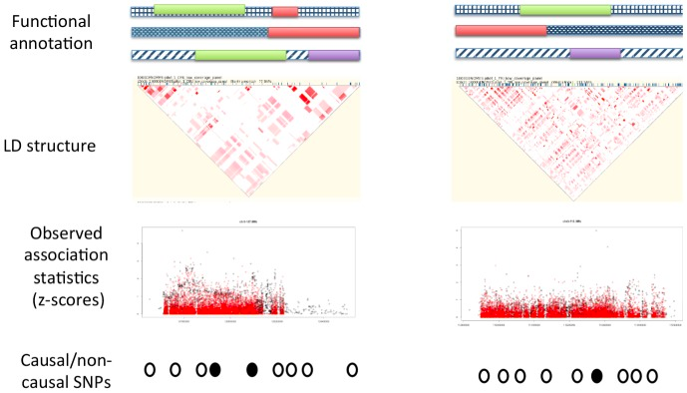
Fine-mapping example: PAINTOR
Kichaev et al. 2014

Slide 79
Haplotype methods test *combinations* of SNPs
Haplotypes, rather than single SNPs, may better capture:
Rare variants
Epistasis between variants on the same haplotype
Recurrent variants

