Slide 1
Controlling for confounding
(04/26/21)
Today’s schedule:
GWAS + QQ Plots
Controlling for confounding
Break
Project Overview
Announcements:
PS3 due Friday

Slide 2
Precision genomics: going from genotype to phenotype
Predict:
Cancer risk?
Heart disease?
Diabetes?
Cystic fibrosis?
AACGGCTACTACTGGTACAGCACTACGGTGCATAGGCTTATATAA
AACGCCTACTATTGGTACAGCACTACGATGCATAAGCTTATCTAA
Inform treatment
Mendelian traits
Trait controlled by a single gene
Relatively straightforward to predict
e.g. Cystic Fibrosis
Eye color (kind of)
Tay-Sachs
Marfan Syndrome
Complex traits
Trait controlled by a combination of many genes and/or environment factors
More difficult to predict
e.g. Heart disease
Height
Schizophrenia
Diabetes

Slide 3
Recall our single-SNP model
Inputs: Phenotype values (Y)
Genotype values (X)
Outputs:
Estimated effect size ($β)$
P-value: how confident are we that $β≠0$?
3
$$Y_{i}=βX_{i}+ε_{i}$$
Phenotype (e.g. Height)
0
-3
0 (AA)
1 (AG)
2 (GG)
Genotype
Effect size ($β)$ for each SNP can help us predict the trait (Y) for a given sample
Key question: is $\left|β\right|>0?$

Slide 4
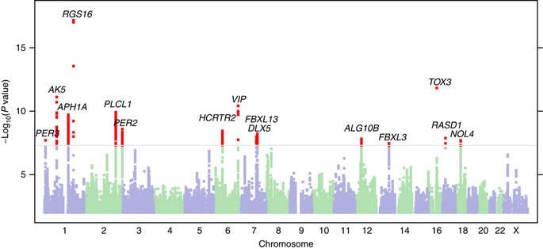
GWAS – which SNPs are associated with a trait?
Example “Manhattan Plot” to visualize p-values
Are you a morning or a night person?
Distribution of GWAS p-values can tell us a lot of info!
Notes:
TODO
Don’t get causal variant itself
Find possible genes
More on interpretation later

Slide 5
P-values and QQ Plots

Slide 6
A closer look at p-values
P-value: what’s the probability of seeing a result as extreme as I did given that my data is actually just random?
(Think: How surprised am I to see this result?)

Slide 7
Review – toy p-value example
Example: we flip a coin 10 times and see 9 heads. Assuming our coin is fair, how surprised are we about this result?
$$P\left(k heads\right)= \left({10 \atop k}\right){0.5}^{k}{\left(1−0.5\right)}^{10−k}={\left({10 \atop k}\right)0.5}^{10}$$
$P\left(≥9 heads\right)= \left({10 \atop 9}\right){0.5}^{10}+\left({10 \atop 10}\right){0.5}^{10}=$0.010
P-value: 0.01
Notes:
https://www.dummies.com/education/math/business-statistics/how-to-graph-the-binomial-distribution/

Slide 8
What is a p-value? Definitions
Null hypothesis (H₀): my data is random. Whatever I’m testing for is not true
Coin is fair (50/50 chance to get H or T)
Test statistic: the value we are interested in testing
# heads seen (k)
Null distribution: the distribution of the test statistic under the null hypothesis
P(k heads) = (n choose k)0.5^{n}
P-value: what percentage of values in the null distribution are at least as extreme as the test statistic I observed?
P(>=k heads | fair coin)

Slide 9
P-values in GWAS (linear regression)
3
Null hypothesis (H₀):
(my data is random)
H₀: β=0
Phenotype (e.g. Height)
0
Test statistic:
|β|
0 (AA)
1 (AG)
2 (GG)
Genotype
Null distribution: what will I measure the slope (|β|) to be when there really is no association between the SNP and a trait?
How to compute this?
Method 1: math (t-test, Plink will do this for you)
Method 2: simulate random data (“empirical null”) (almost no actual math required)
Notes:
walk through inuition of second method here
will come again, and I think it's a really helpful way to think about where p-values come from

Slide 10
Simulating a null distribution - example
Simulate data under the “null” (β=0):
Phenotype ~ β *Genotype + Noise
X
Simulation 1
Simulation 2
Simulation n
3
3
…
3
Phenotype
Phenotype
Phenotype
0
0
0
-3
-3
-3
0 (AA)
1 (AG)
2 (GG)
0 (AA)
1 (AG)
2 (GG)
0 (AA)
1 (AG)
2 (GG)
Genotype
Genotype
Genotype
…
|β| = 0.1
|β| = 0.05
|β| = 0.02
This is the null distribution!

Slide 11
Example: linear regression (GWAS!) – the null distribution
null_dist =
…
|β| = 0.1
|β| = 0.05
|β| = 0.02
ax.hist(null_dist)
Actual data:
3
β = 0.1
99% of null distribution less than observed slope
P-value is 0.01!
Phenotype (e.g. Height)
0
-3
0 (AA)
1 (AG)
2 (GG)
Genotype
In reality, we’ll use the t-statistic way, although results should be the same!
See optional “exercises” notebook to explore this more.

Slide 12
P-value distributions under the null
Test 1000 SNPs. None of them are actually associated with the trait (they are all null)
How many do you expect to have p-values < 0.5 ?
0.5*1000 = 500
How many do you expect to have p-values < 0.05 ?
0.05*1000 = 50
How many do you expect to have p-values < 0.01?
0.01*1000 = 10
If the data is null, p-values should follow a *uniform distribution*
(by definition)
If this is true (null p-values are uniformly distributed), the P-values are *well calibrated*
Notes:
in gwas, we're not testing a single SNP
we're testing often millions
the *distribution* of p-values across all of those SNPs can be informative about whether our gwas worked
first let's think about what the p-values will look like if we're analyzing a trait for which there really is no genetic component, i.e. everything is null

Slide 13
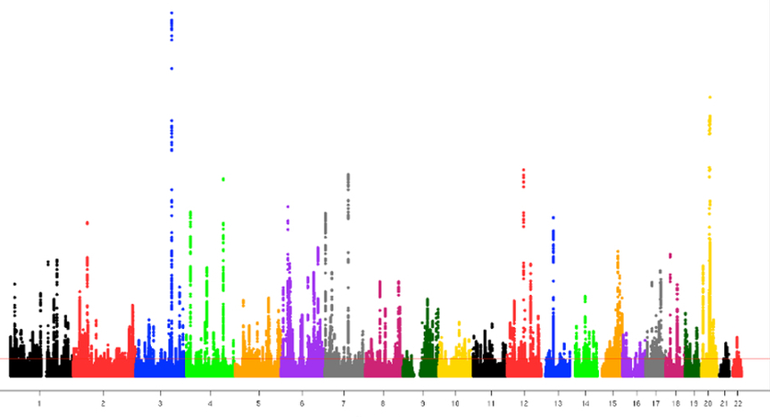
P-value distributions when there is and isn’t a GWAS signal
GWAS # 1
(not much signal)
GWAS # 2
(lots of significant signals)
-log10 P-value
-log10 P-value
Position along the genome
Position along the genome
P-values uniform between 0 and 1
Excess of small p-values

Slide 14
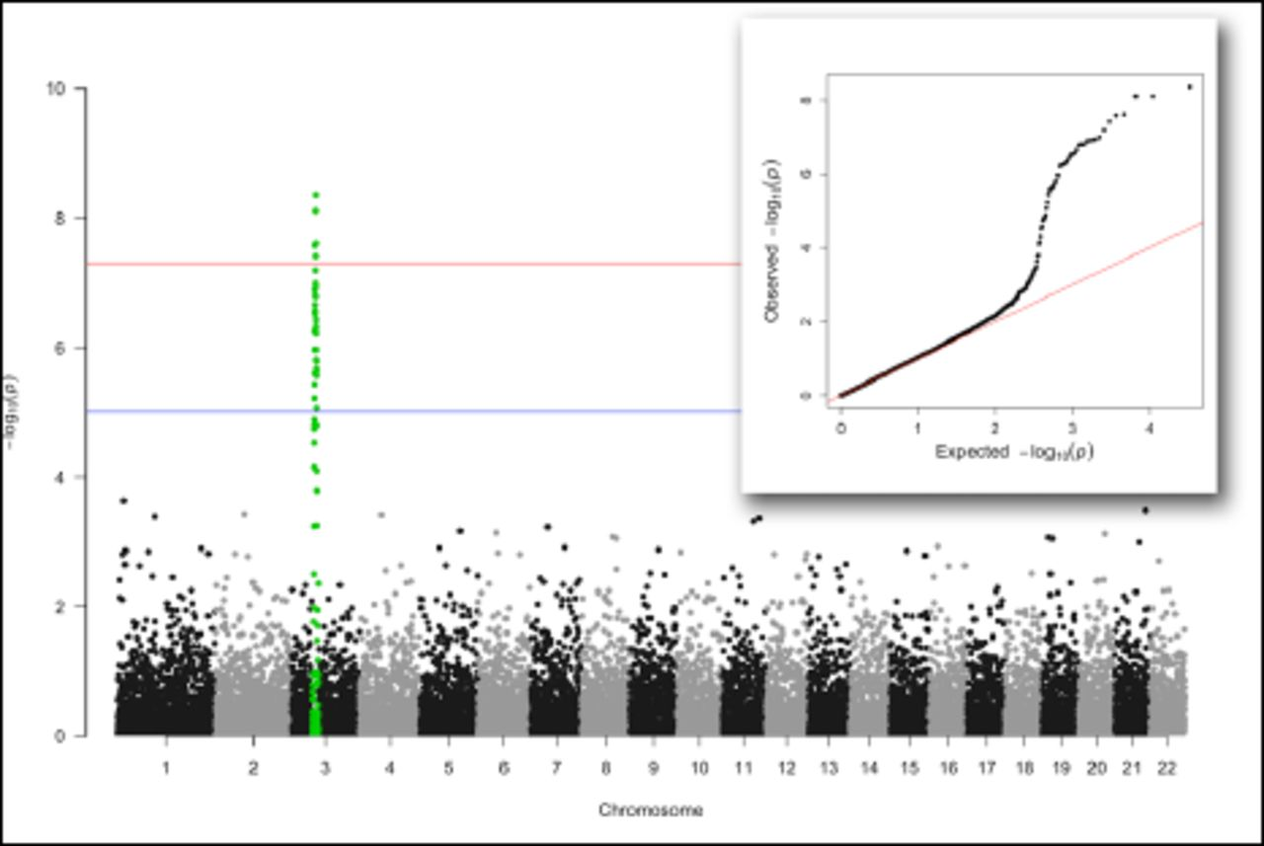
QQ plots – another way to visualize p-value distributions
QQ plot
Manhattan plot
https://www.biorxiv.org/content/10.1101/005165v1.full (”QQman” R package)

Slide 15
QQ plots: another way to visualize p-value distributions
P-values from our association tests
Generate Random p-values (from null/uniform)
Sort each list and compare
SNP | P-value
rs1 | 0.75
rs2 | 0.40
rs3 | 0.86
rs4 | 0.13
rs5 | 0.041
rs6 | 0.94
rs7 | 0.17
rs8 | 0.21
rs9 | 0.58
rs10 | 0.12
P-value
0.087
0.59
0.77
0.11
0.37
0.84
0.67
0.51
0.09
0.17
Sorted p-vals (observed) | Sorted p-vals (null)
0.041 | 0.087
0.12 | 0.09
0.13 | 0.11
0.17 | 0.17
0.21 | 0.37
0.4 | 0.51
0.58 | 0.59
0.75 | 0.67
0.86 | 0.77
0.94 | 0.84
Does this distribution of p-values match what we’d expect under the null hypothesis? (uniform distribution?)
Notes:
previous slide stared at histograms
instead could more directly compare

Slide 16
Quantile-quantile (QQ) plots: comparing two distributions
Sorted p-vals (observed) | Sorted p-vals (null)
0.041 | 0.087
0.12 | 0.09
0.13 | 0.11
0.17 | 0.17
0.21 | 0.37
0.4 | 0.51
0.58 | 0.59
0.75 | 0.67
0.86 | 0.77
0.94 | 0.84
Diagonal (x=y)
Max value from each distribution similar
Observed p-val
Median value from each distribution similar
Expected p-val (null)
Min value from each distribution similar
If all the points fall along the diagonal, it means the two distributions are similar
(i.e., all their quantiles are approximately the same)
Compare using a scatter plot

Slide 17
We’re mostly interested in really small p-values
We don’t care about e.g. p=0.3 vs. p=0.7
We do care if p=0.1 vs. p=0.01 vs. p=10⁻⁶
Taking –log10 P allows us to better compare small p-values
(note, we really should be using quantiles rather than simulating random numbers. But this is easier and looks almost the same if the number of data points is large enough.)

Slide 18
Typical GWAS QQ Plot (when all goes well)
Points above the diagonal = likely true associations
Way stronger p-values than expected by chance
For GWAS, we perform millions of association tests
The QQ plot has one point for each SNP
Most of the distribution is similar to the null
i.e. most SNPs not associated with the trait
QQ Plot can help us diagnose problems, and learn about genetic architecture, from GWAS data!
Notes:
For GWAS we perform millions of individual tests
Assume most SNPs are not associated with the trait, so most of our p-value distribution should be similar to the null distribution

Slide 19
Confounding factors

Slide 20
Extra variables might affect our association analyses
Covariate
Collider bias
Covariate
Collider
Genotype
Phenotype
Genotype
Phenotype
Confounding
Mediation
Confounder
Mediator
Genotype
Phenotype
Genotype
Phenotype
These situations can:
Introduce bias (giving false positives)
Increase variance (giving false negatives)
(We’ll touch on all of these, but will mostly focus on confounders)
Notes:
Will focus mostly on confounding
Look at others briefly

Slide 21
Common confounders in GWAS
ancestry
Genotype
Height
Example possible confounders in GWAS:
Batch effects (e.g. genotyping technology)
Ancestry

Slide 22
Example – eye color GWAS
A C G T T G C A T A C C T T T
Common ancestor
A A G T A G C A C A C C G T T
Population 1
(e.g. Northern Europe)
A C C T T G C A T A C C G T T
A A C T A G C A C A C C T T T
A C C T T G C A T A C C G T T
A A C T A G C A C A C C G T T
A C C T T G C A T A C C T T T
A A C T A G C A C A C C G T T
T C G T T G C G T A C C G T T
N. Europe
S. Europe
T A G T A G C G C A C C G T T
T C G T T G C G T A C C T T T
Population 2
(e.g. Southern Europe)
T A G T A G C G C A C C G T T
More recent SNPs will be specific to a certain population
T C G T T G C G T A C C T T T
T A G T A G C G C A C C T T T
T C G T T G C G T A C C G T T
T A G T A G C G C A C C G T T

Slide 23
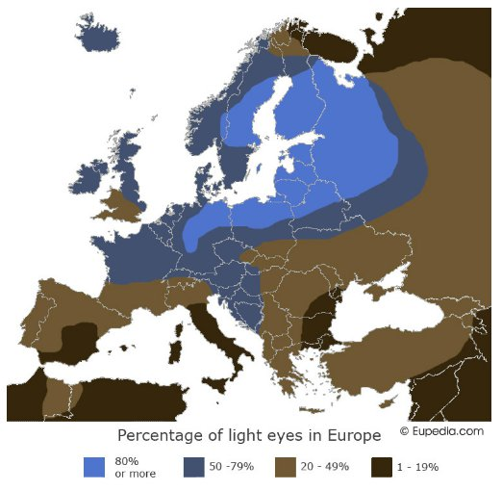
Example – eye color GWAS

Slide 24
Example – eye color GWAS
A C G T T G C A T A C C T T T
brown
A A G T A G C A C A C C G T T
Population 1
(e.g. Northern Europe)
A C C T T G C A T A C C G T T
blue
A A C T A G C A C A C C T T T
Many false positives due to different allele frequencies in Northern vs. Southern Europe!
A C C T T G C A T A C C G T T
blue
A A C T A G C A C A C C G T T
A C C T T G C A T A C C T T T
blue
A A C T A G C A C A C C G T T
T C G T T G C G T A C C G T T
brown
T A G T A G C G C A C C G T T
T C G T T G C G T A C C T T T
brown
Population 2
(e.g. Southern Europe)
T A G T A G C G C A C C G T T
T C G T T G C G T A C C T T T
brown
T A G T A G C G C A C C T T T
T C G T T G C G T A C C G T T
brown
T A G T A G C G C A C C G T T
SNP that actually controls eye color
Much higher prevalence in Northern Europe

Slide 25
Example – eye color GWAS w/o ancestry correction
Possible explanations:
Almost all of the genome is associated with eye color (probably not true…)
We are not controlling for some important confounding factor and have a bunch of false positives (much more likely)
P-values “inflated”
(way above the QQ plot diagonal)

Slide 26
Detecting evidence of confounding – the art of QQ
Above the diagonal -> population structure or other confounding
(or highly polygenic signal. See LD score regression on Weds)
Follows diagonal -> null distribution
Observed [-log10]
Strong departure from the null -> true hits?
Expected [-log10p]
Notes:
Show qq plots
Inflated
Underpowered
Null
Just right
Mention genomic control metric
Might need to simulate myself?...

Slide 27
QQ plots and power (example eQTL analysis)
Generally:
Bigger sample size = higher power
Higher power = stronger pvalues
Stronger pvalues = farther from diagonal
Low power: close to diagonal
In some cases, may go *below* diagonal
Fotsing et al Nature Genetics 2019
Notes:
Show qq plots
Inflated
Underpowered
Null
Just right
Mention genomic control metric
Might need to simulate myself?...

Slide 28
Extra variables might affect our association analyses
Covariate
Collider bias
Covariate
Collider
Genotype
Phenotype
Genotype
Phenotype
Confounding
Mediation
Confounder
Mediator
Genotype
Phenotype
Genotype
Phenotype
These situations can:
Introduce bias (giving false positives)
Increase variance (giving false negatives)
Notes:
Will focus mostly on confounding
Look at others briefly

Slide 29
Examples of covariates in GWAS
Sex (e.g. height, weight, cancer prevalence, gene expression)
Age, Age²
Cohort (if samples collected from many sites)
Ischemic time (gene expression)
Smoking status
These variables may introduce noise in our phenotypes.
Noisier phenotypes =
Reduced power to detect true genetic associations
Underestimates of effect sizes

Slide 30
Covariates could obscure true signals
AA
AT
TT
TT
AA
AT
AT
TT
64
65
65
68
72
72
75
76
The A/T SNP is associated with height
But the difference between males/females masks that difference!
Mean(AA) = 68, Mean (AT) = 70.7, Mean (TT) = 69.7
Solution: adjust for sex as a covariate (C)
Y = βX +ΥC
Notes:
A: 64, 72
AT: 65, 72, 75
TT: 65, 68, 76

Slide 31
Collider bias
Collider bias
If genotype and phenotype are uncorrelated, but both causally affect “Z”, adjusting for “Z” as a covariate can falsely induce a correlation
Collider (Z)
Genotype
Phenotype
Example:
GWAS for “sex”, but adjust for height as a covariate

Slide 32
Collider bias – JC2
How could collider bias be relevant to disease-related PRSs?

Slide 33
Possible example?
Hospitalization
SNP
Heart disease
SNP unrelated to heart disease
But, causal for other traits that do result in hospitalization
Conditioning on hospitalization may falsely induce a correlation between this SNP and heart disease

Slide 34
Mediator
Mediator
More examples:
SNP affects gene expression, which affects the trait
SNP affects cholesterol which affects heart disease risk
BMI
Genotype
Diabetes
Adjusting for the mediator will mediator will obscure the signal
Whether or not adjustment makes sense depends on the analysis

Slide 35
Controlling for confounding

Slide 36
Back to confounders
ancestry
Genotype
Height
Many possible confounders in GWAS!
Batch effects (e.g. genotyping technology)
Ancestry
How can we control our analyses for confounding factors?

Slide 37
Side notes – interesting GWAS regression relationships
Our model:
$$Y=βX+ε$$
If we normalize such that:
Mean(Y) = 0; Var(Y) = 1
Mean(X) = 0; Var(X) = 1
Then:
$β$ is equal to the Pearson correlation between X and Y

Slide 38
Controlling for pop. stratification – “Genomic control”
Intuition: $λ$ tells us how inflated the QQ plot is. If $λ$=1, no inflation and no correction needed
Don’t need to know what was causing the inflation!
Biometrics 1999
For each SNP, compute Armitage trend statistic:
$$A_{i}=Nβ_{i}^{2}$$
Under the null, $A_{i}\sim χ^{2}(1)$. If inflation, will deviate from expected Chi2 distribution
Compute:
$$λ= \frac{median(A_{1},…A_{m})}{0.456}$$
(0.456 is the median of a $χ^{2}(1)$ distribution)
Adjust statistics by this correction:
$$A_{i}′= \frac{A_{i}}{λ}$$
Notes:
http://faculty.washington.edu/tathornt/SISG2015/lectures/Taipei2015/Taipei2015session06.pdf

Slide 39
Genomic control and QQ plots
Genomic control factor (lambda) often computed as a QC metric. Closer to 1 = better
Vooman et al Plos One 2011

Slide 40
Controlling for population stratification – take 2
Height (Y)
10
10
11
12
12
13
14
15
16
16
Genotype (X)
AG
GG
AG
GG
GG
AG
AA
AG
AG
AA
Population (P)
CEU
YRI
CEU
CEU
CEU
YRI
YRI
CEU
CEU
YRI
0
1
0
0
0
1
1
0
0
1
Y = βX +Υ₁P
Relies on self-reported ancestry and discrete population groups
Only captures high level population structure. Doesn’t accurately capture admixture, cryptic relatedness
Notes:
Use population label

Slide 41
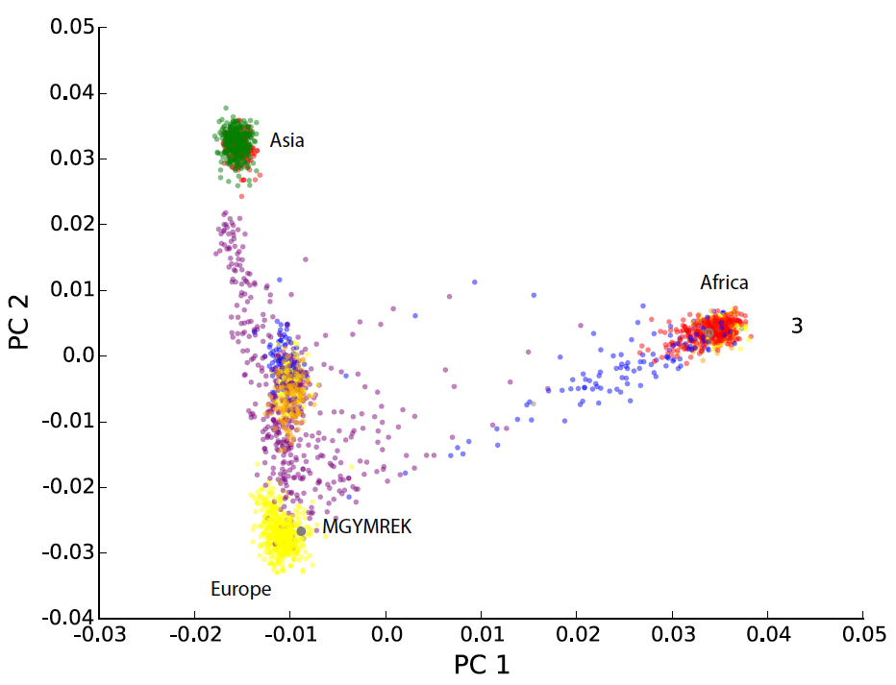
Recall from Week 3 – Inferring ancestry with PCA
m
X^{T}Q =
n
PC1
PC2
Each column gives the projection of each sample along that PC
A quantitative measure of ancestry!
Notes:
Using PCs as covariates
Show picutre -> pc matrix
Show example regression with 5 pcs as covars
Mention theory from plos 2006 for how many pcs to use

Slide 42
Controlling for population stratification – take 3
Height (Y)
10
10
11
12
12
13
14
15
16
16
Genotype (X)
AG
GG
AG
GG
GG
AG
AA
AG
AG
AA
Top n Principle components
v_{i}
v_{n}
Q
Notes:
Using PCs as covariates
Show picutre -> pc matrix
Show example regression with 5 pcs as covars
Mention theory from plos 2006 for how many pcs to use

Slide 43
Controlling for population stratification – take 2
Height (Y)
10
10
11
12
12
13
14
15
16
16
Genotype (X)
AG
GG
AG
GG
GG
AG
AA
AG
AG
AA
PC₁
0.1
0.3
-0.4
0.1
0.2
0.3
0.4
-0.2
0.5
-0.5
PC₂
-0.1
0.2
-0.1
0.1
0.5
-0.3
0.2
-0.1
0.6
-0.4
…
PC_{n}
-0.1
0.1
-0.5
0.1
0.6
0.2
-0.2
-0.3
0.7
0.2
Y = βX +Υ₁PC₁+Υ₂PC₂ + … Υ_{n}PC_{n}
Notes:
Using PCs as covariates
Show picutre -> pc matrix
Show example regression with 5 pcs as covars
Mention theory from plos 2006 for how many pcs to use

Slide 44
QQ plot – before and after ancestry correction
Height ~ GT
Height ~ GT + PC1+PC2+PC3+PC4+PC5
P-values way stronger than expected
Probably not reliable
Most p-values look null
Evidence of real signal for top SNPs

Slide 45
Controlling for ancestry – PCs considerations
How many PCs? Typically ~5-10. See theory in Price et al. Plos 2006
Advantages/disadvantages in taking too many/too few PCs?
Too few: will not completely control for confounding, p-values may still be inflated
Too many: lower-down PCs may actually capture true variation related to our trait!
Taking this to extreme, if we use *all* PCs, we’ll kill all genetic variation
Notes:
Using PCs as covariates
Show picutre -> pc matrix
Show example regression with 5 pcs as covars
Mention theory from plos 2006 for how many pcs to use

Slide 46
Controlling for confounding – linear mixed models

Slide 47
Not all confounding captured by top PCs
Top PCs capture overall population structure
e.g. what population group(s) does a sample belong to?
Another issue is related individuals. Even after pruning close relatives, “cryptic” relatedness can confound analysis
Notes:
TODO top PCs capture overall pop structure
Another issue is related individuals. Not independent if they share a lot of the genome
“cryptic relatedness”
Options:
Remove them. Show relatedness metrics
Another option: LMM

Slide 48
Why shouldn’t we include related individuals
Standard GWAS assumes samples are “unrelated”
Including closely related samples can result in bias, since closely related individuals will (usually) have more highly correlated phenotypes than two random samples. Especially true for highly polygenic traits.
Options:
Remove them. Possible for close relatives
Control for relatedness in our model
Notes:
Using PCs as covariates
Show picutre -> pc matrix
Show example regression with 5 pcs as covars
Mention theory from plos 2006 for how many pcs to use

Slide 49
Detecting and removing related samples
Recall using plink to determining P(IBD=0), P(IBD=1), P(IBD=2)
Standard: remove one sample from each pair with $π$>~0.2
$$π=\frac{P\left(IBD=1\right)}{2}+P(IBD=2)$$
1.0
Parent/child
(e.g. uncle/nephew, grand parent/child)
% IBD=1
Siblings
2nd order
First cousins
Distant cousins
0.0
0.0
1.0
% IBD=0
Notes:
Using PCs as covariates
Show picutre -> pc matrix
Show example regression with 5 pcs as covars
Mention theory from plos 2006 for how many pcs to use

Slide 50
Linear mixed models (LMM) to control for ancestry
Recall our original model (for n total samples):
“Fixed effects” (assume constant)
$$Y=βX+Cγ+ε$$
$$Y$$
: Vector of phenotypes ($Y=\{Y_{1},…Y_{n}\}$)
Assume has mean=0, variance=1
$$X$$
: Vector of genotypes ($X=\{X_{1},…X_{n}\}$)
$$β$$
: SNP effect size (scalar)
$$C$$
: $n×C$ matrix of covariates (e.g. PCs)
$$γ$$
: $C×1$ vector of covariate coefficients
$$ε$$
: Vector of errors ($ε=\{ε_{1},…ε_{n}\}$)
Assume errors are random, independent, and normal $ε\sim N\left(0, σ_{e}^{2}I\right)$
$I$ is an $n×n$ identity matrix
$σ_{e}^{2}$ captures how much trait variance is due to non-genetic effects

Slide 51
Linear mixed models (LMM) to control for ancestry
$$Y=βX+Cγ+u+ ε$$
“Fixed effects”
(constant)
“Random effects”
(drawn from a distribution)
Capture relatedness
$$u$$
: Vector of random effects ($u=\{u_{1},…u_{n}\}$)
Drawn from multi-variate normal distribution
$$u\sim MVN(0, σ_{g}^{2}K)$$
$$K$$
: Genetic relatedness matrix (GRM). $n×n$ matrix giving pairwise relatedness between samples (usually based on IBD, more on this in a second)
$$σ_{g}^{2}$$
: captures how much trait variance is due to genome-wide genotype sharing

Slide 52
Linear mixed models (LMM) – computing the GRM
Z-normalize SNP genotypes based on minor allele frequency $p_{i}$of SNP $i$
$X_{ij}$ gives normalized genotype for sample $i$ at SNP $j$
$$X_{ij}∈\left\{\frac{−2p_{i}}{\sqrt{2p_{i}\left(1−p_{i}\right)}},\frac{1−2p_{i}}{\sqrt{2p_{i}\left(1−p_{i}\right)}}′\frac{2−2p_{i}}{\sqrt{2p_{i}\left(1−p_{i}\right)}}\right\}$$
K
(GRM)
n
GRM gives pairwise SNP-similarity:
n
$$K=X^{T}X/m$$
Interpretation: $K_{ab}$ gives the relatedness (~correlation of genotypes, adjusting for allele frequencies) between individual $a$ and $b$.

Slide 53
LMM intuition – random effects add structure to error
$$Y=βX+Cγ+ ε$$
Fixed effects only
Errors are random and independent
$$ε\sim MVN(0, σ_{e}^{2}I)$$
$$σ_{e}^{2}$$
$$0$$
$$0$$
$$0$$
$$0$$
$$0$$
$$0$$
$$σ_{e}^{2}$$
$$0$$
$$0$$
$$0$$
$$0$$
$$0$$
$$0$$
$$σ_{e}^{2}$$
$$0$$
$$0$$
$$0$$
n
$$0$$
$$0$$
$$0$$
$$σ_{e}^{2}$$
$$0$$
$$0$$
$$0$$
$$0$$
$$0$$
$$0$$
$$σ_{e}^{2}$$
$$0$$
$$0$$
$$0$$
$$0$$
$$0$$
$$0$$
$$σ_{e}^{2}$$
n
Errors for a sample have mean 0 and variance $σ_{e}^{2}$
Errors for two different samples are not correlated

Slide 54
LMM intuition – random effects add structure to error
$$Y=βX+Cγ+ ε+u$$
Random effects adds structure to our error term
Errors for related samples are correlated
$$ε+u\sim MVN(0, σ_{e}^{2}I+σ_{g}^{2}K)$$
$$σ_{e}^{2}I$$
$$σ_{g}^{2}K$$
$$1$$
$$0$$
$$0$$
$$0$$
$$0$$
$$0$$
$$0$$
$$1$$
$$0$$
$$0$$
$$0$$
$$0$$
$$K$$
$$σ_{e}^{2}$$
$$0$$
$$0$$
$$1$$
$$0$$
$$0$$
$$0$$
$$+$$
$$σ_{g}^{2}$$
$$0$$
$$0$$
$$0$$
$$1$$
$$0$$
$$0$$
$$0$$
$$0$$
$$0$$
$$0$$
$$1$$
$$0$$
$$0$$
$$0$$
$$0$$
$$0$$
$$0$$
$$1$$
More closely related = “error” terms more similar

Slide 55
Putting it all together – PCA + GRM
$$Y=βX+Cγ+u+ ε$$
PC covariates
(fixed effects)
Capture global ancestry
Relatedness
(random effects)
Capture cryptic pairwise relatedness
$C$gives eigenvectors of K
$$u\sim MVN(0, σ_{g}^{2}K)$$
K=X^{T}X
(GRM)
n
n

Slide 56
Solving an LMM
Y = Xβ +Zu + ε
1. BLUE: Henderson’s mixed model equations give the “BLUE” (best linear unbiased estimates) of fixed and random effects coefficients. (R here is var(ε))
2. REML: Restricted maximum likelihood to estimate variance components. (more complicated) Write down likelihood of the data (Y) in two parts, one which doesn’t depend on fixed effects. Maximize likelihood w.r.t variance parameters, then estimate fixed effects. (implemented in GCTA, also BOLT-LMM, EMMA, fastGWA)

Slide 57
Example – fastGWA + UK Biobank

Slide 58
Break
Project Overview

Slide 59
Project overview
For your project you may:
Implement an analysis method we covered in class
Perform an analysis to answer an original research question related to personal genomics
You may work in groups of 1-3 people
Sign up on the Google sheet (linked from Canvas)

Slide 60
What makes a good project idea?
The topic is interesting!
The topic is related to personal genomics in some way.
It is something you can make progress on within 3-4 weeks. You can be ambitious, but at the end of the day you’ll have to write something about what you did!
It’s ok if multiple groups work on similar projects.
It can be related to your current thesis research, but should not be exactly the same.

Slide 61
Notes on implementation projects
Option 1: implement method we learned in class
It should be something non-trivial and can’t be something you already did in a problem set (e.g. no PCA, no SNP caller)
Benchmark your solution against existing tools. (run time, accuracy) (e.g. compare to plink. It’s ok if you do worse! You can discuss why in the paper)
Provide a github repo pointing to your code with a user-friendly interface

Slide 62
Ideas for implementation projects
Estimating % IBD using plink method of moments
Finding shared IBD segments for a pair of samples
Mapping shared segments/recombination breakpoints in pedigrees (e.g. from 1000 Genomes samples)
Implement a simple HMM for phasing/imputation
Estimate PRSs for one or more traits in 1000 Genomes samples and compare across populations

Slide 63
Notes on analysis projects
Option 2: Perform a novel analysis
This could mean:
Applying existing tools to answer a novel personal genomics related question
Benchmarking multiple existing tools that perform a certain type of analysis
Exploring ideas for a novel method
As for Option 1, all code should be made available in a github repo.

Slide 64
Notes on analysis projects - ideas
Develop a tool that simulates "offspring" from a potential "mating" between two genomes. Use this to analyze the distribution of monogenic "Mendelian" and polygenic disease risk in siblings.
Explore ideas for performing haplotype rather than single SNP-based association tests.
Analyze Y-haplogroups or mitochondrial haplogroups in 1000 Genomes Project samples.
Investigate the use of alternative techniques to PCA for analyzing population structure (e.g. UMAP, t-SNE)
Benchmark alignment+variant calling methods for Nanopore data. Compare calls from short vs. long reads for 1000 Genomes samples
Apply fine-mapping techniques/functional analysis to summary statistics from a GWAS of interest
See posted spreadsheet for more ideas and a list of last year’s project titles

Slide 65
Possible Datasets
1000 Genomes Project
Phased genome-wide genotypes for 2500 samples
New high-coverage data publicly available for all
GWAS summary statistics
Easy to obtain for many traits
Consider simulating data, depending on the project
We prefer you not use controlled access data since we won’t have access

Slide 66
Computational resources
Projects should be completed on datahub
Choose small datasets (e.g. focus analysis on one small chromosome) since we don’t have unlimited compute
If you anticipate bigger compute needs let us know, we may be able to increase for the project period.

Slide 67
Project deliverables
The final project is worth a total of 30% of your grade and consists of the following components:
Proposal (5%) Due 05/05/21
Presentation (5%) to take place 05/26/21 and 06/02/21
Paper (20%) Due 06/04/21
**Even though it’s a group project, please have each group member submit each assignment on Canvas**.

Slide 68
Proposal (100 pts)
The proposal should contain the following labeled sections:
Project title (5 pts)
A list of team members and their expertise areas (5 pts)
An abstract (maximum 200 words) briefly describing the project and motivation (50 pts)
Resources and datasets that will be used (30 pts).
Describe which specific datasets you will use. This will help us know which common datasets to make available in the public directory.
Describe which tools you will need and if they are already available on JupyterHub or not
Deliverables (10 pts)
What do you anticipate will be the major results of your project? A tool? Method idea? Dataset? Something else?
Format:
Your proposal must be in PDF format. You may use minimum 0.5-inch margins and 11 pt Arial font. One page maximum
Grading notes:
Proposals are graded out of 100 points.
We will take off 5 points for each page over the 1 page limit.
We will take off up to 5 points if you don't follow formatting guidelines.
Notes:
Using PCs as covariates
Show picutre -> pc matrix
Show example regression with 5 pcs as covars
Mention theory from plos 2006 for how many pcs to use

Slide 69
Presentation
Each group will give a presentation about their project. Presentations will take place during class 05/26/21 and 06/02/21.
Timing will be updated when we have a final teams list, but we anticipate presentations will be approximately 5 minutes each with a short time for Q&A.
During your presentation, you should:
Briefly introduce your project and the dataset.
Summarize your methods and results.
Highlight one more challenges you faced and how you dealt with it.
Presentations are graded out of 10 points:
The talk gives a clear and interesting description of your project (5 pts)
Talk includes all the items listed above (2 pts)
The talk is within time (1 pt)
How well you respond to Q&A (2 pts)
Notes:
Using PCs as covariates
Show picutre -> pc matrix
Show example regression with 5 pcs as covars
Mention theory from plos 2006 for how many pcs to use

Slide 70
Paper
The final paper should be 5 pages maximum and contain:
Project title, author list, abstract (200 words max).
Introduction (approximately 1 page): Describe the motivation behind your project and how it fits with current literature in the field.
Methods: Describe the methods used in your project, including software, statistical tests, and datasets.
Results: Describe the major results of your study. When helpful, include figures and tables to display results.
Discussion: Briefly summarize the major findings. What are the limitations of your project? How could it be expanded? What future directions does it point to?
Author contributions (0.25 pages): Describe the contributions of each team member to the project.
Reflection (0.25 pages): Overall, how was your experience working on this project? How much time did you spend? How were the team dynamics? Did you receive adequate guidance? What were the major challenges?
Final reports will be graded out of 100 points. Reports should be in PDF format, with minimum 0.5-inch margins and 11-pt Arial font. Single-spaced.

Slide 71
Project competitions
We’ll be award 2 points extra credit for each of the following:
Best figure
Best code documentation
Best presentation
The points will be added to the project report grade (out of 100. so you could earn up to 102/100 for the report).

Slide 72
Project discussion
Please sign up ASAP on the Google sheet so we know how many teams there are
I hope to set up a chance to talk with each team briefly.

