Slide 1
CSE284: Personal genomics for bioinformaticians
Crowd genomics + privacy concerns
Today’s schedule:
Genetic genealogy
Case studies in privacy concerns with DTC genomics
Break
Privacy concerns in genomics
Announcements:
PS2 due Friday
PS3 released

Slide 2
Questions from last time + PS2 FAQ
For the RFMix problem:
  Don’t copy code directly from the slides. There are some non-ASCII characters
  My examples used hapcol=3 since I was working with a map file with one less column. If you follow our code you probably want to start with hapcol=4
  See discussion on Piazza
Question: does local ancestry inference require phased data?
  RFMix requires phased data
  LAMP-LD (which the slides covered) should work with unphased data

Slide 3
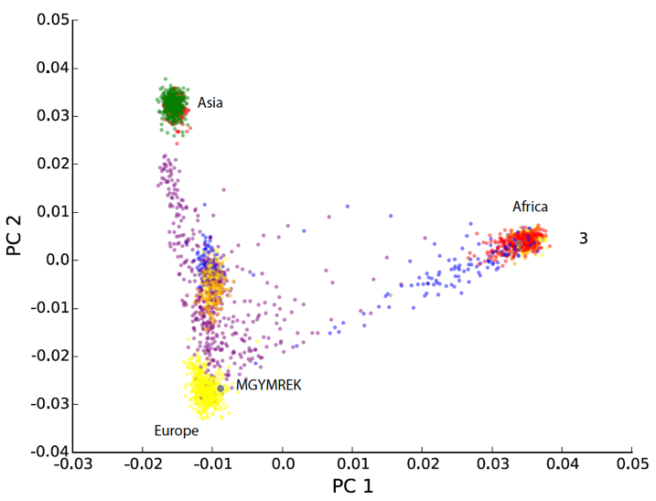
Q: how to determine most important features in PCA?
m
1 dot = 1 sample
X^{T}Q =
n
PC1
PC2
Notes:
https://scentellegher.github.io/machine-learning/2020/01/27/pca-loadings-sklearn.html

Slide 4
Q: how to determine most important features in PCA?
PC1
PC2
height
weight
eigvec1
eigvec2
100.1
92.0
64.37
119.8
0.94
-0.33
101.9
92.2
65.96
120.6
=
0.33
0.94
…
…
…
…
Q
Proj
X^{T}
Can also look at correlation between original features and each PC
Projection of sample 1 on PC1
Dot product of sample 1 * eigvec 1
“Loadings” of each feature given by the values in the eigenvector
pca = sklearn.decomposition.PCA(n_components=2)
pca.components_ # should give the loadings
https://stats.stackexchange.com/questions/104306/what-is-the-difference-between-loadings-and-correlation-loadings-in-pca-and/104640#104640
https://scentellegher.github.io/machine-learning/2020/01/27/pca-loadings-sklearn.html

Slide 5
Module | Date | Lecture | Homework
Intro to personal genomics | 03-29 (M) | Introduction to your genome
Ancestry | 03-31 (W) | Basic Population genetics/JC1 | JC1 questions
 | 04-05 (M) | Phasing and Imputation/HMMs | PS1 (due 4/5)
 | 04-07 (W) | Relative finding
 | 04-12 (M) | Determining ancestry
 | 04-14 (W) | Genetic genealogy/Ethics | PS2 (due 4/16)
Trait Prediction | 04-19 (M) | Mendelian(ish) Traits
 | 04-21 (W) | Risk prediction | JC2 questions
 | 04-26 (M) | Controlling for confounding
 | 04-28 (W) | Missing heritability | PS3
Next-generation sequencing | 05-03 (M) | Intro to NGS
 | 05-05 (W) | Alignment+variant calling | Project proposal
 | 05-10 (M) | Clinical genome sequencing | JC3 questions
 | 05-12 (W) | Long reads
 | 05-17 (M) | Ancient genomes | PS4
 | 05-19 (W) | Ethics part 2 | JC4 questions
Special Topics/Final Projects | 05-23 (M) | Deep learning in genomics
 | 05-57 (W) | Project presentations
 | 05-31 (M) | Memorial Day – no lecture
 | 06-02 (W) | Project presentations | Project Due (06/04)
Notes:
We’ve spent first couple weeks talking about ancestry
Today talk about some remaining applications for how people use genetics to track their extended families
Then spend the rest of today talking about significant ethical concerns that can arise from our ability to do these types of analyses, focusing on privacy concerns
Next week we’ll dive into our next module about trait prediction

Slide 6
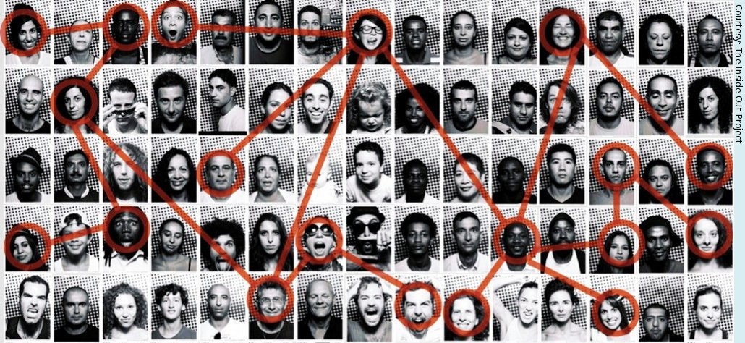
Genetic genealogy is a major personal genomics application
Genetic genealogy: involves combining DNA tests and traditional genealogy methods to study family history, or infer biological relationships between individuals
Notes:
Talk about genetic genealogy both because it’s a major application of the personal genomics revolution
But also, highlights some of the privacy issues that can arise when dealing with genetics datasets

Slide 7

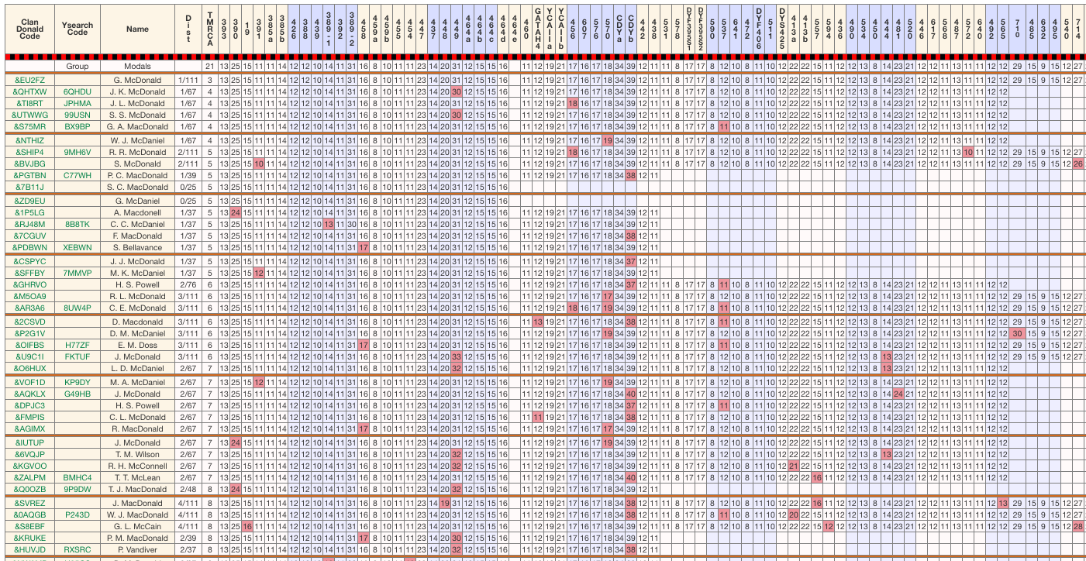
There is a very active genetic genealogy community online
Surname studies
Active blogs + analysis sites
http://clandonaldusa.org/
Notes:
Vibrant online scene
Some intense amateur groups using genealogy to study their family’s history
While many of these are amateur genealogists not trained in genetics, they actually have some highly detailed blog posts, often doing paper reviews of recent literature, or walking through how some of the methods they use work. Make for some good reading.
Not all of these are without controversy…

Slide 8
A genetic genealogist’s toolkit
Autosomal DNA
SNP genotyping (e.g. 23andMe, 1.5 million SNPs, across the 22 autosomes
Can determine recent relatives (e.g. siblings, aunts/uncles, grandparents) (Lecture #4)
Can determine overall ancestry decomposition (Lectures #4,5)
Y chromosome DNA (paternal lineage)
STR genotyping (e.g. FTDNA), Y-SNP analysis (23andMe, FTDNA), Y chromosome sequencing (BigY)
Determine ancestry along paternal lineage
Mitochondrial DNA (maternal lineage)
mtDNA SNPs (23andMe, FTDNA)
Determine ancestry along maternal lineage
Notes:
Three main types of data people using to trace family history
We’ve talked about autosomal DNA
But left out two other very widely used genetic tests

Slide 9


Review: how the genome is inherited
mtDNA
chrX
chr1
chr1
chrX
chrY
mtDNA
mtDNA
chrX
chr1
chr1
chrX
chrY
mtDNA
chrY and mtDNA don’t have recombination! Inherited as one big (easy to analyze) segment
Exceptions: pseudoautosomal region (PAR) on X and Y can recombine. Also mtDNA can be mosaic

Slide 10

Paternal Lineage – Y chromosome
Males share a Y chromosome (minus mutations) with:
Their sons
Their fathers
Their male siblings
Nth cousins that can trace a male line back to the same common ancestor
Females don’t have a Y chromosome, so don’t share it with anyone.

Slide 11
Maternal Lineage – mtDNA
Females share mtDNA (minus effects of mutation and mosaicism) with:
Their children
Their mothers
Their siblings
Nth cousins that can trace a female line back to the same common ancestor
Males share mtDNA with:
Their siblings
Their mothers
Nth cousins on the same maternal line

Slide 12


Maternal, paternal, autosomal inheritance
Y
…
Founders
mtDNA
Y
mtDNA
Y
mtDNA
Y
mtDNA
Y: Paternal lineage
Y
mtDNA
mtDNA: Maternal lineage
Autosomal: patchwork of many ancestral lineages (many are lost!)

Slide 13
Y chromosome analysis

Slide 14
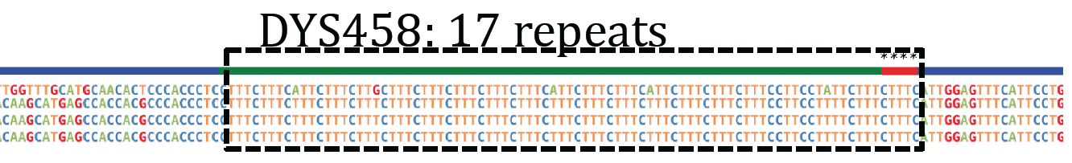
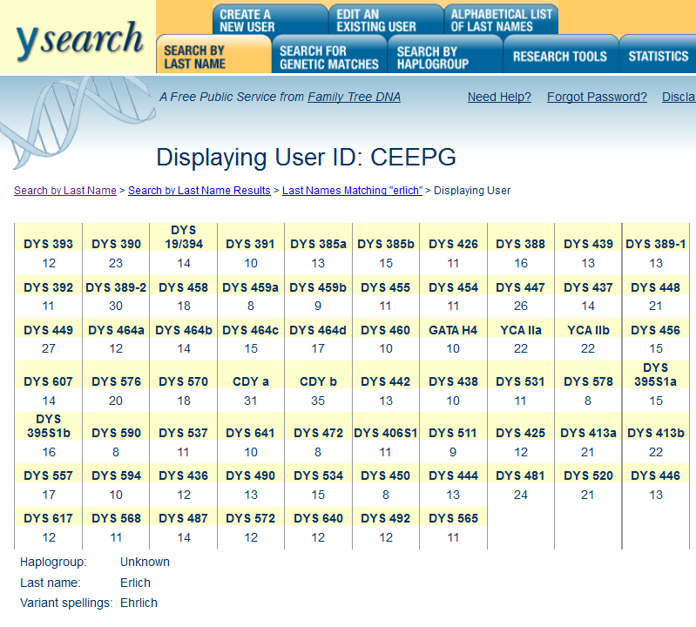
Y-STRs
Y-STRs: short tandem repeats on the Y chromosome
Example: DYS458
Reference genome contains 16 copies of “TTTC”
Example genome (Craig Venter) contains 17 copies of “TTTC”
Common Y-STR panels type 12, 67, or 111 markers (more markers = better resolution)
Y-STR haplotype: ordered results of number of repeats at each marker
Example Y-STR panel:
FTDNA
Genographic
SMGF
AncestryDNA

Slide 15
Surnames and Y chromosomes
Smith Y
Closely matching Y chromosomes are likely to share a surname
Smith Y
Smith Y
Smith Y
Smith Y
If you share a Y chromosome with someone in the last several hundred years, you likely share a surname!

Slide 16
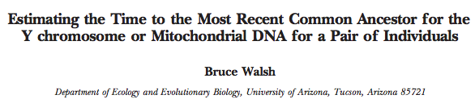
Calculating TMRCA of a pair of Y chromosomes
Common application: Given a pair of Y chromosomes, how many generations ago do they share a common ancestor?
(time to most recent common ancestor = TMRCA)
If t is small (<~20), likely to share a surname
MRCA (most recent common ancestor)
t(# generations)
Present-day sample 1
Present-day sample 2

Slide 17
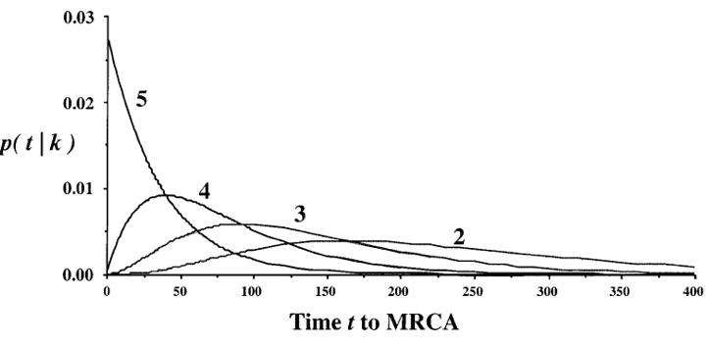
Calculating TMRCA of a pair of Y chromosomes
Let q_{i}(t) be the the probability that marker i matches after t generations:
q_{i}(t) = (1-μ_{i})^{2t}
L(t) = Π_{i}q_{i}(t)^{xi}(1-q_{i}(t))^{1-xi}
Where x_{i} is 1 if v_{i}=u_{i}, else 0.
t
Given:
Two Y-STR haplotypes with n markers:
V = v₁, v₂, v₃, … v_{n}
U = u₁, u₂, u₃, … u_{n}
Mutation rates (# mutations/generation) for each STR:
μ = μ₁, μ₂, μ₃, …μ_{n}
Example P(t|k) for 5 markers scored with k matches
Walsh Genetics 2001

Slide 18
Surname Projects
http://clandonaldusa.org/
TMRCA based on # mismatches in STR profiles
And many more…

Slide 19
Y-Search

Slide 20
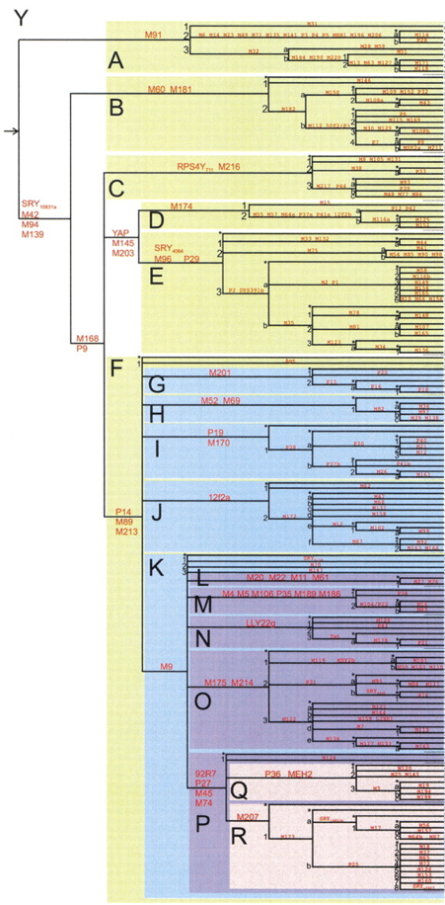
Y-SNPs and Y-Haplogroups
Y-SNPs: common single nucleotide polymorphisms on the Y chromosome
Example: M173 (173rd SNP documented by the Human Population Genetics Laboratory at Stanford, which uses code “M”.) (modern nomenclature: rs2032624, chrY:15026424)
Y-haplogroups: defined based on where you fall in this tree:
Major clades are labeled with capital letters A (base) through R
One or more specific mutations defines the branch points
Subclades within a capital letter group are named using alternative alphanumeric symbols. * used for parent.
  E.g. E* contains E1, E2, E3
  E*1 contains E1a, E1b, etc
  It can get crazy. E.g. R1b1a2a1a1b3
The Y Chromosome Consortium, Genome Research 2002

Slide 21
Y Haplogroups
Nomenclature #1 (by subclade)
Major clades are labeled with capital letters A (base) through R
One or more specific mutations defines the branch points
Subclades within a capital letter group are named using alternative alphanumeric symbols. * used for parent.
  E.g. E* contains E1, E2, E3
  E*1 contains E1a, E1b, etc
  It can get crazy. E.g. R1b1a2a1a1b3
Nomenclature #2 (by mutation)
Keep capital letter names
Include a dash and mutation name. If multiple mutations, choose one
e.g. Alon’s Y haplogroup:
R2a, or R-M124
The Y Chromosome Consortium, Genome Research 2002

Slide 22
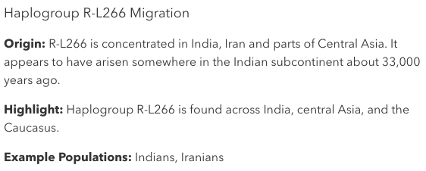
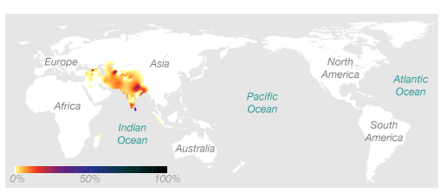
Example – 23andMe

Slide 23
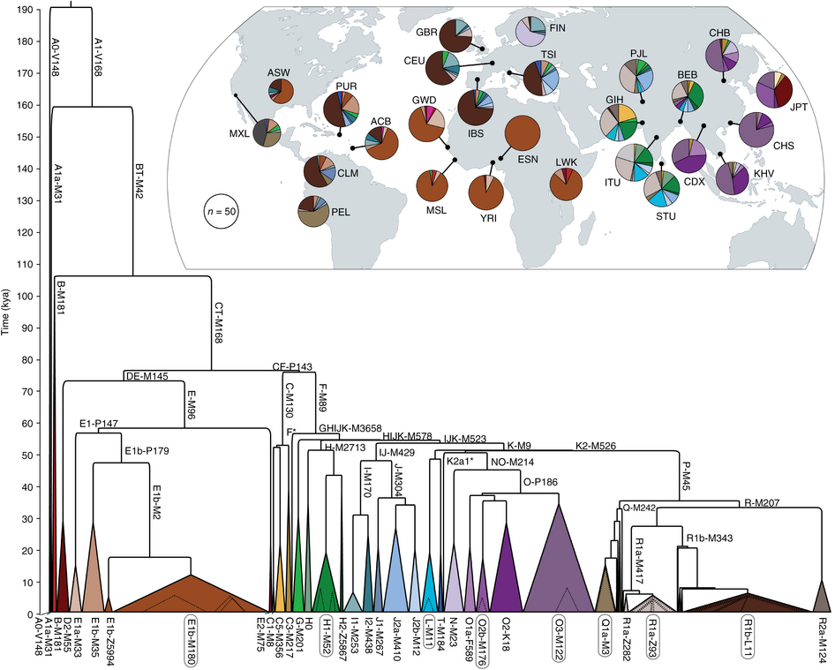
The entire Y Haplotype tree
“Y chromosome Adam” (~200-300Kya)
Poznik et al. Nature Genetics 2016

Slide 24
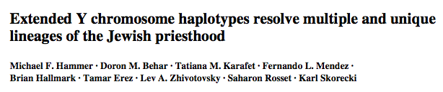
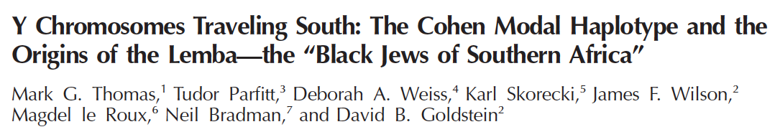
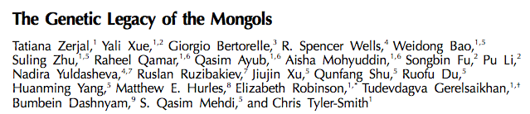
Y-STRs confirm written and oral history

Slide 25
mtDNA analysis

Slide 26
Maternal Lineage – mtDNA
Females share mtDNA (minus effects of mutation and mosaicism) with:
Their children
Their mothers
Their siblings
Nth cousins that can trace a female line back to the same common ancestor
Males share mtDNA with:
Their siblings
Their mothers
Nth cousins on the same maternal line

Slide 27
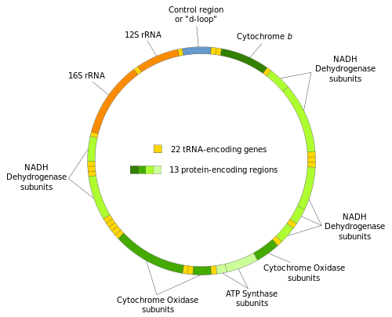
mtDNA genetic genealogy testing
Most commonly sequence “Hypervariable regions” (HVR1 and HVR2) in the “d-loop”
Family Tree DNA also offers sequencing of the full mtDNA sequence (16,569 bp)
23andme tests a selected number of mtDNA SNPs
https://isogg.org/wiki/Mitochondrial_DNA

Slide 28
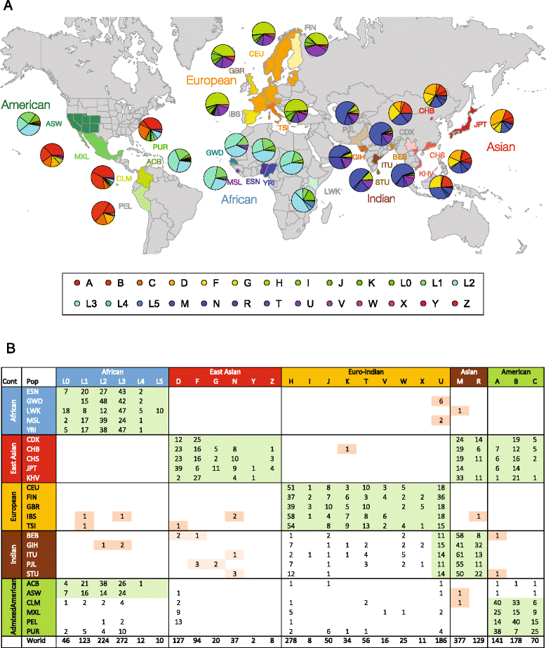
mtDNA haplogroups in 1000 Genomes
Rishishwar and Jordan, BMC Genomics 2017

Slide 29
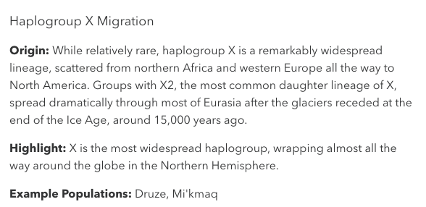
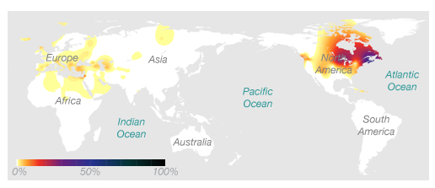
Example – 23andMe

Slide 30
You can upload your genome to these sites for free
Gedmatch.com
DNA and genealogical tools for researchers and genealogists
DNA.land
Free site where you can upload genotypes from e.g. 23andMe or FTDNA and get additional analyses and tutorials
Donate your genome to scientific research
GENI.com
Build your pedigree and connect with others
Available in analyzable format from familinx.org. Largest connected pedigree = 13 million people!
And many more…
Notes:
Put example companies,
Couple examples in next slides
23andme
Genographic
FTDNA
Ancestry.com
DNA.land
GENI.com

Slide 31
Ethics Part I - Privacy
(what could possibly go wrong when we have genetic databases of millions of people?)
Today: Focus on implications of relative finding+ancestry
Part II (Week 8): ethical considerations related to health info

Slide 32
Privacy implications of ancestry analysis
We’ll go over anecdotes arising from:
Relative finding surprises
Privacy concerns in research and forensics

Slide 33
Relative finding is fun and allows us to learn about our family tree
But… you might find relatives you don’t expect, and might not have wanted to know about

Slide 34
Relative finding scenario #1
You log in to the relative finder and extremely surprised to see at the top of your list someone listed as “father”. But you know for a fact that your father has not submitted a sample to 23andme!
You think this might be a mistake. After all, relative finding can be error prone and maybe there was a bug in their site.

Slide 35
Relative finding scenario #1 (continued)
You investigate further and use 23andme’s genome comparison tool.
You find that all 22 of your autosomal chromosomes are shared 50%.
You also find that you share identical Y haplogroups.
Assuming this it not a bug or sample swap issue, what do you conclude?
Relative finding can be highly uncertain for nth cousins
But father-child relationship is hard to get wrong
This person must be your biological father (or his identical twin).
Non-paternity rate in the general population is close to 2%
So there are going to be a lot of surprises in a database of 10M people

Slide 36
Relative finding scenario #2
You and your brother got 23andme kits as gifts. You both sent in your samples and your results are now ready to view!
You head over the “relative finding” feature. While you see a cousin there that you recognize, you’re surprised to find that your brother isn’t in your list of results. Why might he not be showing up as a relative?
You investigate further and download your and your brother’s VCF file, and use plink to analyze IBD sharing. You find you and your brother share 10% of your genome at IBD=1 (and none at IBD=2). What is your conclusion?
Consistent with you and your brother being unrelated but of similar ancestry.
A likely explanation is that your brother was adopted.

Slide 37
Relative finding scenario #3
You log in to the relative finder and confused to see at the top of your list someone listed as “granddaughter”. This is especially confusing, since you don’t even have any children! You don’t recognize this person.
What might have gone wrong? What conclusion do you make?

Slide 38


Some genetic relationships easily confused
Grandparent/grandchild
IBD=1
IBD=1
IBD=0
IBD=0
P(IBD=0)=2/4=0.5
P(IBD=1)=2/4=0.5
P(IBD=2)=0
(on average!)

Slide 39
Some genetic relationships easily confused
Half sibling
P(IBD=0)=2/4=0.5
P(IBD=1)=2/4=0.5
P(IBD=2)=0
(on average!)

Slide 40
Limitations of only considering % IBD?
1.0
Parent/child
Some relations can’t be distinguished!
Avuncular vs. grandparent
Half-sibling vs. grandparent
Distant cousins difficult
% IBD=1
Siblings
2nd order
First cousins
Distant cousins
0.0
0.0
1.0
% IBD=0

Slide 41
Relative finding scenario #3 (continued)
Even though you were surprised by the granddaughter result, you let it go thinking maybe it’s just a weird fluke.
A year later you remember this weird result and log back in to see if anything has changed in your relative finder results.
You see the “granddaughter” result has now been changed to “half sister”. This makes more sense, but is still concerning because you don’t know of any half siblings!
But something else is weird, in addition to that sister, you see 4 other results for additional half siblings of similar ages. You don’t know any of them. Based on their names they all seem to be from different families. What could explain this?

Slide 42



Relative finding scenario #3 (continued)
Anonymous sperm donor
A single sperm donor may contribute to many offspring, resulting in large half-sibships

Slide 44
Break
Genetic privacy concerns

Slide 45
Someone hands you an “anonymous” DNA sample…
Could we figure out who the sample is from, just from the DNA sample alone?

Slide 46
When could this happen?
Criminal investigation
“Anonymous” research subjects (e.g. 1000 Genomes)
Commonly used human cell lines in the lab
Other less likely settings: spying on someone, dishonest insurance companies, and more…

Slide 47

(2013)

Slide 48
Public sequencing projects have been essential to genetics
More than 3,000 whole genomes freely available online for research use
First genome-wide portrait of genetic variation in human populations
Critical for methods development
Widespread applications: e.g. imputation, population structure, medical genetics

Slide 49
1000 Genomes samples presumed “anonymous”

Slide 50
Starting point
”All -omics data are theoretically identifiable, albeit at considerable effort and cost, and provided that a matching sample is available. [T]he risk for re-identification from -omics data is still highly remote.”
From the executive summary of NCI Think Tank on the Identifiability of Biospecimens and -Omic Data (June 2012)
http://1.usa.gov/XW261q

Slide 51
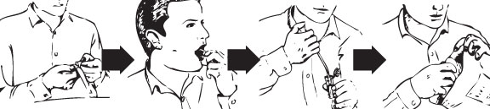
Co-segregation between Y-chromosomes and surnames
Y
www.ysearch.org:
Smith
Smith
Y
Smith
Smith
Y
Erlich

Slide 52

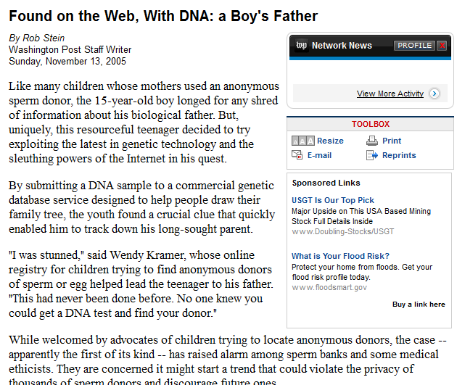
Exploiting genetic genealogy databases
Is this just an anecdote? Can it work on personal genomes??

Slide 53
Can we recover the identity of anonymous sequencing datasets using this technique?

Slide 54
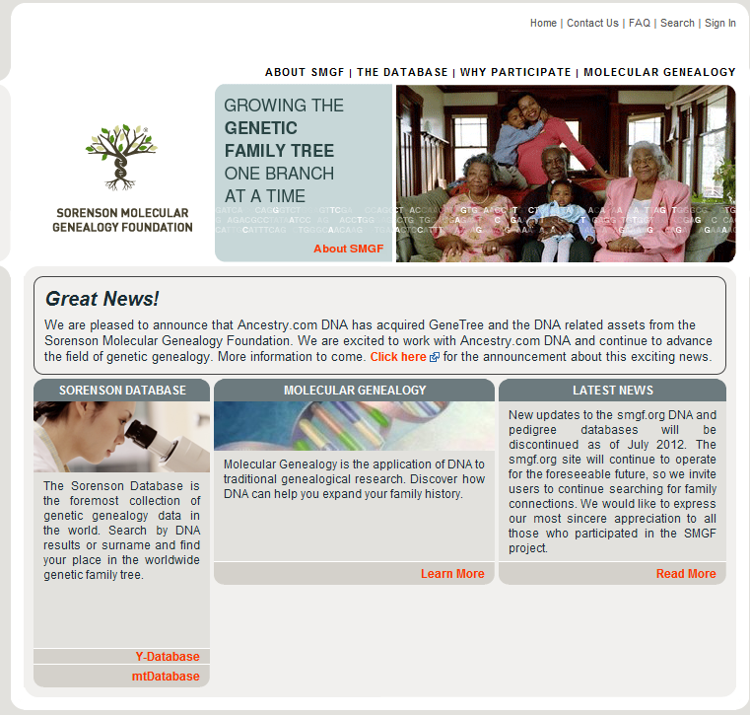
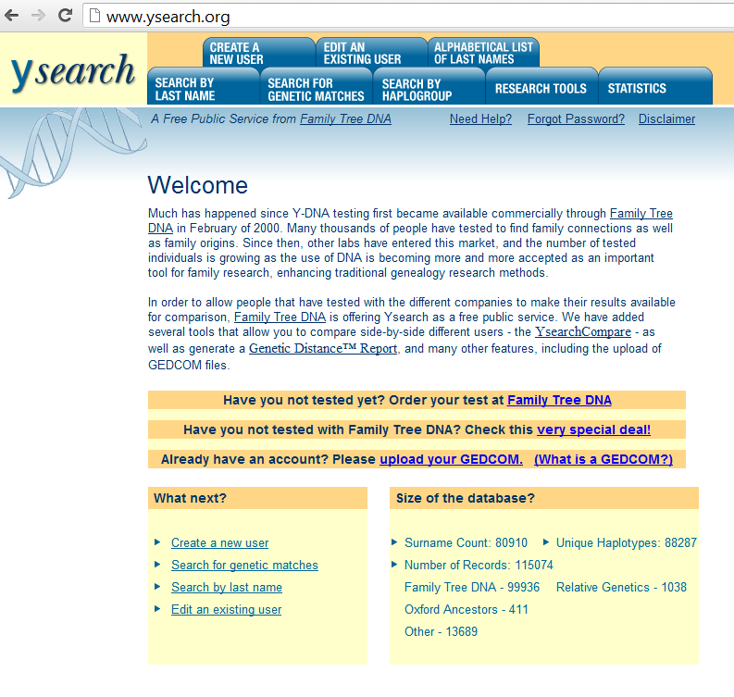
Databases of interest
135,000 surname-YSTR records…
www.smgf.org
www.ysearch.org

Slide 55
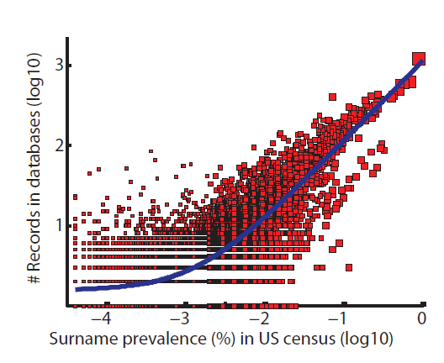
The databases reflect the US population
Blue line – best fit (p<10⁻⁵)

Slide 56
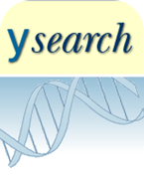


Empirical test: what is prob. To recover a surname?
Inferring surname
Querying Ysearch and SMGF
Y-STR of a real person
Calculating surname confidence score
x911
Comparing the predicted surname to the true one
12% Successful recoveries
5% Wrong recoveries
83% Unknown (low confidence score)
Yaniv Erlich

Slide 57
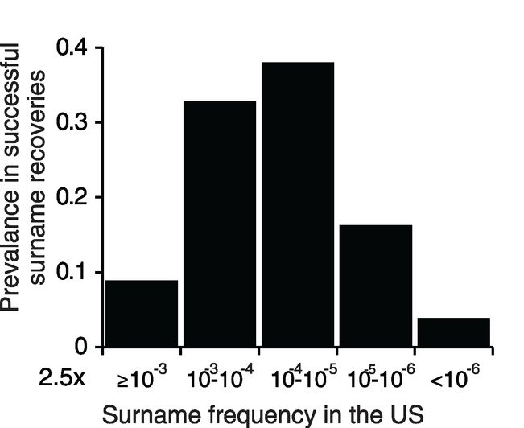
Distribution of inferred surnames
Given a success, what is the expected distribution of surnames?
Most of the inferred surnames are relatively rare

Slide 58
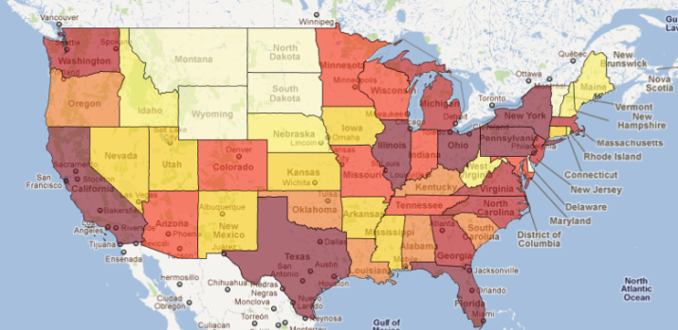
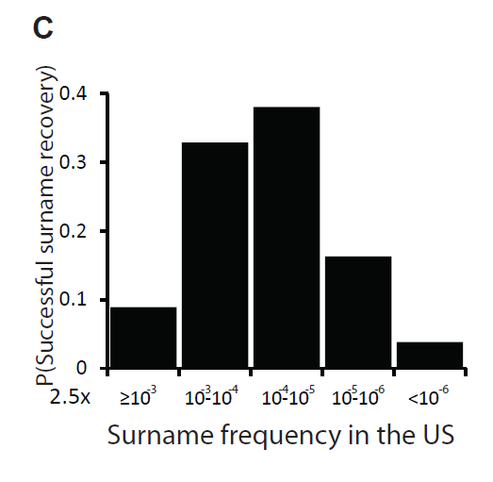

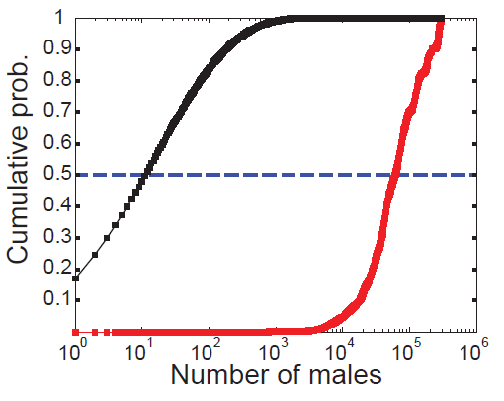
Simulation: can we identify an individual?
Age
State
Surname
Adams
100,000 rounds
Age+state+surname points on ≤12 males in more than half of the cases
Age+state+surname
Only age+state

Slide 59
HIPAA: Health Insurance Portability and Accountability Act
Protected health information (PHI) includes:
Name
Address (> state resolution)
Birth date (> year resolution)
Telephone numbers
Fax number
Email address
Social security number
Medical record number
Health plan beneficiary number
Account number
Certificate or license number
12. Vehicle serial number
13. Web URL
14. IP Address
15. Finger or voice print
16. Photograph
17. Any other information that could uniquely identify an individual

Slide 60
But can we do it with sequencing data?

Slide 61

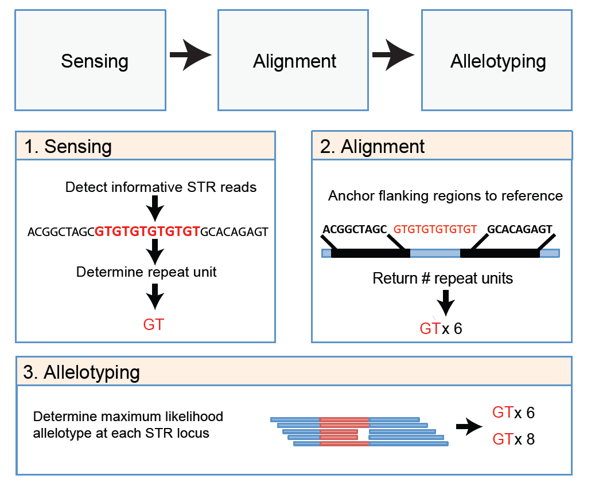
LobSTR: genotyping STRs from sequencing data!

Slide 62

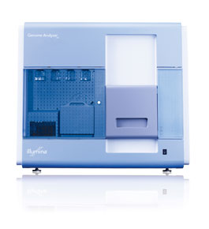
An Illumina case
Our record was the top match
61Y-STR markers
Genetic genealogy service
www.Ysearch.org
gDNA
Online search
37 Y-STR markers
3 Runs of 101PE Illumina GAIIx
lobSTR
Yaniv Erlich

Slide 63
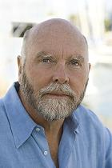


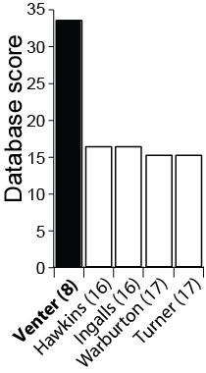
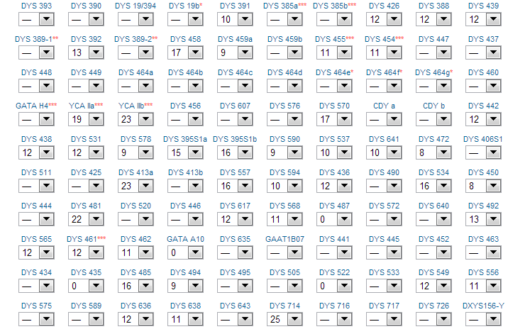
Putting it all together: the Venter case
We got a surname from whole genome sequencing data
The DNA does not belong to Craig Venter
DYS458: 17 repeats
lobSTR
www.ysearch.org:
11/19/12
Yaniv Erlich

Slide 64
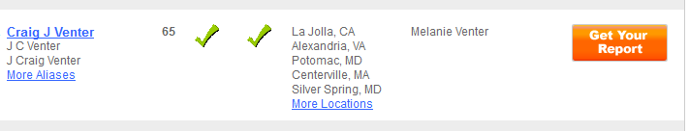
Finding Craig Venter
Searching for:
Venter
California
Born in 1946
Male
In USsearch.com and PeopleFinders.com
Two matches, including:

Slide 65
Intro. | Risk assessment | lobSTR | The Venter case | Anonymous datasets
Can we identify anonymous personal genomes?

Slide 66


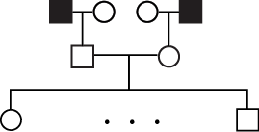
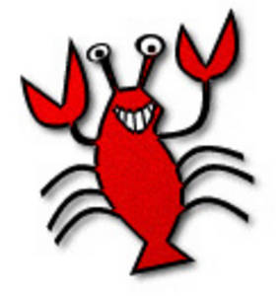


Recovering the identities of CEU individuals
10 CEU genomes
Winfield Utah
Found an obituary that has the exact description of the pedigree
8 Surname predictions with Utah ancestry
Probability of a random match < 5x10⁻⁹

Slide 67
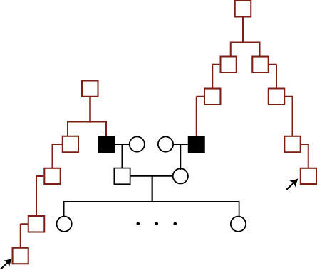
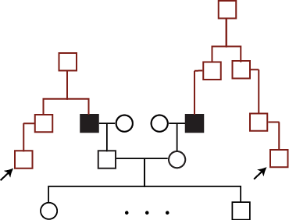
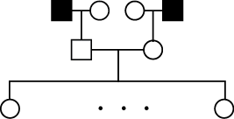

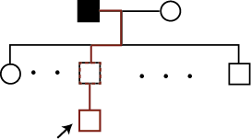
Beginner’s luck?
p<5x10⁻⁶
p<10⁻⁵
p<5x10⁻⁹
p<5x10⁻⁶
p<10⁻⁵
Successful surname recovery (targeted individual)
Person tested by genetic genealogy service (source)
Patrilineal line from source to target
In total:
5 successful surname recoveries
Breaching the privacy of close to 50 CEU samples.
11/19/12
Yaniv Erlich

Slide 68
Summary of surname inference
Our approach:
No experimental work involved.
The identifying information propagates via deep genealogical ties.
The attack completely relies on public resources.
Testing more than 900 Y-STR haplotypes,
demonstrating complete identification of Venter and close to 50 CEU individuals.

Slide 69

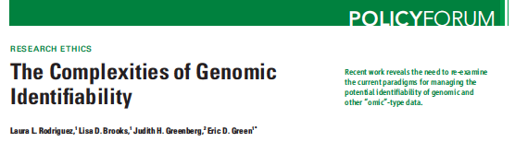

Aftermath
Before publication, we notified 1000Genomes, NHGRI, and University of Utah about our results.
"..And Erlich responded in an exemplary way to his team’s findings by
contacting the NIH and other genetics researchers with his findings
before publishing them. This sets an important precedent for
constructively dealing with newly discovered privacy loopholes, and
other researchers should take note.. ” (Nature Editorial, 1/17/13)
Based on our recommendations, the NHGRI removed the ages from Coriell.
Part 2

Slide 70
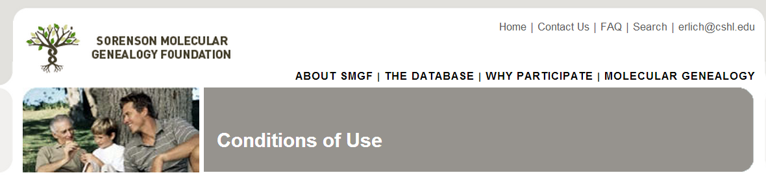
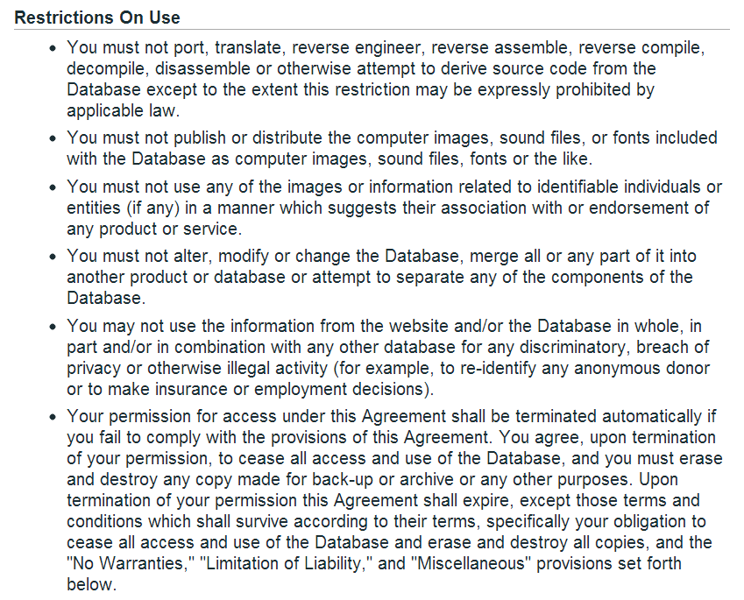
Aftermath
SMGF

Slide 71
More methods for “genome hacking”
2017

Slide 72
More methods for “genome hacking”
2017

Slide 73
Fast forward 5-10 years

Slide 74
But wait are they allowed to do that?

Slide 75
Email from Gedmatch in June 2019

Slide 76
https://www.23andme.com/law-enforcement-guide/

Slide 77
Policy solutions: prohibit re-identification

Slide 78
Technical solutions: homomorphic encryption
2017
Homomorphic encryption: enables computation on decrypted genomic data
Operation | Application
Max (over genes) | Small disease cohort (e.g. find the gene with the loss of function mutations in the most cases).
Setdiff (over variants) | Familial disorder (find variants in a child but in neither parent)
Intersection (over variants) | Two hospitals (compare lists of mutations)

Slide 79
Major advances in privacy-preserving genomics
idash.ucsd.edu

Slide 80
Should I be allowed to post my own genome online?
We saw multiple cases where a *relative*’s genome put someone at risk
What if I’m an identical twin?
Will I put the privacy of my family members at risk?
Will I expose information my family doesn’t want to know?
02/26/18
Genome Privacy
Melissa Gymrek
Notes:
Explain 1000 genomes project in case ppl don’t kno

Slide 81
Can a genome ever be “anonymized”?
Could we “mask” identifying information?
What about taking down genealogy sites?
What if a genome harbors a very rare pathogenic mutation?
02/26/18
Genome Privacy
Melissa Gymrek
Notes:
Explain 1000 genomes project in case ppl don’t kno

