Slide 1
CSE284: Personal genomics for bioinformaticians
Relative Finding + Local ancestry inference
Today’s schedule:
3:30-4:10 Relative finding using IBD
4:10-4:15-break
4:15-4:50 More relative finding + intro to local ancestry inference

Slide 2
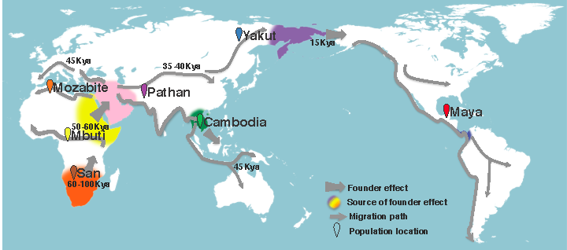
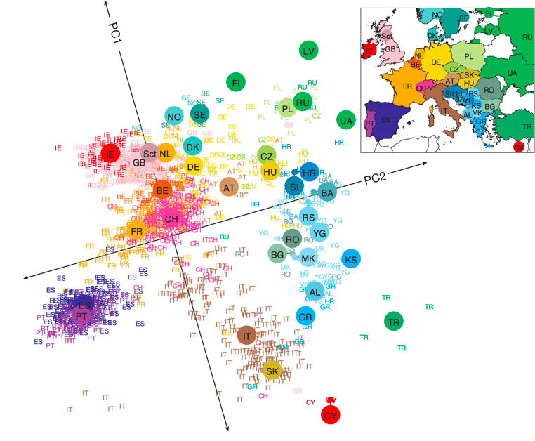
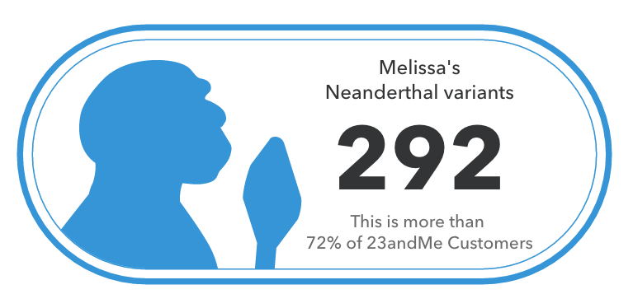
Genomes reveal history across many time scales
Recent history
Today
Ancient history
Familial relationships
Parents, siblings, cousins, etc.
Populations
Human migration, ancient humans
https://aliciarmartin.com/research/migration_map_revised-2/
Novembre, et al. 2008

Slide 3
Outline
Intro to identity by descent
Relative finding - % IBD
Relative finding – IBD segments
Intro to local ancestry inference

Slide 4
Our DNA is a patchwork from our ancestors
Relationship
Founders
Siblings
1st cousins
2nd cousins
Shared segments
3rd cousins
Notes:
http://www.cs.columbia.edu/igert/courses/EECS6898/peer_slides.pdf slide 6
Pedigree
Show ibd chunks at the bottom
Add relationship degree (name and number, define) and number of meisoes separating

Slide 5
Close relatives share large segments
Parent - child
The child shares exactly 50% of her genome with each parent
Siblings
Siblings share on average 50% of their genomes (same mean as parent/child, but different pattern)
Relative finding (Part I)

Slide 6
Distant relatives share smaller segments
…
…
Local ancestry analysis (Part II)

Slide 7
“Identity by descent” (IBD)
Identity by descent (IBD):
chromosomal segments share a common ancestor
Characterized by long stretches of identical genotypes
IBD=1 (one copy is shared)
IBD=0 (no copies are shared)
IBD=2 (both copies are shared)

Slide 8
“Identity by state” (IBS)
Identity by state (IBS): alleles are shared (even if not related)
0
0
1
1
1
1
0
1
1
1
1
0
1
0
0
0
1
0
1
1
0
1
0
1
0
0
1
0
IBS=1
IBS=2 (but IBD=1)
IBS=0
Alleles that are IBD are also IBS
Alleles that are IBS are not necessarily IBD

Slide 9
Relative finding - % IBD

Slide 10
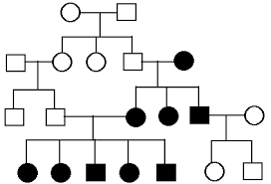
Given a set of genomes, estimate all pairwise relationships

Slide 11
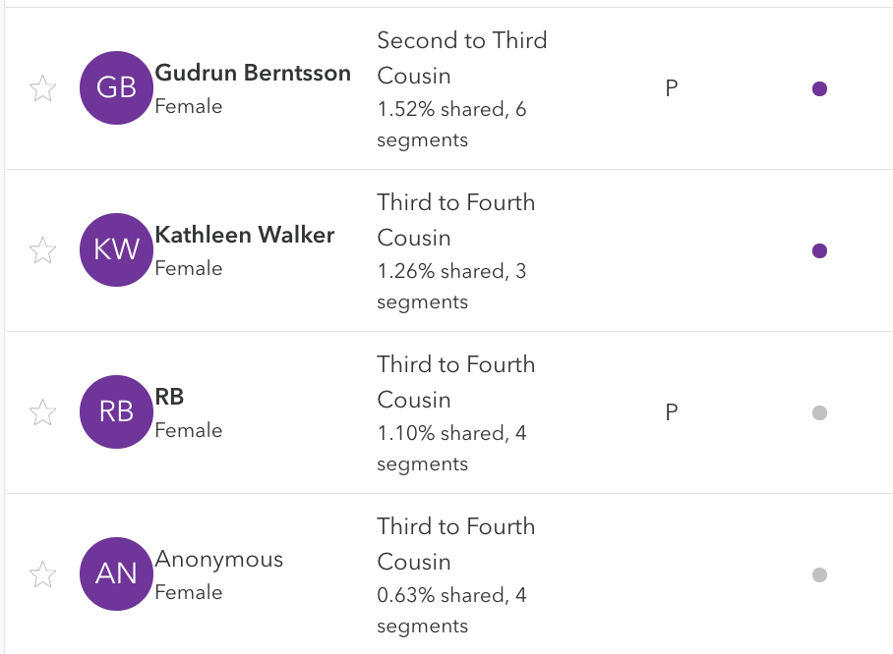
23andMe Relative Finder tool
On average, a person has ~1,000 4th cousins! (and >10⁶ 9th cousins!)

Slide 12
“Identity by descent” (IBD)
Part 1: % IBD
What % of the genome is shared IBD=0,1, or 2 for a pair of relatives?
Part 2: IBD segments
How many, and how long, of segments are shared IBD for a pair of relatives?
IBD=1
IBD=0
IBD=2

Slide 13
IBD in close relatives – parent/child
Parent - Child
P(IBD=0)=0
P(IBD=1)=1
P(IBD=2)=0
(exactly)
For a parent/child, what percent of the genome is shared at:
IBD=0? IBD=1? IBD=2?

Slide 14
Side note – what about recombination?
We drew:
But actually:
P(IBD=0)=0
P(IBD=1)=1
P(IBD=2)=0
P(IBD=0)=0
P(IBD=1)=1
P(IBD=2)=0
Question: does recombination affect expected %IBD=0,12?
Answer: no! expected percentages are unaffected

Slide 15
IBD in close relatives – siblings
Possible sibling combinations
IBD=0
IBD=1
IBD=1
IBD=2
Full Siblings
P(IBD=0)=1/4 = 0.25
P(IBD=1)=2/4 = 0.5
P(IBD=2)=1/4 = 0.25
(on average!)
For a sibling pair, what percent of the genome is shared at:
IBD=0? IBD=1? IBD=2?

Slide 16
Determining %IBD in close relatives – GP/GC
Mother gets one chrom from each grandparent
Assume the father is unrelated. So brings in new chromosomes
IBD=1
IBD=1
IBD=0
IBD=0
P(IBD=0)=2/4=0.5
P(IBD=1)=2/4=0.5
P(IBD=2)=0
(on average!)
Possible grandchildren
What about grandparent/grandchild?

Slide 17
Determining %IBD in close relatives – 1st cousins
We know each grandchild will have one of the 4 ancestral copies
Cousins
P(IBD=0)= 3/4 =0.75
P(IBD=1)=1/4 = 0.25
P(IBD=2)=0
(on average!)
What about 1st cousins?
IBD=0
0
1
0

Slide 18
Determining %IBD in close relatives – 2nd cousins
50%
25% each
50%
50%
Prob. to inherit ancestral chrom
Prob. it’s the same one
P(IBD=1) = 0.5*0.5*0.25 = 6.25%

Slide 19
Determining %IBD in close relatives – nth cousins
Founders
M = # meioses
Siblings (m=2)
1st cousins (m=4)
2nd cousins (m=6)
3rd cousins (m=8)
$$P\left(IBD=1 | nth cousins\right)=\frac{1}{2^{n−1}}×\frac{1}{2^{n−1}} ×\frac{1}{4}=\frac{1}{2^{2n}}$$
Prob. Cousin #1 inherits founder chrom
Prob. Same founder chrom
Prob. Cousin #2 inherits founder chrom

Slide 20
It gets more complicated with inbreeding
Higher than expected IBD between siblings from 1st cousin marriage
Individual may have a high fraction of the genome consisting of identical copies -> increase risk for recessive disorders

Slide 21
Review - IBD in close relatives
Parent - Child
Half Siblings
Why are numbers for parent/child exact, whereas for others they are averages?
P(IBD=0)=0.5
P(IBD=1)=0.5
P(IBD=2)=0
(on average)
P(IBD=0)=0
P(IBD=1)=1
P(IBD=2)=0
(exactly)
Grandparent/grandchild
Full Siblings
P(IBD=0)=0.25
P(IBD=1)=0.5
P(IBD=2)=0.25
(on average!)
P(IBD=0)=0.5
P(IBD=1)=0.5
P(IBD=2)=0
(on average)

Slide 22
Summary of IBD in close relatives
IBD=0 No common ancestry in that region
IBD=1 1 copy of the chromosome has shared common ancestry
IBD=2 both copies of the chromosomes have shared common ancestry
Relationship | IBD₂ | IBD₁ | IBD₀ | % shared (IBD₂+0.5IBD₁)
Identical twins | 1 | 0 | 0 | 100%
Full siblings | 0.25 | 0.5 | 0.25 | 50%
Parent-child | 0 | 1 | 0 | 50%
Half siblings | 0 | 0.5 | 0.5 | 25%
Grandparent/ grandchild | 0 | 0.5 | 0.5 | 25%
Avuncular | 0 | 0.5 | 0.5 | 25%
First cousins | 0 | 0.25 | 0.75 | 12.5%
Unrelated | 0 | 0 | 1 | 0%
Notes:
Show twins, siblings, parents, 0 1 2
Define coancestry coefficient

Slide 23
%IBD in close relatives
1.0
Parent/child
(e.g. uncle/nephew, grand parent/child)
% IBD=1
Siblings
2nd order
First cousins
Distant cousins
0.0
0.0
1.0
% IBD=0

Slide 24
Estimating % IBD from SNPs

Slide 25
Plink estimates genome-wide IBD
Genotypes (--bfile)
ps2_ibd.lwk (bed/bim/fam files)
Options
--genome
plink
Output (--out)
${prefix}.genome
Output contains: “P(IBD=0)”, “P(IBD=1)”, “P(IBD=2)” for each pair of samples

Slide 26
IBD estimation – “Method of moments”
Goal: what percent of two genomes is shared IBD=0, IBD=1, and IBD=2?
Idea: can we just count the number of SNPs shared IBS?
0
0
1
1
1
1
0
1
1
1
1
0
1
0
0
0
1
0
1
1
0
1
0
1
0
0
1
0
No! many SNPs could be shared IBS by chance. Need to account for that
(btw, implementing plink’s method or alternatives could be a good project idea)

Slide 27
Plink IBD estimation with method of moments
Possible IBS states: i=0, 1, 2
Possible IBD states: z=0, 1, 2
We observe this
(fraction of SNPs shared IBS=i)
We can model this
We’d like to estimate this!
$$P\left(IBS=i\right)=\sum_{z∈\{0,1,2\}}{P\left(IBS=i | IBD=z\right)P(IBD=z)}$$
We can rearrange this set of equations to solve for P(IBD=0), P(IBD=1), and P(IBD=2)

Slide 28
Trivial case – IBD=2
$$P\left(IBS=i\right)=\sum_{z∈\{0,1,2\}}{P\left(IBS=i | IBD=z\right)P(IBD=z)}$$
For a single SNP m at IBD=2:
$$P_{m}\left(IBS=0 | IBD=2\right)=0$$
?
$$P_{m}\left(IBS=1 | IBD=2\right)=0$$
$$P_{m}\left(IBS=2 | IBD=2\right)=1$$

Slide 29
Next case: IBD=0
$$P\left(IBS=i\right)=\sum_{z∈\{0,1,2\}}{P\left(IBS=i | IBD=z\right)P(IBD=z)}$$
For a single SNP m at IBD=0:
$$P_{m}\left(IBS=0 | IBD=0\right)= ?$$
$$P_{m}\left(IBS=1 | IBD=0\right)= ?$$
$$P_{m}\left(IBS=2 | IBD=0\right)= ?$$
If IBD=0, any IBS sharing is by chance!

Slide 30
Recall – Hardy Weinberg Equilibrium
Present day humans have two copies each, randomly drawn from the pool of available chromosomes (not exactly)
Hardy-Weinberg Equilibrium principal says:
If frequency( ) = p, and If frequency( ) = q=1-p, then we expect for diploid humans:
Frequency( ) = p²
Frequency( ) = q²
Frequency( ) = 2pq

Slide 31
Recall – Hardy Weinberg Equilibrium
For pairs of genomes at a given SNP, with:
freq(A) = p and freq(B) = q:
P(AA, AA) = p⁴ (IBS=2)
P(AA,AB) = 2p³q (IBS=1)
P(AA, BB) = p²q² (IBS=0)
…

Slide 32
Plink IBD estimation with method of moments
$$P\left(IBS=i\right)=\sum_{z∈\{0,1,2\}}{P\left(IBS=i | IBD=z\right)P(IBD=z)}$$
For a single SNP m at IBD=0:
Possible genotype pairs
HWE prob
00, 11
11, 00
$$p^{2}q^{2}$$
$$q^{2}p^{2}$$
$$P_{m}\left(IBS=0 | IBD=0\right)=2p^{2}q^{2}$$
00, 01
11, 01
01, 00
01, 11
$${2p}^{3}q$$
$${2q}^{3}p$$
$${2p}^{3}q$$
$$2q^{3}p$$
$$P_{m}\left(IBS=1 | IBD=0\right)=4p^{3}q+4pq^{3}$$
$$P_{m}\left(IBS=2 | IBD=0\right)=p^{4}+q^{4}$$
00, 00
11, 11
$$p^{4}$$
$$q^{4}$$

Slide 33
In practice, correct these for small sample sizes
Purcell et al AJHG 2007

Slide 34
Plink IBD estimation with method of moments
$$P\left(IBS=i\right)=\sum_{z∈\{0,1,2\}}{P\left(IBS=i | IBD=z\right)P(IBD=z)}$$
Sum over all m SNPs
$$P\left(IBS=i | IBD=z\right)=\frac{1}{m}\sum_{m}{P_{m} (IBS=i|IBD=z)}$$

Slide 35
Plink IBD estimation with method of moments
$$P\left(IBS=i\right)=\sum_{z∈\{0,1,2\}}{P\left(IBS=i | IBD=z\right)P(IBD=z)}$$
For IBS=0:
$$P\left(IBS=0\right)=P\left(IBS=0 | IBD=0\right)P\left(IBD=0\right)+$$
$$P\left(IBS=0 | IBD=1\right)P\left(IBD=1\right)+$$
$$P\left(IBS=0 | IBD=2\right)P\left(IBD=2\right)+$$
Rearranging the above:
Fraction of SNPs that are IBS=0
$$P\left(IBD=0\right)=\frac{P(IBS=0)}{P\left(IBS=0 | IBD=0\right)}$$
Fraction expected if IBD=0

Slide 36
Plink IBD estimation with method of moments
$P\left(IBD=0\right)= \frac{P(IBS=0)}{P(IBS=0|IBD=0)}$
$P\left(IBD=1\right)= \frac{N\left(IBS=1\right)−N\left(IBS=1 | IBD=0\right)P(IBD=0)}{N(IBS=1|IBD=1)}$
$P\left(IBD=2\right)= \frac{N\left(IBS=2\right)−N\left(IBS=2 | IBD=0\right)P\left(IBD=0\right)−P\left(IBS=2 | IBD=1\right)P(IBD=1)}{N(IBS=1|IBD=1)}$
You can work this out on your own ☺ or see the plink paper

Slide 37
Plink estimates genome-wide IBD
Genotypes (--bfile)
ps2_ibd.lwk (bed/bim/fam files)
Options
--genome
plink
Output (--out)
${prefix}.genome
Output contains: “P(IBD=0)”, “P(IBD=1)”, “P(IBD=2)” for each pair of samples

Slide 38
Limitations of only considering % IBD?
1.0
Parent/child
Some relations can’t be distinguished!
Avuncular vs. grandparent
Half-sibling vs. grandparent
Distant cousins difficult
% IBD=1
Siblings
2nd order
First cousins
Distant cousins
0.0
0.0
1.0
% IBD=0

Slide 39
Break

Slide 40
“Identity by descent” (IBD)
Part 1: % IBD
What % of the genome is shared IBD=0,1, or 2 for a pair of relatives?
Part 2: IBD segments
How many, and how long, of segments are shared IBD for a pair of relatives?
IBD=1
IBD=0
IBD=2

Slide 41
Every meiosis breaks down shared segments
Relationship
Founders
Siblings (d=1, m=2)
1st cousins (d=3, m=4)
2nd cousins (m=6)
Shared segments
3rd cousins (m=8)
d=“degree”
m=number of meioses events
Notes:
http://www.cs.columbia.edu/igert/courses/EECS6898/peer_slides.pdf slide 6
Pedigree
Show ibd chunks at the bottom
Add relationship degree (name and number, define) and number of meisoes separating

Slide 42
Length and number of segments is also informative
Identical twins
44 segments shared, full chromosome length
(only counting autosomes)
Siblings
~92 segments shared
1st cousins
~40 segments shared
2nd cousins
~15 segments shared
(using simulations to estimate num/length of shared fragments for different relatives could also be a fun project!

Slide 43
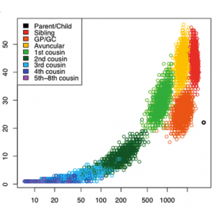
Length and number of segments is also informative
Avuncular and GP/GC share similar length, but different num. segments
GP/GC: 2 meiosis
Avuncular: 3 meiosis
# Shared segments
Parent-child sharing is exact (23 segments)
Segment length (cM) shared IBD=1
https://journals.plos.org/plosone/article?id=10.1371/journal.pone.0034267
https://thednageek.com/meiosis-schmeiosis/

Slide 44
“Centimorgans (cM)” vs. bp
You’ll see distances along a chromosome described either using:
Phyiscal distance (bp) (the number of base pairs. E.g. chr10:10000 refers to the 10000’th base in the chromosome
Genetic map (cM): defined by recombination probabilities. 1cM is the distance between chromosome positions for which the average number of crossovers in a single generation is 0.01. Can be thought of as “effective distance”
In humans, 1 cM ~ 1 million bp (on average)
https://isogg.org/wiki/CentiMorgan
Notes:
Estimating % IBD
Find pairwise IBD segments
Infer ancestry from IBD segments
Challenges:
We don’t observe IBD
Just have alleles
IBS vs. IBD
http://www.nature.com/nrg/journal/v7/n10/full/nrg1960.html
http://jorde-lab.genetics.utah.edu/ersa/Witherspoon_ASHG_2010.pdf
Also background relatedness

Slide 45
Take 2: Inferring ancestry from IBD segments
We need to:
Find pairwise IBD segments (GERMLINE, BEAGLE)
Infer ancestry from IBD segments (ERSA)
Notes:
Estimating % IBD
Find pairwise IBD segments
Infer ancestry from IBD segments
Challenges:
We don’t observe IBD
Just have alleles
IBS vs. IBD
http://www.nature.com/nrg/journal/v7/n10/full/nrg1960.html
http://jorde-lab.genetics.utah.edu/ersa/Witherspoon_ASHG_2010.pdf
Also background relatedness

Slide 46
Finding IBD segments
Beagle fastIBD
Model IBD sharing as an HMM!
(another project idea)
GERMLINE
Dictionary of haplotypes to quickly discover short exact matches, which are then extended

Slide 47
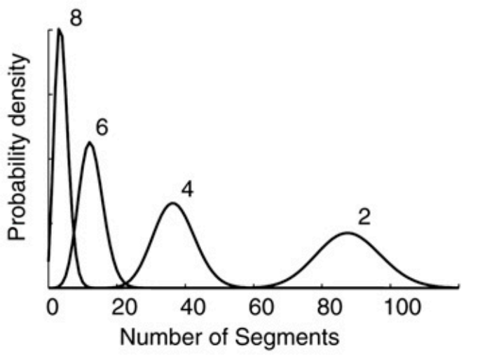
Estimating relationships from segments - ERSA
Expected number of IBD segments between a pair of individuals:
r = number of recombinations per meiosis (~35)
d = # meioses in the path between relative pairs
c = number of autosomes (22)
a = number of common ancestors (1 or 2)
rd+c
E[#] ~ Poisson[ ]
2^{d-a}
Third cousins
But… unrelated samples from the same population will also share some common ancestry!
e.g. CEU share ~ 15 segments on average
Second cousins
First cousins
Siblings
Huff, et al. Genome Research 2011
Notes:
Number of ibd segments between two samples
Is poisson
Show plot, also show unrelated ceu
http://genome.cshlp.org/content/21/5/768.full.pdf

Slide 48
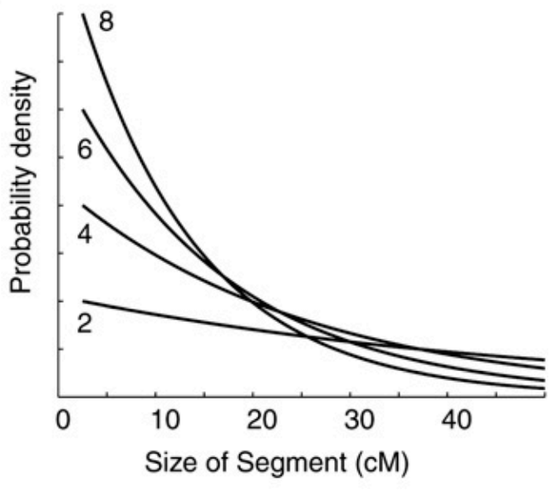
Estimating relationships from segments - ERSA
Expected length IBD segments between a pair of individuals:
Third cousins
E[length] ~ Exponential(d/100)
Unrelated samples will have very short shared segments
Siblings
Huff, et al. Genome Research 2011
Notes:
Length of segments, exponential
Show segments small between unrelateds

Slide 49
Estimating relationships from segments - ERSA
H₀: IBD segment sharing is not due to recent relatedness (use background population as a control)
L₀ = P(n₀, S₀) ➔ likelihood unrelated pair shares n₀ segments with set of sizes S₀
H_{A}: IBD segment sharing is due to recent shared ancestry with a common ancestors and separated by d meiosis events
L_{A} = P(n_{A}, S_{A} |d,a) ➔ likelihood target pair shares n_{A} segments with set of sizes S_{A}, given parameters d, a
If L_{A}/L₀ large, likely related! Infer relationship from best d, a
Huff, et al. Genome Research 2011
Notes:
Maximum likelihood framework

Slide 50
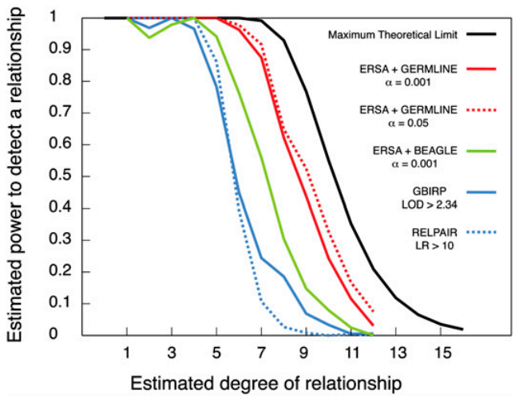
Estimating relationships from segments - ERSA
Huff, et al. Genome Research 2011

Slide 51
Local ancestry inference
(intro. More next week)

Slide 52
Admixture results in mosaic genomes
European
African
Native Amr.
(These chunks are similar to, but older than, IBD segments we studied earlier today)
e.g. present-day Latino populations in the U.S.
(recall JC 1)

Slide 53
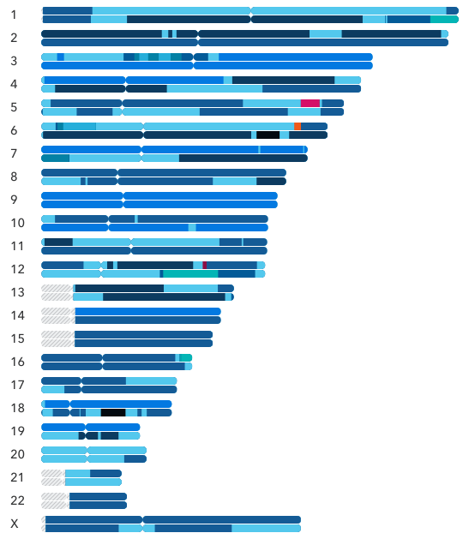
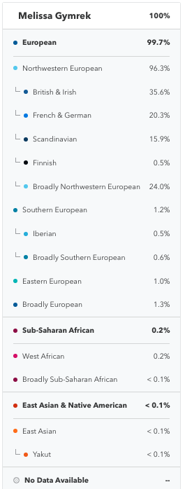
Chromosome “painting”

Slide 54
Visualizing local ancestry along each chromosome
Blue=European
Red=African

Slide 55
We can model local ancestry with HMMs!
chrom A
chrom B
SNPs
0 1 1 2 2 0 0 1 1 2 0 0 1 1 1 0 0 0 1 1 0 0 2 2 1 0 0 1 2 0 1 2 0 0 1 1 2 0 1 0
Use Viterbi algorithm to infer most probable sequence of local ancestry across the genome
(more details on Monday)

Slide 56
RFMix (PS2) allows fast LAI

Slide 57
Running RFMix – input files
*_chr${chrom}.alleles
*_chr${chrom}.snp_locations
0 0 0 0 0 0 1 0 0 0 0 0 1 1 0 1 1 0 0 1 1 0
0 1 1 0 1 0 0 0 0 1 0 0 1 1 0 1 1 0 0 1 0 0
0 1 1 0 0 0 0 0 0 0 0 0 1 1 0 0 1 0 0 1 1 0
0 1 0 0 0 0 1 1 0 0 0 0 1 1 0 1 1 0 0 1 1 0
0 1 0 0 0 0 0 0 0 0 0 0 1 1 0 1 1 1 0 0 1 0
0 0 0 1 0 0 0 0 0 0 0 0 1 1 0 1 1 0 0 1 1 0
0 1 0 0 0 0 0 0 1 0 0 0 1 1 0 0 1 0 0 1 1 0
0
3.2
10.5
25
30
50
200.5
1 row/SNP
1 row/SNP
1 col/haplotype
If N samples, should have 2N columns
*.classes
1 1 1 2 2 2 3 3 3 4 4 4 0 0 0 0 0 0 0 0 0 0
1 col/haplotype
Ancestral populations labeled 1,2,3,etc.
“0” denotes unknown (admixed)
(run 1 job/chromosome)

Slide 58
Running RFMix – output files
*_chr${chrom}.0.Viterbi.txt
2 1 3 1 2 3 2 1 1 2
2 1 3 1 1 3 2 1 1 2
2 1 3 3 1 3 2 1 1 3
2 1 2 3 1 1 2 1 1 3
2 1 2 1 1 1 2 1 1 3
1 2 2 1 1 1 2 1 1 3
1 2 2 1 3 1 2 1 3 3
Entry i,j gives the Viterbi decoding (most likely inferred local ancestry group) at SNP i in haplotype j
1 row/SNP
1 col/target haplotype

Slide 59
Converting RFMix output to ancestry tracks (BED format)
*_chr${chrom}.0.Viterbi.txt
*_chr${chrom}.map
2 1 3 1 2 3 2 1 1 2
2 1 3 1 1 3 2 1 1 2
2 1 3 3 1 3 2 1 1 3
2 1 2 3 1 1 2 1 1 3
2 1 2 1 1 1 2 1 1 3
1 2 2 1 1 1 2 1 1 3
1 2 2 1 3 1 2 1 3 3
1000 0
2000 3.2
3000 10.5
4000 25
5000 30
6000 50
7000 200.5
1 row/SNP
Output.bed (1 file/haplotype)
chr1 1000 5000 YRI 0 30
chr1 6000 7000 CEU 50 200.5
File needed for plotting:
1 line/segment. Each line has:
Chrom
Segment start (bp)
Segment end (bp)
Ancestry
Segment start (cM)
Segment end (cM)
Plot karyotypes

Slide 60
Helpful commands
paste ps2_rfmix_chr${chrom}.map rfmix_${chrom}.0.Viterbi.txt | sed ‘s/ /\t/g’
1000 0
2000 3.2
3000 10.5
4000 25
5000 30
6000 50
7000 200.5
2 1 3 1 2 3 2 1 1 2
2 1 3 1 1 3 2 1 1 2
2 1 3 3 1 3 2 1 1 3
2 1 2 3 1 1 2 1 1 3
2 1 2 1 1 1 2 1 1 3
1 2 2 1 1 1 2 1 1 3
1 2 2 1 3 1 2 1 3 3
Paste horizontally concatenates files
Sed replaces space with tabs
hapcol=3 # look at haplotype in column 3 (so, the 1st haplotype in our pasted file)
datamash –g ${hapcol} min 1 max 1 min 2 max 2 # “groupby” hapcol
2 1000 5000 0 30
1 6000 7000 50 200.5

Slide 61
Helpful commands - continued
2 1000 5000 0 30
1 6000 7000 50 200.5
sed ‘s/^1/CEU/’ | sed ‘s/^2/YRI/’ | sed ‘s/^0/UNK/’ # replace 0/1/2 with
# UNK/CEU/YRI
YRI 1000 5000 0 30
CEU 6000 7000 50 200.5
chrom=chr1
awk –v “chr=$chrom” ‘{print chr “\t” $2 “\t” $3 “\t” $1 “\t” $4 “\t” $5}’
chr1 1000 5000 YRI 0 30
chr1 6000 7000 CEU 50 200.5
For plotting, you’ll need to concatenate all the outputs from each chromosome
For each sample, you’ll need two separate files like this (one for each haplotype)

