Slide 1
CSE284: Personal genomics for bioinformaticians
Phasing + Imputation + HMMs
Today’s schedule:
3:30-4:10 Intro to phasing/imputation
4:10-4:15 break
4:15-4:50 Phasing/imputation using HMMs
Announcements:
PS1 due tonight 11:59pm
Will aim to get PS1+JC1 grades out this week
PS2 is out. Due April 16

Slide 2
Recombination and Linkage Disequilibrium

Slide 3
Four forces driving genome evolution
Mutation: introduces genetic variation
Genetic drift: Evolution is inherently a stochastic process in a finite population size
Natural selection: Advantageous mutations more likely to spread
Gene flow: exchange of genetic material between populations
(+recombination)
“Nothing in biology makes sense except in the light of evolution” – Theodosius Dobzhansky (1973)
Notes:
Last week talked about 4 forces of evolution
Main one of those was mutation

Slide 4
Cell division – meiosis (germline)
DNA replication
Homologous recombination
Meiosis I
Meiosis II
Four haploid cells
(egg or sperm)
Notes:
When talking about mutation, we said every cell division is chance for mutation
But this other key process is going on in germline cells
Process called meiosis, where one diploid cell splits into four haploid cells, e.g. egg or sperm
During this process, there is an opportunity for the two copies of the chromosomes to exchange genetic material
The germ cells then have unique rearrangements of the material in the original cell.

Slide 5
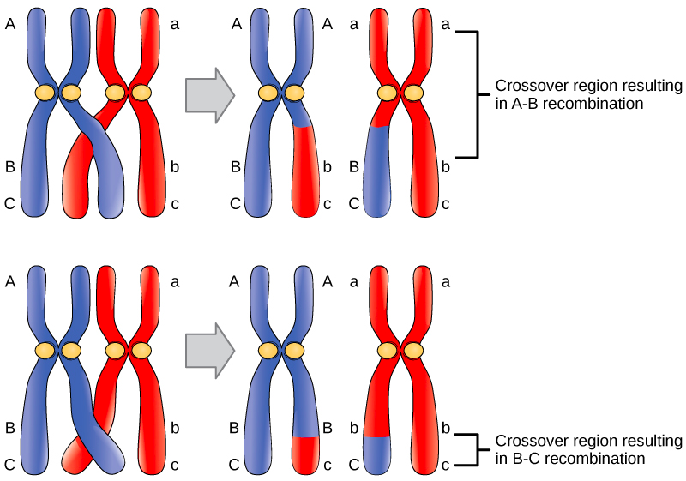
Recombination
Typically: ~1 recombination event/chromosome/generation
https://www.reddit.com/r/askscience/comments/3hq4zl/does_crossover_occur_in_all_4_nonsister/
Notes:
Closer look at this process
On the order of 1 event/chrom/gen

Slide 6
Example history of two neighboring alleles
Present-day polymorphisms are the result of ancient mutation events:
A
Ancestral haplotype
C
A
After mutation
C
T
C
A
After another mutation
C
T
C
T
G
Haplotype: combination of variants on the same copy of a chromosome
Notes:
http://csg.sph.umich.edu/abecasis/class/666.03.pdf
Look at how this affects patterns of variation

Slide 7
Recombination rearranges ancestral alleles
Before recombination
A
C
T
C
T
G
After recombination
A
C
T
C
T
G
A
G
Recombination event!
Notes:
http://csg.sph.umich.edu/abecasis/class/666.03.pdf
Reocmbination is a way to allow us to shuffle these alleles and break up that correlation

Slide 8
Linkage disequilibrium – present day samples
The closer two SNPs are:
- The less likely they are to recombine
- the more likely they are to share the same ancestral haplotype
Recombination events clustered at “hotspots”
Over time, break down ancestral haplotypes
Patterns at present-day haplotypes depend on:
Recombination rate
Mutation rate
Population size
Natural selection
Ancestral haplotype
Present-day haplotypes

Slide 9
Are there sequence features that control where recombination hotspots occur?

Slide 10
Linkage disequilibrium metrics
LD typically measured by “r²”:
Sampled chromosomes
SNP2
SNP1
1
2
3
4
5
6
7
8
9
10
…
n
0
1
1
0
1
1
0
0
0
1
…
0
0
0
1
0
1
0
0
0
0
1
…
0
SNP1 (0/1)
SNP2 (0/1)
r² = Squared Pearson correlation

Slide 11
Linkage disequilibrium metrics
 | B | b | Total
A | p_{AB} | p_{Ab} | p_{A}
a | p_{aB} | p_{ab} | p_{a}
Total | p_{B} | p_{b} | 1.0
A/a
B/b
Frequencies:
Linkage equilibrium:
p_{AB}=p_{A}p_{B}
p_{Ab}=p_{A}(1-p_{B})
p_{aB}=(1-p_{A})p_{B}
p_{aB}=(1-p_{A})(1-p_{B})
D: p_{AB}-p_{A}p_{B}
Sign is arbitrary
Range depends on allele frequencies
D’: D/D_{min} (normalize by theoretical maximum)
D_{min}=max(-p_{A}p_{B}, -(1-p_{A}) (1-p_{B}) if D<0
D_{min}=min(p_{A}(1-p_{B}), (1-p_{A})p_{B}) if D>0
Range between -1 and +1
Linkage disequilibrium:
p_{AB}≠p_{A}p_{B}
p_{Ab}≠p_{A}(1-p_{B})
p_{aB}≠(1-p_{A})p_{B}
p_{aB}≠(1-p_{A})(1-p_{B})
r: D/sqrt[p_{A}(1-p_{A}) p_{B}(1-p_{B})]
Same as correlation coefficient. Between -1 and +1.
R² gives power loss in association studies
Most commonly used in population genetics

Slide 12
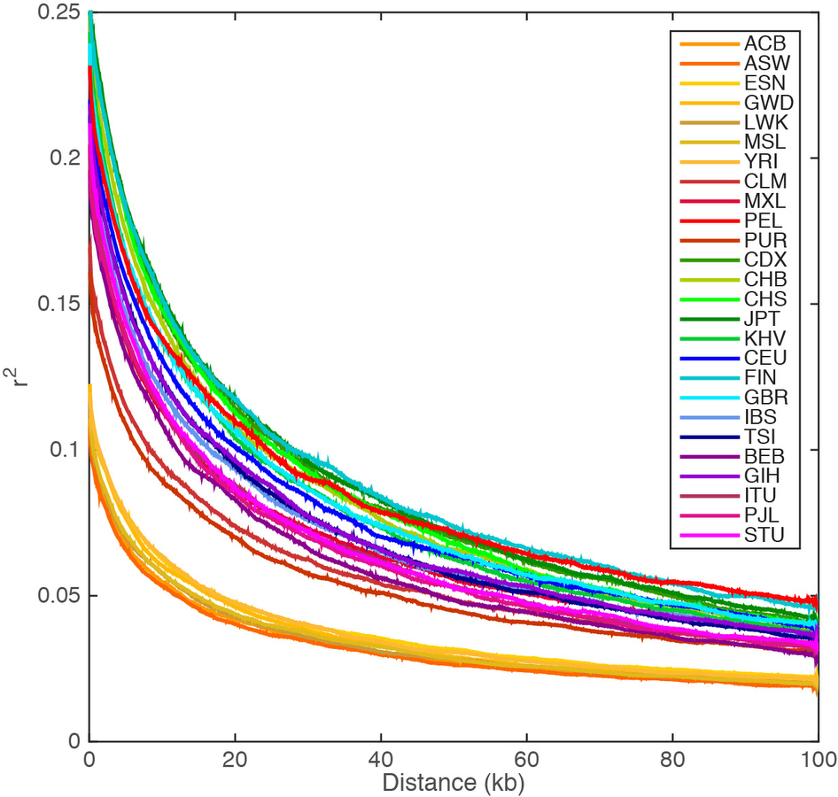
Recombination results in “LD blocks”
Recombination induces haplotype “blocks” of correlated SNPs
Linkage disequilibrium decays with distance
http://graphics.cs.wisc.edu/WP/vis10/archives/458-hapmap-linkage-disequilibrium-plot
A global reference for human genetic variation

Slide 13
Factors affecting LD
LD decays faster in populations that have been evolving longer
Appears lower in admixed populations
Non-African
African
A global reference for human genetic variation. Nature 2015
Notes:
Mammalian recombination hot spots: properties, control and evolution

Slide 14
LD ends up saving us $$ - “Tag SNPs”
LD induces tight correlation between nearby variants
Rather than genotyping and testing each SNP for association with disease, can focus on a few “tag” SNPs
Both a curse and a blessing. Why?
Haplotype 1
AACACAAGCTAGCTACCTACGTAGCTACAT
30%
Haplotype 2
AACACAAGCTAGCTACCTACGTAGGTACAT
30%
Haplotype 3
AACACTAGCAAGCTACCTACGTAGGTACAT
20%
Haplotype 4
AACACTAGCAAGCTACCTACGTAGGTACAT
10%
Haplotype 5
AACACTAGCAAGCTACCTATGTAGATACGT
10%
23andme=$100, WGS=$1000

Slide 15
LD ends up saving us $$ - Imputation
AACACAAGCTAGCTACCTACGTAGCTACAT
AACACAAGCTAGCTACCTACGTAGGTACAT
Reference haplotype panel (e.g. 1000 Genomes)
AACACTAGCAAGCTACCTACGTAGGTACAT
AACACTAGCAAGCTACCTACGTAGGTACAT
AACACTAGCAAGCTACCTATGTAGATACGT
AACACTAGC?AGCTACCTA?GTAGGTAC?T
Your data genotyped on SNP chip
AACACAAGC?AGCTACCTA?GTAGGTAC?T

Slide 16
Phasing+imputation overview
Notes:
http://csg.sph.umich.edu/abecasis/class/666.03.pdf

Slide 17
Haplotypes vs. Genotypes
Heterozygous genotype (CA or AC)
A C G T T G C A T A C C - T T
A A G T A G C A C A C C G T T
Haplotype
A C G T T G C A T A C C - T G
A C G T A G C A C A C C G T T
Homozygous genotype (TT)
A A G T A G C A T A C C G T T
A A G T A G C A T A C C G T T
Phase: are “T” and “C” on the same copy of the chromosome?”
A C G T T G C A C A C C G T T
A A G T A G C A T A C C - T G
Notes:
Show diploid data
Make distinction between
Genotype, haplotype, phase

Slide 18
Imputation
A ? G T T G C A ? A C C - T T
A ? G T A G C A ? A C C G T T
A ? G T T G C A ? A C C - T G
A ? G T A G C A ? A C C G T T
A ? G T A G C A ? A C C G T T
A ? G T A G C A ? A C C G T T
A ? G T T G C A ? A C C G T T
A ? G T A G C A ? A C C - T G
Notes:
Show diploid data
Make distinction between
Genotype, haplotype, phase

Slide 19
Phasing and imputation
Phasing:
Intuitively: For a given position, which allele came from mom and which from dad?
Or: for a set of adjacent heterozygous sites, which alleles are on the same chromosome (homozygous sites trivially phased)
Imputation:
Given a set of genotyped positions and a reference haplotype panel, infer missing genotypes
Process:
Usually: first phase, then use phased haplotypes to impute. But as we’ll see these processes are inherently related

Slide 20
Applications of phasing and imputation
Save $$ on association tests by genotyping fewer variants (phasing->imputation)
A ? G T A G C A ? A C C G T T
Resolving compound heterozygotes (phasing)
AGCATCAGATATG
AGCATTAGATATA
AGCAT(T/C)AGATAT(G/A)
AGCATTAGATATG
AGCATCAGATATA
Ancestry analysis (phasing)
Detecting selection, studying recombination/mutation, and more
Notes:
Genotype less variants for assoc studies
Compound hets
Pop gen applications
Learn about properties of recomb/mut
Selection by detecting long haplotypes

Slide 21
Phasing methods – Part I

Slide 22
Phasing methods
Experimental phasing (e.g. physical phasing)
True sequence
AAACTACGTCTATACG
Observed sequencing read
ACTACGTCT
Phasing from related individuals
AG
TT
AA
GT
G A
T G
Statistical phasing of unrelated individuals
Inferred haplotypes:
AAACGACATCTACTACG
AAATGACGTCTCCTACG
ATATGAAGTCTCCTGCG
Notes:
Using sequencing technology (e.g. physical phasing
Families, IBD
Statistical phasing
Focus on the 2nd two here
2nd two are not completely separate problems

Slide 23
Measuring phasing accuracy – switch error
True haplotypes
A G T C T A G G G A T C C A A G C A T A T T
C G A T A T C C A T C G G G T C T T A G C C
Inferred haplotypes
A G T C T A G G G A T C
G G G T C T T A G C C
C G A T A T C C A T C G
C A A G C A T A T T
Switch error = s/(n-1)
n: number of heterozygous sites in the individual
s: minimal number of switches needed to recover the true haplotype

Slide 24
Phasing in families
Unphased genotypes
0 1 2 2 0 0 1 0
1 1 0 0 1 1 1 2
0 ? 1 1 0 0 1 0
0 ? 0 0 0 1 1 1
0 ? 1 1 0 0 0 0
1 ? 0 0 1 0 0 1
Phased haplotypes
0 1 1 1 0 1 2 1
Mom:
0 ? 1 1 0 0 1 0
Dad:
0 ? 0 0 0 1 1 1
Family-based phasing is generally treated as the gold standard, since we can directly trace inherited haplotypes
Notes:
Gold standard
Intuitively, show example trios

Slide 25
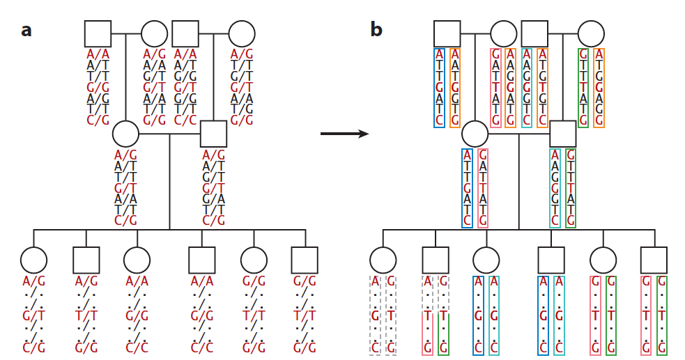
Phasing in families
Li et al. 2009

Slide 26
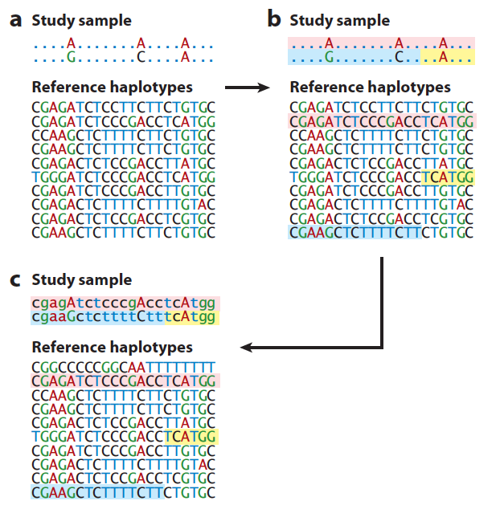
Phasing and imputation in unrelated individuals
Li et al. 2009

Slide 27
Extracting haplotypes from unrelated samples
Naïve Example: Clark’s Algorithm
02101
10000
21212
00200
02000
?
10000/00000
?
00100/00100
01000/01000
01001/01100 or 01000/01101
10000/00000
10101/11111 or 10111/11101
00100/00100
01000/01000
Step 1: Find all easy cases (homozygotes, single heterozygotes) and make a list of all haplotypes that can be uniquely resolved
Step II: While there are remaining genotypes unresolved, try to find a match from the current list of haplotypes. If so, add that haplotype and its pair to the list.
Simple, but you might get stuck!
Alternative: EM method, alternate between estimating haplotype frequencies and estimating phase

Slide 28
(break)
Hidden Markov Models
(HMMs)

Slide 29
HMMs: modeling a series of states
Example: gene-finding
Intergenic
Gene
Intergenic
Gene
States are hidden!
States:
Genome:
Observe:
ACGATCGACTTAGGCTAGGTCGATCGTTAGCTACGGAGCATTCCGGGCCTA
Goal: how can we figure out the hidden sequence of states based on what we can actually observe?
Answer: HMMs! Huge number of applications in bioinformatics
Notes:
Goal: model series of states along a sequence
here: sequence = the genome
states: examples: gene or not gene? domain of a protein? enhancer vs. not? haplotype?
states hidden
we observe some data. e.g. the sequence. or some measurement
goal: figure out the hidden sequence of states
many possible applications. will come up again
go through here a simple example to review how HMMs work. then see how can build up to solve our phasing/imputation problem, and later, other problems
point to Richard Durbin's book on this

Slide 30
Toy problem: finding CpG islands
What is a “CpG island”:
“CG” dinucleotides often mutate to “CT” when the “C” is methylated
“CG” is relatively rare in the genome, except in promoter regions where methylation is suppressed
“CpG” islands refers to these GC rich stretches, where you see many “CG” dinucleotides, and also in general mores “Cs” and “Gs” than elsewhere
Notes:
What is a CpG island
Show state diagram. Highlight how only depend on previous state
With transmission probs and emission probs
Goal: infer which parts of the seq are cpg islands vs. not

Slide 31
Toy problem: finding CpG islands
Goal: how can we infer which parts of a genome sequence are from CpG islands and which are not?
Observe: nucleotide at each position
$x_{i}$: Observed nucleotide at position$i$
ACGATCGACTTAGGCTAGCGCGCGACGCGCGGCGCGCGCGGAGCATTTATATCGCGTA
0000000000000000011111111111111111111111111100000000000000
$π_{i}$: State at position$i$
Infer: state at each position
0=not CpG island; 1=CpG island
Notes:
What is a CpG island
Show state diagram. Highlight how only depend on previous state
With transmission probs and emission probs
Goal: infer which parts of the seq are cpg islands vs. not

Slide 32
Formal(ish) definition of an HMM
2. Transition probabilities
0.3
$$a_{kl}=P(π_{i}=l|π_{i−1}=k)$$
1. States
Is CpG
Not
CpG
0.7
0.9
A: 10%
T: 10% C: 40%
G: 40%
A: 25%
T: 25% C: 25%
G: 25%
0.1
3. Emission probabilities
$$e_{k}\left(b\right)=P(x_{i}=b|π_{i}=k)$$
4. (Initial probabilities)
Notes:
States
observations
Transition probs
Emission probs
Initial probs

Slide 33
The probability of a *particular* path
$$x$$
ACGAGCGCGCGACGCGCGGCGCGCGCGGAGCATTTATATCGCGTA
$$π$$
000011111111111111111111111111100000000000000
Initial prob
$$P\left(x, π\right)=$$
$$p\left(π_{1}=0\right)e_{0}\left(A\right) ×a_{00}e_{0}\left(C\right)×a_{00}e_{0}\left(G\right)×a_{00}e_{0}\left(A\right)×a_{01}e_{0}\left(G\right)…$$
Emission prob
Transition prob from state 0 to state 0
$$P\left(x, π\right)=p\left(π_{1}\right)Π_{i=1}^{L}e_{π_{i}}\left(x_{i}\right)a_{π_{i}π_{i+1}}$$
But, we don’t actually know the path!
And, there are lots of possible paths…
Notes:
\

Slide 34
Finding the most likely path
$$x$$
ACGAGCGCGCGACGCGCGGCGCGCGCGGAGCATTTATATCGCGTA
$$π$$
000011111111111111111111111111100000000000000
$$P\left(x, π\right)=p\left(π_{1}\right)Π_{i=1}^{L}e_{π_{i}}\left(x_{i}\right)a_{π_{i}π_{i+1}}$$
Goal: find the path that maximizes this probability:
$$π^{∗}=argmax_{π}P(x, π)$$

Slide 35
The Viterbi algorithm - intuition
“v”
$$v_{k}\left(i\right):$$
Most probable path ending in state $k$ with observation $i$
CpG=1
States
CpG=0
1
2
3
4
e.g. $v_{0}\left(4\right)$
Obs.
A
C
G
T
Notes:
TODO recursion (eqn. 3.8)
Arrows from previous states
Show zoomed in grid

Slide 36
The Viterbi algorithm - intuition
“v”
$v_{0}\left(4\right)$ =
CpG=1
$$e_{0}\left(4\right)(v_{1}\left(3\right)a_{10})$$
States
CpG=0
or
$$e_{0}\left(4\right)(v_{0}\left(3\right)a_{00})$$
1
2
3
4
Obs.
A
C
G
T
The best path ending at position 4 has to be an extension of a best path ending at position 3
Notes:
TODO recursion (eqn. 3.8)
Arrows from previous states
Show zoomed in grid

Slide 37
The Viterbi algorithm - intuition
“v”
$$v_{0}\left(4\right)$$
CpG=1
$$e_{0}\left(T\right)(v_{1}\left(3\right)a_{10})$$
States
CpG=0
or
$$e_{0}\left(T\right)(v_{0}\left(3\right)a_{00})$$
1
2
3
4
Obs.
A
C
G
T
$$v_{l}\left(i\right)=e_{l}\left(x_{i}\right)\max_{k}(v_{k}\left(i−1\right)a_{kl})$$
Notes:
TODO recursion (eqn. 3.8)
Arrows from previous states
Show zoomed in grid

Slide 38
The Viterbi algorithm
Initial prob: CpG=1: 50%; CpG=0: 50%
CpG=1
0.05
CpG=0
A
T
C
T
G
C
G
G
C
C
T
A
Obs.
$v_{1}\left(0\right)$ = P(start at CpG=1)*$e_{1}(A)$ = 0.5*0.1 = 0.05
Notes:
Show dynamic programming matrix
Point to a single cell, gives us v
Then can fill in next col. Keep track of pointer
Keep filling in, get to end
can trace back pointers to get most likely path

Slide 39
The Viterbi algorithm
Initial prob: CpG=1: 50%; CpG=0: 50%
CpG=1
0.05
CpG=0
0.125
A
T
C
T
G
C
G
G
C
C
T
A
Obs.
$v_{0}\left(0\right)$ = P(start at CpG=0)*$e_{0}(A)$ = 0.5*0.25 = 0.125
Notes:
Show dynamic programming matrix
Point to a single cell, gives us v
Then can fill in next col. Keep track of pointer
Keep filling in, get to end
can trace back pointers to get most likely path

Slide 40
The Viterbi algorithm
Store a pointer to keep track of the path
CpG=1
0.05
0.0035
CpG=0
0.125
A
T
C
T
G
C
G
G
C
C
T
A
Obs.
$e_{1}(T)(v_{1}\left(1\right)a_{11}) =$0.10*0.05*0.70= 0.0035
$$v_{1}\left(1\right)= max⁡$$
$e_{1}\left(T\right)\left(v_{0}\left(1\right)a_{01}\right)$ = 0.10*0.125*0.1= 0.00125
Notes:
Show dynamic programming matrix
Point to a single cell, gives us v
Then can fill in next col. Keep track of pointer
Keep filling in, get to end
can trace back pointers to get most likely path

Slide 41
The Viterbi algorithm
CpG=1
0.05
0.0035
CpG=0
0.125
0.028
A
T
C
T
G
C
G
G
C
C
T
A
Obs.
$e_{0}(T)(v_{1}\left(1\right)a_{10}) =$0.25*0.05*0.30= 0.00375
$$v_{0}\left(1\right)= max⁡$$
$e_{0}\left(T\right)\left(v_{0}\left(1\right)a_{00}\right)$ = 0.25*0.125*0.9= 0.028
Notes:
Show dynamic programming matrix
Point to a single cell, gives us v
Then can fill in next col. Keep track of pointer
Keep filling in, get to end
can trace back pointers to get most likely path

Slide 42
The Viterbi algorithm
CpG=1
0.05
0.0035
CpG=0
0.125
0.028
A
T
C
T
G
C
G
G
C
C
T
A
Obs.
Keep filling in the matrix
Keep track of pointers
Find max value in last column

Slide 43
The Viterbi algorithm
CpG=1
CpG=0
A
T
C
T
G
C
G
G
C
C
T
A
Obs.
Keep filling in the matrix
Keep track of pointers
Find max value in last column

Slide 44
Tons of applications of HMMs in genomics
Phasing+imputation (up next!)
Local ancestry analysis (more on Wednesday)
Gene finding
“Chromatin states” to identify regulatory regions
And more…
If you have an annotation that can be used to “segment” the genome, consider using HMMs

Slide 45
HMMs – application to phasing/imputation (and other things)

Slide 46
Modeling phasing/imputation using an HMM
H is the set of possible haplotypes (e.g. from a known reference panel)
h₁
h₂
h₃
h₄
h₅
States: represent pairs of haplotypes for each individual (h_{i}, h_{j})
Goal: infer the state (pair of haplotypes) for each position (heterozygous SNP) along the chromosome based on observed genotypes

Slide 47
Modeling phasing/imputation using an HMM
States: represent pairs of haplotypes for each individual (h_{i}, h_{j}) (unobserved)
Emissions: diploid genotype at each SNP
Emission probability: P(obs genotype | haplotype pair). Based on probabilities of mutation and genotyping error
SNP₁
SNP₂
SNP_{n}
…
Reference panel
hap₁₁
hap₁₂
hap_{1n}
States
(True haplotype)
h₁
0 0 1 1 0
…
h₂
0 1 0 0 1
hap₂₁
hap₂₂
hap_{2n}
h₃
0 0 1 0 0
h₄
0 0 1 1 1
h₅
1 1 1 0 0
Observed GTs
0
1
2

Slide 48
Emission probability - example
State (hap. Pair)
Emissions P(gt|state)
Reference panel
0
P(0)=1 P(1)=0 P(2)=0
0
h₁
0 0 1 1 0
0
h₂
1
P(0)=0 P(1)=1 P(2)=0
0 1 0 0 1
h₃
0 0 1 0 0
0
P(0)=1 P(1)=0 P(2)=0
0
h₄
0 0 1 1 1
0
P(0)=0 P(1)=1 P(2)=0
h₅
1 1 1 0 0
1
0
P(0)=1 P(1)=0 P(2)=0
0
1
P(0)=1 P(1)=0 P(2)=0
1
1
P(0)=0 P(1)=1 P(2)=0
0
…
(simplified) example with error rate e:
P(0) = (1-e)²
P(1) = 2e(1-e)
P(2) = e²
0
0

Slide 49
Modeling phasing/imputation using an HMM
States: represent pairs of haplotypes for each individual (h_{i}, h_{j}) (unobserved)
Emissions: diploid genotype at each SNP
Emission probability: P(obs genotype | haplotype pair). Based on probabilities of mutation and genotyping error
Transition probability: represent recombination events, can incorporate recombination rates
SNP₁
SNP₂
SNP_{n}
…
Reference panel
hap₁₁
hap₁₂
hap_{1n}
States
(True haplotype)
h₁
0 0 1 1 0
…
h₂
0 1 0 0 1
hap₂₁
hap₂₂
hap_{2n}
h₃
0 0 1 0 0
h₄
0 0 1 1 1
h₅
1 1 1 0 0
Observed GTs
0
1
2

Slide 50
Read more about modeling recombination
Li and Stephens: “Modeling linkage disequilibrium and identifying recombination hotspots using single nucleotide polymorphism data” (Genetics 2003) [major classic popgen paper]
Stephens and Scheet: “Accounting for decay of linkage disequilibrium in haplotype inference and missing-data imputation” (AJHG 2005)

Slide 51
Decoding an HMM
Decoding problem: Given an HMM and an observed sequence of outputs, calculate the most likely sequence of hidden states
Time -> (or position along a DNA sequence)
Possible States
(haplotype pairs)
A
0
1
1
0
1
1
2
0
0
1
2
2
1
1
2
0
1
1
2
0
2
1
0
0
1
1
1
1
2
0
1
1
Observed data
Recall the Viterbi algorithm: dynamic programming algorithm to find the most likely sequence of hidden states

Slide 52
The Viterbi algorithm
Recall: Let V_{t,k} be the probability of the most likely sequence of states responsible for the first t observations ending at state k
t
0.1
k
State
(haplotype pair)
0.2
0.1
0.1
0.1
A
0.2
A
0
1
1
0
1
1
2
0
0
1
2
2
1
1
2
0
1
1
2
0
2
1
0
0
1
1
1
1
2
0
1
1
Observed data (y)
Max value in this column gives the answer!
x_{T} = argmax_{x in S} V_{T,x}
Use initial probabilities
V_{1,k} = P(x₁=0|k) *π_{k}
Calculate from previous column
V_{2,k} = max_{x in S} P(x₂=1|k)*a_{x,k}V_{1,x}
Keep track of best x
Backtrack from x_{T} to trace the path of states leading to it. That is the Viterbi path!

Slide 53
Using HMM results to phase/impute
Viterbi decoding will give us the path of haplotype pairs across the chromosome
Read off genotypes from our reference panel for those haplotype pairs
We can guess (impute) the value of missing genotypes based on the haplotype pairs inferred for surrounding SNPs
Viterbi decoding:
0
0
0
0
1
Reference panel
0
0
1
1
1
h₁
0 0 1 1 0
h₂
0 1 0 0 1
Unphased Genotypes:
h₃
0 0 1 0 0
0
?
1
1
?
h₄
0 0 1 1 1
After imputation
h₅
1 1 1 0 0
0
0
1
1
2

Slide 54
Measuring imputation accuracy
Concordance: what percent of imputed genotypes match the true genotypes?
Inflated for rare variants
R²: square the Pearson correlation between imputed and true genotypes
Others: IQS, IMPUTE2 INFO, which take into account allele frequencies (see review article posted)

Slide 55
How might these factors influence phasing/imputation?
Sample size of reference panel?
Genotype accuracy?
Degree of relatedness?
Sample ethnicity?
Allele frequency?

Slide 56
Factors influencing phasing/imputation accuracy
Sample size: larger=better
Genotype accuracy: hard to get the haplotypes right if the genotypes were wrong! Genotype likelihoods helpful
Degree of relatedness: Related individuals produces superior phase, since we can directly trace inheritance patterns
Sample ethnicity: does the reference panel match the target population?
Allele frequency: rarer alleles (low MAF) are harder to impute

Slide 57
Example phasing algorithms
Beagle
HMM-based method for imputation. Clustering method for phasing and identifying haplotypes
Impute2
Alternately estimate haplotypes at typed positions and impute genotypes at untyped positions using Markov chain Monte Carlo. Integrates over unknown phase.
Suggest to pre-phase using e.g. SHAPEIT
SHAPEIT (phasing)
HMM to represent haplotypes consistent with observed genotypes
duoHMM method incorporates family information
Eagle
Use “positional Burrows Wheeler Transform” data structure with search-based algorithm
Very fast, can phase hundreds of thousands of samples

Slide 58
Running imputation in practice
Reference haplotypes (-h)
1000GP_Phase3_${refpanel}_chr${chrom}.hap.gz
Reference legend (-l)
1000GP_Phase3_chr${chrom}.legend.gz
Genetic map (-m)
genetic_map_chr${chrom}_combined_b37.txt
Options
-phase
-Ne 20000
-int 5e6 10e6
Raw genotypes (-g)
ps2_impute.subset.gen.gz
IMPUTE2
Output (-o)
ps2_impute.phased.${refpanel}.impute2

Slide 59
Data + tools overview
See https://canvas.ucsd.edu/courses/12840/files/1034081/download for a tutorial on data and tools used frequently in problem sets

