Slide 1
Introduction to population genetics
(03/31/21)
Today’s schedule:
3:30-4:15 Intro to popgen
4:15-4:20 Break
4:20-4:50 Journal Club #1 (Ancestry)
Announcements:
PS1 due Monday (4/5)
PS2 due April 16

Slide 2
“On a scale of 1-5, where 5 is above average, how would you rate your sense of humor?” n=466,828
Relative sense of humor by geography
https://blog.23andme.com/23andme-research/does-your-dna-make-you-lol/

Slide 3
Reminders/FAQ
Datahub access – If you are enrolled, the access list gets automatically updated every night. Otherwise, email me with your name+UCSD email to be added.
Piazza: http://piazza.com/ucsd/spring2021/cse284
All Zoom lecture recordings posted on the Home page on Canvas
Hopefully you have turned in JC1 assignment. If not, we’re being lenient about week 1 deadlines, but please turn in asap.

Slide 4
Module | Date | Lecture | Homework
Intro to personal genomics | 03-29 (M) | Introduction to your genome
Ancestry | 03-31 (W) | Basic Population genetics/JC1 | JC1 questions
 | 04-05 (M) | Phasing and Imputation/HMMs | PS1
 | 04-07 (W) | Relative finding
 | 04-12 (M) | Determining ancestry
 | 04-14 (W) | Web 2.0 Genomics/Ethics | PS2 (due 4/16)
Trait Prediction | 04-19 (M) | Mendelian(ish) Traits
 | 04-21 (W) | Risk prediction | JC2 questions
 | 04-26 (M) | Controlling for confounding
 | 04-28 (W) | Missing heritability | PS3
Next-generation sequencing | 05-03 (M) | Intro to NGS
 | 05-05 (W) | Alignment+variant calling | Project proposal
 | 05-10 (M) | Clinical genome sequencing | JC3 questions
 | 05-12 (W) | Long reads
 | 05-17 (M) | Ancient genomes | PS4
 | 05-19 (W) | Ethics part 2 | JC4 questions
Special Topics/Final Projects | 05-23 (M) | Deep learning in genomics
 | 05-57 (W) | Project presentations
 | 05-31 (M) | Memorial Day – no lecture
 | 06-02 (W) | Project presentations | Project Due (06/04)

Slide 5
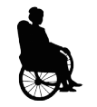
Population genetics: the study of genetic differences and their dynamics within and between populations
vs.
If we want to do any personal genomics (n=1), we first need to understand some population genetics (n=lots)
Notes:
To understand our ancestry and trace history through the genome over time, it’s going to be very important to understand genetic variation within populations and have some basic terminology to describe that.
That’s why we’re starting this module with an intro to pop gen.

Slide 6
Outline
Forces of genome evolution
Overview of PS2
Journal club: Ancestry

Slide 7
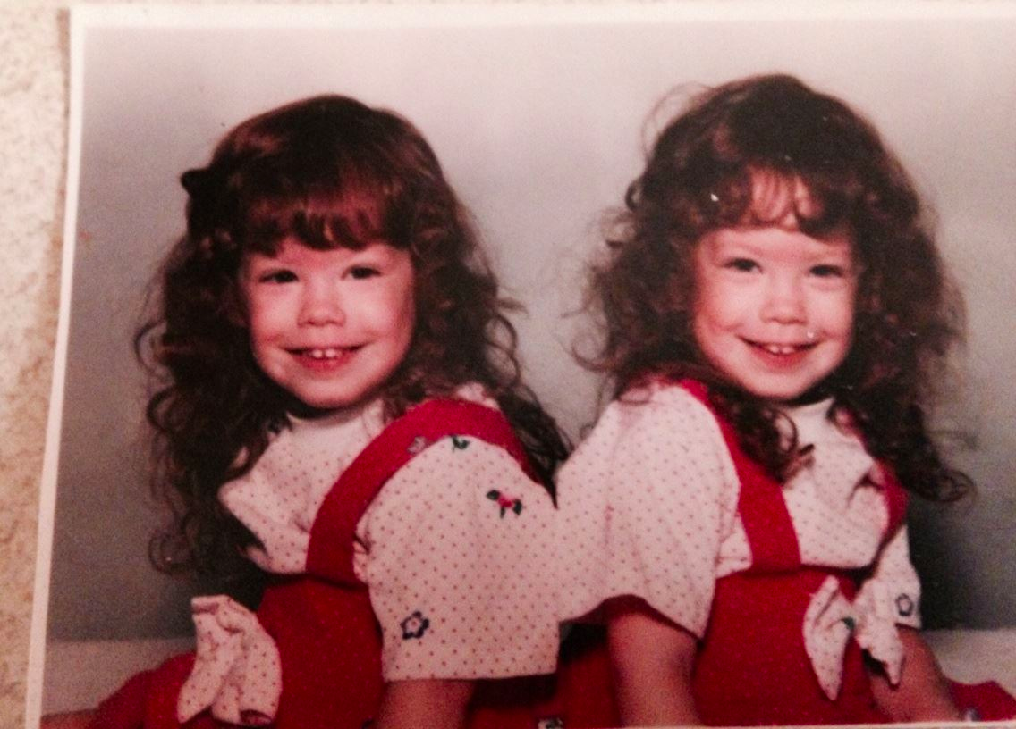
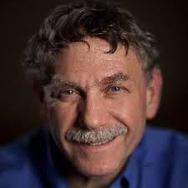
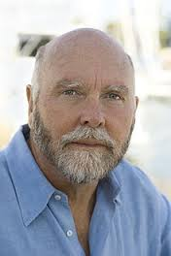
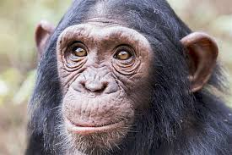
Genetic similarity gives insight into ancestry
Identical twins:
0 differences
Africa
West Eurasia
Unrelated humans
1/1,000 differences
South Asia
America
East Asia/Oceania
Human vs. chimp
1/100 differences
Mallick, et al. 2016
Notes:
Although obvious, it’s worth noting that we can use genetic variation between two individuals as a proxy for how closely those two individuals are related
More differences = more time since those two shared a common ancestor
e.g. twins, unrelated humans, non-human primates.
Similar idea applies to learning about differences between human populations. As we’ll see in the JC, can use genetics to infer these relationships
There are four main forces driving these differences in the genome over time

Slide 8
Four forces driving genome evolution
Mutation: introduces genetic variation (+recombination, next week)
Genetic drift: Evolution is inherently a stochastic process
Natural selection: Advantageous mutations more likely to spread
Gene flow: exchange of genetic material between populations
“Nothing in biology makes sense except in the light of evolution” – Theodosius Dobzhansky (1973)
Notes:
Mutations are what makes this all interesting, these are the fuel driving these differences

Slide 9
Mutation: the fuel for evolution
TCATTTGAGCATTAAATGTCAAGTTCTGCAC
Rs12913832
(e.g. eye color mutation)
TCATTTGAGCATTAAGTGTCAAGTTCTGCAC
Human mutation rate ~1.5 x 10⁻⁸ mutations/bp/generation (for SNPs).
~50-100 new mutations per generation
Mutation rate highly dependent on paternal age
Mutation rate highly variable across the genome!
Roach et al. 2010; Conrad et al. 2011
Notes:
Any time a cell divides, each generation of a species, it is an opportunity for a mutation to occur anywhere along the genome.
As we’ll see, these changes accumulate over time and get passed on through generations, leading to present day differences
For the ancestry part of the course, we’ll focus mostly on single base changes, or SNPs
Mut rate 10^-8, get 50-100 new mutations each new human
Note this is an average, many complicating factors
Let’s look at how these mutations behave when we look at them in populations over time

Slide 10
All copies of the genome share a common ancestor
Ancestral chromosome
…TCATTTGAGCATTAAATGTCAAGTTCTGCAC…
Each present-day person has two copies
= 1 chromosome
Notes:
Look at living humans, each of us has two copies of each chromosome
All of these actually descended from a common ancestor

Slide 11
All copies of the genome share a common ancestor
Ancestral chromosome
…TCATTTGAGCATTAAATGTCAAGTTCTGCAC…
Time (~50-100Kyr)
Present day chromosomes
Notes:
Break this up into single copies of the chromosome to make this easier to look at

Slide 12
History of a genetic variant
Ancestral chromosome
…TCATTTGAGCATTAAATGTCAAGTTCTGCAC…
Mutation occurs (e.g. A->G)
It can then be passed on to future generations
Notes:
Occasionally over time, mutation occurs
e.g. here A to a G
This mutation can then get spread to future generations
All of these ones with the G likely descended from a single common ancestor

Slide 13
History of a genetic variant
Very old mutations tend to be more common
Very recent mutations usually rare in the population
This is not always true!
(e.g. selection)
Ancestral chromosome
Notes:
Frequency of a mutation in the population can be informative about how long ago it happened
Common -> old
Rare -> newer. (or selected against)
Think about when there will be exceptions to this rule

Slide 14
Hardy Weinberg Equilibrium
Present day chromosomes
Present day humans have two copies each, randomly drawn from the pool of available chromosomes (not exactly)
Hardy-Weinberg Equilibrium principal says:
If frequency( ) = p, and If frequency( ) = 1-p, then we expect for diploid humans:
Frequency( ) = p²
Frequency( ) = (1-p)²
Frequency( ) = 2*p*(1-p)
Notes:
Can think of present-day humans sampling from pool of available chromosomes
Not exactly true
If we know the frequency of a mutation, straightforward to estimate how many people should have 0, 1, or 2 copies
But this property of random mating controls the types of geenotypes we’re going to see. For example, if the red copy is very rare, we’re almost always going to see it in a het state, or paired with a black allele, rather than homozygous
This is something called Hardy-Weinberg Equilibrium principal, which will come up throughout the course.

Slide 15
Genetic variation - terminology
Reference genome
rsid: identifier for each SNP according to dbSNP (e.g. rs1393350)
A
AA
GA
AA
GG
Genotype: refers to the two allele combination of an individual, e.g. AA, AG, or GG are possible genotypes in this example
(We’ll treat GA same as AG)
Major allele: the allele with the higher frequency (here, “A”)
Minor allele: the allele with lower frequency in the population (here, “G”)
Minor allele frequency (“MAF”): the frequency of the minor allele in the population (here, 3/8 = 0.375)
2 alleles: “A” or “G”
Reference allele: “A”
Alternate allele: “G”
Notes:
Formalize some of these things to make sure we’re all using same vocabulary

Slide 16
Most SNPs are bi-allelic
TTAAATGTC
Ancestral chromosome
Two alleles: A, G
A -> G
G
G
G
G
A
A
A
A
A
A
A
A
A
A
A
A

Slide 17
Tri-allelic SNPs exist but are rare
TTAAATGTC
Ancestral chromosome
Two alleles: A, G, C
Rare to have more than one mutation at a single position
A -> G
A -> C
G
G
G
G
A
A
A
A
C
C
A
A
A
A
A
A

Slide 18
Example – genotype + allele frequencies
CC
CT
TT
TT
TT
TT
TT
TT
TT
TT
What are all the possible genotypes?
CC, CT, TT
What is the minor allele?
C
What is the genotype frequency of TT?
8/10 = 80%
What is the minor allele frequency?
(2 (CC) + 1 (CT))/20 = 0.15

Slide 19
Tri-allelic example
CC
CT
CA
CA
TA
TT
TT
TT
TT
AA
What are all the possible genotypes?
CC, TT, AA, CT, CA, TA
What is the major allele?
T (C and A are minor alleles)
What is the genotype frequency of TT?
4/10 = 40%
What is the allele frequency of C?
5/20 = 0.25

Slide 20
Some genetic variation is population specific
Ancestral genome
SNP common in all populations
African
European
Asian
Notes:
As we’ll see in the JC, some of this variation is population specific

Slide 21
Some genetic variation is population specific
Ancestral genome
SNP common in European and Asian populations
Absent in African populations
African
European
Asian

Slide 22
Some genetic variation is population specific
Ancestral genome
SNP specific to African populations
African
European
Asian

Slide 23
Genetic variation is like a “molecular clock”
Ancestral genome
Time
African
European
Asian
# mutations = 2*TMRCA*mutation rate*genome size
TMRCA=time to most recent common ancestor
(but not always that simple! Factors besides mutation are important)
Notes:
If we know the mutation rate, can use this as a proxy for time

Slide 24
Four forces driving evolution
Mutation: introduces genetic variation
Genetic drift: Evolution is inherently a stochastic process in a finite population size
Natural selection: Advantageous mutations more likely to spread
Gene flow: exchange of genetic material between populations
“Nothing in biology makes sense except in the light of evolution” – Theodosius Dobzhansky (1973)

Slide 25
Genetic drift (effect of finite population size)
Each generation: choose n alleles with replacement
Allele Freq.
Gen. 1
p_{red}=0.50; p_{blue}=0.50
Gen. 2
p_{red}=0.35; p_{blue}=0.65
Gen. 3
p_{red}=0.40; p_{blue}=0.60
Gen. 4
p_{red}=0.30; p_{blue}=0.70
Gen. 4
…
p_{red}=0.20; p_{blue}=0.80
Fixation
p_{red}=0.00; p_{blue}=1.00
Notes:
Human population sizes are finite
That has some important implications, described by this phenomenon that we refer to as genetic drift
Some ancestral population of size n chromosomes, p=0.5 have the red allele
But every new generation of humans, we’re sampling chromosomes from previous generation
On average, expect freq to stay the same, but there is some noise inherent in this process
See in this toy example
If we were to run this process to infinite, only two possible outcomes: all red or all blue!

Slide 26
Wright-Fisher model
N individuals
2N alleles in a diploid population
2 alleles: A, B
p frequency of allele A
q frequency of allele B
Assumptions:
Non-overlapping generations
Constant population size
New generation drawn at random
(
)
Probability that next generation has k copies of allele A:
(this is taken directly from the binomial distribution)
2N
p^{k}q^{2N-k}
k
In a finite population, what eventually happens to allele frequencies?
Fixation or loss
How is rate of fixation related to population size?
Slower in larger populations
Time to fixation:
T_{fixed} = -4N(1-p)ln(1-p)
p
≈4N in large population with p=1/2N
What is the probability of fixation of an allele due to drift?
Initial frequency p
Notes:
Whole theory to describe this, called the Wright Fisher model
Essentially a random walk of allele frequencies between 0 and 1, each generation alleles drawn at random
Some interesting things come out of this:
Population size! Drift more severe in smaller populations, fixation will take much longer in larger populations
Changes in population size can have huge effects on allele frequencies

Slide 27
Example: Effect of bottlenecks
Ancestral population: p_{red}= 7.4% p_{green}=7.4% p_{blue}=85.2%
Bottleneck
Founder population: p_{red}= 25% p_{green}=0% p_{blue}=75%
Bottlenecks have dramatic effects on frequencies of rare alleles
Example bottleneck populations:
Early American settlers
Several thousand French Canadian settlers. High rate of Leigh Syndrome, Tyrosinemia Type I
Ashkenazi Jewish
Descend from several hundred people. High rate of e.g. Gaucher, Tay-Sachs, CF
Finland
Bottleneck 4000 yrs ago. 36 “Finnish heritage diseases” e.g. Usher Syndrome Type III
Notes:
Interesting example of genetic drift that we’ll talk about in the JC is concept of drift
Reduce genetic variation, also have big effects on frequency of rare alleles

Slide 28
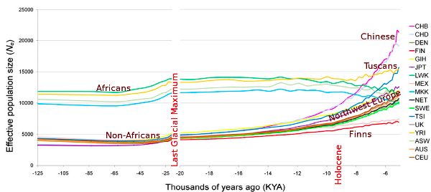
Effective population size – differs by ancestry
Larger effective population size -> more genetic diversity
Recent population explosion -> tons of new rare alleles.
In reality, population size history is complex and not constant!
Differs by ancestry
McEvoy et al. 2011

Slide 29
Four forces driving evolution
Mutation: introduces genetic variation
Genetic drift: Evolution is inherently a stochastic process
Natural selection: Advantageous mutations more likely to spread
Gene flow: exchange of genetic material between populations
“Nothing in biology makes sense except in the light of evolution” – Theodosius Dobzhansky (1973)

Slide 30
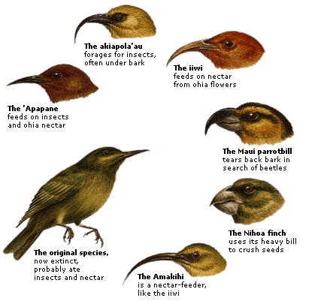
Natural selection
https://9sc4evolution.wikispaces.com/4.+Natural+Selection

Slide 31
Natural selection
Selection coefficient s: relative fitness of red vs. blue
p_{red}(1+s)
s<0: red is deleterious
s>0: red is beneficial
s=0: standard Wright Fisher, no selection
P(red sampled) =
p_{red}(1+s) + p_{blue}
e.g. with s>>0, fixation happens quickly
Gen. 1
p_{red}=0.50; p_{blue}=0.50
Gen. 2
p_{red}=0.60; p_{blue}=0.40
…
Gen. 3
p_{red}=0.80; p_{blue}=0.20
Fixation
p_{red}=1.00; p_{blue}=0.00
with s<<0, mutation quickly removed from the population

Slide 32
Patterns of positive selection
Directional
Balancing
Disruptive
Fitness
Fitness
Fitness
AA
AB
BB
AA
AB
BB
AA
AB
BB
Genotype
Genotype
Genotype
Example: lactose tolerance,
Skin color
Example: sickle-cell anemia
Example: ?

Slide 33
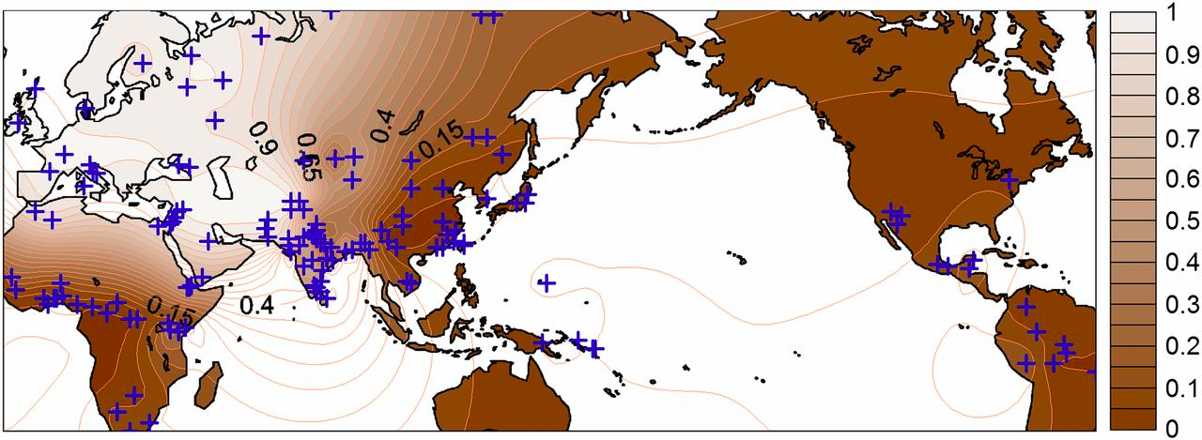
Example directional selection: skin color
World distribution of A111T polymorphism in SLC24A5
A111T mutation in SLC24A5 associated with lighter skin pigmentation in Europeans
Became predominant in Europe ~10-20K years ago
Hypothesis: selection for derived allele based on need for sunlight to produce vitamin D
One of the strongest signals of positive selection in Europeans
On 23andMe: rs1426654 A/G in SLC24A5. (I am AA=light skin)
Canfield et al. 2014
Sabeti et al. 2007

Slide 34
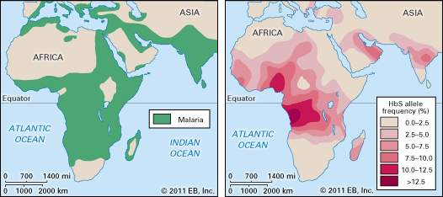
Example balancing selection: sickle cell anemia
Observation (Haldane): red blood cell disorders (e.g. sickle-cell anemia, thalassemias) common in areas where malaria is endemic.
Sickle cell anemia: due to mutations in beta hemoglobin (HBB), patients experience infections, pain, and fatigue
Homozygous wildtype: normal
Heterozygous: “sickle cell trait”, resistant to malaria!
Homozygous mutant allele: affected by sickle cell anemia
https://prezi.com/5yynhkp0ffnj/sickle-cell-anemia/
On 23andMe: i3003137 (rs334) T/A in gene HBB. (I am TT=homozygous wildtype)

Slide 35
Purifying selection removes deleterious alleles
severe
e.g. Tay-Sachs
Severe Mendelian disorders
Nonexistent
(removed by selection)
Effect size
Likely many examples, but low power to detect these
e.g. high cholesterol, Crohn’s Disease, Type II Diabetes
(many common alleles with small effect sizes)
mild
rare
common
Allele Frequency

Slide 36
Four forces driving evolution
Mutation: introduces genetic variation
Genetic drift: Evolution is inherently a stochastic process
Natural selection: Advantageous mutations more likely to spread
Gene flow: exchange of genetic material between populations
“Nothing in biology makes sense except in the light of evolution” – Theodosius Dobzhansky (1973)

Slide 37
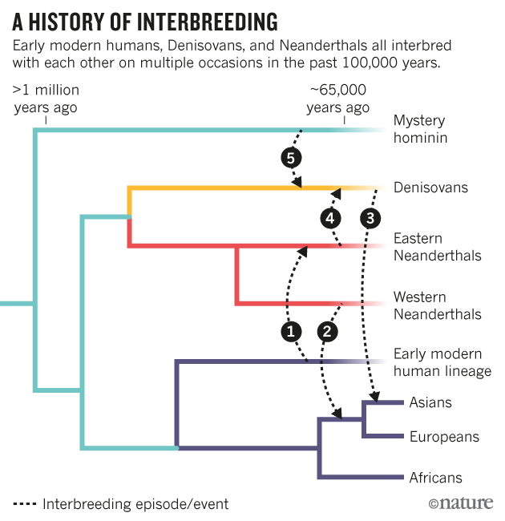
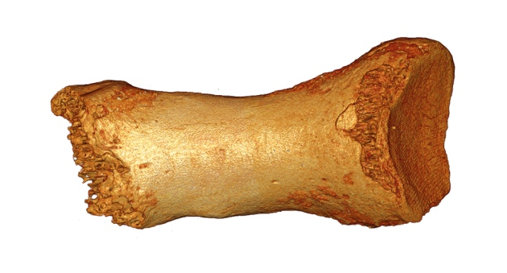
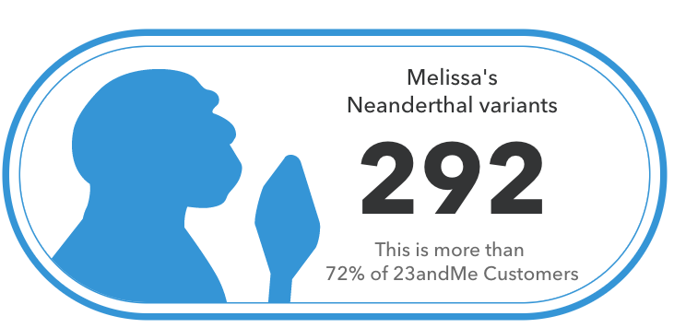
Admixture in modern and ancient humans
Week 8: Ancient Genomics
Also see: “Who we are and how we got here” by David Reich
Present-day populations actually result of repeated admixture
Ewen Callaway Nature News 2016

Slide 38
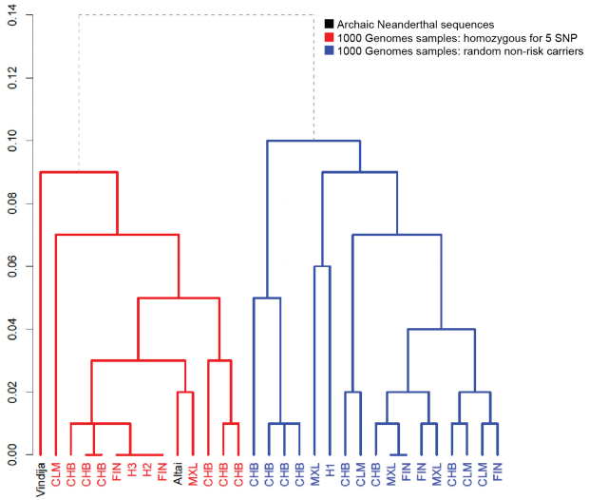
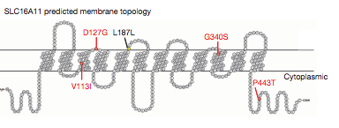
Neanderthal admixture and diabetes
Risk variants inherited from Neanderthal admixture!

Slide 39
PS2 Overview

Slide 40
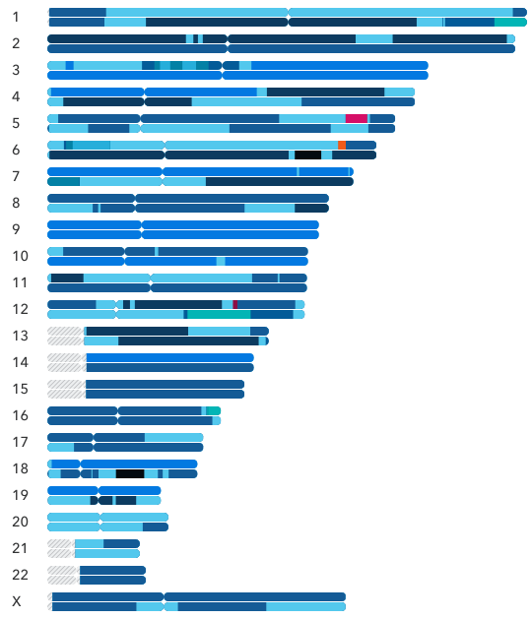
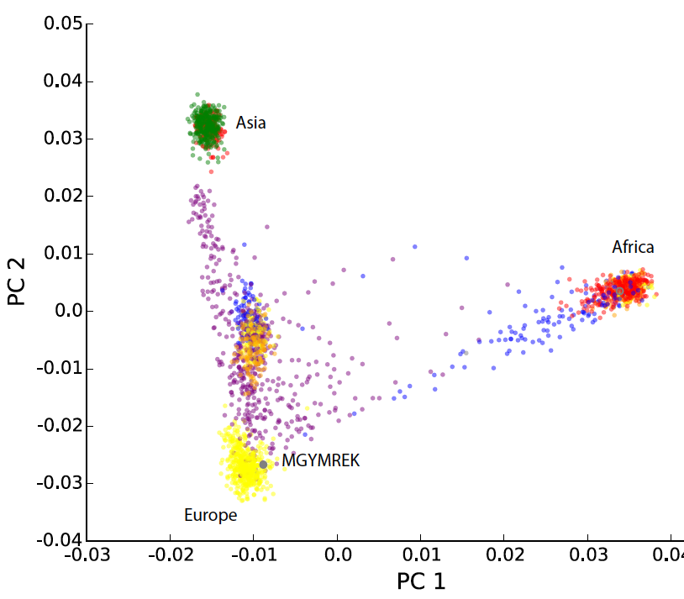
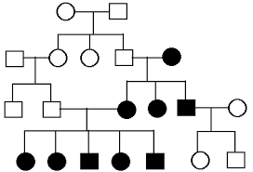
PS2 (datahub) Due *Friday* 4/16
Part 2: Local Ancestry
(04/07/21, 04/12/21)
Part 4: Imputation (04/05/21)
AACACAAGCTAGCTACCTACGTAGCTACAT
AACACAAGCTAGCTACCTACGTAGGTACAT
Ref panel
AACACTAGCTAGCTACCTATGTAGGTACAT
AACACTAGCAAGCTACCTACGTAGGTACAT
AACACTAGCAAGCTACCTACGTAGGTACGT
AACACTAGC?AGCTACCTA?GTAGGTAC?T
Your data
AACACAAGC?AGCTACCTA?GTAGGTAC?T
AACACTAGC?AGCTACCTA?GTAGGTAC?T
AACACTAGC?AGCTACCTA?GTAGGTAC?T
AACACAAGC?AGCTACCTA?GTAGCTAC?T
Part 1: Global ancestry (04/12/21)
Part 3: Relative finding (04/07/21)

Slide 41
Break (5 mins)
Journal club: Ancestry

