Slide 1
CSE185–Week 8 Part2
Phylogenetics Analysis
May 20, 2021
Announcements:
Sign up for project meetings next T/R 10am-12:30pm
Starting next week I won’t be holding 9pm OH.

Slide 2
From genomes to trees
FASTA
(genomes)
Step 1: MSA
(mafft)
FASTA
(alignment)
Step 2: build tree (RAxML)
NEWICK
(tree)
>Virus genome 1
ATTCTAGT
>Virus genome 2
ATCCTTCTAGT
>Virus genome 3
ACCTTCGA
…..
>Virus genome 1
AT---TCTAGT
>Virus genome 2
ATCCTTCTAGT
>Virus genome 3
A-CCTTC--GA
…..
(V1(V2,V3))

Slide 3
Today’s schedule
Multiple sequence alignment
Building phylogenetic trees
Projects
Course wrap-up info

Slide 4
Multiple sequence alignment

Slide 5
Goal: compare genomes of multiple species
Before MSA
Gene X
Chimpanzee
ACATCGACTGGCGATC
Bonobo
ACATCGGGCGATC
Input: homologous sequences from multiple species (nucleotides or amino acids)
Goal: introduce gaps so columns of the alignment are homologous (=comparable)
Output: Aligned sequences accounting for possible gaps between sequences
Human
ATCGACTGGCGAAC
Gorilla
AACTGGCGAAC
Orangutan
AGACTGGCTAAC
After MSA
Chimpanzee
ACATCGACTGGCGATC
Bonobo
ACATCG---GGCGATC
Human
A--TCGACTGGCGAAC
Gorilla
A-----ACTGGCGAAC
Orangutan
A----GACTGGCTAAC

Slide 6
MSA Intuition
Before MSA
Gene X
Score many possible alignments and choosing the one with the best “score”
Different scores for matching nucleotide, mismatching nucleotide, and gaps
Chimpanzee
ACATCGACTGGCGATC
Bonobo
ACATCGGGCGATC
Human
ATCGACTGGCGAAC
Gorilla
AACTGGCGAAC
Orangutan
AGACTGGCTAAC
After MSA
Let’s first start with aligning a pair of sequences. Then move to aligning more than two!
Chimpanzee
ACATCGACTGGCGATC
Bonobo
ACATCG---GGCGATC
Human
A--TCGACTGGCGAAC
Gorilla
A-----ACTGGCGAAC
Orangutan
A----GACTGGCTAAC

Slide 7
Pairwise alignment – Needleman Wunsch Dynamic Programming
Goal: align two sequences to each other in order to maximize some score function
Score: (Example)
Match: +1
Mismatch: -1
Indel: -1
E.g.: GCATGCA and GATTACA
GCATG-CA
G-ATTACA
Score = 2.
# Possible alignments between two length N sequences is 2^{2N}/sqrt(pi*N). Need a smart way to narrow this down!

Slide 8
Pairwise alignment – Needleman Wunsch Dynamic Programming
Dynamic programming principle: simplify the problem by solving subproblems. Subproblem solutions make it easier to compute the overall solution
 |  | G | C | A | T | G | C | A
 | 0 | -1 | -2 | -3 | -4 | -5 | -6 | -7
G | -1
A | -2
T | -3
T | -4
A | -5
C | -6
A | -7
For NW alignment: D[i, j] gives score of optimal alignment ending at position A[i] and B[j]. Where “A” and “B” are the two sequences.

Slide 9
Pairwise alignment – Needleman Wunsch Dynamic Programming
 |  | G | C | A | T | G | C | A
 | 0 | -1 | -2 | -3 | -4 | -5 | -6 | -7
G | -1 | 1 | 0 | -1 | -2 | -3 | -4 | -5
A | -2 | 0 | 0 | 1 | 0 | -1 | -2 | -3
T | -3 | -1 | -1 | 0 | 2 | 1 | 0 | -1
T | -4 | -2 | -2 | -1 | 1 | 1 | 0 | -1
A | -5 | -3 | -3 | -1 | 0 | 0 | 0 | -1
C | -6 | -4 | -2 | -2 | -1 | -1 | 1 | 0
A | -7 | -5 | -3 | -1 | -2 | -2 | 0 | 2
D[i-1, j-1] + match(A[i], B[j])
D[i-1,j] + G
D[i,j-1] + G
Match(A, B) = +1 if A=B, else -1
G = gap penalty
D[i,j] = max{
Trace back the process to create the optimal alignment!

Slide 10
Affine gap penalties
Motivation:
Scoring scheme above treats all gaps the same
More plausible to have one long gap vs. multiple short gaps
ACGATCATCAAAAAAAAAAAACTGATGTTCATA
ACGATCATC-A-AA--A--A-CTGATGTTCATA
ACGATCATCAAAAA-------CTGATGTTCATA
Affine gap penalty:
Gap open penalty (expensive) (O)
Gap extension penalty (cheaper) (E)
Score = O + E*L, where L is length of gap
But you need to keep track of 3 DP matrices…
Setting scores is somewhat of an art form…

Slide 11
What if we have more than two sequences?
Needleman Wunch – O(L²) where L is sequence length
Could be extended to N sequences, but becomes O(L^{N}) – computationally intractable
Practical MSA solutions need to use some heuristics (reasonable shortcuts) to speed up (won’t be optimal)
Common MSA programs:
  MAFFT (used in our lab)
  MUSCLE (used in the NEJM paper)
  Clustal (for amino acid sequences)
Notes:
https://watermark.silverchair.com/bbn013.pdf?token=AQECAHi208BE49Ooan9kkhW_Ercy7Dm3ZL_9Cf3qfKAc485ysgAAAmkwggJlBgkqhkiG9w0BBwagggJWMIICUgIBADCCAksGCSqGSIb3DQEHATAeBglghkgBZQMEAS4wEQQM_zhXrfhZuiXTTX0UAgEQgIICHDZ9YveaZY2m-mZpBhSLTyHYRjs0CdlIYKAV0u-OD2wh2jHdnHqXufc7GySLGjXmtvJVuB_QnwQT2WfmD89GXJPr_Q8g2Wo4QPDTGz2ISG_84lZGi8iMXqriTj5QcXPvKEtFPIQwchZbwfQ__rdXdaSjmWmN2WNWzHh_ZxUsUuqrYc776v2NHjfxN0vhx36s61nj750DaLly5SWWNsX_M6VGCl1FUvjD8YqmMq0_wq6BSy53jxfL4fZv-oJRNScXQD50lwELqB0FvxnWUXPrCjmB_Q6pNeExUvS-XkqebeYslUGmUolDR1_JqtdN4RJUxWrVrc5lxHNoORrdtmmnKvkUp0aYTnXTIv3h_2jl3PWQPnPJDRGYgZUV_z2k0ef0xbcr2eMMEqm0s6Vzmc3gvLL8WIH2tQDQulXwukdhJL6zsuNDdMM5DtTt_Ldi_-BRPGWq5Foatj1GRIBjExXyveoSxizUvypDfxbW2WEh3ZOhIxKFUpe91oFt3fLujbg3U8QxLh0otg0OeLhWbO3rM2iPA_FZvOWhU8Z173mZoCE9wVDiuCaFI-Fg_g1Hs_F-JIimbMRCb50NmDoW4MMLbp8r3datnptWPa-vYTWDbjf36GGxEkCxfqqnzbWTobxrrgdfToC_lHQP9SOdoAqn7GIxBg3HGpP9lZZw544p1K18MDqmYqAYorLRrFP3yVm8yPQvrsrSdcHmevwoEg

Slide 12
MSA: the progressive method
Seqs 1-2
Overview:
Step 1: Compute a pairwise comparison of all alignments (e.g. using NW or other score)
Seqs 1-3
Seqs 4-5
Distance matrix
1
2 | 0.2
3 | 0.1 | 0.1
4 | 1.0 | 0.8 | 0.8
5 | 1.6 | 0.9 | 0.9 | 1.1
 | 1 | 2 | 3 | 4 | 5
Notes:
http://bioinfo.vanderbilt.edu/zhanglab/lectures/AB2011Lecture04.pdf

Slide 13
MSA: the progressive method
Overview:
Step 1: Compute a pairwise comparison of all alignments
Step 2: Construct a tentative “guide tree” to order the sequences
  UPGMA tree – hierarchical clustering
  Greedily combine most similar sequences/groups
1
2 | 0.2
3 | 0.1 | 0.1
4 | 1.0 | 0.8 | 0.8
5 | 1.6 | 0.9 | 0.9 | 1.1
 | 1 | 2 | 3 | 4 | 5
Guide tree
1
2
3
4
5
Notes:
http://bioinfo.vanderbilt.edu/zhanglab/lectures/AB2011Lecture04.pdf

Slide 14
MSA: the progressive method
1
2
3
Overview:
Step 1: Compute a pairwise comparison of all alignments
Step 2: Construct a tentative “guide tree” to order the sequences (UPGMA tree)
Step 3: “Fix” the alignment for a high scoring pair
4
5
Notes:
http://bioinfo.vanderbilt.edu/zhanglab/lectures/AB2011Lecture04.pdf

Slide 15
MSA: the progressive method
1
2
3
Overview:
Step 1: Compute a pairwise comparison of all alignments
Step 2: Construct a tentative “guide tree” to order the sequences (UPGMA tree)
Step 3: “Fix” the alignment for a high scoring pair
Step 4: Progressively add other sequences, or groups of sequences
4
5
1
2
3
4
5
1
2
3
4
Lots of choices, vary by method:
How to choose the order?
Align single sequences or groups of sequences?
Scoring framework
5
1
2
3
Iterative methods: Can go back and refine previously calculated alignments
4
5
Notes:
http://bioinfo.vanderbilt.edu/zhanglab/lectures/AB2011Lecture04.pdf

Slide 16
A real example (on amino acids)
https://www.thelancet.com/journals/lancet/article/PIIS0140-6736(20)30251-8/fulltext

Slide 17
Building phylogenetics trees

Slide 18
From genomes to trees
FASTA
(genomes)
Step 1: MSA
(mafft)
FASTA
(alignment)
Step 2: build tree (RAxML)
NEWICK
(tree)
>Virus genome 1
ATTCTAGT
>Virus genome 2
ATCCTTCTAGT
>Virus genome 3
ACCTTCGA
…..
>Virus genome 1
AT---TCTAGT
>Virus genome 2
ATCCTTCTAGT
>Virus genome 3
A-CCTTC--GA
…..
(V1(V2,V3))
Step 2.1: Building the tree
Step 2.2: Quantifying uncertainty (bootstrapping)

Slide 19
Basic tree terminology
Internal node
Branches
Leaves (present-day species/sequences)
Species 1
Species 2
Species 3
Root
Species 4
Species 5
Ultrametric Tree: all leaves are equidistant from the root
Species 1
Species 2
Unrooted tree
Rooted tree
Species 3
Species 4
Species 5
Non-ultrametric tree: allow non-equal evolutionary rates
Notes:
TODO
Leaves branches, clades
How to describe branch lengths – ultrametric
Rooted vs. unrooted

Slide 20
How to build a tree – there are many ways
UPGMA
Parsimony: find the tree that requires the fewest evolutionary changes (e.g. mutations)
Unweighted Pair Group Method (UPGMA): based on hierarchical clustering of the distance matrix. At each step, nearest two clusters combined to a high-level cluster (rooted)
Neighbor Joining (NJ): similar to UPGMA, but allow for unequal rates of evolution (unrooted)
Maximum likelihood (used in RAxML) based on the MSA
1
2 | 0.2
3 | 0.1 | 0.1
4 | 1.0 | 0.8 | 0.8
5 | 1.6 | 0.9 | 0.9 | 1.1
 | 1 | 2 | 3 | 4 | 5
NJ

Slide 21
Building a maximum likelihood tree
MSA (data)
INPUT
Assumptions:
Each position in the MSA is evolving independently
After species diverge, they evolve independently
+
Substitution model M (e.g. GTRCAT)
Tree T that maximizes P(data|T, M)
OUTPUT
Notes:
Assume:
Positions evolved independently
After species diverge, they evolve independently (e.g. no recomb)

Slide 22
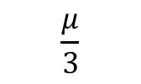
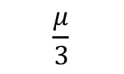

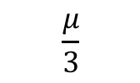

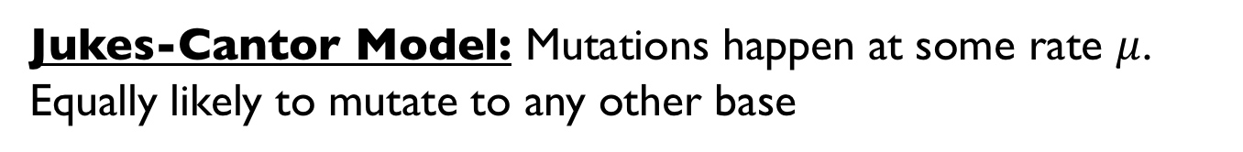






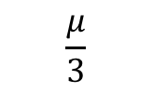



Substitution model
To this nucleotide
A
G
C
T
$$1−μ$$
$$\frac{μ}{3}$$
$$\frac{μ}{3}$$
$$\frac{μ}{3}$$
A
Mutate from this nucleotide
$$\frac{μ}{3}$$
$$1−μ$$
$$\frac{μ}{3}$$
$$\frac{μ}{3}$$
G
C
$$\frac{μ}{3}$$
$$\frac{μ}{3}$$
$$1−μ$$
$$3$$
T
$$\frac{μ}{3}$$
$$\frac{μ}{3}$$
$$\frac{μ}{3}$$
$$1−μ$$
Jukes-Cantor Model: Mutations happen at some rate $μ$. Equally likely to mutate to any other base

Slide 23












Substitution model
A
G
C
T
$$β$$
$$β$$
A
$$∗$$
$$α$$
$$∗$$
$$β$$
$$β$$
G
$$α$$
C
$$β$$
$$β$$
$$∗$$
$$α$$
T
$$β$$
$$β$$
$$α$$
$$∗$$
Kimura (2 param) Model: Separate rate for transitions (A/G+C/T) vs. transversions
Generalized time-reversible Model (GTR): 6 rate parameters (also takes into account nucleotide frequencies)

Slide 24
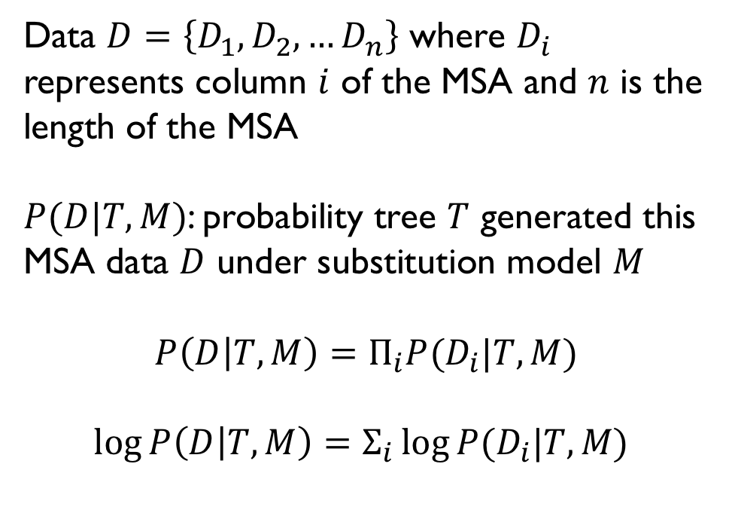
Building a maximum likelihood tree
Data $D=\left\{D_{1},D_{2},…D_{n}\right\}$ where $D_{i}$ represents column $i$ of the MSA and $n$ is the length of the MSA
$P(D|T, M)$: probability tree $T$ generated this MSA data $D$ under substitution model $M$
$$P\left(D | T, M\right)=Π_{i}P(D_{i}|T, M)$$
$$\log{P\left(D | T, M\right)}=Σ_{i}\log{P(D_{i}|T, M) }$$
Chimpanzee
ACATCGACTGGCGATC
Bonobo
ACATCG---GGCGATC
Human
A--TCGACTGGCGAAC
Gorilla
A-----ACTGGCGAAC
Orangutan
A----GACTGGCTAAC
Assume each position in the MSA is evolving independently
Just need to know how to compute for one position!

Slide 25
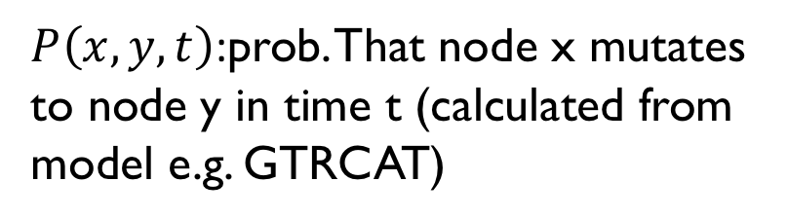
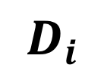
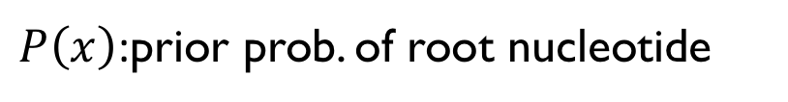
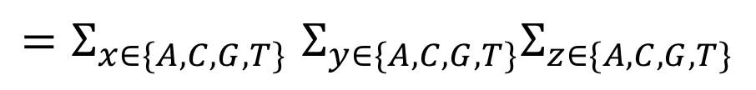
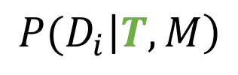
Computing the probability for one position
X
y
t₃
Z
$P\left(x\right)$:prior prob. of root nucleotide
t₁
$P\left(x,y,t\right)$:prob. That node x mutates to node y in time t (calculated from model e.g. GTRCAT)
t₂
t₆
t₄
t₅
A
B
C
D
(“A”)
(“A”)
(“T”)
(“T”)
$$D_{i}$$
$${P(D}_{i}\left|T, M\right)$$
Sum over all possible values for internal nodes since we don’t actually observe them!
$${=Σ}_{x∈\{A,C,G,T\}}Σ_{y∈\{A,C,G,T\}}Σ_{z∈\{A,C,G,T\}}$$
$$P\left(x\right)P\left(x,y,t_{1}\right)P\left(y,A,t_{2}\right)P\left(y,B,t_{6}\right)P\left(x,z,t_{3}\right)P\left(z,C,t_{4}\right)P(z,D,t_{5})$$
Notes:
Show P(D_i|T,M)
https://www.ncbi.nlm.nih.gov/CBBresearch/Przytycka/download/lectures/PCB_Lect11_Phylogen_Trees.pdf slide 61

Slide 26
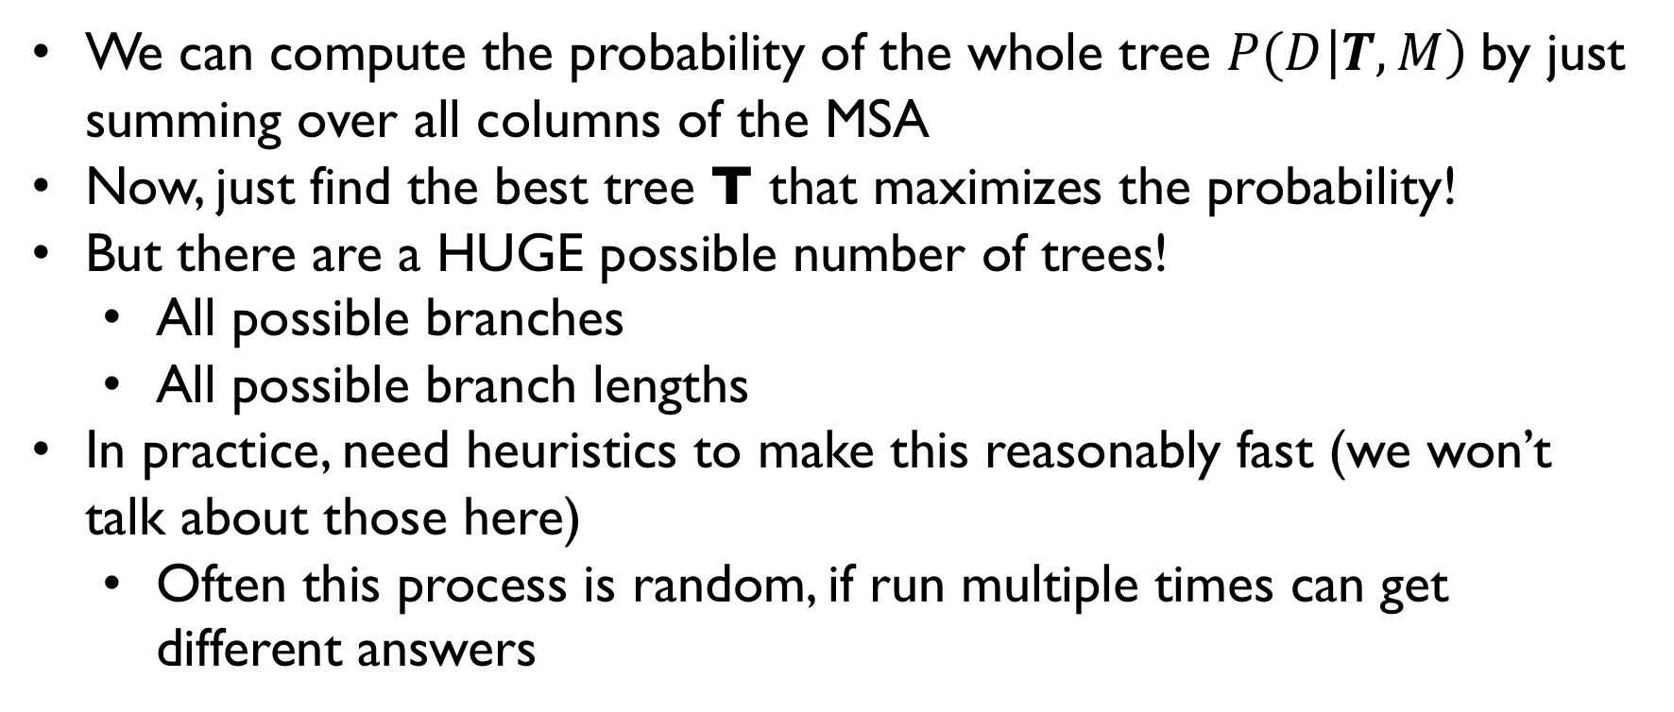
Find the tree that maximizes the likelihood (not so easy)
We can compute the probability of the whole tree $P(D\left|T, M\right)$ by just summing over all columns of the MSA
Now, just find the best tree T that maximizes the probability!
But there are a HUGE possible number of trees!
  All possible branches
  All possible branch lengths
In practice, need heuristics to make this reasonably fast (we won’t talk about those here)
  Often this process is random, if run multiple times can get different answers

Slide 27
In practice - RAxML
raxml \
-s lab7_virus_genomes.aln \
-m GTRCAT \
-n lab7_raxml \
-p 12345 \
-# 20 \
-T 10
Input: MSA from mafft
Input: Model
Output prefix
Seed. Since it’s stochastic, can use to make reproducible
Number of tries to get the ML tree
You can try to use multiple processors to speed it up

Slide 28
Quantifying uncertainty - bootstrapping
t₁
t₃
Are we confident this branch is correct?
t₂
t₆
t₄
t₅
A
B
C
D

Slide 29
Quantifying uncertainty - bootstrapping
Randomly sample positions (with replacement) from our MSA
Build a new tree
Repeat N times (e.g. 100 in the lab, 1,000 in the paper)
For each edge of the original tree, calculate the % of times it is present in the bootstrap trees
Should be robust to extreme outlier positions in MSA
Chimpanzee
ACATCGACTGGCGATC
Bonobo
ACATCG---GGCGATC
Human
A--TCGACTGGCGAAC
Gorilla
A-----ACTGGCGAAC
Orangutan
A----GACTGGCTAAC
96%
100% of BS samples had these 4 strains forming a clade

Slide 30
In practice – Newick files
Bracketed numbers give bootstrap support values for each edge
(AY390556.1:0.00003637225049064436,(((((KY770859.1:0.01387409618377601767,KJ473816.1:0.01104642888137926868):0.01670508892486941357[100],((KY417142.1:0.01104020442760675520,KY417148.1:0.01378429115850069234):0.00326396829504533225[73],(KJ473815.1:0.04591818406253295876,(JX993988.1:0.06424733764405721193,(MK211374.1:0.04966343157142111275,(((MG772933.1:0.01390183522608306500,MG772934.1:0.01468061084685984979):0.04404600826351990489[100],(MT188341.1:0.00037039951406170742,NC_045512.1:0.00043206693660585282):0.10313867793099791570[100]):0.10326793107311695030[100],(KF636752.1:0.67312255458994796342,((KU762338.1:0.36116072886906985806,EF065513.1:0.36066627096315262424):0.77969138610909249909[100],((((EF065509.1:0.25033334892850872544,EF065505.1:0.26373153406348648353):0.11737907990044371687[100],JX869059.1:0.25391338225585191601):0.08201005122809228165[100],KC545386.1:0.30891969069664665382):0.58912595603095330166[100],((KM349744.1:0.30002105470615114680,AY391777.1:0.18945287536434426978):0.06548123302769244536[100],(MK167038.1:0.28485652870514382995,FJ647223.1:0.23906916319451873565):0.05416533351513019151[0]):1.05420590099099809045[100]):0.18282182583111139529[98]):0.28006375118467108365[100]):0.48653845907785669977[100]):0.09006874231024417088[100]):0.01912348970320522021[83]):0.00747160597154931504[79]):0.01170301006061528169[100]):0.00705099075874861692[100]):0.02329829975358251384[100],(MK211376.1:0.00733071157151126643,(KY417151.1:0.00492535095120821484,KY417152.1:0.00410397520465797735):0.00406148894763068858[100]):0.00726195699348327218[100]):0.00571413403037812108[100],KT444582.1:0.01213992303237837987):0.03047550507804399483[100],(AY508724.1:0.00043644382191545606,AY485277.1:0.00032551326925554889):0.00086260628645615928[100]):0.00041588086609119061[100],AY278489.1:0.00065154685942304870);

Slide 31
Complications when working with real data
All of these methods rely on heuristics. Computationally intractable to find best MSA/phylogeny for reasonably sized datasets
Ultimately, we don’t have a “ground truth”. We can only do as well as our models actually capture real biology
Gene vs. species trees
  Recombination and other processes break up genomes
  Different genes/genome regions may have different trees!

Slide 32
Spike protein shows little variation across human isolates
Different trees in different regions -> suggests recombination!
“COVID-19: Epidemiology, Evolution, and Cross-Disciplinary Perspectives”

Slide 33
Some project FAQ

Slide 34
Project FAQ
How should I find a good paper for the project? Do you prefer we use one of the examples?
Google/pubmed/SRA/GEO good places to start.
Strongly prefer you find your own rather than use our examples!
Does R/Seurat count as a “command line tool we didn’t use in class?” Yes that’s fine with me
For scRNA-seq, should I start from the fastqs? Count matrix? Filtered count matrix? You can start with the filtered count matrix. Usually available on GEO
How should I determine which results to reproduce? Focus on the figure (or possibly table) you think tells the most interesting story. I’ll show some examples in a second.

Slide 35
Each figure should tell a story!
What is this figure trying to say?
SARS-CoV-2 likely has a complex evolutionary history
Most recent common ancestor with bat BetaCoV/RaTG13/2013
Different trees in different genomic regions show evidence of recombination with other viruses and complex evolutionary history
https://www.cell.com/trends/molecular-medicine/fulltext/S1471-4914(20)30065-4

Slide 36
Each figure should tell a story!
What is this figure trying to say?
HFD changes in liver reversed after returning mice to a Chow diet
Each panel gives us pieces of evidence about this story
https://www.ncbi.nlm.nih.gov/pmc/articles/PMC5223143/

Slide 37
Course wrap-up

Slide 38
Week | Date | Topic
Week 1 | 03/30/2021 | Python Lightning course / start on Lab 1
Week 2 | 04/06/2021 | Lab 1: Mutation hunting: find the needle in a haystack NGS, sequence alignment, variant calling
Week 3 | 04/13/2021 | Lab 2: So where do all those reference genomes come from, anyway? Genome size estimation, genome assembly Quiz 1
Week 4 | 04/20/2021 | Lab 3: How tall should I be? GWAS, Ancestry, PCA
Week 5 | 04/27/2021 | Lab 4: You are what you eat RNA-seq, differential expression Quiz 2
Week 6 | 05/04/2021 | Lab 5: The dark matter of the genome ChIP-seq, machine learning
Week 7 | 05/11/2021 | Lab 6: Don’t get lost in the crowd Single-cell genomics Quiz 3
Week 8 | 05/20/2021 | Lab 7: COVID-19 Comparative genomics, phylogenetics Project proposals due
Weeks 9-10 | 05/27/2021 | Independent Projects (report due in Finals week)

Slide 39
What we didn’t cover
Short answer: a LOT!
We focused on mammal (human, mouse) applications, and looked at a lot of NGS data
Some things we didn’t cover:
Metagenomics, microbiome
Metabolomics
Cancer genomics
DNA methylation, Hi-C, ATAC-seq
Lots of proteomics
And lots more

Slide 40
Fill our course evaluations!
http://www.cape.ucsd.edu/
You should be getting an email from CAPE.
Your feedback is very valuable to us! Help us improve future courses.
If we get at least 90% participation, we’ll add 2% extra credit points to each person’s grade.

Slide 41
If you’re looking for more
CSE284: Personal Genomics
  Offered in spring
  Focus on human genetics
CSE290: Seminar in Medical and Population Genetics
  http://gymreklab.com/teaching/medpopgen_seminar.html
BISB Seminars
  Thursdays 12-1
Or, email me and I’m happy to chat after the quarter’s over!

Slide 42
Thank you!
See you at presentations next week

