Slide 1
CSE185 – Week 7 Part 1 Single-cell RNA-sequencing
May 11, 2021
Announcements:
Lab 6 released
Reminder Quiz 3 Thursday
Quiz 3 info released
Macosko et al. 2015

Slide 2
Week | Date | Topic
Week 1 | 03/30/2021 | Python Lightning course / start on Lab 1
Week 2 | 04/06/2021 | Lab 1: Mutation hunting: find the needle in a haystack NGS, sequence alignment, variant calling
Week 3 | 04/13/2021 | Lab 2: So where do all those reference genomes come from, anyway? Genome size estimation, genome assembly Quiz 1
Week 4 | 04/20/2021 | Lab 3: How tall should I be? GWAS, Ancestry, PCA
Week 5 | 04/27/2021 | Lab 4: You are what you eat RNA-seq, differential expression Quiz 2
Week 6 | 05/04/2021 | Lab 5: The dark matter of the genome ChIP-seq, machine learning
Week 7 | 05/11/2021 | Lab 6: Don’t get lost in the crowd Single-cell genomics Quiz 3
Week 8 | 05/20/2021 | Lab 7: COVID-19 Comparative genomics, phylogenetics Project proposals due
Weeks 9-10 | 05/27/2021 | Independent Projects (report due in Finals week)
Week 7: COVID-19+prepare for project
Proposals due end of week 8 (next week)
Notes:
now we're going to shift gears
and use similar tools to look at other aspects of biology
next 3 weeks generally looking at different aspects of gene regulation
this week we'll talk about RNA-seq to look at gene expression
next week use ChIP-seq to get further insights into gene regulation
then lab 6 will go back to rna-seq, but looking at single cell RNA-seq data
finally our last lab, lab 7, will be using comparative genomics to analyze genome of the virus that causes covid-19
this week we're also starting a new lab format to get ready for writing project reports
less overall stuff for you to do, a little more open-ended
I'll say more on this at the end of today

Slide 3
Today’s schedule
Why sequence single cells?
scRNA-seq technologies
scRNA-seq analysis pipeline
Overview of quiz 3 + lab 6

Slide 4
RNA-seq typically performed on “bulk” tissues
Lyse cells and collect cDNA in bulk
Sequence!
Millions of cells collected

Slide 5
But maybe not every cell is “average”!
Brain cell 1
Brain cell 2
Brain cell 3
Bulk measurement =
Mean across population of cells

Slide 6
Organs are often made of many distinct cell types
Cell types
Expression level
Rod cells
Cone cells
Gene
Unclassified cells
Retinal bipolar cells (RBCs)
Sekhar et al. 2016
Different cell types have different expression signatures

Slide 7
Goal: quantify expression in each cell individually
 | Cell 1 | Cell 2 | Cell 3 | Cell 4 | Cell 5 | Cell 6 | Cell 7 | Cell 8 | Cell 9 | …
Gene 1 | 1 | 0 | 5 | 7 | 8 | 9 | 8 | 7 | 4 | 0
Gene 2 | 0 | 8 | 6 | 4 | 0 | 8 | 7 | 6 | 0 | …
Gene 3 | 9 | 7 | 5 | 4 | 6 | 7 | 8 | 9 | 8 | …
Gene 4 | 1 | 2 | 3 | 2 | 1 | 2 | 3 | 4 | 3 | …
Gene 5 | 0 | 0 | 0 | 0 | 0 | 0 | 0 | 0 | 0 | …
Gene 6 | 0 | 0 | 4 | 0 | 0 | 5 | 0 | 0 | 0 | …
Gene 7 | 7 | 8 | 9 | 10 | 11 | 11 | 9 | 8 | 7 | …
Gene 8 | 3 | 4 | 5 | 4 | 3 | 2 | 3 | 4 | 5 | …
… | … | … | … | … | … | … | … | … | … | …

Slide 8
What can we do with single-cell information?
Identify novel cell types
Track developmental trajectories
Trapnell et al. 2014
Sekhar et al. 2016
Study effects of genetic variation! (ask me if you’re interested!)
Each cluster is a distinct cell type of retinal bipolar cells
(14 BC clusters, only 7 align with known cell types)

Slide 9
scRNA-seq technologies

Slide 10
Single cell workflow
Experimental pipeline
(focus on 10X Genomics. But there are others)
Sequence
Separate to single cells
Extract and label cDNA separately for each cell
Pool data from all cells
Extract cells
Analysis pipeline
More on computational challenges + t-SNE Thursday
Compute gene x cell (feature x barcode) expression matrix
Identify cell types (clustering)
Characterize cell types
Align reads

Slide 11
How to separate individual cells?
Key: perform reactions for each cell separately in “droplets”, or “gel beads”, equipped with reagents and unique labels (other solutions exist)
Zilionis et al 2016
See Dropseq video:
https://www.youtube.com/watch?v=dCCZVrnsvUE

Slide 12
10X Genomes single-cell RNAseq – the bead
Microfluidic device loads:
~1 bead/droplet
~1 cell/droplet
(not always - see Exercises!)
R1
(adapter for sequencing)
UMI (“unique molecular identifier) ~10bp
“GEM” bead
Gel emersion
Poly dT (30bp)
Droplet
10X barcode
(~16bp) unique per bead
GEM
cell
Each bead has a unique barcode
Millions of oligos with the barcode attached to each bead
750K unique barcodes available
Barcode (usually) uniquely identifies a cell

Slide 13
10X Genomes single-cell RNAseq – generating cDNA
barcode
UMI
mRNA (w/ polyA tail)
GEM
Poly dA/dT (30bp)
AAAAAAAAA
TTTTTTTTTT
Oligo (attached to the bead)
Reverse transcription (convert to cDNA, amplify)
AAAAAAAAA
TTTTTTTTTT

Slide 14
More on barcodes and UMIs
4¹⁶ possible barcodes
(4,294,967,296)
10X uses 750K in total
1 barcode/bead
R1
(adapter for sequencing)
UMI (“unique molecular identifier) 10bp
“GEM” bead
Gel emersion
Poly dT (30bp)
4¹⁰ possible UMIs
(1048576)
1 million+ UMIs per bead
1 UMI/molecule
10X barcode
(16bp) unique per bead
Barcode: unique for each cell
UMI: unique for each molecule (used to correct for PCR duplication)

Slide 15
10X Genomes single-cell RNAseq - pooling
AAAAAAAAA
TTTTTTTTTT
AAAAAAAAA
TTTTTTTTTT
AAAAAAAAA
TTTTTTTTTT
AAAAAAAAA
TTTTTTTTTT
Remove oil and pool all fragments together
Now that cDNA is labeled, no longer need to separate cells in droplets

Slide 16
10X Genomes single-cell RNAseq – library prep
UMI
BC
R1
AAAAAAAAA
TTTTTTTTTT
Add Illumina adapters (P5/P7) and sample indices
P7
index
UMI
BC
R1
P5
AAAAAAAAA
TTTTTTTTTT
Index: used if you are pooling multiple libraries in one run. Later, samples are “demultiplexed” by index
Sequence!

Slide 17
10X Genomes single-cell RNAseq – the numbers
10X Single-cell RNAseq
Up to 10,000 total cells
~20,000 read pairs/cell
~200 million read pairs total
Recall: ~15-20K genes expressed, but we’re only getting 20K reads. Data is going to be very sparse! Mean ~1 read/transcript
Bulk RNA-seq
~10M-100M reads per sample
Mean ~hundreds to thousands of reads per transcript

Slide 18
10X captures 3’ends of mRNAs
UMI
BC
R1
AAAAAAAAA
TTTTTTTTTT
What kinds of things will we *not* be able to analyze with 10X?
Examples:
Splicing/isoform quantification
Mutations in beginning of transcript
Ntranos et al. 2019

Slide 19
10X experimental design considerations
Duplication: one cell gets labeled with more than one barcode
Doublet: artifactual library generated from two cells
(i.e., two different cells are labeled with the same barcode)
Technical doublet: two cells get loaded into the same droplet
Synthetic doublet: two cells get loaded into separate droplets, but receive the same barcode (barcode collision)
Need to design # droplets, # barcodes carefully to avoid these types of errors.
Topic of Exercises #1.

Slide 20
Full transcript methods (well-based, lower throughput)
Isolate cells in wells, add barcodes and adapters to all fragments
“SMART-seq” (https://www.takarabio.com/)

Slide 21
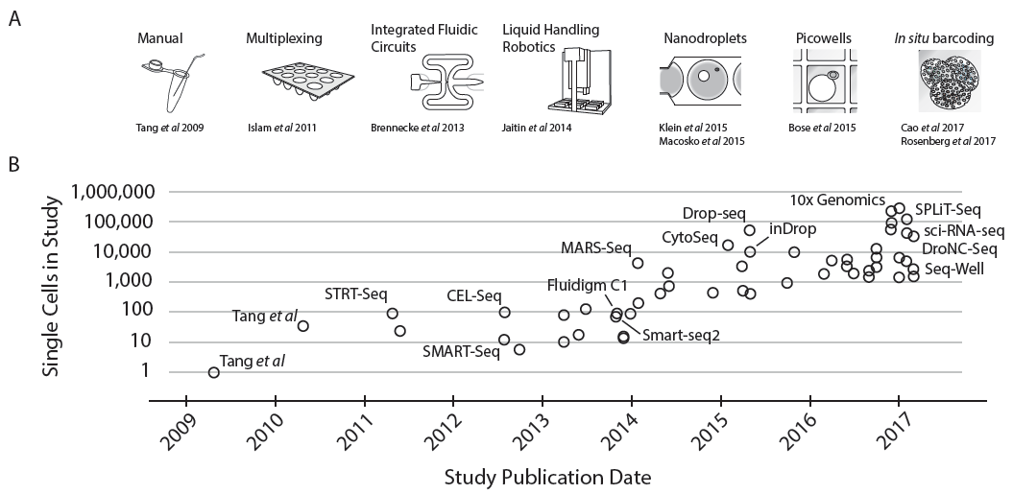
Single cell technologies have become higher throughput
Full-length mRNA
Few cells
3’-end mRNA
Many cells
Svensson et al., 2017 arXiv:1704.01379

Slide 22
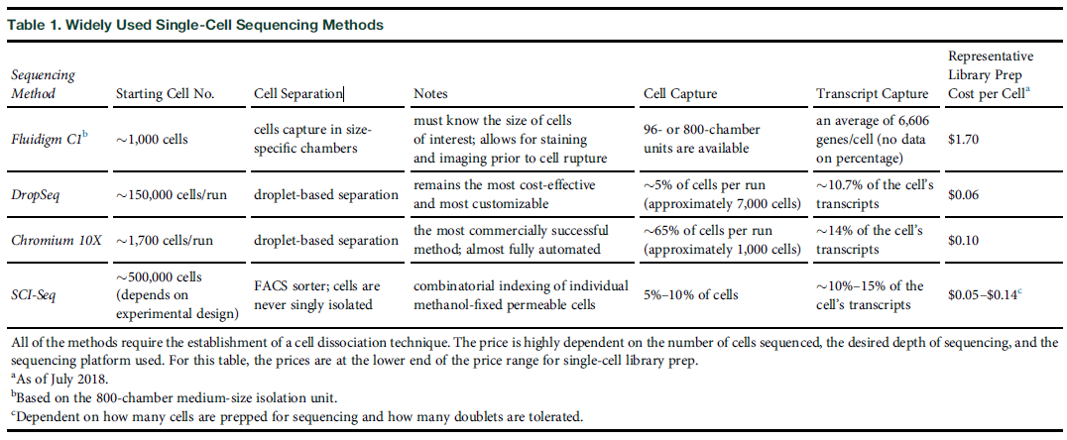
Single cell technologies – cost comparison
Smart-seq
10X

Slide 23
scRNA-seq analysis pipeline

Slide 24
Single cell workflow
Experimental pipeline
Sequence
Separate to single cells
Extract and label cDNA separately for each cell
Pool data from all cells
Extract cells
Analysis pipeline
Compute gene x cell (feature x barcode) expression matrix
Identify cell types (clustering – t-SNE)
Characterize cell types
Align reads

Slide 25
10X Genomes single-cell RNAseq – the data!
Three fastq files per sequencing lane:
Read 1: (first read in each pair, contains barcode + UMI)
neuron_1k_v3_S1_L00X_R1_001.fastq.gz
Read 2: (second read in each pair, contains transcript)
neuron_1k_v3_S1_L00X_R2_001.fastq.gz
Index: (sample index, if multiple samples pooled in one run)
neuron_1k_v3_S1_L00X_I1_001.fastq.gz

Slide 26
10X “Cell ranger” performs many scRNA-seq analyses
“cellranger count”: main analysis pipeline
1. Aligns reads to a reference transcriptome (using STAR)
2. Generates feature-barcode matrices
3. Filter poor quality barcodes (e.g. droplets that didn’t get any cells)
4. Performs clustering
5. Performs gene expression analysis
ALIGN_READS
COUNT_GENES
FILTER_BARCODES
RUN_TSNE
RUN_DIFFERENTIAL_EXPRESSION
https://support.10xgenomics.com/single-cell-gene-expression/software/pipelines/latest/map/cr-counter

Slide 27
”cellranger count” output
alignment/: BAM files with alignments (from STAR)
filtered_feature_bc_matrix/: expression counts per cell (filtered)
raw_feature_bc_matrix/: expression counts per cell (unfiltered)
analysis/: analysis including dimensionality reduction, cell clustering, and differential expression

Slide 28
The “Feature-barcode” matrix
Columns = “barcodes” (cells)
 | Cell 1 | Cell 2 | Cell 3 | Cell 4 | Cell 5 | Cell 6 | Cell 7 | Cell 8 | Cell 9 | …
Gene 1 | 1 | 0 | 5 | 7 | 8 | 9 | 8 | 7 | 4 | 0
Gene 2 | 0 | 8 | 6 | 4 | 0 | 8 | 7 | 6 | 0 | …
Gene 3 | 9 | 7 | 5 | 4 | 6 | 7 | 8 | 9 | 8 | …
Gene 4 | 1 | 2 | 3 | 2 | 1 | 2 | 3 | 4 | 3 | …
Gene 5 | 0 | 0 | 0 | 0 | 0 | 0 | 0 | 0 | 0 | …
Gene 6 | 0 | 0 | 4 | 0 | 0 | 5 | 0 | 0 | 0 | …
Gene 7 | 7 | 8 | 9 | 10 | 11 | 11 | 9 | 8 | 7 | …
Gene 8 | 3 | 4 | 5 | 4 | 3 | 2 | 3 | 4 | 5 | …
… | … | … | … | … | … | … | … | … | … | …
Rows = “features” (genews)
The matrix is “sparse”: many zeros!

Slide 29
The “Feature-barcode” matrix
Matrix files:
Matrix.mtx.gz: matrix in “Matrix market format”
Features.tsv.gz: list of gene names for each row
Barcodes.tsv.gz: list of barcodes for each cell
For spare matrices, it’s silly to store a bunch of 0s!
Stores:
Row index, column index, count
Row
Column
Count

Slide 30
Identifying outlier and poor quality data
Gene-level filters
Remove genes not expressed in enough cells (not interesting)
Remove genes with very low expression (not reliable)
Cell-level filters
Remove cells with not enough genes expressed (probably not reliable)
Remove cells that are problematic for other reasons
You’ll be doing this in the lab. Will have to make some judgements about what the outliers are!

Slide 31
Markers of poor quality cells – high mitochondria content
Cell
Nucleus
Mitochondria (have their own genome!)
Many copies per cell
“Broken” cells enriched for expression of mitochondria genes
Genome packaged in the nucleus
https://genomebiology.biomedcentral.com/articles/10.1186/s13059-016-0888-1
Notes:
https://bioinformatics.stackexchange.com/questions/3349/are-mitochondrial-genes-to-exclude-in-scrna-seq-such-as-ribosomal-genes

Slide 32
Filtering outliers with scanpy
# cells
Which cells are outliers?

Slide 33
Clustering the count matrix to identify distinct cell types
 | Cell 1 | Cell 2 | Cell 3 | Cell 4 | …
Gene 1 | 1 | 0 | 5 | 7 | 0
Gene 2 | 0 | 8 | 6 | 4 | …
Gene 3 | 9 | 7 | 5 | 4 | …
Gene 4 | 1 | 2 | 3 | 2 | …
Gene 5 | 0 | 0 | 0 | 0 | …
Gene 6 | 0 | 0 | 4 | 0 | …
Gene 7 | 7 | 8 | 9 | 10 | …
Gene 8 | 3 | 4 | 5 | 4 | …
… | … | … | … | … | …
Cluster cells (columns)
e.g. by:
1. PCA (we’ve seen)
2. t-SNE/UMAP
Macosko et al. 2015
More on clustering single cell RNAseq data on Thursday!

Slide 34
Characterizing gene expression signatures of each cell type
Cell types
Gene
Sekhar et al. 2016

Slide 35
What else might we have to worry about? (more Thurs.)
Cell-cycle fluctuations
If your cells are in a mixture of cell-cycle states (e.g. G1, S, G2) genes that fluctuate throughout the cell cycle could dominate your signal
Batch/clonality effects
If you pool cells from different experiments or clonally derived cell lines, they may cluster by batch/clonal origin!
And many more things can go wrong… (as usual in biology!)

Slide 36
Lab 6 Overview

Slide 37
Lab 6: scRNA-seq analysis of mouse brain tissues
Cells from brain of a mouse embryo (day 18, or E18)
Cortex
Hippocampus
Sub-ventricular zone
10X scRNA-seq
931 cells
56,000 reads/cell
https://support.10xgenomics.com/single-cell-gene-expression/datasets/2.1.0/neurons_900
Analysis:
Alignment + expression quantification (Cell Ranger)
Preprocessing and filtering (Scanpy)
Clustering with t-SNE

Slide 38
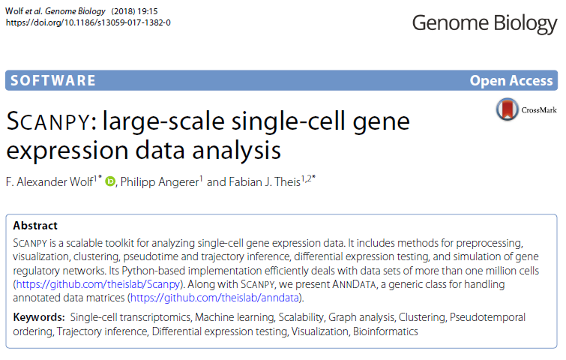
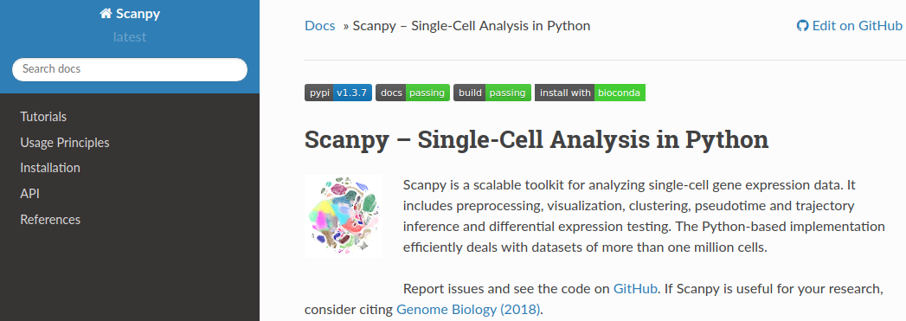
Scanpy library for processing scRNAseq
Popular R library “Seurat” performs similar operations.

Slide 39
Installing scanpy
Until now, we’ve mostly installed packages for you!
This week and next, you’ll install required packages yourself
“pip” package manager allows you to easily install python packages and their dependencies. E.g.:
pip install <mypackage>
We don’t have sudo (root) access. To install to your home directory:
pip install --user <mypackage>
You can install multiple packages at once:
pip install --user scanpy louvain

Slide 40
Scanpy data objects
import scanpy as sc
adata = sc.read_10x_mtx(‘filtered_feature_bc_matrix/’,var_names='gene_symbols’)
AnnData object
adata.var
Pandas data frame with annotations for each gene
adata.obs
adata.X
Pandas data frame with info about each cell
numpy array storing count matrix
Rows=cells
Columns=genes

Slide 41
Filtering AnnData by rows/columns
Filtering syntax:
adata_filt = adata[ <which rows to take>, <which cols to take>]
Example:
Take all genes (“:” means all)
adata_filt = adata[(adata.obs["n_counts"]<50000) & (adata.obs["percent_mito"]<0.2), :]
Only take rows (cells) with at least 50000 total reads and <2% mitochondrial genes
(adata.obs)

Slide 42
Scanpy workflow
Load data into AnnData object
adata = sc.read_10x_mtx(‘filtered_feature_bc_matrix)
Filter problematic genes/cells (“pp”=preprocessing module)
sc.pp.filter_cells(adata, min_genes=100)
Generate some QC plots (“pl”=plotting module)
sc.pl.violin(adata, keys=["n_genes","percent_mito","n_counts"], multi_panel=True)
Normalize data
sc.pp.log1p(adata_filt)
Perform some analysis (“tl”=analysis tools module)
sc.tl.tsne(adata_var, n_pcs=7)
See https://scanpy.readthedocs.io/en/stable/index.html for more info!

Slide 43
Quiz 3 Topics – what to expect
P-values/FDR: Given a list of p-values from a bunch of tests you have performed, how can you account for multiple hypothesis correction using the Bonferronni method? How could you chose a p-value threshold to give you a particular FDR?
Enrichment testing: Know how to perform a Fisher’s Exact Test (you can use Python for help)
Command line: As usual there will be one question requiring you to pipe together some UNIX commands to wrangle data into a desired format
Motif finding: Interpretation of PWMs. How does the choice of background nucleotide frequencies matter?
Gene regulation: expect conceptual question about gene regulation. Know the difference between TFs, histone modifications, nucleosomes, enhancers, promoters. Know basic concepts of ChIP-seq and TFs. Vs. HMs.

