Slide 1
CSE185 – Week 6 Part 1 ChIP-sequencing May 4, 2021
Announcements:
Lab 5 released
Final project instructions will be introduced Thursday
If you have questions on quiz 2, please email me and CC TA’s
https://www.encodeproject.org/

Slide 2
Today’s schedule
More on gene regulation + epigenomics
ChIP-sequencing
Lab 5 overview + lab tips

Slide 3
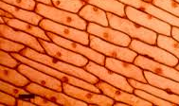
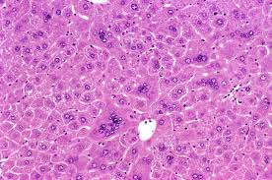
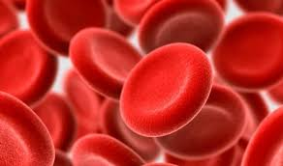
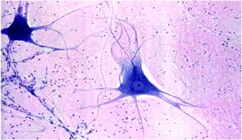
Major difference between cell types is what genes are expressed
DNA
RNA
Protein
DNA ~identical!
RNA is a useful intermediate!
~Informative of protein level/sequence
Made from nucleic acids = we can sequence that!
Real difference in the proteins, but hard to measure
Skin cells
Hepatocytes
What drives these tissue specific differences?
Transcription factors
Chromatin structure
Probably many other factors
Red blood cells
Neurons
Notes:
question this week is what drives those differences
focus on two major factors, TFs and chromatin structure
in reality gene regulation is highly complex process controlled by many factors

Slide 4
Non-coding (“regulatory”) regions control gene expression
Transcription Factors and other proteins bind to the promoter/enhancer DNA and regulate expression of the gene
TF
TF
TF
Exon 1
Exon 2
Exon 3
Exon 4
Promoter: ~ +/- 1kb from Transcription Start Site (TSS)
TFs often recognize specific sequence motifs
In many cases gene regulation is cell-type specific
Notes:
we've mentioned before only ~1-2% of genome is protein coding
key realization from studying whole genomes is that a lot of the information encoding how these genes get regulated, or how cell decides if they get expressed, comes from signals in the non-coding region of the genome
complex process. but key part of the puzzle are proteins clled TFs. recognize short sequences called motifs, often in the promoter of a gene or elsewhere nearby.
when those bind, they turn on that gene

Slide 5
Regulatory elements confer tissue specificity of expression
Liver
TF
Heart
TF
TF
Tissue-specific TF’s and other factors cause genes to be expressed in some tissues but not in others
Skin
Enhancer
Promoter
Notes:
these TFs themselves cn be highly tissue specific
enhancers
combinatorial way to precisely control expr in each cell type

Slide 6
Transcription factors recognize sequence specific motifs
https://weblogo.berkeley.edu/Crooks-2004-GR-WebLogo.pdf
Notes:
If we were to zoom in at the molecule level to give you an idea of what's happening when these TFs bind DNA
, something like this: protein bound to DNA. Key contact points must have a specific base to be recognized

Slide 7
Example motifs for human transcription factors
STAT1
NFY
CTCF
SP1
HNF4A
ZEB1
V1.factorbook.org
More on motif analysis on Wednesday + in exercises
Notes:
each TF is recognizing a specific motif. different one for different TFs
more about this on Weds and in the lab exercises

Slide 8
Mutations in TFs can cause disease
Examples:
Healthy individual
FOXP2 – Brain TF
Mutations lead to defects in language/speech disorders
(key component in human evolution for language development!)
TF
TF
Affected individual – TF mutation reduces its ability to bind to target motifs
HNF4A – Liver TF
Mutations lead to diabetes
TF
TF
Can result in expression changes at hundreds or thousands of genes
Notes:
Because these TFs so key to controlling gene expression, if we mess them up (e.g. by mutations) then some catastrophic things can start to happen

Slide 9
Mutations in TF binding sites can cause disease
FTO locus implicated by GWAS in obesity
>90% of GWAS hits in “non-coding” regions
Many likely altering regulatory regions! (e.g. TF binding sites)
T->C mutation disrupts conserved binding site for ARID5B (a repressor)
Alters expression of nearby genes IRX3 and IRX5 which affect adipocyte function
https://www.nejm.org/doi/full/10.1056/NEJMoa1502214
Notes:
can also cause more localized or sublte changes by altering one of the motifs it binds to in the genome

Slide 10
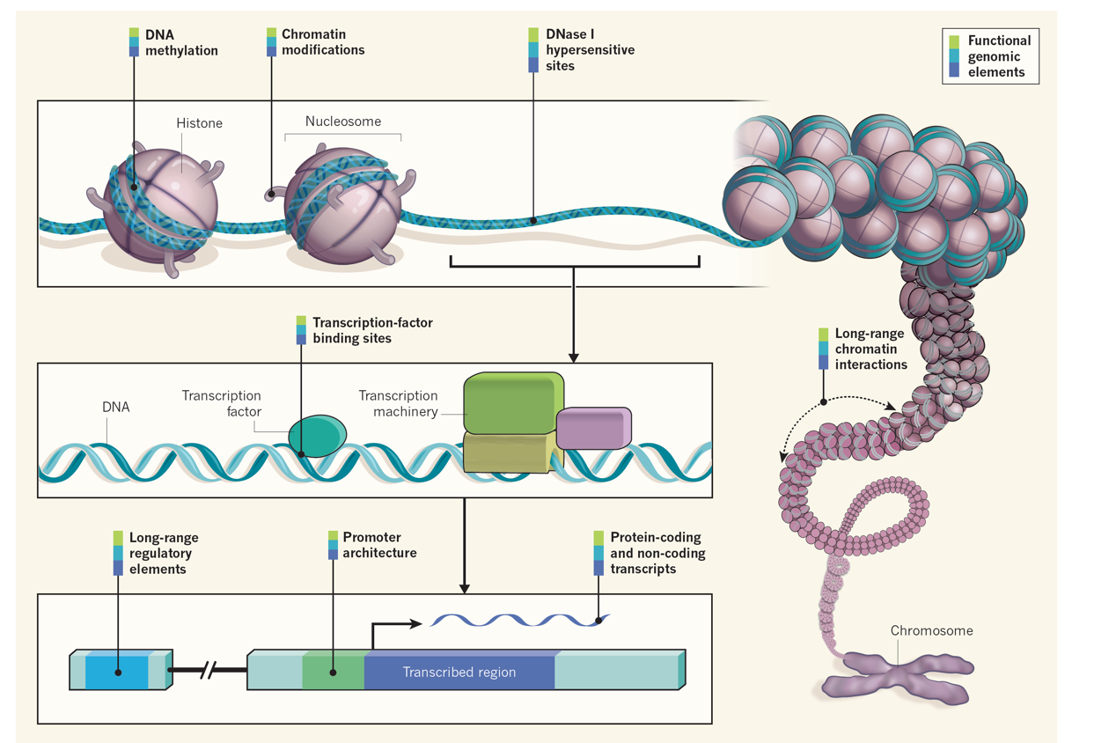
Epigenomics: chromatin structure and organization
“chromatin”: DNA and associated proteins
“epigenomics”: refers to the study of this structure and modifications to it using genomic methods
Promoters: directly upstream of a gene. Typically TSS +/- 3kb (flexible)
Enhancers: may be dozens of kb away. Long-range interaction with TSS to regulate gene expression
Ecker et al., Nature 2012
Notes:
we've already mentioned that gene regultion is complex. we focused on TFs and drew the genome as a linear structure. in reality genome is folded into this complex hierarchy of structures
The combination of this complex structure plus all the different transcription factors that can bind DNA work closely together to finely control how much of each gene is expressed.
Genes that are expressed tend to be in these more open regions, where TFs can have access to them
Structure of nearby nucleosomes also tells us something about which regions are active.
Focus here on two things: TFs, HMs, where they are falling

Slide 11
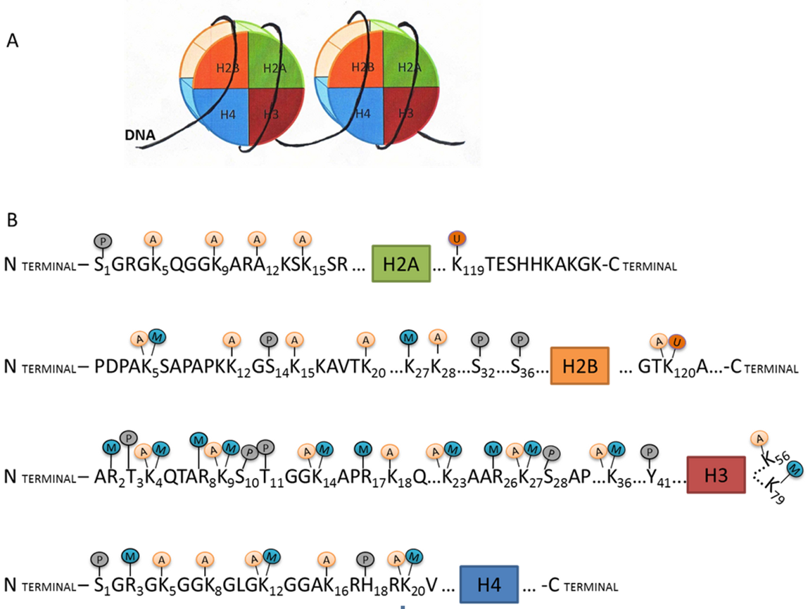
Distinct histone modifications found at regulatory regions
A: acetylation
M: methylation
P: phosphorylation
U: ubiquination
“Histone modification code”
Modification | Location
H3K4me3 | Promoters
H3K27ac | Promoters & Enhancers
H3K4me1 | Enhancers
H3K36me3 | Gene bodies
Wei Wang

Slide 12
Regulatory regions marked by TF binding and distinct histone modifications
RNA-seq
H3K27ac
mRNA
GENE
ChIP-seq
H3K4me2
All of these are things we can measure using sequencing!

Slide 13
ChIP-sequencing
H3K27ac
mRNA
GENE
H3K4me1
Goal: Which places in the genome are associated with a specific protein or modification?
Those are likely to be regulatory regions!

Slide 14
ChIP-sequencing

Slide 15
“Chromatin immunoprecipitation sequencing” - overview
TF
TF
Step 1: Cross link (stick together) the DNA to nearby proteins
TF
TF
Step 2: Shear (chop) the DNA to small fragments
Step 3: Pull down (immunoprecipitate) only the bound DNA fragments using an antibody
TF
TF
Step 4: Purify remaining DNA and sequence as usual!
Similar process for histone modifications

Slide 16
ChIP-sequencing – w/ input control (WCE)
TF
TF
Cross-linking
TF
TF
Shearing
Immunoprecipitation (IP)
Control (no IP)
Referred to as “input”, “whole cell extract”, or “control”
TF
TF
TF
Sequencing

Slide 17
ChIP-seq – “peaks” identify potential regulatory elements
TF2
TF1
TF1
TF2
H3K27ac
(Promoters/enhancers)
Input
(control)

Slide 18
ChIP-seq pipeline
Step 1: Perform ChIP-seq for TF or HM
Target TF/HM
FASTQ
(single or paired end)
Input control
FASTQ
Step 2: Align reads to reference genome
Same as for whole genome sequencing!
BAM
Example tools: bwa, bowtie, maq
BAM
Step 3: Identify binding sites (“peaks”)
BED
Example tools: Homer, macs
Downstream analyses
Visualize binding patterns
Motif analysis
Differential binding
Many more…

Slide 19
Zooming in on ChIP-seq peaks – ChIPseq for TFs
Fragment (paired end)
Reference genome
Read 1
Read 2
Aligned reads
Forward reads
Reverse reads
Coverage histogram
(by strand)
Coverage histogram
(combined)

Slide 20
Real data– an example peak
Sox2
(TF)
# Reads
WCE
Genomic coordinate
Peak

Slide 21
Peak calling intuition: identifying enriched regions
Reference genome
Aligned reads
(TF)
Aligned reads
(control)
Window 1
Window 2
Window 3
FoldChange: 3/2
FoldChange: 5/2
FoldChange: 3/3
Potential peak

Slide 22
Peak calling hypothesis testing
Is window n a “peak”? (i.e., is the TF bound to the DNA at window n?)
Null hypothesis:
The TF is not bound
Test-statistic:
Number of reads in the window OR
FoldChange: Number of reads in ChIP data/Number of reads in WCE
P-value:
If there was no binding, what is the probability to see that many reads, or that fold change, by chance?

Slide 23
Example peak calling method (MACS)
Reference genome
Aligned reads
(TF)
Aligned reads
(control)
Compute $λ_{\left\{BG\right\}}$ (mean background coverage per window) on WCE
Test sliding windows of 2*mean fragment length across the genome
For each window: compute p-value by comparing read count to null distribution: Poisson${(λ}_{\left\{BG\right\}})$
Some tools (e.g. CisGenome, GLMNB) use negative binomial rather than Poisson.
Similar to RNA-seq, ChIP-seq read counts may show overdispersion (more variance than expected by Poisson)

Slide 24
Peak calling – the data
BED format (chrom, start, end, + 9 other optional fields)
chr1 700 750 scores…
chr3 7000 7050 scores…
chr4 100 170 scores…
chr22 10000 10100 scores…
Homer peak format (similar to BED)
Header lines start with “#”
Important columns (one line per peak):
1=peakID, 2=chrom, 3=start, 4=end
8=score, 12=p-value

Slide 25
Visualizing sequencing datasets - IGV

Slide 26
Real data is messy
Sox2
(TF)
WCE
Peak
Peak
Not all peaks created equal!
Why might one peak be higher than another?
Hard to tell! Potential explanations:
Second peak only bound in a fraction of cells
Lower binding affinity at one site vs. another

Slide 27
Real data is messy
Sox2
(TF)
WCE
WCE signal looks pretty correlated with Sox2!
Why might our “background” look similar to the actual ChIP-seq data?
Coverage correlated with:
GC content
“Openness” of the chromatin
Alignment/mappability biases

Slide 28
Real data – HMs vs. TFs
Sox2
(TF)
peaks
H3K27ac
(HM)
peaks
Histone modifications have “broad” peaks sometimes spanning many kb
TFs have more “focal” peaks
How can you explain the “dips” in the HM peak?

Slide 29
Visualizing ChIP-seq binding patterns
“Composite plots” summarize binding patterns across multiple regions
Transcription start site (TSS)
GENE 1
GENE 2
GENE 3
Compute average read count per position relative to TSS

Slide 30
Intro to motif analysis
Sox2
(TF)
WCE
What sequence is Sox2 binding to?
GCCATTGTTC
TTCATTGTTT
GCTATTGTCC
TTCTTTGTCA
GCCTTTGTTG
“motif”
Extract sequences in peaks:
Exercises 1 and 2 explore motif finding and enrichment analysis. More info Wednesday!

Slide 31
Lab 5 overview

Slide 32
How do different cell types arise?
Stem cells differentiate into adult cell types
Lineage specific transcription factors control cell identity
Example: blood cell types
gorenlab.github.io
Barreto et al 2014
“Pluripotent”: cells can differentiate into many possible cell types
“Terminally differentiated” cells are fully committed and can’t differentiate further!

Slide 33
Differentiation can actually be reversed!
Adult cells
“Induced pluripotent stem cells” (iPSCs)
Treat with a cocktail of transcription factors
Klf4 Oct4
Sox2
C-Myc
“Yamanaka factors”
Discovered in 2006 (Nobel prize)
Highly expressed in embryonic stem cells
(also: similar pathways reactivated in cancer cells)
Huge implications for bioengineering

Slide 34
Lab 5 Overview
Lab:
Alignment (bwa)
Peak calling (Homer)
Visualizing ChIP data (Homer+IGV)
Differential binding (Homer+plotting)
Motif analysis (Homer+meme+bedtools)
Exercises 1: Intro to motif analysis
Scoring motifs with position weight matrices (PWMs)
Scanning sequences for motif matches
Exercises 2: Motif enrichment
Implementing motif enrichment analysis on sequences extracted from real peaks
Mouse embryonic stem cells
ChIP-seq for:
Klf4
Oct4 Sox2
H3K27ac (promoters/enhancers)
H3K4me2 (mostly enhancers)

Slide 35
Lab report format – similar to a research article
Introduction: Background, motivation, summarize what you did
Methods: Give enough info on what you did so others can reproduce it e.g.:
Which tools did you use and why? Which version?
Did you use any non-default parameters?
Which reference genome did you use? How did you determine which signals are “significant”?
Results: Summarize the main results of your analysis.
Usually includes a text description, plus figures and tables summarizing the results
Should be objective without over-interpreting the data
Discussion: Interpretation of the results- what do they mean and why are they important?
Limitations of the current study
Future directions
For your project, you’ll need to reproduce results in a published paper! So it’s good to get familiar with how to navigate research articles

Slide 36
Example Intro – Chronis et al. (Lab data)
Motivation
What’s been done so far. How they will build on this
What they did

Slide 37
Example Methods – Chronis et al. (Lab data)

Slide 38
Example Results – Chronis et al. (Lab data)
Motivate why doing this analysis
What you did you do?
Main findings. Reference figures/tables with results

Slide 39
Example Discussion – Chronis et al. (Lab data)
Summarize the study
Interpret what the results mean
Future directions

Slide 40
Lab 5 tips - Python pandas library is your friend

Slide 41
Visualizing datasets with IGV

