Slide 1
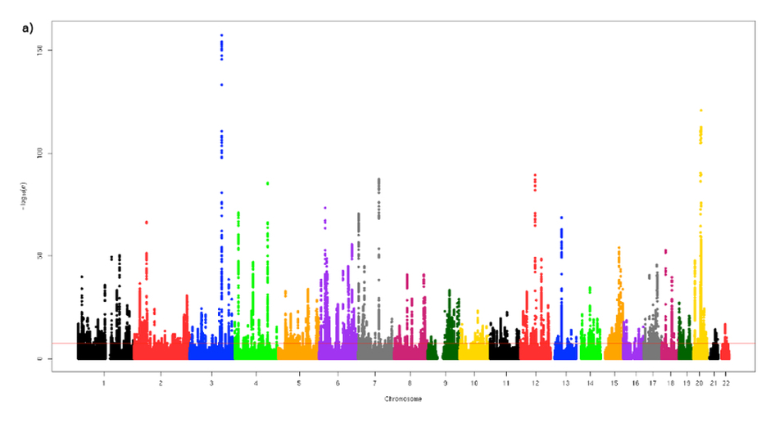
CSE185 – Week 4 Part 2 Genome-wide association studies April 22, 2021
Notes:
reminder recording
2nd topic in pop-gen: GWAS

Slide 2
Today’s schedule
Intro to complex traits
Genome-wide association studies
P-values + QQ Plots
Confounding factors
Plink overview

Slide 3
Mendelian vs. complex traits
Mendelian ➔ one gene, one trait
0 1
0 1
Examples:
cystic fibrosis (CFTR)
eye color (kind of)
Blood type
Haemophilia
Sickle-cell disease
1 1
(The kind of thing we were looking at in lab 1.
Remember Punnett squares from genetics class)

Slide 4
Mendelian vs. complex traits
Mendelian ➔ one gene, one trait
0 1
0 1
1 1
Complex ➔ multiple genes control a trait (“Polygenic”)
Examples:
height, cholesterol (quantitative);
schizophrenia, diabetes, Crohn’s disease (case/control)
https://www.csun.edu/~hcmth031/ihhb.pdf

Slide 5
Complex trait example: height
https://www.csun.edu/~hcmth031/ihhb.pdf
Height is controlled by a combination of genes + environment (e.g. diet)
80% of variation in height is controlled by genetics (from twin studies)
More than 1,000 genes have been shown to control height!
The Punnett square approach isn’t going to work well for analyzing height…

Slide 6
Genome-wide association studies (GWAS)

Slide 7
What is a genome-wide association study? (GWAS)
Case/control: (e.g. disease vs. no-disease)
+see bonus slides on case control
Controls
(e.g. no diabetes)
Cases
(e.g. diabetes)
Today
Quantitative trait: (e.g. height)
What regions of the genome are important for controlling complex (polygenic) traits?

Slide 8
What is a genome-wide association study? (GWAS)
1. Collect (huge) cohorts of DNA samples (modern GWASs have tens of thousands or more)
2. Genotype each sample (person) using a genotyping array. Example SNP:
TT
TG
GG
GG
GG
TG
TT
TT
TG
GG
TG
TT
3. Test each position in the genome for association with the trait
4. Evaluate and interpret results

Slide 9
Testing a single SNP for association with a trait – linear model
Phenotype ($Y_{i}$) value of sample i (e.g. Height)
Usually normalized to have mean=0, variance=1
Genotype ($X_{i}$) genotype of sample i at the SNP
Possible values: 0 (AA), 1(AG), or 2 (GG).
$$Y_{i}=βX_{i}+ε_{i}$$
Error term ($ε_{i}$)
How much variation in phenotype due to other factors
Effect size ($β$)
(how much does each additional copy of “G” at this SNP increase the sample’s height? (additive model)
A/G SNP
TTAAATGTC
TTAAGTGTC

Slide 10
Testing a single SNP for association with a trait
$$Y_{i}=βX_{i}+ε_{i}$$
Inputs: Phenotype values (Y)
Genotype values (X)
Outputs:
Estimated effect size ($β)$
P-value: how confident are we that $β≠0$?
3
Phenotype (e.g. Height)
0
-3
0 (AA)
1 (AG)
2 (GG)
Genotype
Key question: is $\left|β\right|>0?$

Slide 11
Testing millions of SNPs for association with a trait
Genome-wide significance threshold (p<5*10⁻⁸)
-log₁₀ P
Genome
SNP (p₁)
p₂
p₃
p₄
p₅
p₆
p₇
p₈
Most SNPs not relevant to the trait
Example significant association
3
3
Y
Y
0
0
-3
0
1
2
-3
X
0
1
2
X

Slide 12
“Manhattan plots” – real data (height)
Get “clumps” of significant SNPs with similar p-values
Nearby SNPs tend to be correlated
Each “skyscraper” represents an independent association (usually)
-log10 P-value
Position along the genome
(colored by chromosome)
Wood et al. Nature Genetics 2014
Notes:
point out tons of skyscrapers
means tons of independent places in the genome collectively contributing to height

Slide 13
Huge resources allow performing GWAS on many diverse traits!
1,000,000 people
(UCSD has a collection site)
Captures diversity in US population
Genotypes, environment, health information
Million Veterans Program
825,000 participants
Genetics and Health
UK Biobank
500,000 samples
Genotypes, NGS, health information
>10 million samples in commercial DTC databases
Notes:
huge resources have been already collected for doing these sorts of studies
For example, our lab is working with UK Biobank, which has hundreds of phenotypes, like height, cancer risk, scz, diabetes where we and others can go and mine which regions of the genome are most important for those traits
some of my favorite examples are from 23andme

Slide 14
The power of large genomics databases
(based on 23andme data)
Why are some people more susceptible to COVID-19 than others?

Slide 15
More on p-values

Slide 16
What is a p-value? And how do we calculate it?
P-value: what’s the probability of seeing a result as extreme as I did given that my data is actually just random?
(Think: How surprised am I to see this result?)

Slide 17
What is a p-value? And how do we calculate it?
Example: we flip a coin 10 times and see 9 heads. Assuming our coin is fair, how surprised are we about this result?
$$P\left(k heads\right)= \left({10 \atop k}\right){0.5}^{k}{\left(1−0.5\right)}^{10−k}={\left({10 \atop k}\right)0.5}^{10}$$
$P\left(≥9 heads\right)= \left({10 \atop 9}\right){0.5}^{10}+\left({10 \atop 10}\right){0.5}^{10}=$0.010
P-value: 0.01
Notes:
https://www.dummies.com/education/math/business-statistics/how-to-graph-the-binomial-distribution/

Slide 18
What is a p-value? And how do we calculate it? - definitions
Null hypothesis (H₀): my data is random. Whatever I’m testing for is not true
Coin is fair (50/50 chance to get H or T)
Test statistic: the value we are interested in testing
# heads seen (k)
Null distribution: the distribution of the test statistic under the null hypothesis
P(k heads) = (n choose k)0.5^{n}
P-value: what percentage of values in the null distribution are at least as extreme as the test statistic I observed?
P(>=k heads | fair coin)

Slide 19
Example: linear regression (GWAS!)
$$Y_{i}=βX_{i}+ε_{i}$$
3
H₀: β=0
Null hypothesis (H₀):
(my data is random)
Phenotype (e.g. Height)
0
Test statistic:
|β|
0 (AA)
1 (AG)
2 (GG)
Genotype
Null distribution: what will I measure the slope (|β|) to be when there really is no association between the SNP and a trait?
How to compute this?
Method 1: math (t-test, Plink will do this for you in the Lab)
Method 2: simulate random data (“empirical null”) (almost no actual math required)
Notes:
walk through inuition of second method here
will come again, and I think it's a really helpful way to think about where p-values come from

Slide 20
Simulating a null distribution
Simulate data under the “null” (β=0):
Phenotype ~ β *Genotype + Noise
X
Simulation 1
Simulation 2
Simulation n
3
3
3
…
Phenotype
Phenotype
Phenotype
0
0
0
-3
-3
-3
0 (AA)
1 (AG)
2 (GG)
0 (AA)
1 (AG)
2 (GG)
0 (AA)
1 (AG)
2 (GG)
Genotype
Genotype
Genotype
…
|β| = 0.1
|β| = 0.05
|β| = 0.02
This is the null distribution!

Slide 21
Example: linear regression (GWAS!) – the null distribution
null_dist =
…
|β| = 0.1
|β| = 0.05
|β| = 0.02
ax.hist(null_dist)
Actual data:
3
99% of null distribution less than observed slope
P-value is 0.01!
β = 0.1
Phenotype (e.g. Height)
0
-3
0 (AA)
1 (AG)
2 (GG)
Genotype
In reality, we’ll use the t-statistic way, although results should be the same! (Exercises)
We’ll see p-values many more times! E.g. correlation, differential expression (lab 4), motif enrichment (lab 5)

Slide 22
P-value distributions: under the null
Test 1000 SNPs. None of them are actually associated with the trait (they are all null)
How many do you expect to have p-values < 0.5 ?
0.5*1000 = 500
How many do you expect to have p-values < 0.05 ?
0.05*1000 = 50
How many do you expect to have p-values < 0.01?
0.01*1000 = 10
If the data is null, p-values should follow a *uniform distribution*
(by definition)
Notes:
in gwas, we're not testing a single SNP
we're testing often millions
the *distribution* of p-values across all of those SNPs can be informative about whether our gwas worked
first let's think about what the p-values will look like if we're analyzing a trait for which there really is no genetic component, i.e. everything is null

Slide 23
P-value distributions: when there’s a signal
GWAS # 1
GWAS # 2
P-values follow a uniform distribution.
Data consistent with random noise
e.g. not a strong genetic signal for the trait
Excess of small p-values.
Suggests we have identified significant trait-associated SNPs in our GWAS

Slide 24
QQ plots: Another way to visualize p-value distributions
P-values from our association tests
Generate Random p-values (from null/uniform)
Sort each list and compare
SNP | P-value
rs1 | 0.75
rs2 | 0.40
rs3 | 0.86
rs4 | 0.13
rs5 | 0.041
rs6 | 0.94
rs7 | 0.17
rs8 | 0.21
rs9 | 0.58
rs10 | 0.12
P-value
0.087
0.59
0.77
0.11
0.37
0.84
0.67
0.51
0.09
0.17
Sorted p-vals (observed) | Sorted p-vals (null)
0.041 | 0.087
0.12 | 0.09
0.13 | 0.11
0.17 | 0.17
0.21 | 0.37
0.4 | 0.51
0.58 | 0.59
0.75 | 0.67
0.86 | 0.77
0.94 | 0.84
Does this distribution of p-values match what we’d expect under the null hypothesis? (uniform distribution?)
Notes:
previous slide stared at histograms
instead could more directly compare

Slide 25
Quantile-Quantile (QQ) plots: comparing two distributions
Sorted p-vals (observed) | Sorted p-vals (null)
0.041 | 0.087
0.12 | 0.09
0.13 | 0.11
0.17 | 0.17
0.21 | 0.37
0.4 | 0.51
0.58 | 0.59
0.75 | 0.67
0.86 | 0.77
0.94 | 0.84
Diagonal (x=y)
Max value from each distribution similar
Observed p-val
Median value from each distribution similar
Expected p-val (null)
Min value from each distribution similar
If all the points fall along the diagonal, it means the two distributions are similar
(i.e., all their quantiles are approximately the same)
Compare using a scatter plot

Slide 26
We’re mostly interested in really small p-values
We don’t care about e.g. p=0.3 vs. p=0.7
We do care if p=0.1 vs. p=0.01 vs. p=10⁻⁶
Taking –log10 P allows us to better compare small p-values
(note, we really should be using quantiles rather than simulating random numbers. But this is easier and looks almost the same if the number of data points is large enough.)

Slide 27
Typical GWAS QQ Plot (when all goes well)
Points above the diagonal = likely true associations
Way stronger p-values than expected by chance
For GWAS, we perform millions of association tests
The QQ plot has one point for each SNP
Most of the distribution is similar to the null
i.e. most SNPs not associated with the trait
Notes:
For GWAS we perform millions of individual tests
Assume most SNPs are not associated with the trait, so most of our p-value distribution should be similar to the null distribution

Slide 28
Multiple hypothesis correction – GWAS considerations
Test 1.5 million SNPs. By chance, how many will have p<0.05?
0.05*1.5M = 75,000 hits! Even if data is null
“Bonferroni correction”: adjust p-value threshold by number of tests
E.g. if you perform 5 tests, for a significance level of p=0.05 require p<0.05/5 =0.01
We perform 1 test for each SNP. But many SNPs are correlated with each other
The suggested threshold for “genome-wide significance” is <5*10⁻⁸

Slide 29
Confounding factors

Slide 30
Confounding factors can confuse our association tests
e.g. ancestry
Confounder
Genotype
Trait
e.g. AA, AG, GG
e.g. Eye color
A confounding factor is something that is related to both the genotype and trait
Many possible confounders in GWAS!
Age, sex, diet, lifestyle, environment, ancestry

Slide 31
Example: Eye-color GWAS
A C G T T G C A T A C C T T T
A A G T A G C A C A C C G T T
Common ancestor
A C C T T G C A T A C C G T T
Population 1
(e.g. Northern Europe)
A A C T A G C A C A C C T T T
A C C T T G C A T A C C G T T
A A C T A G C A C A C C G T T
A C C T T G C A T A C C T T T
A A C T A G C A C A C C G T T
T C G T T G C G T A C C G T T
N. Europe
S. Europe
T A G T A G C G C A C C G T T
T C G T T G C G T A C C T T T
Population 2
(e.g. Southern Europe)
T A G T A G C G C A C C G T T
More recent SNPs will be specific to a certain population
T C G T T G C G T A C C T T T
T A G T A G C G C A C C T T T
T C G T T G C G T A C C G T T
T A G T A G C G C A C C G T T

Slide 32
Example: Eye-color GWAS
A C G T T G C A T A C C T T T
brown
A A G T A G C A C A C C G T T
A C C T T G C A T A C C G T T
blue
Population 1
(e.g. Northern Europe)
A A C T A G C A C A C C T T T
A C C T T G C A T A C C G T T
Many false positives due to different allele frequencies in Northern vs. Southern Europe!
blue
A A C T A G C A C A C C G T T
A C C T T G C A T A C C T T T
blue
A A C T A G C A C A C C G T T
T C G T T G C G T A C C G T T
brown
T A G T A G C G C A C C G T T
T C G T T G C G T A C C T T T
brown
Population 2
(e.g. Southern Europe)
T A G T A G C G C A C C G T T
T C G T T G C G T A C C T T T
brown
T A G T A G C G C A C C T T T
T C G T T G C G T A C C G T T
brown
T A G T A G C G C A C C G T T
SNP that actually controls eye color
Much higher prevalence in Northern Europe

Slide 33
Example: Eye-color GWAS without correcting for ancestry
Possible explanations:
Almost all of the genome is associated with eye color (probably not true…)
We are not controlling for some important confounding factor and have a bunch of false positives (much more likely)
P-values “inflated”
(way above the QQ plot diagonal)

Slide 34
Controlling for confounding factors with covariates
Height (Y)
10
10
11
12
12
13
14
15
16
16
Genotype (X)
AG
GG
AG
GG
GG
AG
AA
AG
AG
AA
Population (P)
EUR
AFR
EUR
EUR
EUR
AFR
AFR
EUR
EUR
AFR
0
1
0
0
0
1
1
0
0
1
Y = βX +Υ₁P
Relies on self-reported ancestry and discrete population groups
Only captures high level population structure. Doesn’t accurately capture admixture, cryptic relatedness

Slide 35
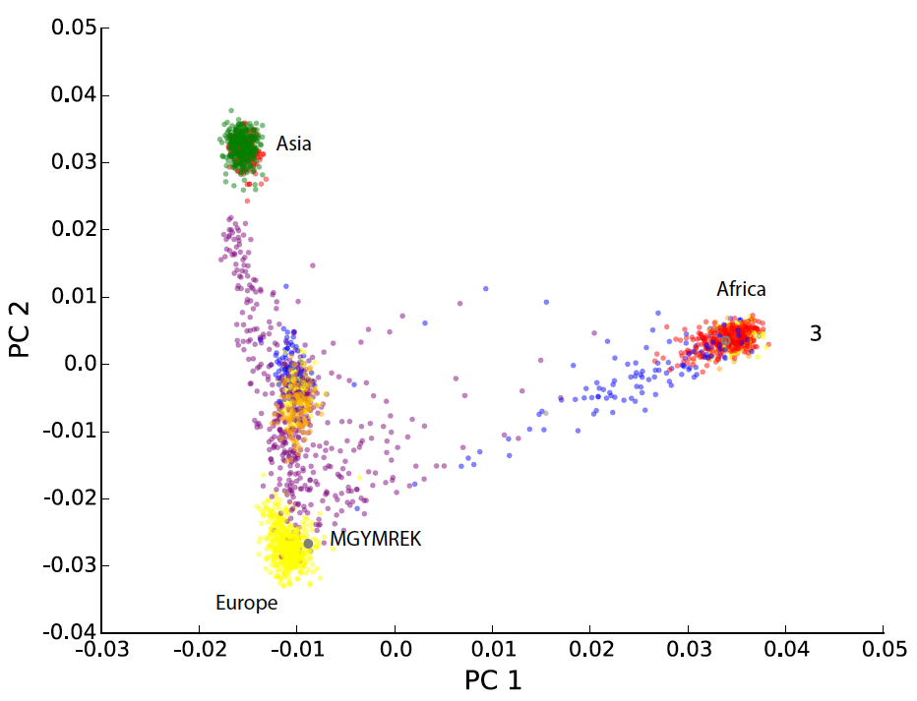
Controlling for population structure in GWAS
Height (Y)
10
10
11
12
12
13
14
15
16
16
Genotype (X)
AG
GG
AG
GG
GG
AG
AA
AG
AG
AA
Top n Principle components
v_{i}
v_{n}
Q

Slide 36
Controlling for population structure in GWAS
Height (Y)
10
10
11
12
12
13
14
15
16
16
Genotype (X)
AG
GG
AG
GG
GG
AG
AA
AG
AG
AA
PC₁
0.1
0.3
-0.4
0.1
0.2
0.3
0.4
-0.2
0.5
-0.5
PC₂
-0.1
0.2
-0.1
0.1
0.5
-0.3
0.2
-0.1
0.6
-0.4
…
PC_{n}
-0.1
0.1
-0.5
0.1
0.6
0.2
-0.2
-0.3
0.7
0.2
Y = βX +Υ₁PC₁+Υ₂PC₂ + … Υ_{n}PC_{n}
How many PCs? Depends. Typically ~5-10.

Slide 37
QQ plot – before and after ancestry correction
Height ~ GT
Height ~ GT + PC1+PC2+PC3+PC4+PC5
P-values way stronger than expected
Probably not reliable
Most p-values look null
Evidence of real signal for top SNPs

Slide 38
Plink

Slide 39
Plink has *tons* of utilities for dealing with genetics datasets
https://www.cog-genomics.org/plink/
We’ll only use a few of these…

Slide 40
Recall VCF files
Plink uses its own formats to encode genotype info…
Notes:
All of the data will be in VCF format
We’ve seen before. Put also a tutorial from the other class I teach up on canvas

Slide 41
Plink file formats
Plink dataset in plain text includes:
“.ped” file with sample, pedigree, and genotype info
“.map” file with information on each SNP
Use “--file <prefix>” option for plink to point to <prefix>.ped and <prefix>.map
Plink dataset in binary format includes the same info, but compressed:
“.bed” file with similar info as ”.ped” files
“.bim” file with similar info as “.map” files ption
Use “--bfile <prefix>” option to point to <prefix>.bed and <prefix>.bim
*Note: there are two totally different file formats, both referred to as “bed” ☹
https://www.cog-genomics.org/plink/1.9/formats#bed
https://genome.ucsc.edu/FAQ/FAQformat.html#format1

Slide 42
The anatomy of a plink command
Looks for prefix.ped/prefix.map
Alternatively:
--bfile prefix looks for prefix.bed/prefix.bim
--vcf myfile.vcf.gz to give VCF file (but not recommended)
plink \
--file prefix \
--out outprefix \
[command] \
[other options]
Name output files “outprefix”.log, etc.
e.g. --pca, --linear, --make-bed
e.g. --keep
# e.g.
# outputs outprefix.eigenvec with PCs
plink --file myprefix --out outprefix --pca

Slide 43
GWAS – caveats

Slide 44
You’ve got a GWAS hit, now what?
Association != causality! Rarely is the top SNP association a causal variant
Often multiple variants in perfect correlation, impossible to determine the causal variant
Most variants identified by GWAS are non-coding or regulatory, difficult to interpret!
Incorporate additional data (e.g. expression, ChIP-seq, more samples, etc.) to better determine which variant might be causal
More on gene regulation weeks 4-6!
Zooming in on one spike:
The SIGMA Type 2 Diabetes Consortium

Slide 45
How did we choose the SNPs on the genotyping arrays?
1998
96% of GWAS participants are European
SNP arrays heavily biased toward SNPs most relevant to European populations

Slide 46
Ancestry matters
Variant low frequency in European populations
Even though it has a large effect on diabetes risk, only found by performing GWAS in other groups
(happens to be a variant introduced by introgression with Neanderthals! But that’s a story for another day…)

