Slide 1
Case/control studies

Slide 2
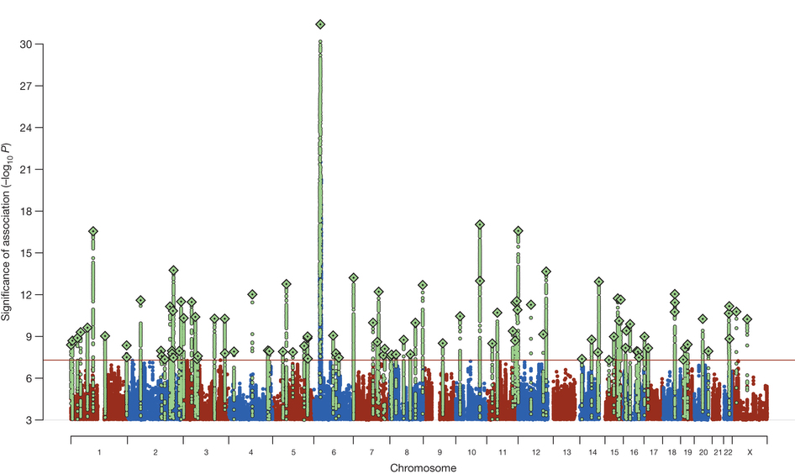
Example: schizophrenia
Heritability: 80%
108 genome-wide significant loci
Explain ~2-3% of heritability
Schizophrenia Working Group of the Psychiatric Genomics Consortium

Slide 3
Testing a single SNP – χ² test
TT
TG
TT
GG
TG
TG
TG
GG
GG
GG
TT
TT
Controls
(e.g. no diabetes)
Cases
(e.g. diabetes)
 | TT | TG | GG
CONTROLS | 3 | 2 | 1
CASES | 1 | 2 | 3
Notes:
Example table
Pvalue
Odds ratio + interpretation

Slide 4
Testing a single SNP – χ² test
Genotype counts
 | TT | TG | GG | Total
CONTROLS | r₀ | r₁ | r₂ | R
CASES | s₀ | s₁ | s₂ | S
TOTAL | n₀ | n₁ | n₂ | N
Observed allele counts
Expected allele counts
 | T | G | Total
CONTROLS | 2r₀+r₁ | r₁+2r₂ | 2R
CASES | 2s₀+s₁ | s₁+2s₂ | 2S
TOTAL | 2n₀+n₁ | n₁+2n₂ | 2N
 | T | G | Total
CONTROLS | (2n₀+n₁)(R/N) | (n₁+2n₂)(R/N) | 2R
CASES | (2n₀+n₁)(S/N) | (n₁+2n₂)(S/N) | 2S
TOTAL | 2n₀+n₁ | n₁+2n₂ | 2N
Chi-square test:
Σ_{i}(obs_{i}-exp_{i})₂/exp_{i} ~ χ² with 1 degree of freedom ➔ p-value
e.g. plink --assoc
Notes:
Example table
Pvalue
Odds ratio + interpretation

Slide 5
Odds ratio
 | T | G
CONTROLS | A=2r₀+r₁ | C=r₁+2r₂
CASES | B=2s₀+s₁ | D=s₁+2s₂
Observed allele counts
Odds: P(event occurs)/P(event doesn’t occur) =
P(event occurs)/(1-P(event occurs))
Odds that T occurs in a case: B/A
Odds that G occurs in a case: D/C
OR=1 no association
OR>1 T increases risk
OR<1 T decreases risk
Odds ratio:
(B/A)/(D/C) = BC/AD

Slide 6
Testing a single SNP – Logistic regression
Y_{i} (phenotype for sample i) (Y_{i}=1 for case, Y_{i}=0 for control)
X_{i} (genotype for sample i) (0, 1 or 2 for TT, TG, GG)
P_{i}=E[Y_{i}|X_{i}] (expected phenotype given genotype of sample i)
Logit(p_{i})=log_{e}[p_{i}/(1-p_{i})]
Logit(p_{i})~β₀+β₁X_{i}
+β₂C_{i}+β₃D_{i}+…
Test: is β₁ significantly different than 0?
e^{β1} gives estimated odds ratio
Advantage: adding covariates
Notes:
Allows for covariates

