Slide 1
CSE185 – Week 4 Part 1 Introduction to population genetics April 20, 2021
Announcements:
Grades for Lab 1 posted on Canvas later today
Quiz 1 grades will be posted shortly
Lab 3 released. New (shorter) format starting lab 4 next week.

Slide 2
Some notes on Jupyter notebooks
Multiple people had validation errors on Lab 2. You will not lose points just because your notebook had a validation issue.
Please avoid directly copying a cell. (i.e. Edit->Copy Cell). This results in a known bug with Jupyter notebook cell metadata.

Slide 3
Overview of labs so far
Lab 1: Finding mutations in a patient using next-generation sequencing (NGS)
Reference genome
Lab 2: How do we get reference genomes in the first place? (Assembly)
Applications:
Ancestry analysis (today)
Genome-wide association studies (Thursday)
Lab 3: Analyzing mutations in populations
Notes:
In lab 1: focus on finding mutations in individual patient using NGS. Sequenced genome, aligned to ref genome
Lab 2: where did that reference genome come from
Lab 3: back to mutations, but analyzing mutations in a population, not just a single individual
Two main applications:
Ancestry analysis
Genome-wide association studies

Slide 4
Today’s schedule
Intro to population genetics
Genotype array data
Ancestry analysis
Lab 3 Overview

Slide 5
Review of Mendelian inheritance + mutation
Child has *two* copies of each chromosome
(one from mom, one from dad. Ignoring recombination)
A
A
A
A
Occasionally, a mutation occurs (rate=~10⁻⁸ /position/generation)
G
A
A
A
The mutation can then be passed on to future generations
A genetic variation (polymorphism) is born!
Most mutations are neutral: don’t affect traits
In some cases, mutations influence some phenotype (e.g. disease, eye color, height)
G
A
A
A
Notes:
review of how our genomes get inherited and how mutations can arise

Slide 6
Mutations come in many forms
SNP
Short indel (1-20bp)
Struct. Var /CNV (>20bp)
ACGACTCGAGCG
ACGACTCGAGCG
ACGACACGAGCG
ACGAC-CGAGCG
μ_{SNP}: 1.20 × 10⁻⁸ /loc/gen
μ_{INDEL}: 0.68 × 10⁻⁹ /loc/gen
Single nucleotide polymorphisms
simple “spelling mistake” of one nucleotide substituted for another
Will focus on these, but many other mutation types exist!
Alu retrotransposition
Short tandem repeat
CAGCAG---CAGCAGCA
CAGCAGCAGCAGCAGCA
Alu
μ_{STR}: 10⁻²-10⁻⁵ /loc/gen

Slide 7
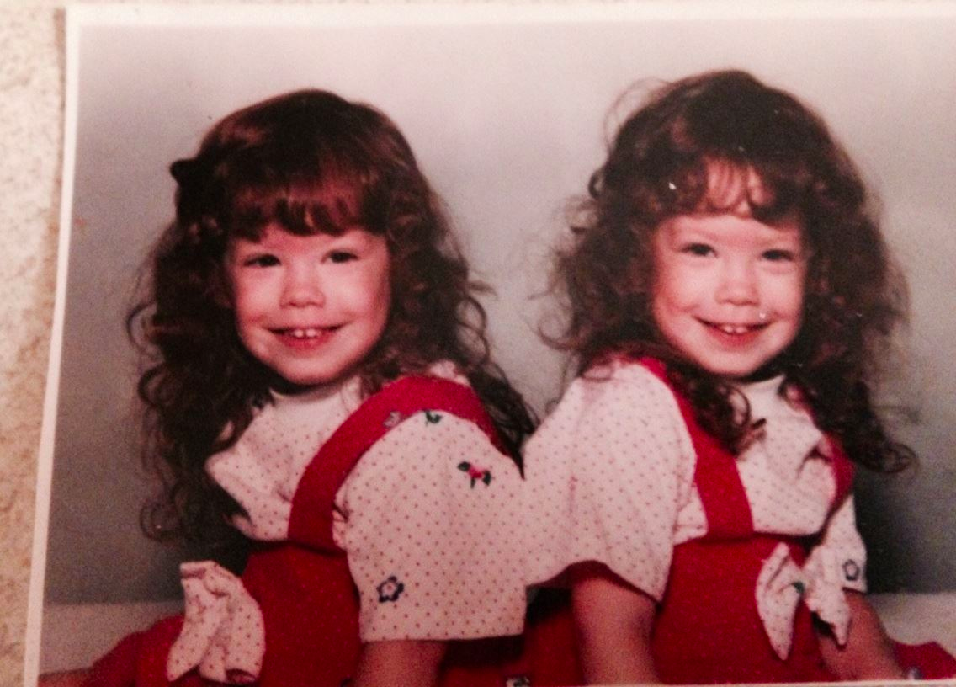
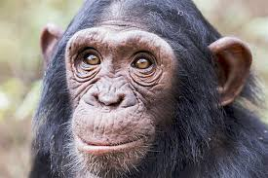
Mutations are the fuel for evolution
Identical twins:
0 differences
Africa
West Eurasia
Unrelated humans
1/1,000
South Asia
America
East Asia/Oceania
Human vs. chimp
1/100
Mallick, et al. 2016
Notes:
Mutations are main fuel for evolution
Give you an idea of what to expect for various comparisons:
Twins, don’t expect any differences
Random unrelated humans: 1/1K differences. Number of mutations between them depends how distantly related. We’ll see today you can use genetic variation to cluster humans into different population groups
Look to chimp, get 10x more diff: 1/100

Slide 8
All copies of the genome share a common ancestor
Ancestral chromosome
= 1 chromosome
Each present-day person has two copies

Slide 9
History of a genetic variant
Ancestral chromosome
Time
Present day chromosomes

Slide 10
History of a genetic variant
Ancestral chromosome
Mutation occurs
It is then passed on to future generations

Slide 11
History of a genetic variant
Variants that are common in the population tend to be older
Very recent mutations usually rare in the population
Ancestral chromosome
Notes:
most SNPs that are common in the population must have arisen a very long time ago

Slide 12
History of a genetic variant
Present day chromosomes
Present day humans have two copies each, randomly drawn from the pool of available chromosomes

Slide 13
Genetic variation - terminology
rsid: identifier for each SNP according to dbSNP (e.g. rs1393350)
Reference genome
A
AA
GA
AA
GG
Major allele: the allele with the higher frequency (here, “A”)
Minor allele: the allele with lower frequency in the population (here, “G”)
Minor allele frequency (“MAF”): the frequency of the minor allele in the population (here, 3/8 = 0.375)
Genotype: refers to the two allele combination of an individual, e.g. AA, AG, or GG are possible genotypes in this example
(We’ll treat GA same as AG)
2 alleles: “A” or “G”
Reference allele: “A”
Alternate allele: “G”

Slide 14
Most SNPs are “bi-allelic”
Ancestral chromosome
TTAAATGTC
Two alleles: A, G
A -> G
G
G
G
G
A
A
A
A
A
A
A
A
A
A
A
A

Slide 15
Tri-allelic SNPs exist but are rare
Ancestral chromosome
TTAAATGTC
Two alleles: A, G, C
Rare to have more than one mutation at a single position
A -> G
A -> C
G
G
G
G
A
A
A
A
C
C
A
A
A
A
A
A

Slide 16
Example genotype+allele frequencies
CC
CT
TT
TT
TT
TT
TT
TT
TT
TT
What are all the possible genotypes?
CC, CT, TT
What is the minor allele?
C
What is the genotype frequency of TT?
8/10 = 80%
What is the minor allele frequency?
(2 (CC) + 1 (CT))/20 = 0.15

Slide 17
Example genotype+allele frequencies (triallelic example)
CC
CT
CA
CA
TA
TT
TT
TT
TT
AA
What are all the possible genotypes?
CC, TT, AA, CT, CA, TA
What is the major allele?
T (C and A are minor alleles)
What is the genotype frequency of TT?
4/10 = 40%
What is the allele frequency of C?
5/20 = 0.25

Slide 18
Some genetic variation is population specific
Ancestral genome
SNP common in all populations
African
European
Asian
Notes:
first lab is going to deal with using SNPs to look at ancestry
if we look at a tree showing the history of major human populaiton groups, can see how SNPs could inform us about ancestry

Slide 19
Some genetic variation is population specific
Ancestral genome
SNP common in European and Asian populations
Absent in African populations
African
European
Asian

Slide 20
Some genetic variation is population specific
Ancestral genome
SNP specific to African populations
African
European
Asian

Slide 21
Genotype array data

Slide 22
Recall using WGS to find SNPs (lab 1)
Homozygous reference
= mismatch from reference
Reference genome
Homozygous non-reference
Recall: humans are diploid (two copies of each chromosome)
Homozygous: both chromosomes have the same nucleotide
Heterozygous: each chromosome has a different nucleotide

Slide 23
Most of the genome is identical between individuals!
Single Nucleotide Polymorphism (SNP): a single base pair variation
Genotyping arrays: only test known “SNPs”. Much cheaper!

Slide 24
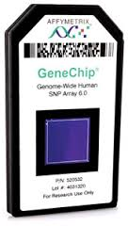
SNP genotype arrays
This is the type of data you’ll get from 23andMe and other companies
Probes analyze a pre-determined set of known polymorphic positions (much cheaper!)
E.g. Affymetrix array has ~1.5 million variants
BB
Probes for allele “A” and “B”
By comparing intensities, can infer genotype (e.g. AA, AB, BB)
AB
AA

Slide 25
Genotyping arrays - the data
A C G T T G C A T A C C G T T
A A G T A G C A C A C C G T T
A C G T T G C A T A C C G T G
A C G T A G C A C A C C G T T
From WGS:
A A G T A G C A T A C C G T T
A A G T A G C A T A C C G T T
A C G T T G C A C A C C G T T
A A G T A G C A T A C C G T G

Slide 26
Genotyping arrays - the data
A C G T T G C A T A C C - T T
A A G T A G C A C A C C G T T
A C G T T G C A T A C C - T G
A C G T A G C A C A C C G T T
Keep only the SNPs
A A G T A G C A T A C C G T T
A A G T A G C A T A C C G T T
A C G T T G C A C A C C G T T
A A G T A G C A T A C C - T G

Slide 27
Genotyping arrays - the data
A 0 G T 1 G C A 0 A C C 1 T 1
A 1 G T 0 G C A 1 A C C 0 T 1
A 0 G T 1 G C A 0 A C C 1 T 1
A 0 G T 0 G C A 1 A C C 0 T 1
0 = reference allele
1 = non-reference (“alternate”) allele
A 1 G T 0 G C A 0 A C C 0 T 0
A 1 G T 0 G C A 0 A C C 0 T 0
A 0 G T 1 G C A 1 A C C 0 T 0
A 1 G T 0 G C A 0 A C C 1 T 1

Slide 28
Genotyping arrays - the data
A 1 0 0 1 0 0 0 1 0 0 0 1 0 2
A 0 0 0 1 0 0 0 1 0 0 0 1 0 2
0 = Homozygous reference
1 = heterozygous
2 = homozygous alternate
A 2 0 0 0 0 0 0 0 0 0 0 0 0 0
A 1 0 0 1 0 0 0 1 0 0 0 1 0 1
VCF or Plink format
(see labs)

Slide 29
Ancestry analysis

Slide 30
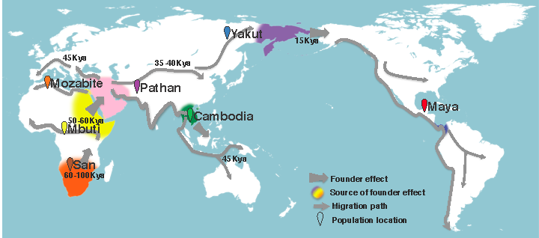
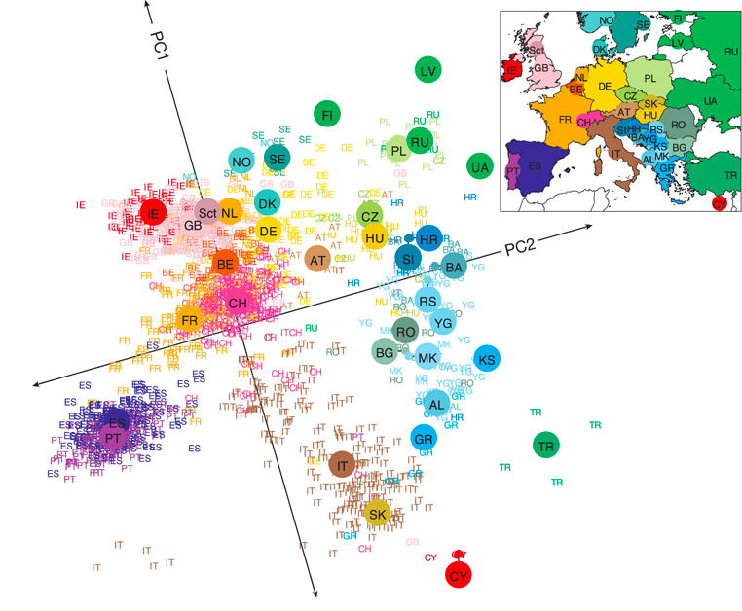
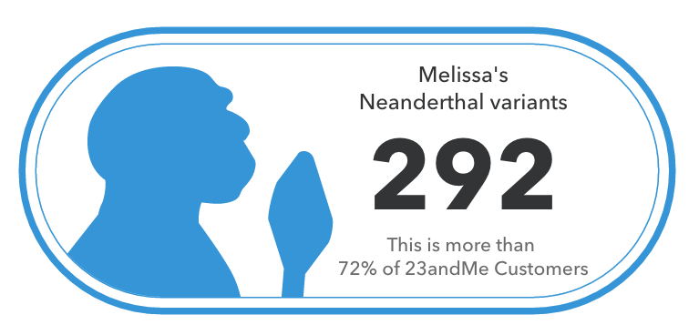
Genomes reveal history across many time scales
Recent history
Ancient history
Familial relationships
Parents, siblings, cousins, etc.
Populations
Human migration, ancient humans
https://aliciarmartin.com/research/migration_map_revised-2/
Novembre, et al. 2008
Notes:
one of the reasons I find genomes so fascinating is because they have hidden within them stories about our past
from comparing genomes, we can learn about history on varying time scales
infer recent family members, infer what part of the world we came from, and even infer things about ancient events occurring at the beginnings of the human species

Slide 31
SNPs act like a “molecular clock”
SNPs in the genome
0 1 2 0 1 1 1 2 1 2 … 0 2 1
Africa
0 1 2 1 1 1 1 1 2 2 … 0 2 1
West Eurasia
Individuals from within the same population will share many SNP genotypes
South Asia
0 1 2 0 1 1 1 2 1 2 … 0 2 1
America
1 2 2 1 0 0 0 0 1 1 … 2 2 0
East Asia/Oceania
Individuals from different populations will have more divergent SNP genotypes
Mallick, et al. 2016

Slide 32
Ancestry analysis goal: where did my genome come from?
SNPs
Label reference samples
0 1 2 0 1 1 1 2 2 2 … 0 2 1
Samples
African
D =
0 0 2 1 0 1 1 0 1 0 … 1 0 1
1 2 2 0 2 1 0 1 1 2 … 0 1 1
Chinese
…
Northern European
0 1 2 1 0 0 1 1 2 2 … 0 2 1
?
A high-dimensional clustering problem!
Notes:
Depict goal
Matrix of genotypes, labeled
Now unknown
Show 23andme ancestry analysis report
Say this is just a clustering problem

Slide 33
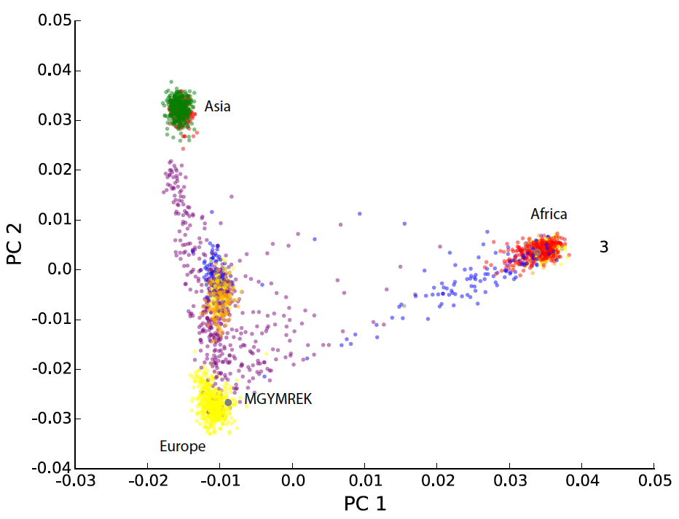
Principal component analysis reveals human relatedness
Worldwide populations
European populations
Novembre, et al.
Notes:
In the lab, we'll use a technique called principal component analysis to learn about ancestry of human populations
We're doing this analysis here for a couple reasons.
First, I think this is one of the coolest genetics analyses ever done
after I learned to do this the first time I decided to become a geneticist :)
Second, PCA is a widely used technique not just in pop gen. Useful to know about it
By applying PCA to SNP data from a set of individuals, can directly pull out relationships between populations
whether it be worldwide, on the left
or on smaller subset. e.g. plot on the right, if you do PCA on European samples, can basically recreate a map of Europe based on genetic data!

Slide 34
What is PCA?
Sample 1 0 0 0 1 1 0 2 0 0 1 0 0 1
Sample 2 1 1 1 1 1 0 0 0 2 0 1 1 1
Sample 3 0 2 0 0 1 1 1 1 0 0 1 1 1
Sample 4 0 0 2 1 1 1 0 0 0 2 1 1 1
…
Intuitively: finds the combination of features (SNPs) that explain the most variation in the data
Feature reduction: derive linearly uncorrelated variables from an initial set of possibly correlated variables
Clustering: Provides visually and often informative clustering of the underlying data for data exploration

Slide 35
PCA finds the features that explain the most variation in the data
After controlling for PC1, most remaining variation along this variation (PC2)
Most variation in the data is along this axis (principal component 1)
Height
Weight
There are as many PCs as original # features, ordered from the PC that explains most to least variance in the data

Slide 36
Genotype PCA – the data
SNPs (features)
0 1 2 0 1 1 1 2 2 2 … 0 2 1
Samples
D =
0 0 2 1 0 1 1 0 1 0 … 1 0 1
1 2 2 0 2 1 0 1 1 2 … 0 1 1
…
0 1 2 1 0 0 1 1 2 2 … 0 2 1
D_{ij} = Number of non-reference alleles for sample j at SNP i (0, 1, or 2)

Slide 37
Genotype PCA – the results
PCs
Plot each sample using PC1 vs. PC2:
5 1 …..
Samples
6 0 ….
-1 2 ….
…
See “Bonus slides” with more details on PCA math (not required for this course, but interesting and worth going through)
2 1 ….
First PC is linear combination of SNPs explaining highest amount of variation in our data
Second PC explains next most variation Etc.

Slide 38
Lab 3 Overview – Part 1

Slide 39
1000 Genomes Project (http://www.internationalgenome.org/)

Slide 40
Lab 3 Overview – Part 1: Ancestry Analysis
Exercises Part I:
Review of population genetics terminology
Allele and genotype frequencies in population
Part 1:
PCA intuition
More on VCF files
Ancestry analysis using PCA
Not responsible for PCA math. But bonus slides posted on week4 resources

Slide 41
Review of our pipelines so far
Lab 2
Reads
(*.fq, *.fastq)
Assembly
*.fa, *.fasta
*.gfa
Assembly
(assembly)
Reads
(*.fq, *.fastq)
Ref. genome assembly (+ index files)
(*.fa, *.fasta)
Lab 1
Alignments
(*.sam, *.bam)
Variants
(*.vcf)
(variant calling)
Alignment
Genotyping
Annotation
PCA
Lab 3
Variants
(*.vcf)
(Popgen)
GWAS
Notes:
really quick review of the pipelines we've talked about so far
important to keep a mental picture of how the different pieces fit together. Sometimes going through the labs you can get stuck in following the steps and lose track of the big picture
we've seen two pipelines so far, and we'll add to this list later
the first was variant calling, aligned reads to ref genome, did some genotyping to find all the variants, then annotated them
in the second, we assume we don't have a ref genome, and use the reads themselves to reconstruct the reference sequence
we've used short reads for these applications so far
but we'll see examples of how long reads can help improve both of these applications

Slide 42
VCF format
See: https://samtools.github.io/hts-specs/VCFv4.2.pdf
Also see “GenotypeDataOverview.html” tutorial posted on Canvas (Module 3)

Slide 43
Tools+tips for working with VCF files
VCF files can be BIG! (the one in lab is not so bad)
We will usually work with compressed (bgzipped) VCF files.
bgzip myfile.vcf # creates myfile.vcf.gz
(The file in lab 3 is already compressed for you)
To view a zipped file:
zcat myfile.vcf.gz | less -S
tabix –p vcf myfile.vcf.gz # creates myfile.vcf.gz.tbi

Slide 44
Tools+tips for working with VCF files - tabix
VCF files can be BIG! (the one in lab is not so bad)
We can index a VCF file with tabix to make it quickly searchable
# creates myfile.vcf.gz.tbi
# Requires the VCF to be bgzipped!
tabix –p vcf myfile.vcf.gz
# After indexing we can query for specific regions
tabix myfile.vcf.gz 15:28365617-28365618
Recall other indices:
bwa index hg19.fa # index ref genome
samtools index myfile.bam # index bam
tabix myfile.vcf.gz # index VCF
In all cases, the indices allow us to quickly query these files.
Much faster than grep!

Slide 45
Tools+tips for working with VCF files - bcftools
bcftools contains tons of utilities for dealing with VCF files
If there is an operation you want to perform, bcftools probably has it. Don’t reinvent the wheel!
Type “bcftools” at the terminal to see the many options
“bcftools index”:
Alternative way to index VCFs
Can also print VCF stats
”bcftools query”:
For manipulating VCFs into user-defined formats
“bcftools view”:
To view a subset of a VCF file

Slide 46
Tools+tips for working with VCF files - bcftools
Type: “bcftools <command>” to see the help message for each utility
bcftools index
bcftools query

Slide 47
Bcftools commands you might find useful!
bcftools index –n myfile.vcf.gz # list the number of variants in a file
bcftools query –l myfile.vcf.gz # list all the samples in the file
bcftools query -f "[%GT\t]\n” # Output genotypes in tab-delimited format
# Output only SNPs overlapping myregions.bed
# Output to a compressed VCF
bcftools view myfile.vcf.gz –R myregions.bed –v snps –O z –o mynewfile.vcf.gz

Slide 48
Running PCA in Python with sklearn
import sklearn.decomposition
# initialize the PCA object
# If you don’t set n_components, all p are computed
pca = sklearn.decomposition.PCA(n_components=3)
# fit PCs of a datamatrix
# datamatrix has dimensions:
# rows=m SNPs
# cols=n samples
pca.fit(datamatrix.transpose())
# Project samples on PCs
proj = pca.transform(datamatrix.transpose())
# proj[:,i-1] gives data projected along PCi
Note: We’re using a tiny subset of genome-wide SNPs. Shouldn’t take more than a couple minutes for your PCA to run.

