Slide 1
Migration and drift led to genetic diversity between groups
Skoglund & Mathieson 2018 (Journal Club 1)

Slide 2
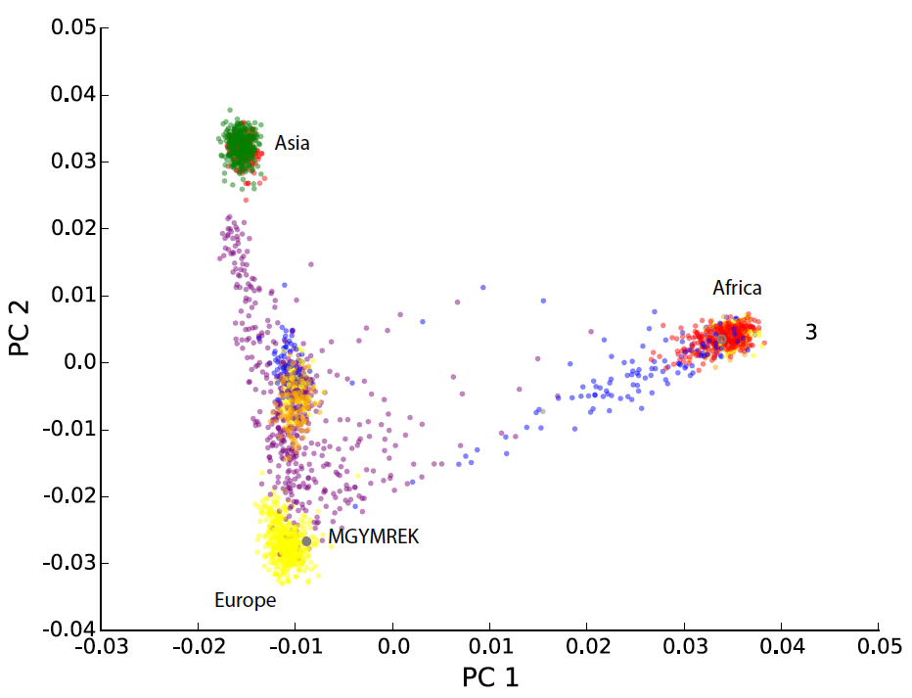
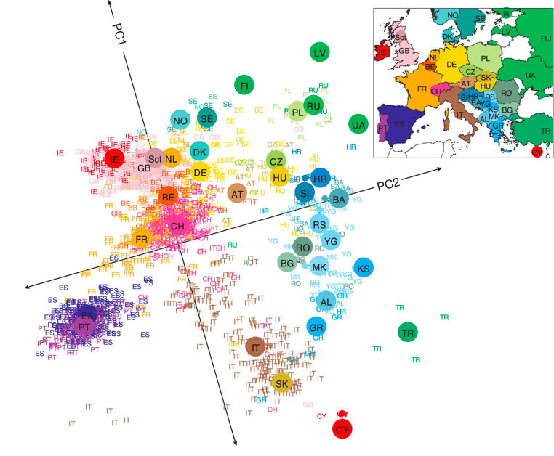
Principal component analysis reveals human relatedness
Problem set 2.1
Novembre, et al. 2008

Slide 3
First, what is PCA?
Sample 1 0 0 0 1 1 0 2 0 0 1 0 0 1
Sample 2 1 1 1 1 1 0 0 0 2 0 1 1 1
Sample 3 0 2 0 0 1 1 1 1 0 0 1 1 1
Sample 4 0 0 2 1 1 1 0 0 0 2 1 1 1
…
Intuitively: finds the set of features that explain the most variation in the data
Feature reduction: derive linearly uncorrelated variables from an initial set of possibly correlated variables
Clustering: Provides visually and often informative clustering of the underlying data for data exploration

Slide 4
PCA Example: weight vs. height
After controlling for PC1, most remaining variation along this variation (PC2)
Most variation in the data is along this axis (principal component 1)
Height
Weight
There are as many PCs as original # features, ordered from the PC that explains most to least variance in the data

Slide 5
Review – mean, variance and covariance
Data: X = x₁, x₂, x₃, … x_{n}
e.g. genotypes at SNP₁ = 0, 1, 2, …
n
1
Σ
Mean:
X =
n
x_{i}
i=1
n
1
Σ
Variance:
Var(X) = σ²(X) =
(x_{i}-x)²
(n-1)
i=1
Standard deviation:
σ(X) = sqrt(σ²(X))
n
1
Σ
Covariance:
Cov(X, Y) =
(x_{i}-x) (y_{i}-y)
(n-1)
i=1
Cov(X, X) = Var(X)
Cov(X, Y) = Cov(Y, X)

Slide 6
Review – covariance matrix
n samples
0 1 2 1 1 0 1 1
X₁
x_{ij} = feature i’s value at sample j
Data: X =
1 1 2 0 0 0 1 2
X₂
m features (SNPs)
2 0 2 1 1 0 1 1
…
0 1 1 1 0 0 1 2
X_{m}
Position a, b gives Cov(X_{a},X_{b})
Var(X₁)
Var(X₂)
Diagonals give variances
Covariance matrix: Cov(X) =
m
Var(X_{m})
Matrix is square and symmetric
m

Slide 7
Covariance matrix example – height+weight
# Generate some random-ish
# but correlated
# height/weight data in Python
import numpy as np
rng = np.random.RandomState(1)
X = np.dot(rng.rand(2, 2), \
rng.randn(2, 200)).T
# Set means to reasonable nums
height = X[:,0]+65
weight = X[:,1]+120
data = np.array([height, weight])
cov = np.cov(data)
Var(Height)
Cov(Weight,Height)
0.68
0.23
Cov(X) =
=
Cov(Height,Weight)
Var(Weight)
0.23
0.10

Slide 8
Covariance matrices easily computed using matrix mult.
Using matrix algebra, and assuming each row has mean 0:
Cov(X)
=
X
X^{T}
n-1
X_{j}
Var(X₁)
Cov(X₁, X₂) ….
X_{i}
m
m
n
m
n
m
n
1
Σ
(Or, you could just use np.cov)
cov = np.cov(data)
Cov(X, Y) =
(x_{i}-x) (y_{i}-y)
(n-1)
i=1

Slide 9
Review – eigenvectors and eigenvalues
Given a square matrix C, which represents some linear transformation
Eigenvector v: of a C is a non-zero vector that does not change direction when C is applied to it
Cv =λv
Where λ is a scalar value known as the eigenvalue associated with v
If C is an m by m matrix, there are m eigenvectors and corresponding eigenvalues:
v₁, v₂, v₃, v₄, … v_{m}
λ₁, λ₂, λ₃, λ₄, … λ_{m}
Ordered by the absolute value of the eigenvalues.
Notes:
http://faculty.iiit.ac.in/~mkrishna/PrincipalComponents.pdf

Slide 10
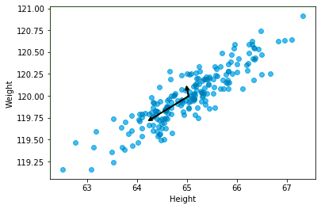
Eigenvector/value – height+weight
Intuitively:
Top eigenvectors describe features that explain the most variation in our data
Corresponding eigenvalues tell us how much variation is explained
import numpy as np
# data is 2xn matrix
cov = np.cov(data)
eigvals, eigvecs = np.linalg.eig(cov)
Eigvec 2
Eigval 1
Eigvals = [0.76, 0.018]
Eigvecs = [[0.94, -0.33],
[0.33, 0.94]]
Eigvec 1
Eigvec 1

Slide 11
Decomposing a matrix with eigenvalues and eigenvectors
If C is an m by m matrix, there are m eigenvectors and corresponding eigenvalues:
v₁, v₂, v₃, v₄, … v_{m}
λ₁, λ₂, λ₃, λ₄, … λ_{m}
Let Q be an m by m matrix with columns v₁, v₂, v₃, v₄, … v_{m}
Let Λ be an m by m diagonal matrix with diagonal entries λ₁, λ₂, λ₃, λ₄, … λ_{m}
Then we can decompose the matrix C in terms of the eigenvalues and vectors:
v_{i}
λ₁
λ₂
λ_{m}
C
=
Q
Λ
Q^{T}
Notes:
http://faculty.iiit.ac.in/~mkrishna/PrincipalComponents.pdf

Slide 12
Eigendecomposition – height+weight
cov = np.cov(data)
eigvals, eigvec = np.linalg.eig(cov)
print(eigvec.dot(np.diag(eigvals)).dot(eigvec.transpose()))
print(cov)
[[0.68217761 0.23093475] [0.23093475 0.09883179]] # Q*L*Q^T
[[0.68217761 0.23093475] [0.23093475 0.09883179]] # cov
0.68
0.23
0.94
-0.33
0.76
0
0.94
0.33
0.23
0.10
0.33
0.94
0
0.018
-0.33
0.94
C
=
Q
Λ
Q^{T}

Slide 13
Projecting the data on the top PCs
PC1
PC2
height
weight
eigvec1
eigvec2
100.1
92.0
64.37
119.8
0.94
-0.33
101.9
92.2
65.96
120.6
=
0.33
0.94
…
…
…
…
Q
Proj
X^{T}
Projection of sample 1 on PC1 Dot product of sample 1 * PC1
(We only had 2 PCs, they explain all the variation in our data)

Slide 14
Performing PCA on SNPs – step-by-step
Step 1: Obtained a cleaned matrix of data! Call it D
Notes:
http://faculty.iiit.ac.in/~mkrishna/PrincipalComponents.pdf

Slide 15
Genotype PCA – the data
n samples
0 1 2 0 1 1 1 2 2 2 … 0 2 1
m SNPs
D =
0 0 2 1 0 1 1 0 1 0 … 1 0 1
1 2 2 0 2 1 0 1 1 2 … 0 1 1
…
0 1 2 1 0 0 1 1 2 2 … 0 2 1
D_{ij} = Number of non-reference alleles for sample j at SNP i (0, 1, or 2)

Slide 16
Performing PCA – step-by-step
Step 1: Obtained a cleaned matrix of data! Call it D
Step 2: Center/scale each feature (not required for PS2, but won’t hurt)
Notes:
http://faculty.iiit.ac.in/~mkrishna/PrincipalComponents.pdf

Slide 17
What do these look like for an example SNP?
Data for the ith SNP, with minor allele frequency p_{i}:
D_{i} = 0 1 2 0 1 1 1 2 2 2 … 0 2 1
Under HWE:
$$P\left(00\right)={\left(1−p\right)}^{2}$$
$$P\left(01/10\right)=2p\left(1−p\right)$$
$$P\left(11\right)=p^{2}$$
$$Mean\left(D_{i}\right)=p_{i}^{2}\left(2\right)+2p_{i}\left(1−p_{i}\right)\left(1\right)+{\left(1−p_{i}\right)}^{2}\left(0\right)=2p_{i}$$
$$Var\left(D_{i}\right)=2p_{i}(1−p_{i})$$

Slide 18
Z-normalizing SNPs reduces effects of rare SNPs
Data for the ith SNP, with minor allele frequency p_{i}:
D_{i} = 0 1 2 0 1 1 1 2 2 2 … 0 2 1
Typically normalize such that:
The normalized data has mean 0
The variance of each SNP is equal to 1 (so we don’t weight SNPs with different MAF too differently)
$$X_{i}= \frac{D_{i}−Mean(D_{i})}{√Var(D_{i})}$$
$$X_{ij}∈\left\{\frac{−2p_{i}}{\sqrt{2p_{i}\left(1−p_{i}\right)}},\frac{1−2i}{\sqrt{2p_{i}\left(1−p_{i}\right)}}′\frac{2−2p_{i}}{\sqrt{2p_{i}\left(1−p_{i}\right)}}\right\}$$

Slide 19
Performing PCA – step-by-step
Step 1: Obtained a cleaned matrix of data! Call it D
Step 2: Center/scale each feature
Step 3: Calculate the covariance matrix
Cov(X) = XX^{T}/n
Notes:
http://faculty.iiit.ac.in/~mkrishna/PrincipalComponents.pdf

Slide 20
Calculating the SNP-SNP covariance matrix
$$X_{i}= \frac{D_{i}−2p_{i}}{√2p_{i}(1−p_{i})}$$
Cov(X)=XX^{T}/n
All the diagonal elements will be 1!
1
Cov(X₁, X₂) ….
1
$${C_{ii}=Cov(X}_{i},X_{i})=Var\left(X_{i}\right)= 1$$
m
1
1
1
Off-diagonals give SNP-SNP covariance
1
1
$${C_{ij}=Cov(X}_{i},X_{j})=\frac{X_{i}X_{j}^{T}}{n}$$
m

Slide 21
Performing PCA – step-by-step
Step 1: Obtained a cleaned matrix of data! Call it D
Step 2: Center/scale each feature
Step 3: Calculate the covariance matrix
Cov(X) = XX^{T}/n
Step 4: Calculate the eigenvalues and eigenvectors of Cov(X).
v₁, v₂, v₃, v₄, … v_{n}
λ₁, λ₂, λ₃, λ₄, … λ_{m}
Step 5: Project your original data along the PCs
X_{proj} = X^{T}Q
Step 6: Plot PCs to visualize. E.g. plot column 1 vs. column 2
Notes:
http://faculty.iiit.ac.in/~mkrishna/PrincipalComponents.pdf

Slide 22
Genotype PCA – results
m
1 dot = 1 sample
X^{T}Q =
n
PC1
PC2

Slide 23
Genotype PCA – Alternative method (“transpose trick”)
Above, we took the covariance of X
Alternatively, we could have taken the covariance of X^{T}
C=XX^{T}/n
C=X^{T}X/n
1
Cov(X₁, X₂) ….
1
m
1
n
1
1
1
1
m
n
Pairwise SNP covariance
Pairwise individual covariance
“GRM”=genetic relatedness matrix
Find eigenvectors Q of C
X^{T}Q gives projection of samples onto PCs
Find eigenvectors V of C
V gives projection of samples onto PCs
Why does this work? If v is an eigenvector of XX^{T}, then X^{T}v is an eigenvector of X^{T}X
https://stats.stackexchange.com/questions/7111/how-to-perform-pca-for-data-of-very-high-dimensionality/7144#7144

Slide 24
PCA on human populations
African
European
Asian
Recall JC1: most variation in human populations comes from African vs. non-African populations (PC1)

Slide 25
PCA on human populations
African
European
Asian
Recall JC1: next most variation in human populations comes East Eurasian (East Asian) vs. West Eurasian (European) (PC2)

Slide 26
PCA on human populations
Admixed Americans
South Asians
African Americans
African
European
Asian
Other groups fall in between these superpopulations

Slide 27
Additional PCs capture finer-grained population info
EAS
AMR
EUR
AFR
EAS
EUR
South Asian (orange)
(note, I miscolored some of the blue ones)
AMR (admixed)
PC5??

Slide 28
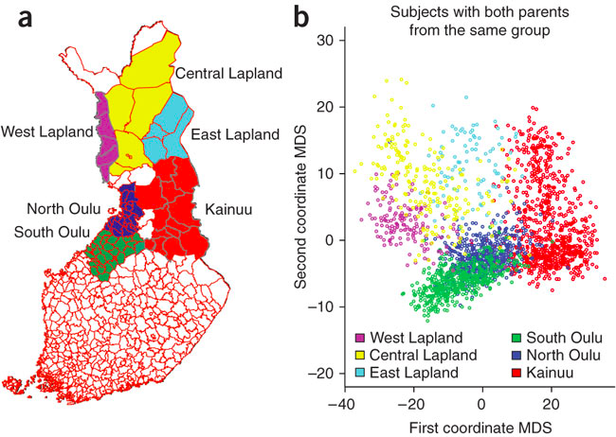
PCA in Finland
Sabatti et al. 2009

Slide 29
How many PCs are informative of population structure?
Example – white British in UK Biobank

Slide 30
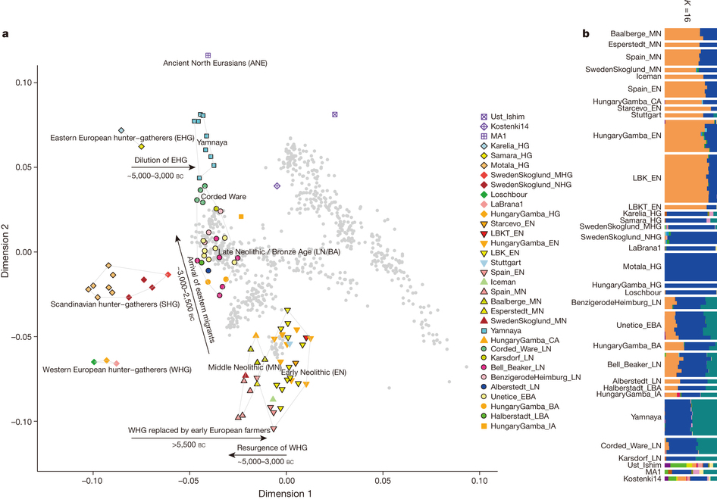
Analyzing ancient samples
Haak et al. 2015

Slide 31
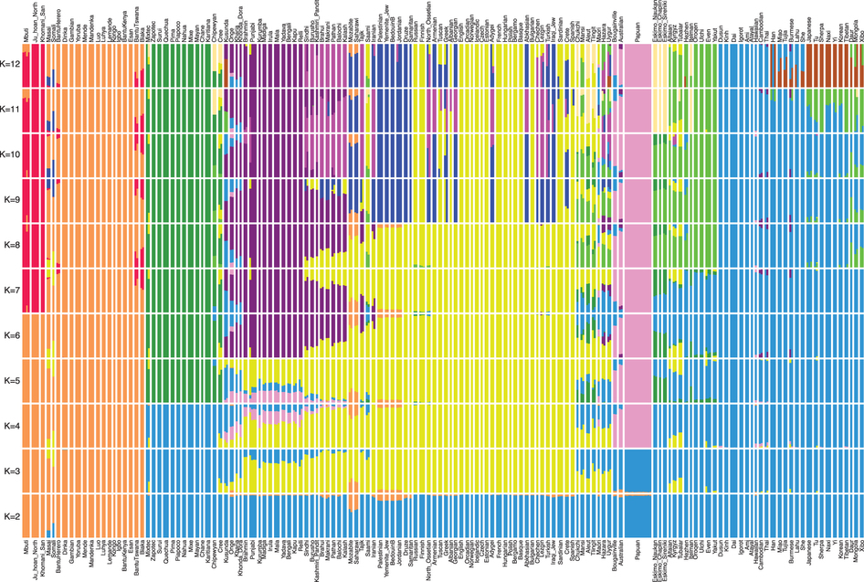
ADMIXTURE – a different way to look at ancestry
https://www.genetics.ucla.edu/software/admixture/
Africa
Native Americans
South/West Eurasians
Oceania
East Asian
Mallick, et al 2016

Slide 32
Running PCA in practice

Slide 33
Genotype matrix caveats
Missing data: Matrix operations will break with missing data. Solutions:
filter SNPs/samples with missing data
Fill in missing data with mean values
Invariant or very rare SNPs
Invariant positions aren’t useful
Very rare SNPs more likely to be incorrect and unlikely to inform population structure
Effects of Z-normalization

Slide 34
Genotype matrix caveats – LD pruning
Recall: nearby SNPs are in high LD (correlation) with each other!
If a large number of correlated SNPs included in PCA, it will over-emphasize importance of larger haplotype blocks
LD pruning with plink:
plink --bfile <prefix> --indep-pairwise 50 5 0.2 --out <outprefix>
(not necessary for PS2)

Slide 35
Run time
If we have m SNPs (features), and n samples (individuals) then:
Computing the covariance matrix is: O(m²n)
Eigendecomposition of m by m matrix is O(m³)
Overall run time is: O(m²n+m³).
Or if we do the transpose trick (usually n<<m): O(n²m+n³). Cubic in the number of samples! yikes

Slide 36
How should I implement PCA in the problem set?
Option 1: Python
Option 1a: implement the methods from previous slides
Option 1b: implement the alternative (GRM) method
Option 1c: use sklearn library’s PCA (easiest)
Option 2: Plink (too easy. Try to use Python for PS2)
plink –bfile <myprefix> --pca 10 --out <myprefix>
Other options:
smartPCA (part of EIGENSOFT) (Price, Patterson, and Reich 2006) first widespread use of PCA on genotype data.
flashPCA (Abraham and Inouye, 2014) PCA implementation based on randomized algorithms
fastPCA (Galinksy et al. 2016) uses random matrix theory to scale PCA linearly with number of samples

Slide 37
Running PCA with sklearn
import sklearn.decomposition
# initialize the PCA object
# If you don’t set n_components, all p are computed
pca = sklearn.decomposition.PCA(n_components=2)
# fit PCs of a datamatrix
# datamatrix has dimensions:
# rows=m SNPs
# cols=n samples
pca.fit(datamatrix.transpose())
# Project samples on PCs
proj = pca.transform(datamatrix.transpose())

Slide 38
Performing PCA yourself – python cheat sheet
import numpy as np
# Subset a matrix by rows and columns
Xsubset = X[rowstart:rowend, colstart:colend]
# Transpose matrix X
Xt = X.transpose()
# Multiple two matrices X, Y
Product = X.dot(Y)
# Get eigenvalues and eigenvectors of matrix X
evals, evecs = np.linalg.eig(X)
# Sort them by eigenvalue
idx = np.argsort(evals)[::-1]
evecs = evecs[:,idx]
# To test your code, compare to sklearn:
from sklearn.decomposition import PCA
pca = PCA(n_components=2)
pca.fit(X.transpose())
newdata = pca.transform(x.transpose())

Slide 39
Read more…
Population structure and eigenanalysis (Price, Patterson, Reich)
Genes mirror geography within Europe (Novembre et al.)
The population genetics of the Jewish people (Ostrer and Skorecki)

