Slide 1
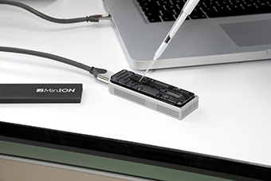
CSE185 – Week 3 Part 2 Long reads April 15, 2021
Announcements:
Quiz during lab at 1:00pm. Under “Quizzes” tab on Canvas. Will remain open until 11:59pm tonight
Lab 2 due Sunday 11:59pm
Lab 3 will be released Friday
Notes:
We’ve been talking the last couple weeks about short read sequencing from Illumina
short reads are great for many applications, and we'll continue to use short reads in more applications in future labs
but, the technology for sequencing is rapidly changing.
new technologies are now enabling us to sequence far longer reads
these technologies have already been used by. many groups to do some amazing things
our lab is just starting to look at long read data, and I'm sure there's a lot we still have to learn
but I think it's important for us to talk about these technologies because they have the potential to be really game changing for a lot of applications

Slide 2
Review of our NGS pipelines so far
Reads
(*.fq, *.fastq)
Ref. genome assembly (+ index files)
(*.fa, *.fasta)
Lab 1
Alignment
Genotyping
Annotation
(variant calling)
Alignments
(*.sam, *.bam)
Variants
(*.vcf)
Reads
(*.fq, *.fastq)
Assembly
*.fa, *.fasta
*.gfa
Lab 2
Assembly
(assembly)
Notes:
really quick review of the pipelines we've talked about so far
important to keep a mental picture of how the different pieces fit together. Sometimes going through the labs you can get stuck in following the steps and lose track of the big picture
we've seen two pipelines so far, and we'll add to this list later
the first was variant calling, aligned reads to ref genome, did some genotyping to find all the variants, then annotated them
in the second, we assume we don't have a ref genome, and use the reads themselves to reconstruct the reference sequence
we've used short reads for these applications so far
but we'll see examples of how long reads can help improve both of these applications

Slide 3
Today’s schedule
Challenges posed by short reads
Long reads – Oxford Nanopore
Long reads – PacBio
Long read assemblers
A look at a complete assembly of human chr8

Slide 4
Many repetitive regions can’t be spanned by short reads
Reference genome
Hard to tell!
Need a read to span all the way across
How many copies of the purple repeat do we have?
(But: see ”GangSTR” and “ExpansionHunter” tools for tricks to deal with this)

Slide 5
Short reads can’t resolve large segmental duplications
Reference genome
A
B
C
D
B
E
??
Assembly
A
ABC
DBE
C
B
or
ABE
DBC
D
E
Notes:
segmental duplications
unless we have a read that goes across the entire repeat, we wouldn't be able to uniquely align reads to the region, or to resolve this region in the assembly

Slide 6
We can’t get long range “phase” information from short reads
Our sample’s genome:
A
G
C
T
TACGTACGTGCTATACGCATCGAGCTA…CGATCGTAATCGCGATCTACGACTTACTACGACTACTACGAT
Heterozygous variants
A
C
TACGTACGTGCTATACGCATCGAGCTA…CGATCGTAATCGCGATCTACGACTTACTACGACTACTACGAT
G
T
TACGTACGTGCTATACGCATCGAGCTA…CGATCGTAATCGCGATCTACGACTTACTACGACTACTACGAT
or
G
C
TACGTACGTGCTATACGCATCGAGCTA…CGATCGTAATCGCGATCTACGACTTACTACGACTACTACGAT
A
T
TACGTACGTGCTATACGCATCGAGCTA…CGATCGTAATCGCGATCTACGACTTACTACGACTACTACGAT

Slide 7
Amplification introduced bias into our dataset
“Complexity”: how diverse our pool of molecules is
Mixed population
(e.g. genetic variation,
Different genomic regions,
mRNA expression)
Biased amplification = low complexity
Amplification can result in bias, e.g. dropout of GC-rich regions

Slide 8
Enter – long reads!

Slide 9
Sequencing – then and now
2000s
Other systems: ABI SOLID, Ion Torrent
Long reads!
1977
Sanger Sequencing
1990
Human Genome Project
started
2003
HGP
completed
~2017
$1,000 Genome
2007
Illumina/Solexa
~1980
Shotgun sequencing
~2020
PacBio Hifi
ONT
2005
First NGS system
(454, Roche)
36bp
75bp
101bp
150bp
100KBp
Read lengths
Notes:
let's revisit our timeline about the history of sequencing technology and see where we are now
long read technologies have been around for 10 years or more. but only recently in the last several years have they become good enough in terms of throughput and accuracy to be widely useaable.
so we'll add long reads to our timeline here spanning the last several years where they have really taken off
also added down here the change in read lengths over time
10 years ago we were dealing with 36bp reads
we'll see today technologies that can give us 100Kbp reads!

Slide 10
Illumina
Genome
Fragment genome
Amplify short fragments
(~300bp)
Fragments
“Sequencing by synthesis”
~100bp reads
Reads
Long reads
Amplification not required
Takes long (“high molecular weight”) DNA strands as input
Sequences those long strands directly
“Single molecule sequencing” (SMS)
Notes:
to get long reads to work, we'll have to think about totally different technology than what we saw for Illumina reads
recall for Illumina, we couldn't seuqnece large chunks. so we had to first fragment the genome, and then amplify so we had enough to work with
then we did this sequencing by synthesis trick, where we synthesized new pieces of DNA, and read off the colors each time
and as we saw with that trick, that the molecules go out of sync after a while and we couldn't resolve the colors anymore
with long reads, we'll instead take long HMW DNA fragments directly as input
no amplification. in fact amplifying long segments like that is tricky
then we'll sequence those long pieces directly, by threading them threw a sensor and reading off a signal for each base
refer to as single molecule sequencing. unlike ILMN where we sequenced clusters of molecules, here we're sequencing an individual molecule at a time

Slide 11
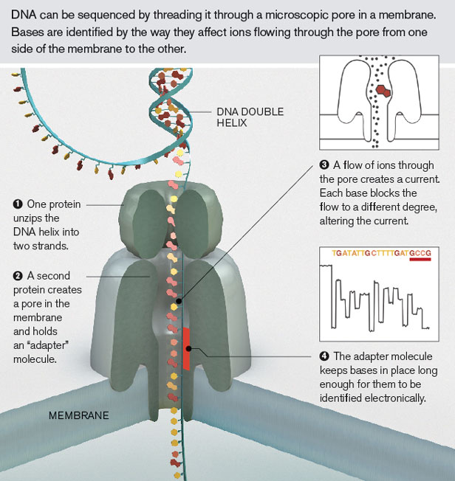
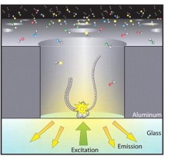
Two major long read technologies
ONT (Oxford Nanopore Technologies)
Pacific Biosciences (PacBio)
Notes:
two major players in the long read game
both have different advantages and disadvantages
we'll give an overview of how each of these work
first is Nanopore, or ONT
second is PacBio

Slide 12
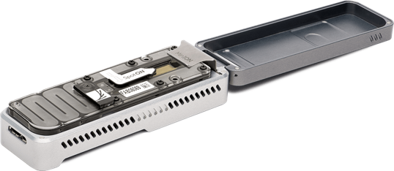
Long reads: Oxford Nanopore Technologies (ONT)
Literally pocket-sized
10 minute sample prep
Reads are dozens to hundreds of kb long
http://www.21stcentech.com/gizmos-gadgets-dna-testing-field/
Notes:
we just got one of these in the lab

Slide 13
Nanopore sequencing
Tether
Flow of ions through the pore
Nanopore
membrane
https://www.youtube.com/watch?v=RcP85JHLmnI

Slide 14
Nanopore sequencing
Motor protein
Adapter sequence
DNA to sequence
Tether
Nanopore
membrane
https://www.youtube.com/watch?v=RcP85JHLmnI

Slide 15
Nanopore sequencing
Each base disrupts the ion flow in a characteristic way
A
G
T
T
G
C
G
“Trace” – contains ionic current signal of a sequence of nucleotides as it’s threaded through the pore
A

Slide 16
Nanopore sequencing – squiggles to bases
https://www.youtube.com/watch?v=GUb1TZvMWsw

Slide 17
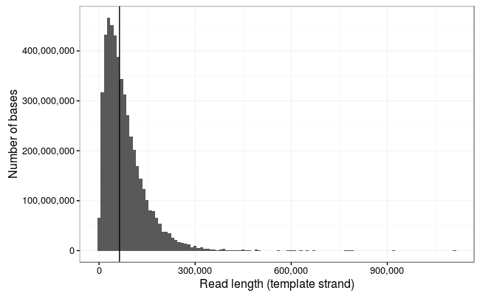
You can get *really long* reads!
Note: variable read lengths.
Not like Illumina, where we have a fixed number of “cycles”
!!!
https://lab.loman.net/2017/03/09/ultrareads-for-nanopore/

Slide 18
But… they are also really noisy

Slide 19
ONT – base calling
ONT error rate is high (10-15% per base error rate. Many indels)
Why is it so hard?
The size of the nanopore is bigger than 1 base. Each signal is an aggregate of multiple adjacent nucleotides
The DNA doesn’t move at a constant rate (avg. 450bp/sec). Might skip bases by accident, leading to indel errors.
But, things are improving

Slide 20
ONT – base calling
Improvements coming from:
Chemistry improvements
Basecalling algorithm improvements

Slide 21
ONT – base calling
R7 pore:
~6bp in the pore at a time
4,096 possible k-mers we need to learn squiggles for
R9 pore:
3bp in the pore at a time
64 possible k-mers we need to learn squiggles for

Slide 22
ONT – base calling
Transducer deal with homopolymer issue
Early algorithms based on HMMs
Later based on RNNs (deep learning)

Slide 23
Other ONT applications
Key = different molecules passing through the pore make different squiggle patterns!
We saw DNA sequencing as an example
Can also sequence:
Base modifications (e.g. DNA methylation)
Native RNA
Maybe even proteins (seems possible. Would be a *huge* deal)
A
G
T
T
G
C
G
A

Slide 24
Short vs. long reads
Accuracy
Illumina
99.9%
Very long reads
Give big picture
But low per-base accuracy
Short but very accurate reads
ONT
~80%
0
Read length (kb)
50kb
* Note the numbers on this graph are very rough approximations. The numbers are changing all the time…
Notes:
TODO: short vs. long reads
X-axis: length
Y-axis: accuracy
Show ILMN vs. ONT
https://www.pacb.com/smrt-science/smrt-sequencing/hifi-reads-for-highly-accurate-long-read-sequencing/

Slide 25
Two major long read technologies
ONT (Oxford Nanopore Technologies)
Pacific Biosciences (PacBio)

Slide 26
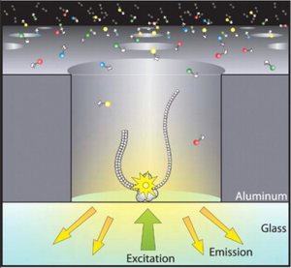
PacBio technology
DNA polymerase bound to bottom of wells
Feed in single-stranded DNA and fluorescently labeled nucleotides
Record bases being incorporated in real time
“SMRT”: single-molecule real-time sequencing
First released ~2011
http://chrisamiller.com/science/tag/sequencing/

Slide 27
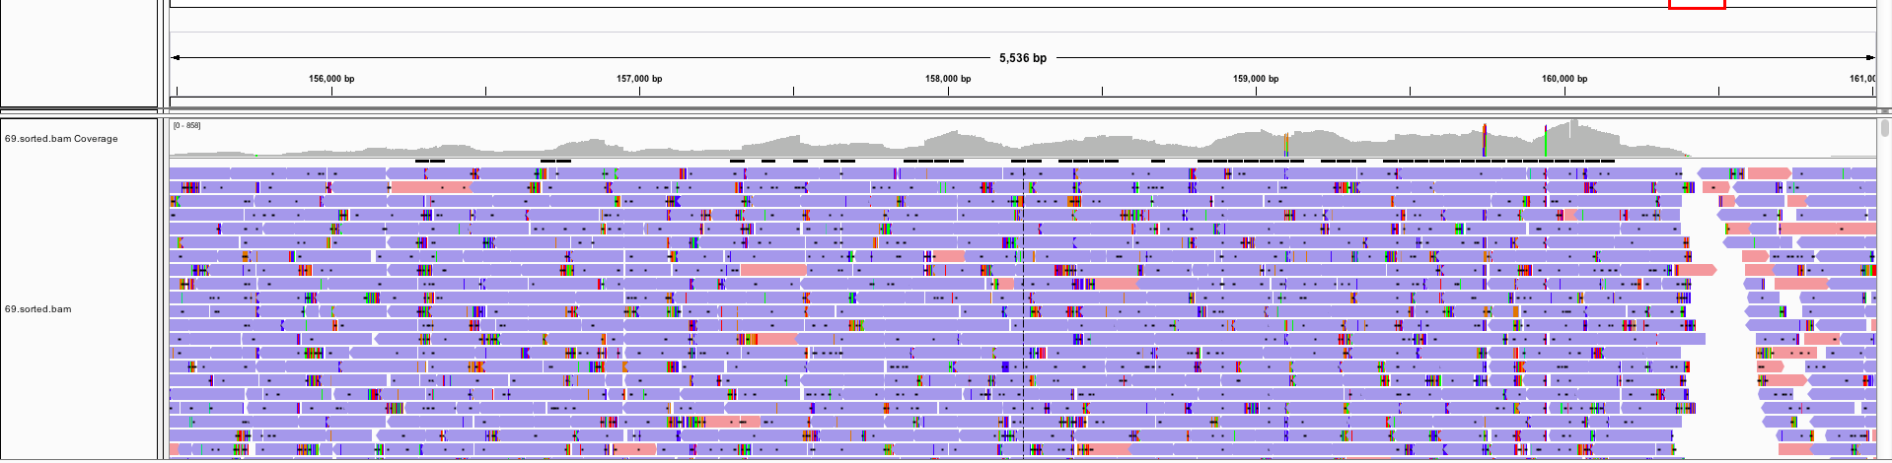
PacBio – early data had very high error rates
Example IGV screenshot of PacBio reads:
In earlier data, really high error rate (~17%), frequent random errors
http://biostar40.rssing.com/chan-9396846/all_p18.html

Slide 28
Pacbio generates “circular” reads
Adapter
Adapter
Fragment of interest (many kb)
Sequence around the circle
Notes:
99.9% accuracy
Two modes of pacbio sequencing
https://www.slideshare.net/GenomeInABottle/giab-grc-workshop-ashg-2019-billy-rowell-evaluation-of-v4-with-ccs-gatk
https://www.pacb.com/smrt-science/smrt-sequencing/
CCS (hifi) vs. CLR
Tradeoff of accuracy vs. read length

Slide 29
Pacbio can be run in two modes
“Continuous Long Read Sequencing”
(CLR)
“Circular Consensus Sequencing”
(CCS, or “Hifi”)
Subread 1
Long read 1
Long read 2
Subread n
Long read 3
Hifi Read
Consensus sequence
Long reads <20kb
>99% accuracy
Long reads >20kb. Up to 175KB
~90% accuracy

Slide 30
Short vs. long reads
Accuracy
Illumina
Pacbio “hifi”
99.9%
Best of both worlds?
Very long reads
Give big picture
But low per-base accuracy
Short but accurate reads
PacBio CLR
ONT
~80%
0
50kb
Read length (kb)

Slide 32
Long read assemblers

Slide 33
Long read assembly considerations
How will our k-mer based de Bruijn graphs perform on ONT? PacBio?
ACGATCGTGTACTGACTC
CGTGTACTGACTCACTAC
Recent long read assemblers taking different approaches
Notes:
https://www.pnas.org/content/113/52/E8396

Slide 34
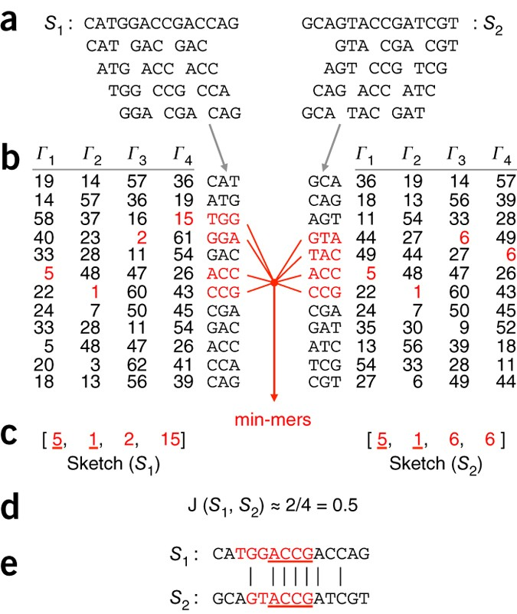
Canu - MinHash
Use MinHash algorithm to efficiently identify overlapping reads
Notes:
Canu looks for pairs of overlap between noisy reads
Can be time consuming to do complete alignment
Instead uses an algorithm called minhash
Original made for comparing websites
Have multiple hash functions. Take hash value of each kmer in the read
Keep track of min value for each has function and compare that set of values between reads

Slide 35
Flye – repeat graphs
Lab 2: Flye on Hifi reads for E. coli
Notes:
Flye is the assembler you’ll be using in the problem set
Use a different data structure called a repeat graph
Form approximate contigs, use those to form these repeat plots
Can thread reads through this graph to resolve repetitive regions

Slide 36
More detailed look at chromosome 8

Slide 37
The “human reference genome” is actually not complete
Contig 1
Contig 2
We know read 1 and read 2 are ~1.5kb apart
Scaffold
NNNNNNNN
Recall in hg19.fa, you probably saw large stretches of “NNNNN”!

Slide 38
2021: First complete sequence of a human chromosome!
Sample: CHM13 (hydatidiform mole. Haploid-like genome!)
Notes:
These gaps have been unresolved despite knowing about them for ~20 years of using the human reference genome
Btw the sample they did for this special cell type derived from

Slide 39
Hybrid assembly approach
Hifi reads give highly accurate contigs (32.4x)
Ultra-long ONT reads provide scaffolding info (20x)

Slide 40
Resolving a human centromere sequence
Alpha satellites (171bp AT rich sequences)
Interspersed with retrotransposons and other repeat types

Slide 41
Resolving a complex variable number tandem repeat
12kb repeat unit, spanning 863kb

Slide 42
Resolving a complex variable number tandem repeat
GRCh38 (the reference genome) has only 26 copies
Most samples observed have >100 copies!
Striking example where the reference genome can be misleading

Slide 43
Other long read applications
Sequencing the SARS-CoV2 genome (and other viral genomes)
Full-length RNA-sequencing
Detecting large structural variants
For ONT: rapid on-site sequencing of viral, clinical, or forensics samples
And many more…

Slide 44
Good luck on Quiz 1!

