Slide 1
CSE185 – Week 2 Part 2 Data Visualization April 8, 2021
Announcements:
Lab 1 due Sunday!
Planning to post lab 2 tomorrow

Slide 2
Someone gives you a pile of data…
What interesting things can I say about my data?
Is my data reliable?
Data visualization will help us answer both of these questions!

Slide 3
We will focus a lot on visualization!

Slide 4
Make your research visualizations a work of art
These are all matplotlib examples made by students in our lab!
Notes:
Figures arguably the most important thing in a paper
it's what people look at first
want to make them beautiful
I'm not an artist
But when we're writing a paper, we spend days deciding on color schemes, tweaking fonts and rearrangements, drawing and redrawing
want to go through a couple lessons I've learned

Slide 5
CSE185 Final Project Preview
Goal: Use the techniques we learned to reproduce a figure (or parts of a figure) from a published paper
You’ll be able to work in teams of 1-3 people
Making visualizations will be critical!
Teams will compete for the “best figure award” (and a couple others)

Slide 6
Today’s schedule
Different ways to visualize data
Using visualizations for QC
Making visualizations for publications and presentations

Slide 7
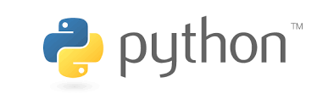
vs
Best* for “data science” – data wrangling + analysis
Easier syntax
Best for statistical modeling
But also tons of plotting functionality (see ggplot)
See also: Rstudio, shiny apps
We’ll occasionally be forced to use R (e.g. lab 4)
(You can also run R code in Jupyter notebooks. See ”%%R” magic)
* These are my opinions. Some people will vigorously argue otherwise
I’m a python person. So we’re using Python)
Also see: emacs vs. vi

Slide 8
Python data science libraries
Pandas – great for wrangling data in “table” format. If you will be wrangling data in Python, learning pandas is essential
Numpy – general purpose library for dealing with arrays or matrices of data
Matplotlib – plotting! (plays nicely with other libraries on this list)
See also: tensorflow (deep learning), scikit-learn (modeling), scipy (linear algebra and more), seaborn (plotting), plotly or bokeh (interactive plotting)
Notes:
Pandas
numpy
Matplotlib
Others built on top of this (e.g. seaborn, bokeh, plotly)
Others to make interactive plots (plotly)

Slide 9
Loading matplotlib
Both of these allow you to access matplotlib plotting functions using “plt”:
%pylab inline # “Magic” function for Jupyter notebooks
# that loads matplotlib and numpy
See here: https://stackoverflow.com/questions/20961287/what-is-pylab for what this magic actually does
from matplotlib import pyplot as plt # can use in a regular python script
# (outside of Jupyter)

Slide 10
The anatomy of a plot
fig = plt.figure() # keeps track of the
# whole figure
ax = fig.add_subplot(111) # add an “axis”
# Alternatively:
fig, ax = plt.subplots()
Axis
Figure

Slide 11
The anatomy of a plot – can have multiple subplots
# Create a 2x2 grid of plots
fig = plt.figure()
ax1 = fig.add_subplot(221)
ax2 = fig.add_subplot(222)
ax3 = fig.add_subplot(223)
ax4 = fig.add_subplot(224)
ax1
ax2
# Alternatively:
fig, axs = plt.subplots(2, 2)
ax3
ax4
Figure

Slide 12
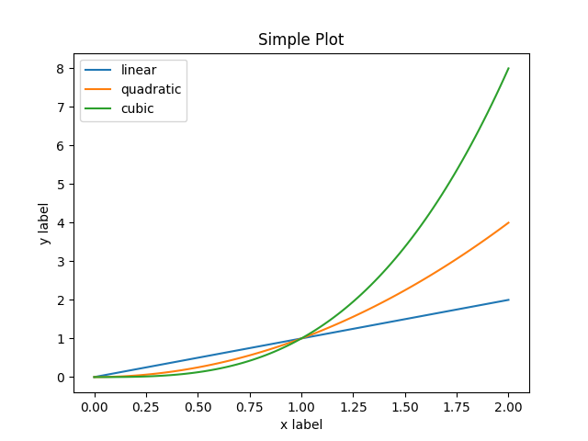
The anatomy of a plot - we can customize all of this!
ax.set_title(“Simplot plot”)
fig = plt.figure()
ax = fig.add_subplot(111) # add an “axis”
ax.plot(…) # plotting commands in next slides
ax.legend()
Can also:
Add a grid
Remove axis lines
Resize the figure
And more…
ax.set_ylabel(“y label”)
ax.set_xticks(…)
ax.set_xticklabels(…)
ax.set_xlabel(“x label”)
https://matplotlib.org/stable/tutorials/introductory/usage.html#sphx-glr-tutorials-introductory-usage-py

Slide 13
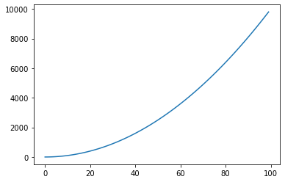
Simple plots – line plot
# Simple line plot
xvals = range(100)
yvals = [i**2 for i in xvals]
fig = plt.figure()
ax = fig.add_subplot(111)
ax.plot(xvals, yvals)
xvals and yvals must be equal length
Can be any array-like object: lists, numpy arrays, pandas series

Slide 14
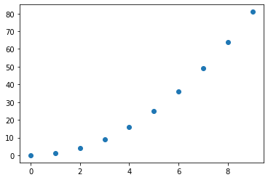
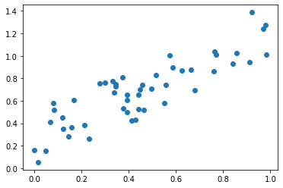
Simple plots – scatter plots
import random
xvals = [random.random() for i in range(50)]
yvals = [item + 0.5*random.random() for item in xvals]
fig = plt.figure()
ax = fig.add_subplot(111)
ax.scatter(xvals, yvals)
xvals = range(10)
yvals = [i**2 for i in xvals]
fig = plt.figure()
ax = fig.add_subplot(111)
ax.scatter(xvals, yvals)
Example use cases:
Checking reproducibility of replicates of a measurement.
E.g. two replicates of a gene expression dataset.
Checking whether two variables are correlated
e.g. height vs. weight
Notes:
TODO
Compare measurements to see reproducibility
See relationship of variables

Slide 15
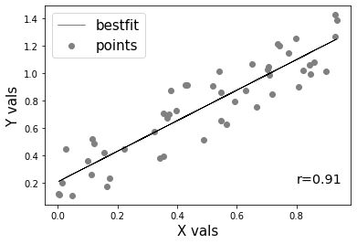
Simple plots – combining and customizing plot types
import numpy as np
import scipy.stats
fig = plt.figure()
ax = fig.add_subplot(111)
ax.scatter(xvals, yvals, color="gray",
label="points")
# Best fit line
m, b = np.polyfit(xvals, yvals, 1)
ax.plot(xvals, [m*item+b for item in xvals],
color="black", linewidth=0.5,
label="bestfit")
# Labels
ax.legend(fontsize=15)
ax.set_xlabel("X vals", size=15)
ax.set_ylabel("Y vals", size=15)
# Annotate with correlation
r, p = scipy.stats.pearsonr(xvals, yvals)
ax.annotate("r=%.2f"%r, (0.8, 0.2), fontsize="x-large")
Can run multiple plot commands sequentially e.g.:
ax.scatter(…)
ax.plot(…)
Original
Customized
Can customize:
Color
Linewidth
Linestyle
And more
Can annotate with text or legend

Slide 16
Variations on scatter plots
# data points
Measurement #2
Measurement #2
Measurement #1
ax.scatter(x, y, s=counts)
Measurement #1
ax.hist2d(x, y, bins=50, norm=LogNorm(), cmap=plt.cm.jet)
import seaborn as sns
sns.jointplot(… kind=“kde”)
“2d histogram”
“Bubble plot”
“Kde plot”

Slide 17
Visualizing distributions
List of numbers
Can summarize with:
Mean
Variance
Mode
Min
Max
??
But these numbers often don’t tell the whole story!
e.g. fragment lengths for each read pair, or coverage at each base

Slide 18
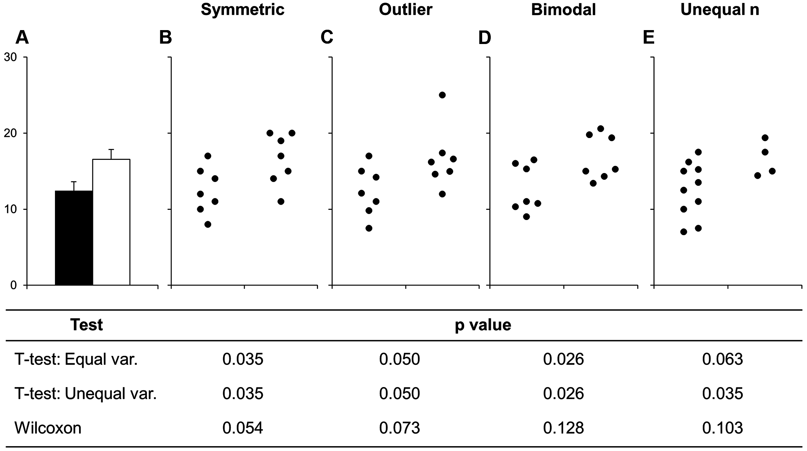
Some visualizations can be misleading
Many different datasets can lead to the same bar graph!
Beyond Bar and Line Graphs: Time for a New Data Presentation Paradigm (Weissgerber, et al.)
Notes:
TODO
Example
https://journals.plos.org/plosbiology/article?id=10.1371/journal.pbio.1002128

Slide 19
“Same stats, different graphs”
All of these datasets have the same: mean (x), mean(y), var(x), var(y), and Pearson correlation(x,y):
But clearly, they are all very different!
Justin Matejka and George Fitzmaurice
https://damassets.autodesk.net/content/dam/autodesk/www/autodesk-reasearch/Publications/pdf/same-stats-different-graphs.pdf

Slide 20
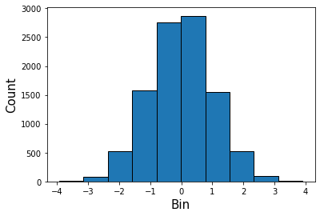
Visualizing distributions - histograms
# Generate random data
# 10K draws from standard normal
data = np.random.normal(size=10000)
# Plot a histogram
fig = plt.figure()
ax = fig.add_subplot(111)
ax.hist(data, edgecolor="black");
ax.set_xlabel("Bin", size=15)
ax.set_ylabel("Count", size=15)
# data points in this bin
Break data into “bins”
(By default, breaks data into 10 equally sized bins)

Slide 21
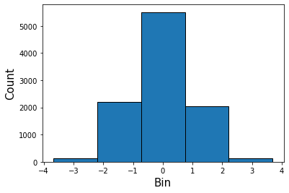
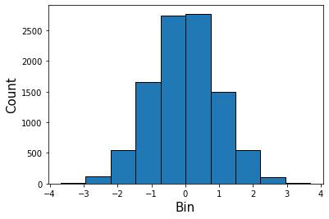
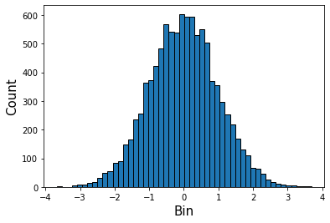
Visualizing multiple distributions - histograms
ax.hist(data, bins=5);
ax.hist(data, bins=10);
ax.hist(data, bins=50);
Same data, different bin sizes
You might have to play around!

Slide 22
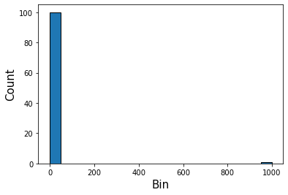
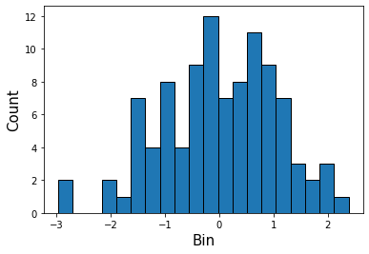
Watch out for outlier samples
Before filtering, bins=20
After filtering, bins=20
1 outlier sample with value=1000
Bins=20

Slide 23
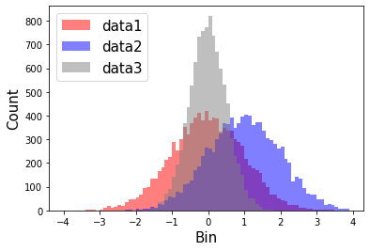
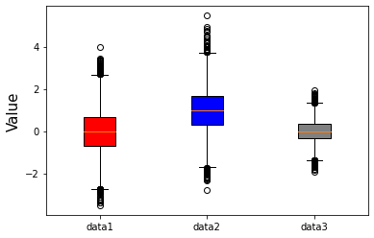
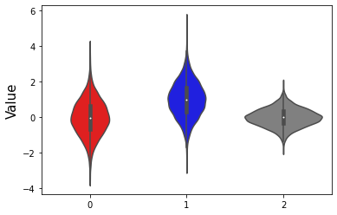
Visualizing multiple distributions
data1 = np.random.normal(size=10000)
data2 = np.random.normal(loc=1, size=10000)
data3 = np.random.normal(loc=0, scale=0.5, size=10000)
Histogram
Boxplot
Violinplot
ax.hist(data1, color=“red”)
ax.hist(data2, color=“blue”)
ax.hist(data3, color="gray);
ax.boxplot([data1, data2, data3])
sns.violinplot([data1, data2, data3])

Slide 24
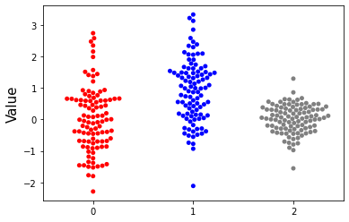
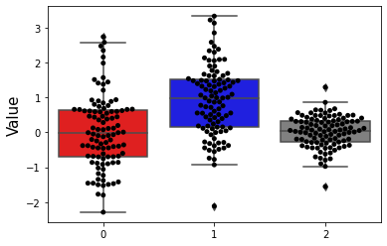
Visualizing multiple distributions – beeswarm plots
data1 = np.random.normal(size=100)
data2 = np.random.normal(loc=1, size=100)
data3 = np.random.normal(loc=0, scale=0.5, size=100)
sns.swarmplot([data1, data2, data3])
sns.boxplot([data1, data2, data3])
sns.swarmplot([data1, data2, data3])

Slide 25
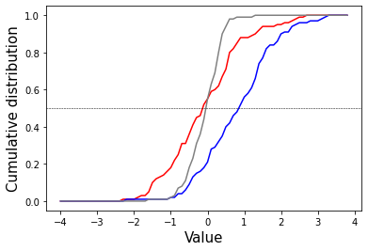
Visualizing distributions – CDF plots
bins = np.arange(-4, 4, 0.1)
fig = plt.figure()
ax = fig.add_subplot(111)
datasets = [data1, data2, data3]
colors = ["red","blue","gray"]
for ds, color in zip(datasets, colors):
total = len(ds)
counts, x = np.histogram(ds, bins)
ds_cum = [item/total for item in np.cumsum(counts)]
ax.plot(bins[:-1], ds_cum, color=color)
ax.axhline(y=0.5, linestyle="dashed", color="black",
linewidth=0.5)
ax.set_xlabel("Value", size=15)
ax.set_ylabel("Cumulative distribution", size=15)
% of data points smaller than x
Y=0.5 crosses the CDF at the median
CDF=cumulative distribution function

Slide 26
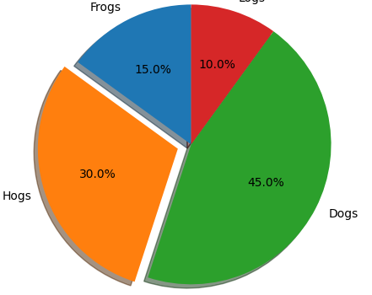
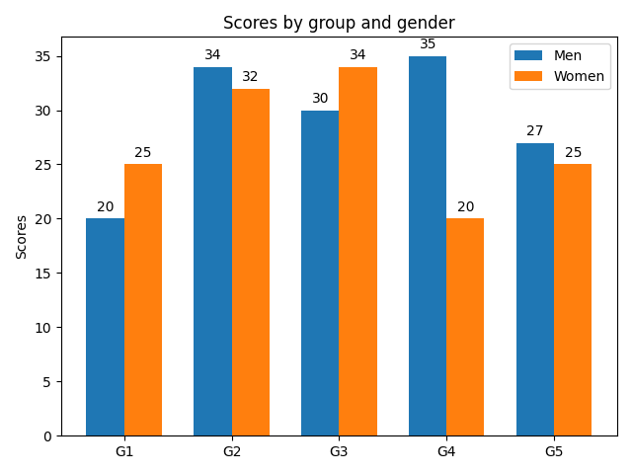
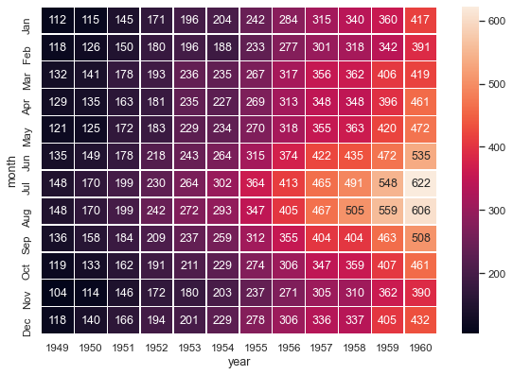
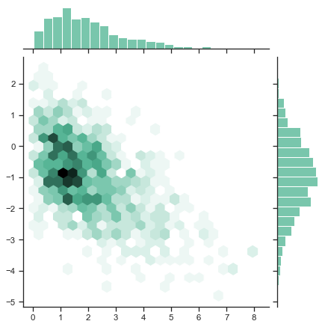
And many others!
ax.pie(…)
ax.bar(…)
sns.heatmap(…)
sns.jointplot(…)
https://github.com/matplotlib/cheatsheets#cheatsheets
https://seaborn.pydata.org/examples/index.html

Slide 27
We’ll see other specialized plot types
We’ll see multiple specialized plot types soon:
QQ plots
Manhattan plots
Volcano plots
T-SNE plots
All build on these basic plot types (line plots, scatter plots, histograms, etc.)
You now have all the tools you need to make powerful, customized, and pretty visualizations!

Slide 28
Visualization for QC

Slide 29
Big data = big potential (and hard to see) problems
Time spent doing bioinformatics analysis:
Testing new hypotheses
Performing sanity checks for which you already know what the answer should be
The more ways you find to visualize your data, the more likely you are to see potential problems

Slide 30
Example checks for our NGS pipeline
Only after all this:
Look for candidate disease-causing mutations
Raw reads
Alignment
Genotyping
# Reads
FastQC checks
…
# variants match expected
Check # variants per chromosome
Transition:transversion ratio
Do variants in families follow Mendelian inheritance rules?
Visualize candidate variants in a genome browser
…
% aligned
What % of genome covered?
PCR duplicates rate
Visualize coverage distribution
Visualize fragment length distribution
Visualize reads in a genome browser
Coverage match expected?
Coverage of sex chromosomes match expected?
…

Slide 31
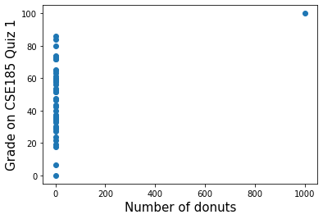
Visualizations for QC – outlier detection
Question: is the number of donuts you eat for breakfast correlated with your score on CSE185 Quiz 1?
Best fit line
Student | # Donuts | Score
1 | 0 | 100
2 | 1 | 100
3 | 0 | 80
4 | 3 | 85
5 | 2 | 90
… | … | …
Your Answer: whoa, I found a significant correlation! R=0.35, pval=0.01
Do you believe this result?
Notes:
TODO
Example
Scatter plot with super high correlation
But driven by outlier point

Slide 32
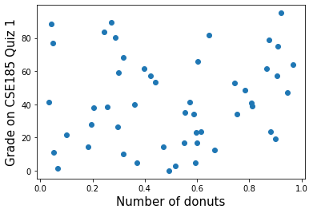
Visualizations for QC – outlier detection
Question: is the number of donuts you eat for breakfast correlated with your score on CSE185 Quiz 1?
After filtering outliers:
No significant correlation…
Notes:
TODO
Example
Scatter plot with super high correlation
But driven by outlier point

Slide 33
Visualizations for QC – outlier detection + missing data
Question: You are studying mutations occurring in children affected by autism (cases), and in their unaffected siblings (controls). You’d like to test whether you see more mutations in cases vs. controls.
Child ID | Affected? | # Mutations
1 | No | 100
2 | No | 100
3 | Yes | 80
4 | Yes | 85
5 | Yes | 90
… | … | …
Your Answer: you find that unaffected children have 20% more mutations compared to their affected siblings
Do you believe this result?

Slide 34
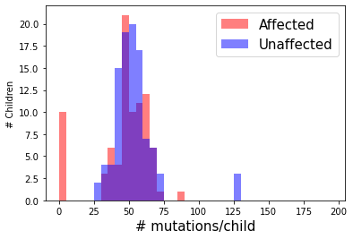
Visualizations for QC – outlier detection + missing data
Contaminated samples
Samples with missing data

Slide 35
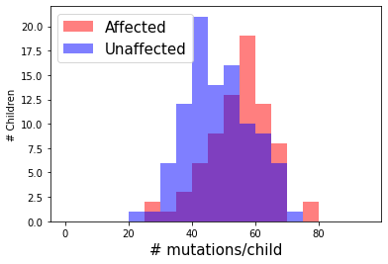
Visualizations for QC – outlier detection + missing data
After filtering outliers:
Affected siblings actually have significantly more mutations!

Slide 36
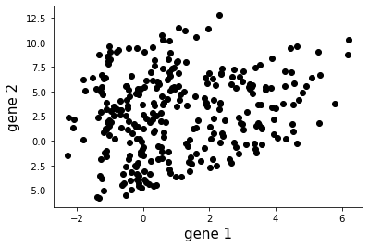
Visualizations for QC – batch effects
Question: You are interested in whether expression of gene 1 is related to expression of gene 2. You and your two friends each measure expression of the two genes in 100 samples of cells each. You then combine your results to look for a correlation.

Slide 37
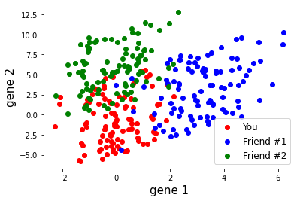
Visualizations for QC – batch effects
Color cells by who measured expression in each of them:
Question: You are interested in whether expression of gene 1 is related to expression of gene 2. You and your two friends each measure expression of the two genes in 100 samples of cells each. You then combine your results to look for a correlation.

Slide 38
You can even make your plots interactive!
Plotly (https://plotly.com) or Bokeh (https://docs.bokeh.org) and dash (https://plotly.com/dash/) for interactive Python plots
R Shiny (https://shiny.rstudio.com) for interactive web visualizations with R
See also D3.js for (very cool) interactive plots in Javascript
Plotly example:

Slide 39
Making visualizations for presentations and publications

Slide 40
Lesson 1: Don’t settle for the default plot settings
Default
Custom plot changes

Slide 41
Lesson 2: Choose pleasing, and consistent, color schemes
Red=cases (probands), blue=controls
Notes:
TODO
Example using same color scheme throughout the paper

Slide 42
Lesson 3: Annotate and combine plot types to tell your story
You can use matplotlib as a starting point, but for the best visualizations, you’ll have to go beyond standard packages.
For publication-quality figures, you can arrange plots using:
Powerpoint
Adobe Illustrator
Or similar programs…
https://www.cell.com/trends/molecular-medicine/fulltext/S1471-4914(20)30065-4

Slide 43
Lesson 4: Maximizing the data/ink ratio
Edward Tufte
Remove “chart junk” that distracts from your story
https://medium.datadriveninvestor.com/the-10-commandments-of-data-science-visualization-d9cdea950b74

Slide 44
Lesson 5: Strive for reproducibility
Jupyter notebooks are great for making reproducible figures!
Example: github.com/gymreklab/gtex-estrs-paper

Slide 45
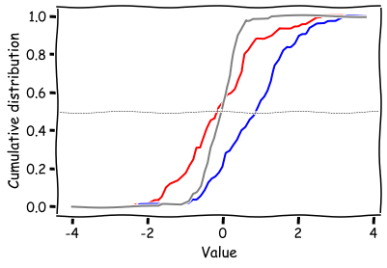
To play around more with these visualizations:
https://nbviewer.jupyter.org/gist/gymreklab/01012f7793a448a18898fa908e34c385
plt.xkcd()
# more plotting commands…
See also on nbviewer:
More plotly examples
A Matplotlib extension to make XKCD-style plots!
And more publicly viewable Jupyter notebooks

Slide 46
You can run Jupyter notebooks locally on your computer
# Install Jupyter and plotting libraries used
conda install -c conda-forge jupyterlab
conda install matplotlib
conda install scipy
conda install seaborn
conda install -c plotly plotly=4.14.3
# Run Jupyter
jupyter notebook # will open web browser with the Jupyter environment
https://jupyter.org/install

