Slide 1
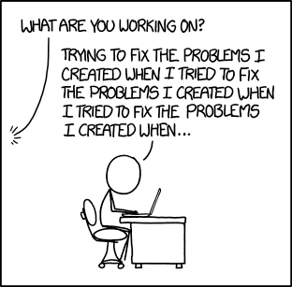
CSE185 – Week 2 Part 1
Sources of error in NGS
April 6, 2021
Announcements:
See “Commands cheatsheet” page on the course website.
Check Piazza and Canvas regularly for announcements/tips on labs.
Lab 1 due Sunday
https://xkcd.com/1739/

Slide 2
Today’s schedule
Sources of errors in our NGS pipeline
Computational methods to detect, and sometimes correct, errors

Slide 3
NGS Variant Calling pipeline
Things can go wrong at every step!!
1. Sequencing
2. Quality Control (QC)
3. Alignment
4. Variant calling
5. Interpretation
????

Slide 4
Sources of sequencing error
Sample collection
“Upstream”
Library preparation
“During”
Sequencing
Analysis

Slide 5
Upstream sources of error - amplification
“Upstream” errors occur during amplification of the DNA or other steps prior to sequencing
DNA in a single human cell: 4pg (4x10⁻¹² grams)
125,000X !!
Need many cells, and many copies of each
Use PCR to amplify
DNA needed for Illumina sequencing ~500ng (4x10⁻⁷ grams)
Every time DNA is copied (amplified), there is an opportunity to introduce errors!

Slide 6
Upstream sources of error - amplification
The earlier a copying error occurs, the more harmful it is (blue=error)
Copying error occurs late
Copying error occurs early
Amplification cycles

Slide 7
Upstream sources of error - amplification
Repetitive regions prone to “stutter” errors:
“GC”-rich sequences difficult to amplify
ATCAGTCGTACGGATCGCGGGCGCGGGCGGCCGGCCGGCCGGGGCCGCGGGCGGCGGGGCCCCGGGCAAATCG

Slide 8
Upstream sources of error - amplification
Representation bias:
Mixed population
(e.g. genetic variation,
Different genomic regions,
mRNA expression)
Biased amplification

Slide 9
Upstream sources of error - amplification
“Complexity”: how diverse our pool of molecules is
Mixed population
(e.g. genetic variation,
Different genomic regions,
mRNA expression)
Biased amplification = low complexity

Slide 10
Upstream sources of error - amplification
“Complexity”: how diverse our pool of molecules is
Mixed population
(e.g. genetic variation,
Different genomic regions,
mRNA expression)
Unbiased amplification
High complexity

Slide 11
Visualizing library complexity
Low complexity = bad sign! Sequencing the same small number of molecules many times
Results might be biased
Reference genome
Reads
Reference genome
Reads
High complexity = good!

Slide 12
Library complexity – detection and correction
Common step is to collapse “PCR duplicates”
(All reads with the same start coordinate and length)
samtools rmdup
or
java –jar picard.jar MarkDuplicates
Reference genome
Reads
Reference genome
Reads
% of duplicates identified indicative of library complexity

Slide 13
Upstream sources of error - contamination
Mouse DNA
(target)
Human DNA
(contamination)

Slide 14
Contamination – how to detect
Mouse reference genome
Reads
samtools flagstat reads.bam
Unaligned reads
Low % reads aligned to the target reference genome could indicate contamination
e.g. from human or other sources

Slide 15
Sources of sequencing error
Sample collection
“Upstream”
Library preparation
“During”
Sequencing
Analysis

Slide 16
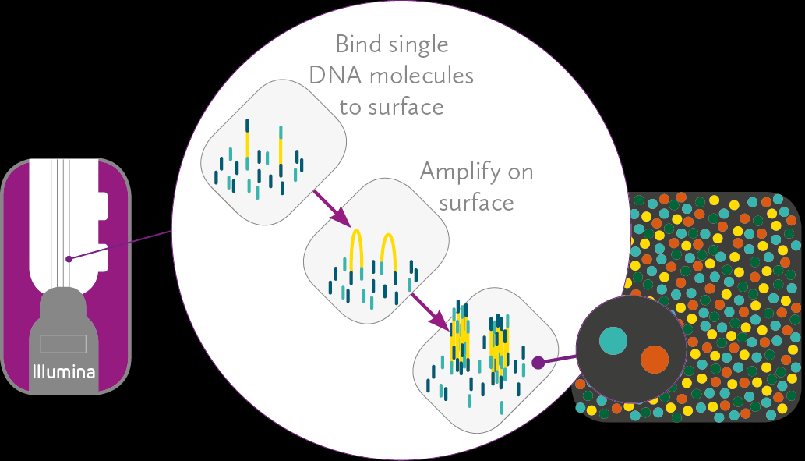
Sources of sequencing error
Incorrect base
“During” errors occur in cluster generation or sequencing by synthesis

Slide 17
Sources of sequencing error
Missing base
“During” errors occur in cluster generation or sequencing by synthesis

Slide 18
Quality scores
Fluorescence intensity
A
C
G
T

Slide 19
Quality scores
Probability that the most intense color is the correct base
Fluorescence intensity
A
C
G
T

Slide 20
Quality scores
@ERR194146.1 HSQ1008:141:D0CC8ACXX:3:1308:20201:36071/1
ACATCTGGTTCCTACTTCAGGGCCATAAAGCCTAAATAGCCCACACGTTCCCCTTAAATAAGACATCACGATGGATCACAGGTCTATCACCCTATTAACCA
+
?@@FFBFFDDHHBCEAFGEGIIDHGH@GDHHHGEHID@C?GGDG@FHIGGH@FHBEG:GGIEEHH;@CHH=EDFFBBE>;@?3;;;>;;;AA?<C>C@@C:
Q = -10 log₁₀P
Phred Score | Prob. Of incorrect call | Base call accuracy
10 | 1 in 10 | 90%
20 | 1 in 100 | 99%
30 | 1 in 1,000 | 99.9%
40 | 1 in 10,000 | 99.99%
50 | 1 in 100,000 | 99.999%
Base quality score symbol = ASCII(Q+33)
e.g. 10=+, 20=5, 30=?

Slide 21
Quality scores and read length
Errors accumulate each cycle
Eventually we have a hard time distinguishing the true base
Fluorescence intensity
Fluorescence intensity
Fluorescence intensity
Fluorescence intensity
Fluorescence intensity
A
A
A
A
A
C
C
C
C
C
G
G
G
G
G
T
T
T
T
T

Slide 22
Quality scores and read length
Typical FastQC plot (recall part 1 of the lab. Although your data there should look better than this!)
Next week: read trimming to improve read quality
Question: Why do quality scores increase over the first couple of cycles?
Read position (cycle number)

Slide 23
Quality scores and read length (NGS trivia)
Calibration
Illumina uses the first 4 cycles (bases) to learn the difference between the 4 colors (nucleotides)
The first 11 cycles (bases) are used for the final color matrix estimation
Caveat: If the beginning of your sequences is all the same (low complexity), the machine won’t be able to learn these models and might fail!
Common solution: spike in 10% PhiX DNA library as a control
Read position (cycle number)

Slide 24
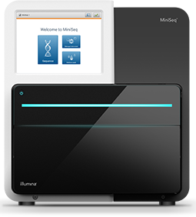
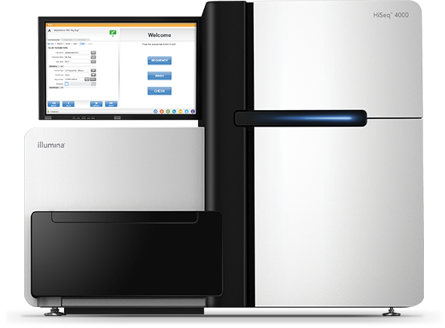
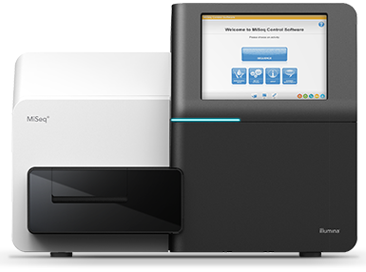
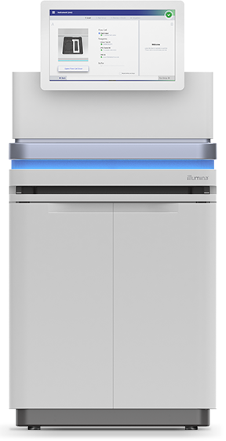
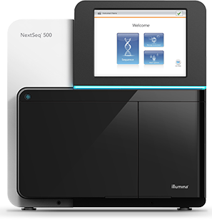
Quality scores and read length
Initial read lengths of 2x36, 2x50, 2x76 from Genome Analyzer or GAII (e.g. 2010)
Currently, most common read lengths 100-150bp
Modern-day Illumina read lengths:
MiniSeq: 2 x 150bp
HiSeq: 2 x 150bp
MiSeq: 2 x 300bp
Novaseq: 2 x 300bp
NextSeq: 2 x 150bp
Stay tuned next week for… long (~50kb+) reads!

Slide 25
What else could go wrong?
Murphy’s Law: If it can go wrong, it will (at some point)
Per-tile quality scores:
What might cause this pattern?

Slide 26
What else could go wrong?

Slide 27
NGS Variant Calling pipeline
Things can go wrong at every step!!
1. Sequencing
2. Quality Control (QC)
3. Alignment
4. Variant calling
5. Interpretation
????

Slide 28
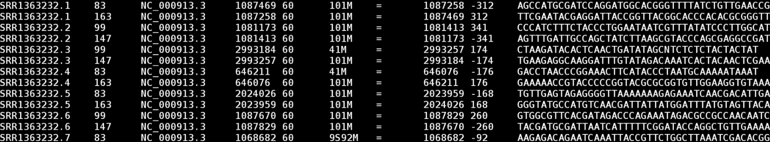
Alignment issue #1 – unique mapping
Duplicated sequence
Reference genome
unique
Non-unique
A read may map equally well to more than one place!
Paired end reads can improve mapping specificity (not always)
Column 5: Mapping quality. MAPQ = -1*log10(Prob. Mapping position is wrong)
0=non-unique
SAM file:

Slide 29
Alignment issue #2 – low/no coverage
Reference genome
Reads
No reads mapped to this region!
Why?
Possible explanations:
The region is not uniquely mappable (e.g. repetitive)
The reference genome is not complete or correct in this region
The region has extremely high or low GC content
Other ideas?

Slide 30
Alignment issue #3 – super high coverage
Reference genome
Reads
Possible explanations:
The region is repeated many times in the genome but only present once in the reference sequence
Others?
Way more reads than expected mapped to this region!
Why?

Slide 31
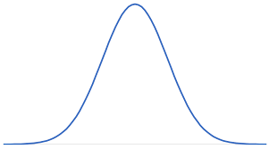
Looking at the fragment length distribution
…
…
Template length (bp)
% Fragments
Expect fragments to follow a ~normal distribution
100
200
300
Template length (bp)

Slide 32
Looking at the fragment length distribution
Reads appear 150bp apart
…
…
Reference genome
Target genome
Observed (at this region)
50bp insertion
Expected
(genome-wide)
200 bp fragment
% Fragments
What would this look like if our target genome had a large deletion?
100
200
300
Template length (bp)

Slide 33
Alignment issue #4 – messy local alignment at repeats
Reference genome
ACGTAGCTACGTATATATATATATACACACACACACACATCGATCGATCTTCTAAA
Reads
ACGTAGCTACGTATATATATA----CACACACACATCGATC
ACGTAGCTACGTATATATATACACA----CACACATCGATC
ACGTAGCTACGTATATATACACACACACACACACATCGATC
ACGTAGCTACGTATATATATATA--CACACACACATCGATC
ACGTACGTAGCTACGTATATACACAC
Potential solutions:
Left align indels
Tune local alignment scoring
Others?

Slide 34
NGS Variant Calling pipeline
Things can go wrong at every step!!
1. Sequencing
2. Quality Control (QC)
3. Alignment
4. Variant calling
5. Interpretation
????

Slide 35
Review: variant calling
Reference genome
T
T
A
T
A
A
A
T
A
Goal: find positions where our target genome differs from the reference

Slide 36
Genotyping variants from short reads – real data example (IGV)
Homozygous
variant
Heterozygous
variant

Slide 37
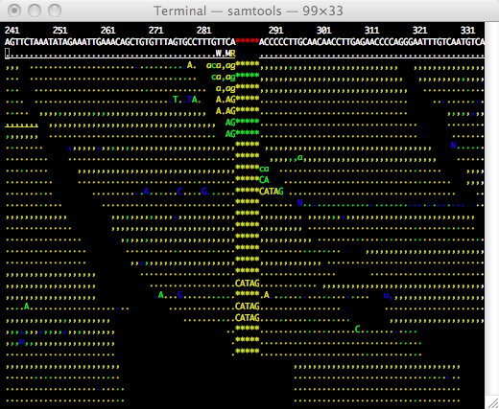
Is this really a variant?
Reference genome
T
A
A
A
T
T
T
All the variant bases are at the ends of reads – bad sign!

Slide 38
Is this really a variant?
Duplicated sequence
Reference genome
T
A
T
A
T
A
T
A
T
A
MAPQ=0
MAPQ=60

Slide 39
Are these really variants?
This one looks more promising…
Unreliable SNP call!
All supporting reads are PCR duplicates

Slide 40
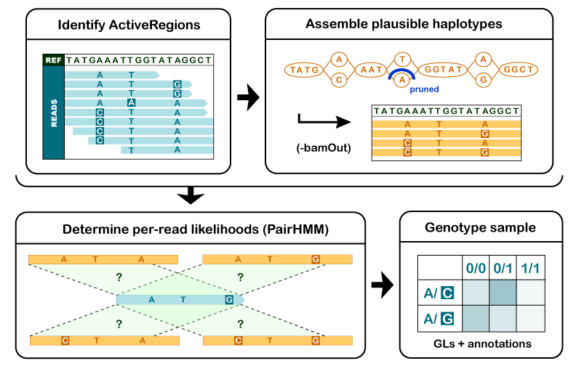
State of the art variant calling approaches – GATK (modeling)
http://gatkforums.broadinstitute.org/

Slide 41
State of the art variant calling approaches – DeepVariant (ML)
Poplin et al Nature Biotechnology 2018

Slide 42
Omg so many things can go wrong…
How can I ever trust my data?

Slide 43
QC QC QC!
Time spent doing bioinformatics analysis:
Testing new hypotheses
Performing sanity checks for which you already know what the answer should be
Before you can draw new conclusions, you have to be confident that your data is high quality, and convince other people that’s the case!
Notes:
Spend 90% of analysis time performing obvious analyses you know what the answer should be
e.g.:
Coverage histogram
Frag length distribution
Types of mutations
Plot everything against everything – more on plotting Thursday

Slide 44
Example checks for our NGS pipeline
Only after all this:
Look for candidate disease-causing mutations
Raw reads
Alignment
Genotyping
# Reads
FastQC checks
…
# variants match expected
Check # variants per chromosome
Transition:transversion ratio
Do variants in families follow Mendelian inheritance rules?
Visualize candidate variants in a genome browser
…
% aligned
What % of genome covered?
PCR duplicates rate
Visualize coverage distribution
Visualize fragment length distribution
Visualize reads in a genome browser
Coverage match expected?
Coverage of sex chromosomes match expected?
…

