Slide 1
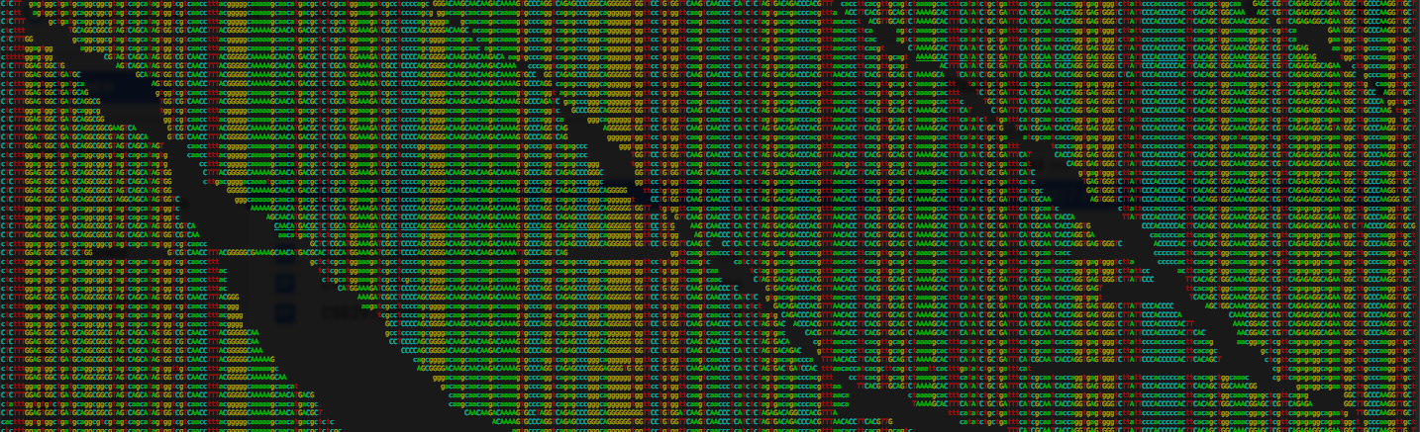
CSE185 – Week 1 Part 2
NGS alignment + variant calling
April 1, 2021
Announcements:
Sign up for Piazza: http://piazza.com/eng.ucsd/spring2021/cse185
Check Piazza and Canvas regularly for announcements/tips on labs.
Please fill out the survey on Canvas.
See Assignments->Surveys->Week1 Survey.

Slide 2
Happy April Fool’s Day ☺
“On a scale of 1-5, where 5 is above average, how would you rate your sense of humor?” n=466,828
Relative sense of humor by geography
https://blog.23andme.com/23andme-research/does-your-dna-make-you-lol/

Slide 3
Lab 1: Mutation hunting: find the needle in a haystack
A patient arrives in your clinic with a rare disorder. You expect the condition is genetic (i.e. due to a mutation in her genome). However since the condition is not observed in any family members, you suspect it could be due to a de novo mutation that occurred in the germline (egg or sperm cells) of one of her parents.
Father
T/T
T/T
Mother
Challenge:
How to go from:
NGS data -> the mutation causing the disease?
A/T
Child

Slide 4
Today’s Schedule
NGS variant calling pipeline
  Alignment
  Genotyping
  Variant Interpretation
FAQ: Dealing with strand info
Intro to Lab 1

Slide 5
NGS variant calling pipeline

Slide 6
NGS Variant Calling pipeline
See Lecture #1 slides
https://www.youtube.com/watch?v=fCd6B5HRaZ8
See “Extra resources” page on Canvas
1. Sequencing
2. Quality Control (QC)
More next week
3. Alignment
4. Variant calling
5. Interpretation
????

Slide 7
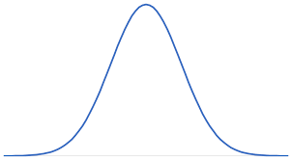
Review of paired end sequencing
…
…
Genome
Fragment
Template length
(fragment length/insert size)
Sequence
Read1
Read 2
Fragment lengths aren’t precise
They follow a *distribution*
% Fragments
100
200
300
Template length (bp)
Notes:
TODO
Show genome at the top
Show how we sequence little fragments
Show distribution of fragment lengths, meaning of “insert size”

Slide 8
Review of paired end sequencing – zoom in
Read 1 (~100bp)
AGTACTAGCTA…
DNA seqs always written from 5’ to 3’:
Fragment
5’ – AGTACTAGCTAGCAT…GCTATCATGCTAGCTACA – 3’
3’ – TCATGATCGATCGTA…CGATAGTACGATCGATGT – 5’
…CGATCGATGT
@Read 1
AGTACTAGCTA…
…
@Read 2
TGTAGCTAGC…
…
Read 2 (100bp)
This part usually not sequenced!
5’
3’
3’
5’
Notes:
Helpful video: http://www.youtube.com/watch?v=HMyCqWhwB8E&t=1m30s

Slide 9
The raw data! (raw reads, fastq)
reads_1.fastq
(first end of each pair)
@ERR194146.1 HSQ1008:141:D0CC8ACXX:3:1308:20201:36071/1
ACATCTGGTTCCTACTTCAGGGCCATAAAGCCTAAATAGCCCACACGTTCCCCTTAAATAAGACATCACGATGGATCACAGGTCTATCACCCTATTAACCA
+
?@@FFBFFDDHHBCEAFGEGIIDHGH@GDHHHGEHID@C?GGDG@FHIGGH@FHBEG:GGIEEHH;@CHH=EDFFBBE>;@?3;;;>;;;AA?<C>C@@C:
@ERR194146.2 HSQ1008:141:D0CC8ACXX:4:1208:5231:93701/1
CCAGCGTCTCGCAATGCTATCGCGTGCATACCCCCCAGACGAAAATACCAAATGCATGGAGAGCTCCCGTGAGTGGTTAATAGGGTGATAGACCTGTGATC
+
?88ADA?BDF8F:@@DB49C>B7C806B<?DEF=@FFC=AABEA<;@D>AC265;ADA;@@?<@B@A<;?5(8+:0>(4:@AAA832?@@BBBB:<4(:>>
@ERR194146.3 HSQ1008:141:D0CC8ACXX:2:1305:18078:8420/1
GATCACAGGTCTATCACCCTATTAACCACTCACGGGAGCTCTCCATGCATTTGGTATTTTCGTCTGGGGGGTATGCACGCGATAGCATTGCGAGACGCTGG
+
@CCFFFFFHHFGHJIGJJJJJJJJJJJIJIIJJJIJJJIGJJJJIIJIGIHIJI=FFIJJJJHHJHGHHDD;@CDDEDDDDDBDDDCECDDDDDBDDDDDD
Each read described by 4 lines
Line 1: “@” + Read ID
Line 2: Nucleotides
Line 3: “+”
Line 4: Base quality scores
reads_2.fastq
(second end of each pair)
@ERR194146.1 HSQ1008:141:D0CC8ACXX:3:1308:20201:36071/2
CCAGCGTCTCGCAATGCTATCGCGTGCATACCCCCCAGACGAAAATACCAAATGCATGGAGAGCTCCCGTGAGTGGTTAATAGGGTGATAGACCTGTGATC
+
<?@DDDBDHHHAAH@CG@FBBGGIEG@D@GCHFG@F/5=C4=B'=7?CA9@?ACDCDCA@<?BDCCCB=BB0<4>?4?>@:CCD???A:@C3>A>AC:++:
@ERR194146.2 HSQ1008:141:D0CC8ACXX:4:1208:5231:93701/2
CCCACACGTTCCCCTTAAATAAGACATCACGATGGATCACAGGTCTATCACCCTATTAACCACTCACGGGAGCTCTCCATGCATTTGGTATTTTCGTCTGG
+
@??BD1:AFHBDDGGHIJIF@EEE>GFHGHEAG?DEG<FD>B;?BB<*/9??C8BB@FHC7=CCGAE;=,5,,.;@@>(5(;>ACCC(,,5;>CCB88<??
@ERR194146.3 HSQ1008:141:D0CC8ACXX:2:1305:18078:8420/2
GATCACAGGTCTATCACCCTATTAACCACTCACGGGAGCTCTCCATGCATTTGGTATTTTCGTCTGGGGGGTATGCACGCGATAGCATTGCGAGACGCTGG
+
@CCFFFFFHHFGHJIGJJJJJJJJJJJIJIIJJJIJJJIGJJJJIIJIGIHIJI=FFIJJJJHHJHGHHDD;@CDDEDDDDDBDDDCECDDDDDBDDDDDD

Slide 10
Alignment: where did my reads come from??
…
…
Human reference genome
Collection of reads from our patient
Notes:
This week we’re assuming we have this “reference genome”
Next week we’ll learn more about where that comes from

Slide 11
The raw data! (reference genome, fasta)
hg19.fasta
>chr5
AGCTTTTCATTCTGACTGCAACGGGCAATATGTCTCTGTGTGGATTAAAAAAAGAGTGTCTGATAGCAGC
TTCTGAACTGGTTACCTGCCGTGAGTAAATTAAAATTTTATTGACTTAGGTCACTAAATACTTTAACCAA
TATAGGCATAGCGCACAGACAGATAAAAATTACAGAGTACACAACATCCATGAAACGCATTAGCACCACC
ATTACCACCACCATCACCATTACCACAGGTAACGGTGCGGGCTGACGCGTACAGGAAACACAGAAAAAAG
CCCGCACCTGACAGTGCGGGCTTTTTTTTTCGACCAAAGGTAACGAGGTAACAACCATGCGAGTGTTGAA
GTTCGGCGGTACATCAGTGGCAAATGCAGAACGTTTTCTGCGTGTTGCCGATATTCTGGAAAGCAATGCC
AGGCAGGGGCAGGTGGCCACCGTCCTCTCTGCCCCCGCCAAAATCACCAACCACCTGGTGGCGATGATTG
AAAAAACCATTAGCGGCCAGGATGCTTTACCCAATATCAGCGATGCCGAACGTATTTTTGCCGAACTTTT
GACGGGACTCGCCGCCGCCCAGCCGGGGTTCCCGCTGGCGCAATTGAAAACTTTCGTCGATCAGGAATTT
Chromosome (everything after “>” until the first space)
For humans: chr1, chr2, …. chr22, chrX, chrY
Pay attention to the reference build!
For humans: reference assembly gets updated every couple of years!
GRCh38 (most recent), hg19 (lab 1), hg18
”Multi-line” vs. ”single-line” fasta format
Notes:
Talk about updates to human ref genome

Slide 12
Sequence alignment
…
…
Human reference genome
Millions of 100bp reads + long (3*10⁹ bp) reference sequence
Naïve solution: search time is O(|ref genome|) for each read.
Too slow!

Slide 13

Solution: index genome in a quickly searchable data structure!
…
bwa index hg19.fa
Create the BWT index first!
(Done for you already)
…
Human reference genome
Chr1:3899292
ATCGACGATAGCCG
ACGATAG
ACGATAG
Genome
Index
Search time: O(read length) !
Burrows Wheeler Transform (BWT)
Implemented in “bwa” (Burrows Wheeler Aligner)
See bonus slides for algorithm details!
Notes:
TODO show BWT
Can query in O(read length)
Rather than O(ref genome)
Command to index ref genome
Creates some special files
Bonus slides for how BWT actually works

Slide 14
Sequence alignment
…
bwa mem hg19.fa reads.fq
…
Single-end reads
…
…
Paired-end reads
bwa mem hg19.fa reads_1.fq reads_2.fq

Slide 15
SAM/BAM format stores alignment info
bwa mem hg19.fa reads_1.fq reads_2.fq > aligned_reads.sam
samtools view aligned_reads.sam
Tab-delimited text file
One line per read (usually)
(lines are cut off on the right so they fit on the slide)
3rd column =
chromosome
4th column =
position
See specs at https://samtools.github.io/hts-specs/SAMv1.pdf
More slides about SAM at the end of this slide deck!
Notes:
Todo show command outputting to sam
Show example SAM line
Chrom, pos, other fields

Slide 16
Visualizing alignments with IGV
Ref genome
Coverage
Reads
https://igv.org/app/
https://tinyurl.com/yg3za9ry

Slide 17
Our NGS pipeline - putting it all together
Reads
(*.fq, *.fastq)
Ref. genome (+ index files)
(*.fa, *.fasta)
Alignments
(*.sam, *.bam)
Alignment
Example aligner: BWA
(many others exist)

Slide 18
Sequencing coverage
Usually sequence many copies of a genome in one run
(e.g. by taking millions of cells as input)
…
…
Reference genome
Coverage/depth: number of reads covering a given base
Notes:
What will be the effects of sequencing coverage on our variant calling pipeline?
What if coverage is too low?
What about really high?
What is a good coverage to aim for?

Slide 19
Sequencing coverage
Coverage: how many times do we sequence a certain position in the genome
Read length * Number of reads
# Sequenced bases
Average coverage =
Length of the genome
e.g. To sequence a human genome (3 billion bp) to 30X coverage with 100bp reads, we need:
(3 billion * 30)/100 = 900 million reads (or 450M read pairs)

Slide 20
Sequencing coverage
You run one lane of a Hiseq instrument with 2x150bp reads to generate 150 million total read pairs. What will be the average coverage of a human genome (3 billion bp)?
150000000*2*150/3000000000 = 15x
You run one lane of a Hiseq instrument with 2x150bp reads to generate 150 million total read pairs. What will be the average coverage of an E. coli genome? (5 million bp)?
150000000*2*150/5000000 = 9000x

Slide 21
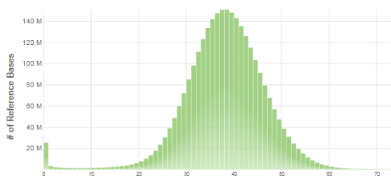
Sequencing coverage – it’s actually a *distribution*
…
…
Reference genome
Coverage:
0 0 0 1 2 3 3 3 4 4 4 4 3 2 1 1 1 0 0 0 0 1 1 2 3 3 3 3 3 3 2 1 1 0 0 0 0 2 2 2 2 2 2 2 2 2 0 0 0 0 0
16
Real data!
~40X WGS
Poisson-like distribution
13
10
# Bases
8
4
Why is there a spike at 0?
0
1
2
3
4
Coverage
Notes:
Show that it’s a distribution
Kind of Poisson like (although asterisk, neg binomial better)
Where does mean fall
Show real distribution
Some places with no coverage
Some places with lots of coverage

Slide 22
NGS Variant Calling pipeline
1. Sequencing
2. Quality Control (QC)
3. Alignment
4. Variant calling
5. Interpretation
????

Slide 23
Genotyping variants from short reads
Haploid organism (e.g. E. coli)
One circular copy of genome (5Mb. See Lab 2)
Reference genome
Not enough info – low coverage region!
Minority of reads have the mutation
Possible sequencing error
Mutation from the reference
Expect ~all reads to have the mutation!
What effect does sequencing coverage on our ability to identify genetic variants?

Slide 24
Genotyping variants from short reads
Diploid organism (e.g. homo sapiens)
Two copies of the genome (one from mom, one from dad)
(22 autosomes, + X, Y, mitochondria)
Reference genome
Homozygous reference
Homozygous non-reference
100% ref, 0% non-ref
0% ref, 100% non-ref
Heterozygous
50% ref, 50% non-ref
Homozygous: both genome copies have the same allele
Heterozygous: each genome copy has a different allele
In each case, what % of reads do you expect to show evidence of the ref vs. alternate allele?
What if we have sequencing errors?

Slide 25
The data! (VCF)
VCF header describes fields
##fileformat=VCFv4.2
##FILTER=<ID=PASS,Description="All filters passed">
##samtoolsVersion=1.2+htslib-1.2.1
##samtoolsCommand=samtools mpileup -g –o test.bcf –f Homo_sapiens_assembly19.fasta /b
##reference=file:Homo_sapiens_assembly19.fasta
##ALT=<ID=X,Description="Represents allele(s) other than observed.">
##INFO=<ID=AC,Number=A,Type=Integer,Description="Allele count in genotypes for each ALT allele, in the same order as listed">
##INFO=<ID=AN,Number=1,Type=Integer,Description="Total number of alleles in called genotypes">
##INFO=<ID=DP4,Number=4,Type=Integer,Description="Number of high-quality ref-forward , ref-reverse, alt-forward and alt-reverse bases">
##FORMAT=<ID=PL,Number=G,Type=Integer,Description="List of Phred-scaled genotype likelihoods">
##FORMAT=<ID=GT,Number=1,Type=String,Description="Genotype">
##INFO=<ID=MQ,Number=1,Type=Integer,Description="Average mapping quality">
. . .
##bcftools_callVersion=1.2+htslib-1.2.1
##bcftools_callCommand=call -vmO z -o test.vcf.gz test.bcf
#CHROM POS ID REF ALT QUAL FILTER INFO FORMAT example
INFO fields describe each locus (e.g. AC)
FORMAT fields describe each individual call (e.g. GT)
Example entries
SNP (A/C)
1 20321 . A C 12.5244 . DP=96;AC=1;AN=2 MQ=8 GT:PL 0/1:45,0,62
1 66377 . A ATTT 13.5315 . INDEL;DP=2;AC=2;AN=2;MQ=30 GT:PL 1/1:41,6,0
Indel (A/ATTT)

Slide 26
Variant interpretation
An average human has ~3 million variants from the reference genome!
How can we know which of these variants is actually “functional”?
Does the variant fall within a gene?
Is that gene related to the trait we’re interested in?
Does the variant actually change the function of the gene?
Have I seen this variant in the population before?
These are good guidelines, but in biology there are always exceptions!
Variant interpretation is an entire field we’ll only touch on here.

Slide 27
Review of variant annotation in coding regions
“Normal” protein
AUG
GCC
UGC
AAA
CGC
UGG
met
ala
ala
lys
arg
trp
“Synonymous”
mutation
AUG
GCT
UGC
AAA
CGC
UGG
met
ala
ala
lys
arg
trp
“Missense”
mutation
AUG
GCC
GGC
AAA
CGC
UGG
met
ala
arg
lys
arg
trp
“Nonsense”
mutation
AUG
GCC
UGA
AAA
CGC
UGG
met
ala
stop
…
…
…
Also: frameshift, splice, and more

Slide 28
Annotating variants from a VCF file
How can we narrow down this list of variants down to mutations most likely to be disease-causing (pathogenic)?
Notes:
Go from list of variants in VCF to which ones affect gene function?

Slide 29
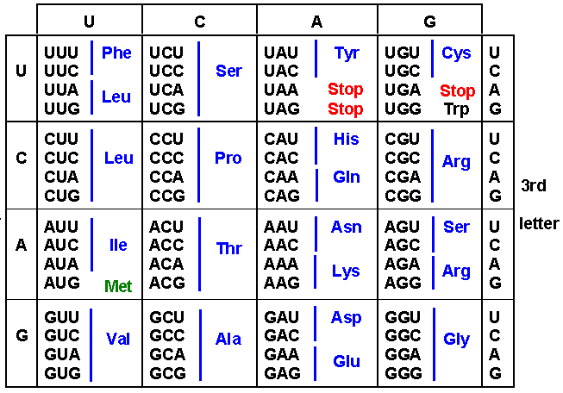
Annotating variants – manually using UCSC Genome Browser
Example SNP at chr7:117199533 Ref=G; Alt=A
http://genome.ucsc.edu/
Genomes
hg19
Can zoom in/out
Search by chrom:pos
Here’s the position of our SNP
“G”: “GUG” codes for Valine (V)
“A”: “AUG” codes for Methionine (M)
This is a missense SNP!
Notes:
Show steps to do this, with screenshots
Highlight genome build exons/introns, UTRs

Slide 30
Annotating variants – Variant Effect Predictor (VEP)
http://grch37.ensembl.org/Homo_sapiens/Tools/VEP
You can enter variants manually, or upload a VCF
Notes:
Show how to upload variants to VEP

Slide 31
Side note – gene annotations on UCSC Genome Browser
Also: you can load tons of different “tracks” with public datasets. More on that in later weeks
Boxes at gene ends = UTRs
Thick boxes = exons
Thin lines = introns
Notes:
Show how to upload variants to VEP

Slide 32
Our NGS pipeline - putting it all together
Reads
(*.fq, *.fastq)
Ref. genome (+ index files)
(*.fa, *.fasta)
Alignment
Genotyping
Annotation
Alignments
(*.sam, *.bam)
Variants
(*.vcf)

Slide 33
FAQ: Dealing with strand info

Slide 34

We have two copies of each chromosome. Each has two strands
“+” strand (arbitrary)
5’ – …ACTATACGACTGTATTTCGCTATT… – 3’
From dad
3’ – …TGATATGCTGACATAAAGCGATAA… – 5’
“-” strand (complementary to “+”)
5’ – …ACTATACGACTGTATTTCGCTATT… – 3’
From mom
3’ – …TGATATGCTGACATAAAGCGATAA… – 5’
We always write DNA sequences in 5’ to 3’ direction
Notes:
Show two chroms (one from mom, one from dad)
Each has two copies. Read from 5’ to 3’
Two strands are reverse complements. Always read from 5’ to 3’

Slide 35
We have two copies of each chromosome. Each has two strands
Heterozygous SNP example:
5’ – …ACTATACGACTTTATTTCGCTATT… – 3’
From dad
3’ – …TGATATGCTGAAATAAAGCGATAA… – 5’
5’ – …ACTATACGACTGTATTTCGCTATT… – 3’
From mom
3’ – …TGATATGCTGACATAAAGCGATAA… – 5’
Notes:
Show two chroms (one from mom, one from dad)
Each has two copies. Read from 5’ to 3’
Two strands are reverse complements. Always read from 5’ to 3’

Slide 36
The reference genome (arbitrarily) gives the “+” strand
Reference genome (“+”)
“+”
“-”
Reads can come from either strand. Always read from 5’ to 3’ direction.
Strand encoded in SAM flag. All sequences given in “+” strand
For paired-end reads, the reads will come from opposite strands
5’
3’
3’
5’
Notes:
Show ref genome sequence at the top. Just gives one strand (“+”)
Show reads from a pair, left on +, right on –
Show another pair in opposite orientation

Slide 37
Genes can be coded on either strand
Example gene on the “+” strand:
Click gene to see strand info (“+” or “-”)
Example gene on the “-” strand:
Reverse complement of ”GAU” is “AUC” (Isoleucine; I)
Notes:
TODO
Show genome browser
If arrows point to the right, “+”
Show amino acid table
Arrows point to the left, “-”
Means need to take the revesrse complement to get protein seq

Slide 38
Lab 1 Overview

Slide 39
Lab 1: Mutation hunting: find the needle in a haystack
A patient arrives in your clinic with a rare disorder. You expect the condition is genetic (i.e. due to a mutation in her genome). However since the condition is not observed in any family members, you suspect it could be due to a de novo mutation that occurred in the germline (egg or sperm cells) of one of her parents.
Father
T/T
T/T
Mother
A/T
Child

Slide 40
Lab 1 – objectives
Exercises 1
Part 1 (Tuesday lab)
Access to JupyterHub
Intro UNIX commands
Intro to NGS file formats
Quality Control
Sequence alignment
Exercises 2
Part 2 (Thursday lab)
Sequencing coverage
Variant calling + binomial distribution
Variant calling
Identifying and interpreting de novo mutations
All 4 Jupyter notebooks due Sunday 04/11/2021 11:59pm!

Slide 41
Lab 1 – the data and the pipeline
Reads
NA12878_child_1.fq
NA12878_child_2.fq
NA12891_father_1.fq
NA12891_father_2.fq
NA12892_mother_1.fq
NA12892_mother_2.fq
QC
FASTQC
Ref. genome (+ index files)
hg19.fa.*
Alignment
Genotyping
Annotation
BWA
Alignments
(*.sam, *.bam)
Varscan
Variants
(*.vcf)
Genome Browser/
VEP
samtools
Data from Platinum Genomes samples NA12878, NA1891, NA12892. See https://www.illumina.com/platinumgenomes.html

Slide 42
See bonus slides below (More on samtools and BWA)

Slide 43
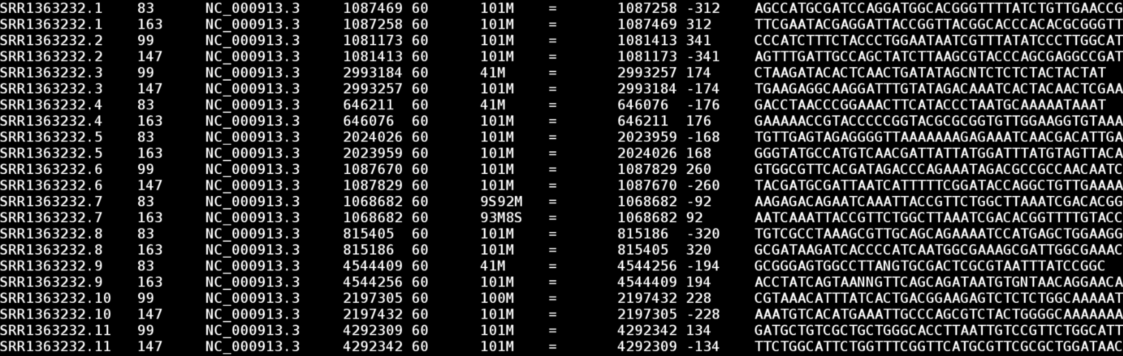
/Informatics – SAM file review
Column 1: read ID
Column 2: flag
Column 3: chromosome
Column 4: start position
…

Slide 44
/Informatics More about SAM: flags
2nd column = flag

Slide 45
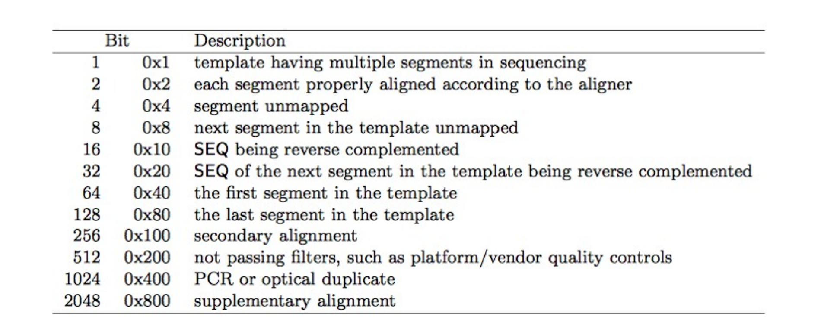
/Informatics More about SAM: flags
# in SAM file flag column = sum of each true bit (in decimal)
Example: paired, unmapped read would get:
0b000000000001 + 0b000000000100 = 0b000000000101 (or 5 in decimal)
See https://broadinstitute.github.io/picard/explain-flags.html

Slide 46
/Informatics More about SAM: flags
163 = 0b10100011 =
0x1 = read is paired
0x2 = Both reads in the pair mapped
0x32 = Mate is on the reverse strand
0x128 = this is the last segment in the template

Slide 47
/Informatics More about SAM: subsetting BAM files
To filter all reads with a set of flags:
> samtools view –f <flag value> file.bam
For example, to get all unmapped reads:
> samtools view –f 4 file.bam
To get all reads within a certain genomic region (requires sort + indexed BAM):
> samtools view file.bam chr1:10-1000

Slide 48
/Informatics More about SAM: CIGAR scores

Slide 49
/Informatics More about SAM: CIGAR scores
M: match
D: deletion
I: insertion
Reference
31M
ACGATCATCAAAAAAAAAACTGATGTTCATA
Read
ACGATCATCAAAAAAAAAACTGATGTTCATA
Reference
19M2I12M
ACGATCATCAAAAAAAAAA--CTGATGTTCATA
Read
ACGATCATCAAAAAAAAAAAACTGATGTTCATA
Reference
9M2D20M
ACGATCATCAAAAAAAAAACTGATGTTCATA
Read
ACGATCATC--AAAAAAAACTGATGTTCATA

Slide 50
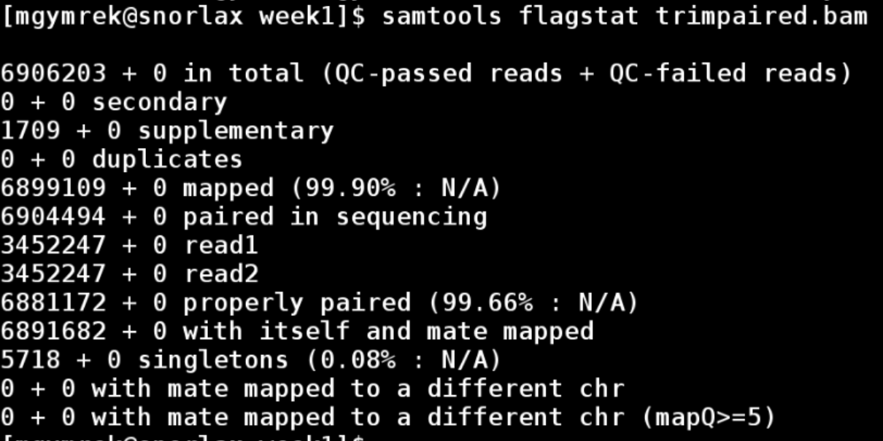
/Informatics More about SAM: flagstats
We started with 6904494 total reads (3452247 pairs)
Primary+alternative+unmapped
Alternative mappings
Primary + alternative mappings
The SAM file has one line per mapping (+ one line per unmapped read)
Mapped reads have 1 primary mapping and 0 or more alternative mappings

Slide 51
Mapping using BWT

Slide 52
The data! – “FASTQ”
ERR194146_1.fastq
(first end of each pair)
@ERR194146.1 HSQ1008:141:D0CC8ACXX:3:1308:20201:36071/1
ACATCTGGTTCCTACTTCAGGGCCATAAAGCCTAAATAGCCCACACGTTCCCCTTAAATAAGACATCACGATGGATCACAGGTCTATCACCCTATTAACCA
+
?@@FFBFFDDHHBCEAFGEGIIDHGH@GDHHHGEHID@C?GGDG@FHIGGH@FHBEG:GGIEEHH;@CHH=EDFFBBE>;@?3;;;>;;;AA?<C>C@@C:
@ERR194146.2 HSQ1008:141:D0CC8ACXX:4:1208:5231:93701/1
CCAGCGTCTCGCAATGCTATCGCGTGCATACCCCCCAGACGAAAATACCAAATGCATGGAGAGCTCCCGTGAGTGGTTAATAGGGTGATAGACCTGTGATC
+
?88ADA?BDF8F:@@DB49C>B7C806B<?DEF=@FFC=AABEA<;@D>AC265;ADA;@@?<@B@A<;?5(8+:0>(4:@AAA832?@@BBBB:<4(:>>
@ERR194146.3 HSQ1008:141:D0CC8ACXX:2:1305:18078:8420/1
GATCACAGGTCTATCACCCTATTAACCACTCACGGGAGCTCTCCATGCATTTGGTATTTTCGTCTGGGGGGTATGCACGCGATAGCATTGCGAGACGCTGG
+
@CCFFFFFHHFGHJIGJJJJJJJJJJJIJIIJJJIJJJIGJJJJIIJIGIHIJI=FFIJJJJHHJHGHHDD;@CDDEDDDDDBDDDCECDDDDDBDDDDDD
ERR194146_2.fastq
(second end of each pair)
@ERR194146.1 HSQ1008:141:D0CC8ACXX:3:1308:20201:36071/2
CCAGCGTCTCGCAATGCTATCGCGTGCATACCCCCCAGACGAAAATACCAAATGCATGGAGAGCTCCCGTGAGTGGTTAATAGGGTGATAGACCTGTGATC
+
<?@DDDBDHHHAAH@CG@FBBGGIEG@D@GCHFG@F/5=C4=B'=7?CA9@?ACDCDCA@<?BDCCCB=BB0<4>?4?>@:CCD???A:@C3>A>AC:++:
@ERR194146.2 HSQ1008:141:D0CC8ACXX:4:1208:5231:93701/2
CCCACACGTTCCCCTTAAATAAGACATCACGATGGATCACAGGTCTATCACCCTATTAACCACTCACGGGAGCTCTCCATGCATTTGGTATTTTCGTCTGG
+
@??BD1:AFHBDDGGHIJIF@EEE>GFHGHEAG?DEG<FD>B;?BB<*/9??C8BB@FHC7=CCGAE;=,5,,.;@@>(5(;>ACCC(,,5;>CCB88<??
@ERR194146.3 HSQ1008:141:D0CC8ACXX:2:1305:18078:8420/2
GATCACAGGTCTATCACCCTATTAACCACTCACGGGAGCTCTCCATGCATTTGGTATTTTCGTCTGGGGGGTATGCACGCGATAGCATTGCGAGACGCTGG
+
@CCFFFFFHHFGHJIGJJJJJJJJJJJIJIIJJJIJJJIGJJJJIIJIGIHIJI=FFIJJJJHHJHGHHDD;@CDDEDDDDDBDDDCECDDDDDBDDDDDD

Slide 53
Challenge: Rapidly align short reads to a reference
Goal: Where in the genome does each read originate?
Reference genome: ~3×10⁹ bp
?
Reads: ~100bp
Solution: Index genome in quickly searchable data structure
Chr1:3899292
ACGATAG
ATCGACGATAGCCG
ACGATAG
Genome
Index
(Burrows Wheeler Transform)

Slide 54
Burrows-Wheeler Transform
String T: AACATCGAGCTACGTACGTACGTACGTACGTACGTACGTACGACGAGGGGAGAGAAT
T
BWT(T)
(Burrows Wheeler Transform)
Size O(|T|), searching in time O(|query string|)
Burrows Wheeler Transform (and related auxiliary data structures) allows:
Compression
Indexing/searching
Notes:
Follow here:
http://www.cs.jhu.edu/~langmea/resources/bwt_fm.pdf
Overall idea is to make a transform of T
Applications:
Compression
indexing

Slide 55
Burrows-Wheeler Transform
String T: BANANA$
m=|T| (length of T)
T ends with a terminator character ($), lexicographically prior to all other characters
Creating BWT(T)
Write down rotations of T
Sort the rows lexicographically to make BWM(T) (Burrows Wheeler Matrix)
The final column of BWM(T) gives BWT(T)
Step 1:
Step 2:
B A N A N A $
$ B A N A N A
A $ B A N A N
N A $ B A N A
A N A $ B A N
N A N A $ B A
A N A N A $ B
$ B A N A N A
A $ B A N A N
A N A $ B A N
A N A N A $ B
B A N A N A $
N A $ B A N A
N A N A $ B A
BWT(T) = ANNB$AA
Notes:
Follow here:
http://www.cs.jhu.edu/~langmea/resources/bwt_fm.pdf
Convert banana to matrix

Slide 56
Relationship to suffix arrays
String T: BANANA$
Creating SuffixArray(T)
Write T’s suffixes, note the starting index of each suffix
Sort lexicographically
BWM(T)
SuffixArray(T)
Suffix given by SA
$ B A N A N A
A $ B A N A N
A N A $ B A N
A N A N A $ B
B A N A N A $
N A $ B A N A
N A N A $ B A
6
5
3
1
0
4
2
$
A $
A N A $
A N A N A $
B A N A N A $
N A $
N A N A $
T[SA[i]-1] if SA[i]>0
BWT(T)[i] =
$ if SA[i]==0
Notes:
Follow here:
http://www.cs.jhu.edu/~langmea/resources/bwt_fm.pdf
Convert banana to matrix

Slide 57
BWT for compression
BWT is reversible, necessary for compression
BWT(T) has same length as T, so not immediately clear where compression comes in.
BUT BWT often brings similar characters together, easier to shrink with run length encoding methods, e.g. bzip2
BWT(BANANA$) = ANNB$AA
BWT(tomorrow and tomorrow and tomorrow) = wwwdd nnoooaatttmmmrrrrrrooo $ooo

Slide 58
Reversing the BWT with LF mapping
Create the BWM, but this time include order of each character
e.g.:
B₀ A₀ N₀ A₁ N₁ A₂ $
Step 1:
Step 2:
B₀ A₀ N₀ A₁ N₁ A₂ $₀
$₀ B₀ A₀ N₀ A₁ N₁ A₂
A₂ $₀ B₀ A₀ N₀ A₁ N₁
N₁ A₂ $₀ B₀ A₀ N₀ A₁
A₁ N₁ A₂ $₀ B₀ A₀ N₀
N₀ A₁ N₁ A₂ $₀ B₀ A₀
A₀ N₀ A₁ N₁ A₂ $₀ B₀
$₀ B₀ A₀ N₀ A₁ N₁ A₂
A₂ $₀ B₀ A₀ N₀ A₁ N₁
A₁ N₁ A₂ $₀ B₀ A₀ N₀
A₀ N₀ A₁ N₁ A₂ $₀ B₀
B₀ A₀ N₀ A₁ N₁ A₂ $₀
N₁ A₂ $₀ B₀ A₀ N₀ A₁
N₀ A₁ N₁ A₂ $₀ B₀ A₀
LF Property: the ith occurrence of a character c in the last column (L) has the same rank as the ith occurrence of c in the first column (F)
e.g. for A, has order 2, 1, 0 in both L and F
e.g. for N, has order 1, 0 in both L and F

Slide 59
Reversing the BWT with LF mapping
T = B₀ A₀ N₀ A₁ N₁ A₂ $
First col (F)
Last col (L)
Rank in last col.
$₀ B₀ A₀ N₀ A₁ N₁ A₂
A₂ $₀ B₀ A₀ N₀ A₁ N₁
A₁ N₁ A₂ $₀ B₀ A₀ N₀
A₀ N₀ A₁ N₁ A₂ $₀ B₀
B₀ A₀ N₀ A₁ N₁ A₂ $₀
N₁ A₂ $₀ B₀ A₀ N₀ A₁
N₀ A₁ N₁ A₂ $₀ B₀ A₀
$
A
A
A
B₀
N
N
A
N
N
B
$
A
A
0
0
1
0
0
2
3
BWM(T)=
Start with the first row, with $ in first column
Last column of first row must have character to the left in T, so A$.
Rank of A is 0, so must correspond to 1st “A” in F. So we get NA$.
Rank of N is 0, so must correspond to 1st “N” in F. So we get ANA$.
Repeat steps to get BANANA$

Slide 60
Searching using LF mapping
T = B₀ A₀ N₀ A₁ N₁ A₂ $
Searching for P = N A N
F
L
Rank in last col.
$₀ B₀ A₀ N₀ A₁ N₁ A₂
A₂ $₀ B₀ A₀ N₀ A₁ N₁
A₁ N₁ A₂ $₀ B₀ A₀ N₀
A₀ N₀ A₁ N₁ A₂ $₀ B₀
B₀ A₀ N₀ A₁ N₁ A₂ $₀
N₁ A₂ $₀ B₀ A₀ N₀ A₁
N₀ A₁ N₁ A₂ $₀ B₀ A₀
0
0
1
0
0
2
3
BWT(T)=
Backwards matching: repeatedly apply LF mapping to range of rows prefixed by successively longer suffixes of P.
First find rows beginning with shortest suffix of P, “N”
From “L”, see both are preceeded by “A”, corresponding to “A2” and “A3”
Now find all rows beginning with next-longest suffix of P, “AN”
See only one is preceeded by “N”, corresponding to “N1”
Number of rows remaining = number of occurrences of P in T.
Notes:
Follow here:
http://www.cs.jhu.edu/~langmea/resources/bwt_fm.pdf
Convert banana to matrix

Slide 61
String search with FM-index
Searching with LF-mapping requires O(m) time, where m=|T| ☹. We’d like O(|P|)
Augment rank array with m x |Σ| matrix. Each row gives how many times that character has been observed up to and including that position in BWT(T)
Occ
F
L
$ A B N
$ B A N A N A
A $ B A N A N
A N A $ B A N
A N A N A $ B
B A N A N A $
N A $ B A N A
N A N A $ B A
0
0
0
0
1
1
1
1
1
1
1
1
2
3
0
0
0
1
1
1
1
0
1
2
2
2
2
2
Now, searching for P=N A N
Look for row beginning with first suffix, “N”. Look up range of next character using corresponding row of Occ(A). Only need to look at the first and last.
Now, only need to lookup next character “A” with the ranks of those occurrences
Still only gives us how many times P occurs in T, not where!

Slide 62
Looking up offsets
T = B₀ A₀ N₀ A₁ N₁ A₂ $
Searching for P = N A N
BWM(T)
F
L
SuffixArray(T)
$ B A N A N A
A $ B A N A N
A N A $ B A N
A N A N A $ B
B A N A N A $
N A $ B A N A
N A N A $ B A
6
5
3
1
0
4
2
Suffix array tells us that the match occurs at offset 2 in the original string T!
To save space, we can store only subsets of SuffixArray and Occ tables
Allows string searching in O(length of query string). Independent of reference (T) size!

Slide 63
Tools for mapping short reads
Tool | Publication | Link | Notes
Maq | Li, Ruan, Durbin 2008 Genome Research | http://maq.sourceforge.net/maq-man.shtml | Widely used early on
Novoalign | www.novocraft.com/ | http://www.novocraft.com/ | High sensitivity
bwa aln | Li and Durbin 2009 Bioinformatics | https://github.com/lh3/bwa | Allows short indels, widely used (e.g. 1000 Genomes)
bowtie | Langmead, et al. 2009 Genome Biology | http://bowtie-bio.sourceforge.net/index.shtml | no indel support
bowtie2 | Langmead & Salzberg 2012 Nature Methods | http://bowtie-bio.sourceforge.net/bowtie2/index.shtml | Allows indels, faster
bwa mem | Li 2013 Arxiv | https://github.com/lh3/bwa | Faster, more indel sensitive
Many others: e.g. Stampy, mrsFast, SOAP

Slide 64
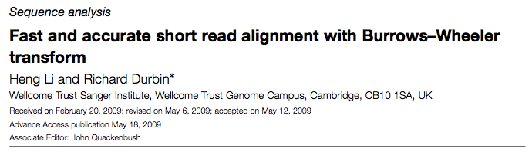
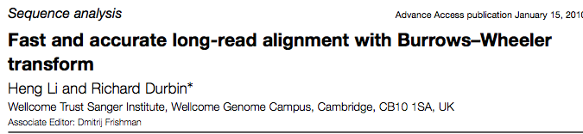
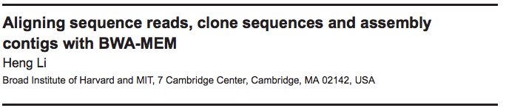
BWA Aligner
Notes:
Go through tricks in bwa
https://academic.oup.com/bioinformatics/article-lookup/doi/10.1093/bioinformatics/btp324

Slide 65
BWA
Exact matching: backward search as described above
Inexact matching: find intervals of the reference that match the query string with no more than z differences (mismatches or gaps)
  Use bounded traversal/backtracking.
  In practice, use a “seed” sequence from beginning of read, which must have minimal match to the genome
  The more errors in the reads, the slower the inexact mapping process is

Slide 66
BWA - continued
BWA-SW:
  Designed specifically to align longer reads (up to 1Mb)
  Build FM-index for both the reference and query sequence
  Dynamic programming to compare the two, similar to the Smith Waterman algorithm (coming up)
BWA-MEM
  “Seed-and-extend” paradigm: for each position, find longest exact match
  Chain together co-linear seeds
  Extend the longest seeds
  Allows for larger gaps, variable length reads

