Slide 1
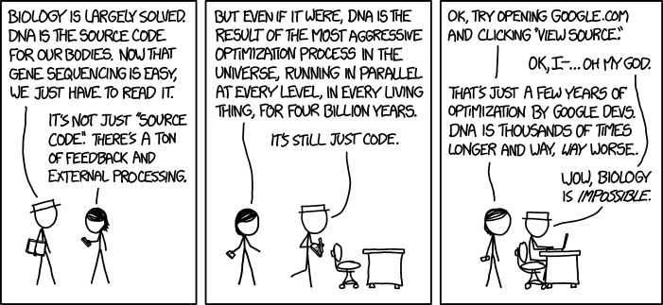
CSE185 – Advanced Bioinformatics Lab – March 30, 2021
https://canvas.ucsd.edu/courses/27424
Bioinformatics: making the impossible possible
Several slides reused with permission from Katie Petrie's BIMM185 course

Slide 2
Our goal: convert biological data into knowledge
Bioinformatics: the science of collecting and analyzing complex biological data such as genetic codes (Definition from Oxford Languages)
???
Enter: us, the bioinformaticians!
Current genome sequencing projects are generating Petabytes of data!
Notes:
Not just each of these in isolation
But how they work together
How to take a bio problem, figure out what sorts of statistics+analyses you need to answer your question
Then actually go and implement
Make a solution fast enough to process 200 TB of data
Example of the types of skillsets we need!

Slide 3
These are just some examples of the skills we’ll need
Modeling
Probability
Statistics
Data science
Programming
Biology
Algorithms
Machine Learning
Notes:
Not just each of these in isolation
But how they work together
How to take a bio problem, figure out what sorts of statistics+analyses you need to answer your question
Then actually go and implement
Make a solution fast enough to process 200 TB of data
Example of the types of skillsets we need!

Slide 4
Bioinformatics has been critical to fighting COVID-19

Slide 5
Identifying the genome sequence (2020)
Jan. 7 – virus isolated
Jan. 12 – genome released
Jan. 24 – publication
Lab 1 - NGS
Lab 2 – Assembly

Slide 6
Mutations allow us to track the virus’s spread
Nextstrain.org/ncov/global
Lab 1 - Mutation hunting
Lab 7 - Phylogenetics
Notes:
https://www.nytimes.com/interactive/2020/04/30/science/coronavirus-mutations.html

Slide 7
Genetic determinants of disease diversity?
(based on 23andme data)
Lab 3 - GWAS

Slide 8
Expression of key receptor genes
A single cell view reveals distinct cell types with expression of key genes ACE2/TMPRSS2
Gtexportal.org
Where is ACE2 expressed?
Lab 4 – RNA-seq
Lab 6 – scRNA-seq
http://shaleklab.com/resource/covid-19-resources/

Slide 9
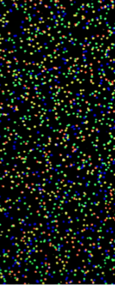
Today’s schedule
Course Overview
Intro to NGS
Lab 1 overview
What does each dot in the image represent?
Notes:
A fluorescently labeled tumor cell
A pixel in the iPhone 6S screen
A single, fluorescent DNA molecule
A star in a galaxy far, far away
**A cluster of related DNA molecules**
First a question! – can send via private zoom message
Hint: it has something to do with sequencing!

Slide 10
Course Overview
Notes:
But before we dive in, let’s just get some logistics out of the way with a brief course overview

Slide 11
Course Objectives
(1) Be able to explain why bioinformatics approaches are important to understand and interpret results
(2) Be able to utilize existing bioinformatics tools individually and in combination to answer complex scientific questions
(3) Develop critical analysis and research skills
(4) Learn and use bioinformatics best practices
Notes:
Understand what types of bioinformatics approaches are appropriate and how to interpret their results
Be able to actually go to the command line and use existing tools, or in some cases implement your own, to use those approaches
Importantly, to use the tools and best practices that actual practicing bioinformaticians use! Things like documentation, bash scripting, Jupyter notebooks, writing command line tools are all things we’ll touch on.

Slide 12
Course Overview
Week | Date | Topic
Week 1 | 03/30/2021 | Python Lightning course / start on Lab 1
Week 2 | 04/06/2021 | Lab 1: Mutation hunting: find the needle in a haystack NGS, sequence alignment, variant calling
Week 3 | 04/13/2021 | Lab 2: So where do all those reference genomes come from, anyway? Genome size estimation, genome assembly Quiz 1
Week 4 | 04/20/2021 | Lab 3: How tall should I be? GWAS, Ancestry, PCA
Week 5 | 04/27/2021 | Lab 4: You are what you eat RNA-seq, differential expression Quiz 2
Week 6 | 05/04/2021 | Lab 5: The dark matter of the genome ChIP-seq, machine learning
Week 7 | 05/11/2021 | Lab 6: Don’t get lost in the crowd Single-cell genomics Quiz 3
Week 8 | 05/20/2021 | Lab 7: COVID-19 Comparative genomics, phylogenetics Project proposals due
Weeks 9-10 | 05/27/2021 | Independent Projects (report due in Finals week)
Day | Time | Location | Event
Tuesday/Thursday | 11:00-11:50am | Zoom! | Lectures (recorded)
Tuesday/Thursday Quiz wks 3,5,7 | 1:00pm-2:50pm | Zoom! | Lab Section (w/ TAs Mia and Nora)
Tuesday/Thursday | 9:00pm-10:00pm | Zoom! | Melissa’s OH
 |  |  | See Canvas for TA OH
Notes:
One module per week first 7 weeks
Last 3 weeks final project more on that soon
MW lecture
TR labs led by Tas
Quizzes 2, 4, 6

Slide 13
Class resources
All course resources available through Canvas
Course website: https://canvas.ucsd.edu/courses/27424
Syllabus
Lecture slides + recordings
All homework due dates
Extra resources
Jupyter Hub: http://datahub.ucsd.edu
Piazza (see link on Canvas)

Slide 14
Grading
One lab module each week. 10% each (100 pts)
All lab assignments completed on JupyterHub notebooks
(datahub.ucsd.edu)
“Exercises” give theoretical background and basic exercises.
“Lab” notebooks involve analysis of real data.
All notebooks released on Mondays
All notebooks due the next Sunday at 11:59pm PDT.
Can work with a partner, use the internet for help, etc.
More on this soon!
Homework – 70%

Slide 15
Grading
Homework – 70%
Three quizzes, worth 5% each
Held on Thursday labs of weeks 3, 5, and 7 at the beginning of lab session (1-1:30pm)
Cover conceptual questions + command line skills
Exercise notebooks will contain quiz review questions.
All quizzes completed using Canvas.
Quizzes – 15%

Slide 16
Grading
Homework – 70%
Use the bioinformatics tools we learned to (attempt to) reproduce results of published papers!
Details coming soon. Draft project guidelines posted on Canvas.
Quizzes – 15%
Final projects – 15%

Slide 17
Grading
Attendance at lectures + labs highly encouraged. Helping your classmates via Piazza or private Zoom meetings also highly encouraged.
Participation is not explicitly graded. However, there are many benefits of being an active member of the class!
We will attempt to have some interaction during lecture through Zoom chat. I will check the chat at various checkpoints during lectures.
Lectures will be recorded and slides posted on the course website.
Homework – 70%
Quizzes – 15%
Final projects – 15%
Participation – 0%
Attendance – 0%
iClickers – 0%

Slide 18
Other policies
Academic integrity
Accommodations for students with disabilities
Diversity and inclusion
Disclaimer
See syllabus and Canvas for more details.
Always feel free to email to set up a private appointment.

Slide 19
Python and UNIX help
Assignment notebooks attempt to introduce all UNIX commands/Python concepts needed to complete lab assignments.
If you are new to the UNIX command line or haven’t coded in Python before and are concerned about this, please reach out to us.
We will continuously update a “cheat sheet” of all commands we’ve learned on Canvas.
There is an optional Python lightning course during week 1. More on this in a bit.

Slide 20
Questions?
(send a private Zoom chat, or “raise your hand”)

Slide 21
Intro to NGS
(and a bit about how we got there)

Slide 22
Sequencing – then and now
2000s
Other systems: ABI SOLID, Ion Torrent, PacBio
1977
Sanger Sequencing
1990
Human Genome Project
started
2003
HGP
completed
~2017
$1,000 Genome
2007
Illumina/Solexa
~1980
Shotgun sequencing
2005
First NGS system
(454, Roche)
Fred Sanger
1980 Nobel Prize for dideoxy (“Sanger”) sequencing
(and also in 1958 for protein sequencing!)

Slide 23
dideoxy (“Sanger”) sequencing
ACGCATCGATCGGGACTACGACTAGCTACGTACACG
Polymerase + mix of dNTPs, fluorescent ddNTPs
ACGCATCGATCGGGACTACGACTAGCTACGTACACG
ACGCATCGATC
ACGCATCGATCG
Separate by size
ACGCATCGATCGGGACTAC
ACGCATCGATCGGGA
ACGCATCGATCGGGA
ACGCATCGATCGGG
ACGCATCGATCGG
ACGCATCGATCG
ACGCATCGATC
Read colors with a laser
Detect

Slide 24
dideoxy (“Sanger”) sequencing
ACGCATCGATCGGGACTACGACTAGCTACGTACACG
ACGCATCGATCGGGA
ACGCATCGATCGGG
ACGCATCGATCGG
ACGCATCGATCG
“A”
“C”
“G”
“T”
ACGCATCGATC
Read off the gel!
ATCGATCGGGA
Smaller <- Size -> Larger
Hard to sequence very long molecules.
(like, we can’t just sequence our whole genome in one go)
Why?
Gel

Slide 25
Sequencing then and now
2000s
Other systems: ABI SOLID, Ion Torrent, PacBio
1977
Sanger Sequencing
1990
Human Genome Project
started
2003
HGP
completed
~2017
$1,000 Genome
2007
Illumina/Solexa
~1980
Shotgun sequencing
2005
First NGS system
(454, Roche)

Slide 26
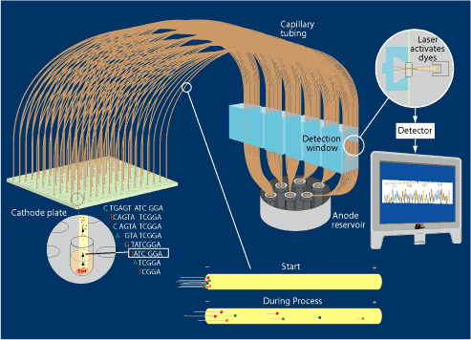
How to sequence a genome?
…
A genome
Shotgun sequencing
Parallelize on 384 well plates
Capillary tubing for size selection
https://jgi.doe.gov
Sanger sequencing

Slide 27
Sequencing then and now
2000s
Other systems: ABI SOLID, Ion Torrent, PacBio
1977
Sanger Sequencing
1990
Human Genome Project
started
2003
HGP
completed
~2017
$1,000 Genome
2007
Illumina/Solexa
~1980
Shotgun sequencing
Enter: the next generation!
First human genome (HGP) based on shotgun sequencing
>10 years for 1 genome!
2005
First NGS system
(454, Roche)

Slide 28
Illumina sequencing (next gen sequencing)
…
A genome
Fragment
Attach adapters

Slide 29
Illumina sequencing
Bind single DNA molecules to surface (using adapter sequence)
Amplify on the surface “Bridge amplification”
Notes:
Difficult to sequence a single copy. Instead, do a special process to amplify all of our little chunks of DNA

Slide 30
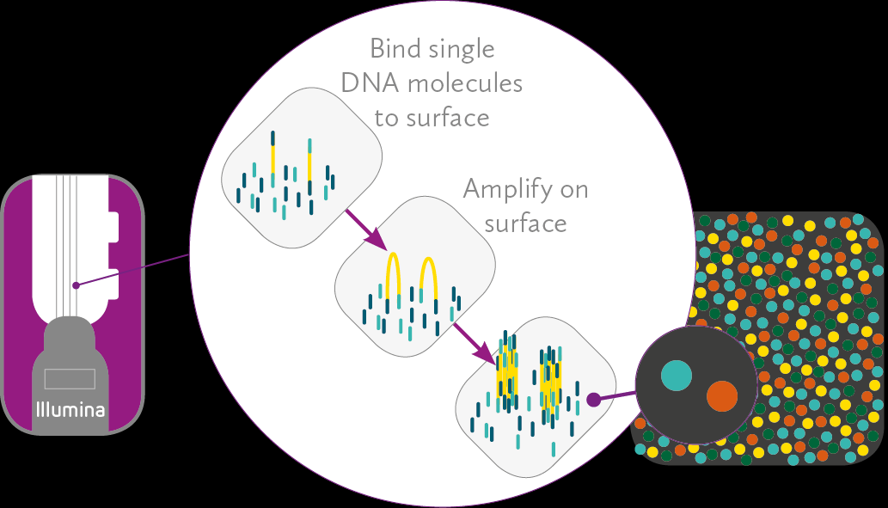
Illumina sequencing
Bind single DNA molecules to surface (using adapter sequence)
Amplify on the surface “Bridge amplification”
Result: “clusters” of clonal DNA copies

Slide 31
Illumina sequencing
“sequencing by synthesis”
Polymerase, reversible terminator dNTPs (similar trick to Sanger seq!)
G
Take picture
A
T
C
G
A
A
T
A

Slide 32
Illumina sequencing
“sequencing by synthesis”
Polymerase, reversible terminator dNTPs (similar trick to Sanger seq!)
G
Take picture
A
Remove terminator
T
C
Repeat
G
T
A
A
T
A
T

Slide 33
Illumina sequencing
“sequencing by synthesis”
Polymerase, reversible terminator dNTPs
C
G
Take picture
T
A
Remove terminator
A
T
G
C
Repeat
C
G
T
A
A
T
…
A
T
C
G
A
T
C

Slide 34
From pictures to reads
Millions of images at once!
“Massively parallel”
Check out this very helpful youtube video:
https://www.youtube.com/watch?v=fCd6B5HRaZ8
http://data-science-sequencing.github.io/Win2018/lectures/lecture2/

Slide 35
Paired end sequencing
Sequence fragment from one end
Wash away strand that is already read
Sequence again, in the opposite direction
~400bp
~100bp
What are advantages of paired-end sequencing? (more on this in next several lectures)

Slide 36
Sequencing then and now
2000s
Other systems: ABI SOLID, Ion Torrent, PacBio
1977
Sanger Sequencing
1990
Human Genome Project
started
2003
HGP
completed
~2017
$1,000 Genome
2007
Illumina/Solexa
~1980
Shotgun sequencing
2005
First NGS system
(454, Roche)

Slide 37
Overview of NGS data
Read 1 (~100bp)
(from forward strand)
5’
3’
3’
5’
Read 2 (~100bp)
(from reverse strand)
Insert size/template length (~several hundred bp)

Slide 38
The raw data! (fastq)
reads_1.fastq
(first end of each pair)
@ERR194146.1 HSQ1008:141:D0CC8ACXX:3:1308:20201:36071/1
ACATCTGGTTCCTACTTCAGGGCCATAAAGCCTAAATAGCCCACACGTTCCCCTTAAATAAGACATCACGATGGATCACAGGTCTATCACCCTATTAACCA
+
?@@FFBFFDDHHBCEAFGEGIIDHGH@GDHHHGEHID@C?GGDG@FHIGGH@FHBEG:GGIEEHH;@CHH=EDFFBBE>;@?3;;;>;;;AA?<C>C@@C:
@ERR194146.2 HSQ1008:141:D0CC8ACXX:4:1208:5231:93701/1
CCAGCGTCTCGCAATGCTATCGCGTGCATACCCCCCAGACGAAAATACCAAATGCATGGAGAGCTCCCGTGAGTGGTTAATAGGGTGATAGACCTGTGATC
+
?88ADA?BDF8F:@@DB49C>B7C806B<?DEF=@FFC=AABEA<;@D>AC265;ADA;@@?<@B@A<;?5(8+:0>(4:@AAA832?@@BBBB:<4(:>>
@ERR194146.3 HSQ1008:141:D0CC8ACXX:2:1305:18078:8420/1
GATCACAGGTCTATCACCCTATTAACCACTCACGGGAGCTCTCCATGCATTTGGTATTTTCGTCTGGGGGGTATGCACGCGATAGCATTGCGAGACGCTGG
+
@CCFFFFFHHFGHJIGJJJJJJJJJJJIJIIJJJIJJJIGJJJJIIJIGIHIJI=FFIJJJJHHJHGHHDD;@CDDEDDDDDBDDDCECDDDDDBDDDDDD
Each read described by 4 lines
Line 1: “@” + Read ID
Line 2: Nucleotides
Line 3: “+”
Line 4: Base quality scores
reads_2.fastq
(second end of each pair)
@ERR194146.1 HSQ1008:141:D0CC8ACXX:3:1308:20201:36071/2
CCAGCGTCTCGCAATGCTATCGCGTGCATACCCCCCAGACGAAAATACCAAATGCATGGAGAGCTCCCGTGAGTGGTTAATAGGGTGATAGACCTGTGATC
+
<?@DDDBDHHHAAH@CG@FBBGGIEG@D@GCHFG@F/5=C4=B'=7?CA9@?ACDCDCA@<?BDCCCB=BB0<4>?4?>@:CCD???A:@C3>A>AC:++:
@ERR194146.2 HSQ1008:141:D0CC8ACXX:4:1208:5231:93701/2
CCCACACGTTCCCCTTAAATAAGACATCACGATGGATCACAGGTCTATCACCCTATTAACCACTCACGGGAGCTCTCCATGCATTTGGTATTTTCGTCTGG
+
@??BD1:AFHBDDGGHIJIF@EEE>GFHGHEAG?DEG<FD>B;?BB<*/9??C8BB@FHC7=CCGAE;=,5,,.;@@>(5(;>ACCC(,,5;>CCB88<??
@ERR194146.3 HSQ1008:141:D0CC8ACXX:2:1305:18078:8420/2
GATCACAGGTCTATCACCCTATTAACCACTCACGGGAGCTCTCCATGCATTTGGTATTTTCGTCTGGGGGGTATGCACGCGATAGCATTGCGAGACGCTGG
+
@CCFFFFFHHFGHJIGJJJJJJJJJJJIJIIJJJIJJJIGJJJJIIJIGIHIJI=FFIJJJJHHJHGHHDD;@CDDEDDDDDBDDDCECDDDDDBDDDDDD

Slide 39
Questions?
(send a private Zoom chat, or “raise your hand”)

Slide 40
Labs – Week 1 Overview

Slide 41
Accessing lab assignments
All labs will be completed at datahub.ucsd.edu
Please check ASAP that you can log in there and navigate to our course!
If you have just enrolled in the course, it can take ~24 hours to gain access.
If you have been enrolled for more than a day, email us so we can ensure you have access.

Slide 42
Labs Overview – Weeks 1 and 2
No labs due week 1. Lab 1 (NGS and mutation hunting) due 4/11.
Goals for week 1 lab sessions:
Review Python: we have posted a link to an intro Python course on Stepik (see Canvas). This is optional but highly encouraged.
Get familiar with the Jupyter Hub environment (TAs will go over in lab.)
Get started on Lab 1 (more details on Thursday)

Slide 43
Lab section logistics
Lab sessions are by Zoom with the TAs
They will begin with a brief overview of the lab assignment or tutorial (~5-20 mins)
Then you may work independently or with a partner.
You can sign up on the Google doc (see Canvas “Jupyter-assignment-instructions” page to ask questions to the TAs over Zoom.

