Slide 1
POLI 120E Scandinavian Politics Prof. Kaare W. Strøm
The Nordic Region, EUROPE,
AND THE WORLD

Slide 2
Questions for Today
How did the legacies of World War II shape Nordic foreign policy?
How and in what policy areas has Nordic integration coincided with European integration?
Why have the Nordics been such reluctant Europeans?
Only 3 Western European countries are outside the EU; two of them are Nordics
The five Nordic countries (pop. 2/3 of CA) use five different currencies
How and why have the Nordic countries been global pioneers and enthusiasts?
What’s special about Nordic Development Assistance (Foreign Aid)?

Slide 3
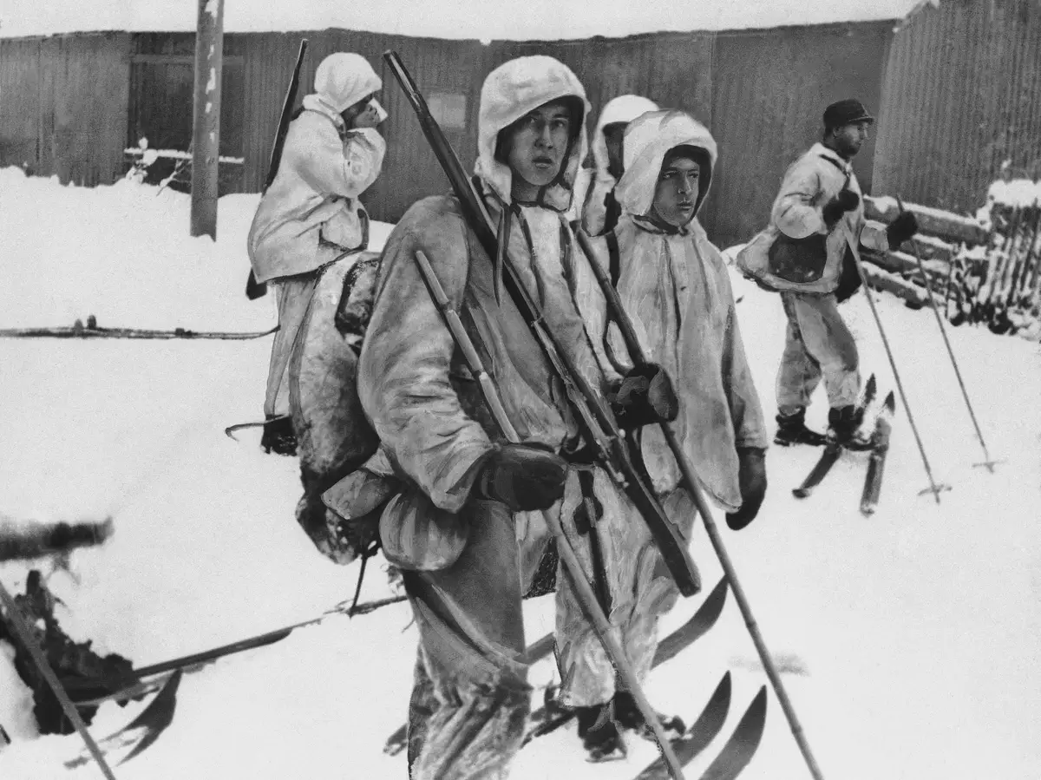
Political Lessons of World War II
Sweden: Neutrality remains feasible, requires strong national defense
Denmark, Norway: Neutrality failed, need for allies; positive experience with Western allies
Finland: Living with a powerful neighbor is dangerous; Neutrality imposed by friendship treaty with USSR, 1948
Iceland: Alliance with Western Allies, dissent about base policies

Slide 4
Landmarks of Nordic Cooperation, 1945-Present Source: Arter (2016)
1952: Nordic Council founded, passport union
1954: Common labor market
1955: Nordic social security convention
1956: Finland joins Nordic Council
1970: NORDEK negotiations fail (common market)
1971: Nordic Council of Ministers founded
1971: Nordic cultural agreement
1972: Nordic transport agreement
1975: Nordic investment bank
1976: Nordic Cultural Fund

Slide 5
Why European Integration?
European integration both economic, political, and security project
Economic integration
Larger markets
Economic standardization (product standards, currency)
Political integration
Global issues: Environment, migration
Relations with Baltics, Eastern Europe
Voice of Europe Globally
Security integration
Western Europe easier to integrate than Nordics
But: Concerns about the Cold War

Slide 6
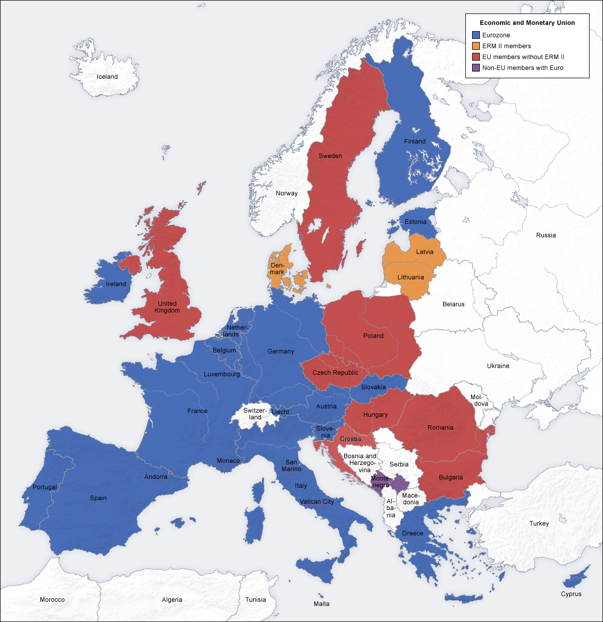
The European Union
Founded 1958; basis in European Coal and Steel Community (1952)
Political and economic union
Originally 6 member states, currently 27
Plus candidates: Iceland, Serbia, Montenegro, Macedonia, Turkey; Applicant: Albania
Population of 500M+ (50% greater than US)
Territory of 2.6M sq mi (70% of US)
19 member states also form Eurozone (monetary union)
Largest economic area in the world, though shrinking in relative terms

Slide 7
EU Policies
Economic Integration: A larger market for industrial goods
Common Market (free trade internally)
Customs Union (common trade agreements with other countries)
Single Market (harmonization of product and work standards within EU)
Free Movement of Goods, Services, Capital, and Labor (People)
Subsidies to agriculture, especially in France
Structural funds (infrastructure, such as roads)
Monetary Integration
Euro
Political Integration
Harmonization, common foreign policy?
Statehood?
Symbols: Flag, Anthem
Ever closer union vs. subsidiarity?

Slide 8
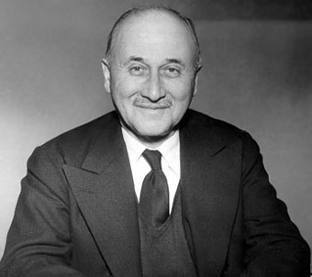
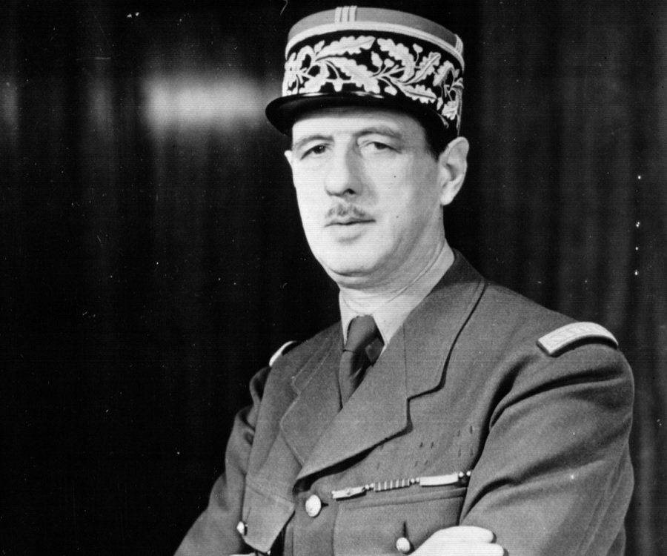
The EU 1958-1970
1952: European Coal and Steel Community Founded
France, Germany, Italy, the Netherlands, Belgium, Luxembourg (“inner six”)
UK stays on sidelines due to Commonwealth, special relationship with the US
1958: European Common Market founded (same 6 countries)
1960: The United Kingdom and six other countries (incl. 3 Nordics) form EFTA (“outer seven”)
1961-67: Two successive British membership applications rejected by France
1969: De Gaulle resigns as French president; opens the door for British and Nordic membership

Slide 9
The European Union and Scandinavia
1959: EFTA formed (outer seven), incl. DK, N, S, and UK; Finland joins in 1961 as an associate member; Iceland joins in 1970
1961: DK, N apply for EU membership; France rejects applications
1970-72: DK and N negotiate EU membership terms, along with the UK
1972: EU membership referendums held in DK and N; Results: DK for (63%), N against (47%)
1985: Single European Act (promoted internal markets, removal of informal trade barriers)
1991: Maastricht treaty promotes political and monetary integration (Euro); in 1992 Danish voters reject Maastricht Treaty (49% in favor)
1994: EU membership referendums held in FIN, N, and S; Results: FIN (57%), and S (52%) for, N against (48%),
2000: Danish voters reject Euro in referendum (47% in favor)
2002: Euro introduced in Finland
2003: Swedish voters reject Euro in referendum (43% in favor)

Slide 10
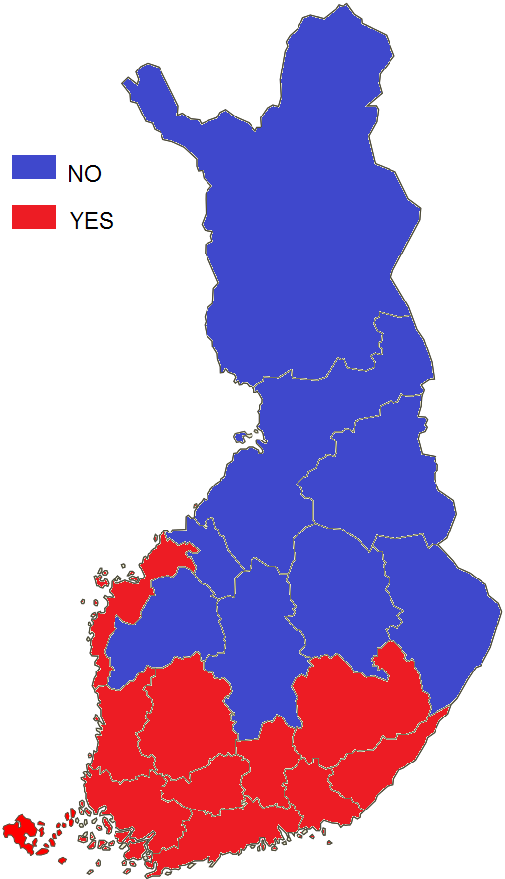
EU Referendums 1994 The Domino Effect that Failed

Slide 11
Why the Nordics Are Reluctant Europeans
For S, FIN the EU meant a challenge to neutrality (“inner six” all in NATO)
The Four Freedoms of the EU were controversial
Free movement of labor, capital, goods, and services
Implications:
Foreign ownership
Outsourcing
Immigration
Conflict between export industries (pro-EU) and primary sectors, including agriculture (exc. DK) and especially fisheries
Environmental concerns
Welfare concerns; welfare policies in Scandinavia state-based, extensive, and universal (entitlement-based)
Cultural concerns (Catholicism, corruption)
Distance to Rome
Small size meant weak representation in Brussels

Slide 12
Scandinavians as Global Enthusiasts and Pioneers
Commitments to League of Nations, United Nations, other international organizations
1921: Åland islands resolutions first conflict solved by League of Nations
Strong supporters of UN peacekeeping, large financial contributors
Commitments to WTO, ICC, Climate regime
International agenda setters, especially in development assistance, gender, and environmental policy areas

Slide 13
Scandinavia and International Organizations
 | Political |  |  | Economic |  | Security
Country | United Nations | Nordic Council | European Union | EFTA (European Free Trade Association) | OECD | NATO
Denmark | 1945 | 1952 | 1973 | 1959-95 | 1948 | 1949
Finland | 1955 | 1956 | 1995 | 1961 (A)-95 | 1969 | -
Iceland | 1945 | 1952 | - | 1970 | 1948 | 1949
Norway | 1945 | 1952 | - | 1959 | 1948 | 1949
Sweden | 1946 | 1952 | 1995 | 1959-95 | 1948 | -

Slide 14
Nordic International Pioneers
Philanthropy and Peace Activists
Alfred Nobel (S) – Nobel Prizes
League of Nations
1921: Fridtjof Nansen (N) founds Commission for Refugees
1939: Carl J. Hambro (N) President of LoN Assembly
World War II efforts to rescue European Jews
Raoul Wallenberg (S)
King Christian X (DK)
First two UN General Secretaries
1945-51: Trygve Lie (N)
1951-61: Dag Hammarskjöld (S)
Pioneer Women in Politics
Vigdis Finnbogadottir (ICE): President 1980
Gro Harlem Brundtland (N): Prime Minister 1981, later head of WHO
Peace Negotiators
Martti Ahtisaari (FIN) – Former Yugoslavia

Slide 15
Nordics Abroad: International Development Aid
Background factors
Limited colonialism
Christian Missionary traditions
Mutual assistance movements
Committed to Intl Organizations (League of Nations, UN)
First Efforts 1950s
Norwegian projects
Fisheries project in Kerala, India
Teaching hospital in South Korea
Expansion of efforts in the 1960s
Decolonization created many new states
Establishment of aid agencies
More specific aid commitments
Attempts to draw on specific expertise (e.g., fisheries)

Slide 16
Objectives of Nordic Development Aid
Poverty reduction
Peace
Protection of weak states
Promotion of Nordic interests
Promotion of welfare states
Increasingly: Promotion of democracy and human rights

Slide 17
The Volume of Official (State) Nordic Aid, 2007

Slide 18
Development Assistance: Characteristics
Extensive Multilateralism (esp. through UN)
Bilateral as well as multilateral efforts, and shift toward bilateralism
Political, more than commercial, aims
State aid dominates private aid, foundations, remittances
Growing inclusion of voluntary associations (e.g., Christian, Red Cross/Health Care, Relief)
Focus on especially poor countries in Africa, Asia
Norway: Mozambique, Kenya, Tanzania
Counterforce: High trade barriers on agricultural products

