Slide 1
POLI 120E Scandinavian Politics Prof. Kaare W. Strøm
Social and Gender Equality IN NORDIC POLITICS

Slide 2
Where is the Welfare State Going?
Stateness
The public sector still accounts for 75-85% of all health care expenditures
But privatization has happened since 1990s, especially in Sweden and in education and health care (e.g., clinics specializing in elective surgery)
The causes have been concerns about cost, efficiency, and business opportunities
Universalism
The basic idea has strong support, but societies are growing more complex due to immigration and more flexible work lives, and more people prefer choice over universalism
Abuse or redundancy of some benefits (e.g., disability pensions, child benefits)
Universalism exaggerated: Many WS services always based on contribution or seniority (e.g., UK pensions more universal than Swedish/Norwegian ones)
Social Goal of Equality
Scandinavia has prioritized poverty prevention (esp. for children) and gender equality, but overall inequality has increased, in some part due to immigration
Comprehensiveness (“cradle to grave”)
The increased supply of medical and educational services has forced difficult decisions about what the welfare state should or should not cover

Slide 3
Scandinavia: Tax Burdens

Slide 4
Taxes in Scandinavia and the USA (Marginal income taxes, top rate and single person at $50k, and Sales Tax/VAT)

Slide 5
The Egalitarian Nordic Tradition: Conditions Favoring Gender Equality
Viking traditions of free farmer societies
Few ethnic/religious divisions
Lack of feudalism
Legal tradition that protected ownership rights, also for women
Protestant reformation promoted universal literacy
Small-scale societies facilitated social interdependence, lack of strict hierarchy
Maritime tradition facilitated women’s independence
Closed-list Proportional Representation elections with sizable districts allowed parties to impose social quotas
Welfare state reflects and promotes social equality

Slide 6
What is Representation?
Descriptive Representation
Do your representatives look like you, have similar background characteristics?
What proportions of politicians are farmers, workers, women?
Substantive Representation
Do your representatives make policy in accordance with your preferences?
How do major policy initiatives reflect the interests of farmers, workers, women?

Slide 7
Descriptive Representation: Four Thresholds of Representation (Rokkan)
Legitimization
Legal rights and recognition
Incorporation
Voting rights and eligibility for office
Representation in Parliament
Nomination and election by competitive political
Executive Power
Members of the national cabinet

Slide 8
Gender Equality
Legitimization
Early 1800s: women had fewer legal rights than men (property, inheritance, education, political eligibility, etc.)
This began to change in the late 1800s, earlier than in many other European countries
Women’s organizations (health, prohibition, suffrage) formed from the 1870s on
Suffrage societies
Health and community associations
Prohibition movement
Missionary movements

Slide 9
Incorporation: Year of Introduction of Universal Adult Suffrage
 | Denmark | Finland | Iceland | Norway | Sweden
Male | 1849 | 1906 | 1915 | 1898 | 1909
Female | 1915 | 1906 | 1920 | 1913 | 1921

Slide 10
Representation: Women’s Share of Parliamentarians
 | Denmark | Finland | Iceland | Norway | Sweden
First MP | 1918 | 1907 | 1922 | 1922 | 1922
10% | 1966 | 1907 | 1983 | 1973 | 1953
30% | 1988 | 1983 | 1999 | 1985 | 1986
As of 2017 | 37% | 43% | 40% | 40% | 44%

Slide 11
Women’s Parliamentary Representation

Slide 12
Executive Power
 | Denmark | Finland | Iceland | Norway | Sweden
First Cabinet Member | 1924 | 1926 | 1970 | 1945 | 1947
First Prime Minister | 2011 | 2003 | 2009 | 1980 | ----
10% of Cabinet | 1953 | 1953 | 1983 | 1965 | 1966
30% of Cabinet | 1993 | 1995 | --- | 1986 | 1991
% in 2007 | 36.8 | 60 | 33.3 | 47.4 | 40.9
First President | NA | 2000 | 1980 | NA | NA

Slide 13
Gender and the Welfare State
The “gendered” welfare state after World War II
Transition from focus on industrial workers to families
Key provisions
Educational expansion
Child benefits
Family leave policies, facilitation of part-time work
Occupational expansion favoring women
Expansion of education, public health, social services
Introduction of generous leave policies, affirmative action, gender quotas, particularly in the public sector
Unintended consequence: A segregated labor market
Women’s participation much higher in public than in private sector
Iceland: A segregated economy of its own (fisheries)

Slide 14
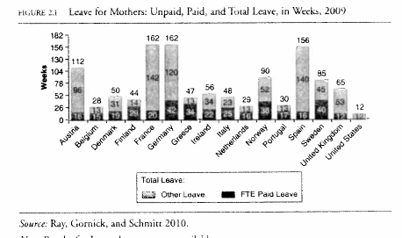
Job-Protected Maternity Leave EU Requirement: Minimum 14 weeks

Slide 15
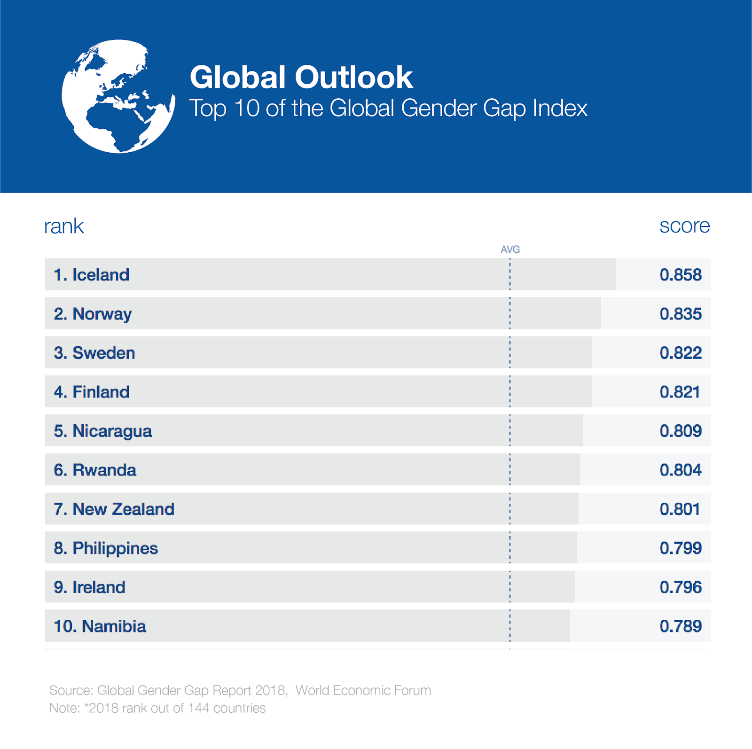
Gender Gap: Work, Money, Knowledge, Time, and Power Source: World Economic Forum

Slide 16
Purposes of Work-Family Policies
Not necessarily just social equality, but also
Alleviate labor shortages
Sustain social insurance revenues
Promote work-life balance
Reduce poverty
Increase birth rate
Conform to international directives

Slide 17
Employment Rates by Gender

Slide 18
Female Employment and the Public Sector

Slide 19
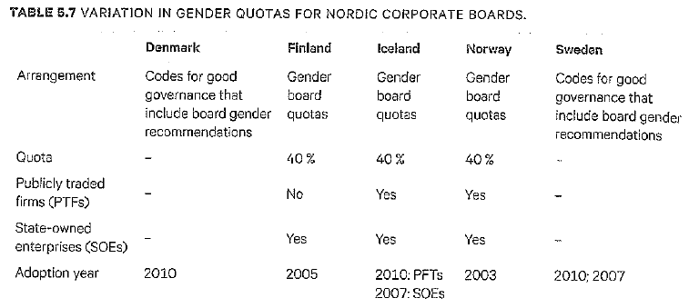
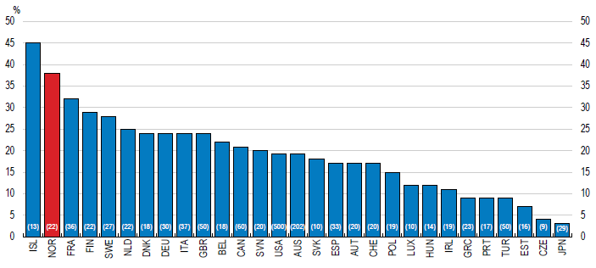
Female Representation on Corporate Boards and Central Banks

Slide 20
Effects of Gender Quotas on Corporate Boards (Source: Sanandaji 2018)
Higher female representation than in most advanced economies
Board diversity generally improves performance due to broader experiences
But for many boards in Norway quotas meant a smaller candidate pool; women members were 8 years younger on average, with less experience
Could be a function of different gender balances across industries (e.g., offshore engineering and shipbuilding vs. design and food)
20% of corporations changed ownership structure to circumvent quotas
Ahern and Dittmar (2012): Market value of corporations declined with the share of female board members, more due to experience than gender
No effect on women’s earnings or gender distribution of managers
Overall positive effects limited to “small elite of women directors” (Seierstad and Opsahl 2011).
Quotas benefit the most resourceful within a favored category and disadvantage the least resourceful outside that favored category

Slide 21
Women as Managers: The Glass Ceiling
Welfare states with large public sectors have prevented small business opportunities in sectors traditionally friendly to women (health, child care, education)
Privatizations (most notably in Sweden) since the 1990s have now opened up such business opportunities
Tax rates disincentivize paid work more for women than for men
Women more readily substitute domestic/family work for paid work when taxes go up
High tax rates and extensive public services reduce the ability of women to hire domestic help
Also motivate “professors to paint their houses rather than teach during the summer”

Slide 22
Women as Managers: Costs of Buying Services (Source: Sanandaji 2018)

