Slide 1
POLI 120E Scandinavian Politics Prof. Kaare W. Strøm
SCANDINAVIA AND INTERNATIONAL Migration

Slide 2
Nordic Immigration
Emigrant societies up to 1920s
Immigration begins in Sweden 1950s; DK, N 1970s
Immigration from Southern Europe, Asia (Turkey, Pakistan, Iran, Vietnam), Eastern Europe, South America
Immigration volume: S>DK>N>ICE>FIN
Foreign-born population: S (15%)>US; DK, N about 8% (half from Europe)
High Concentration
Low Residential Integration

Slide 3
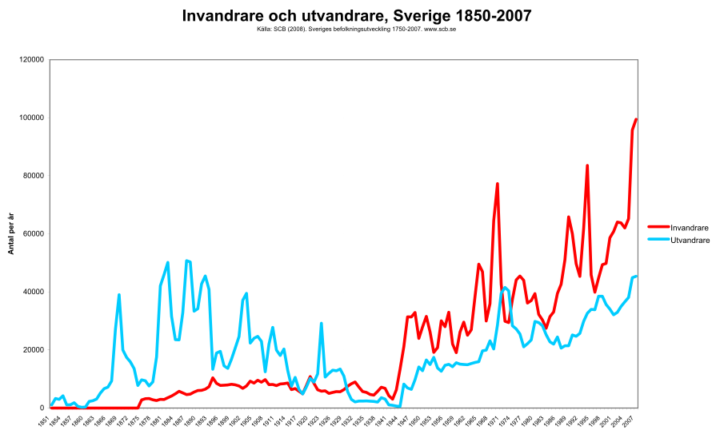
Sweden: Immigration and Emigration, 1850-2007

Slide 4
Sweden: Migration 2000-2017

Slide 5
Categories of Immigrants
Initially
Migrant workers
International spouses
Increasingly also
Family reunification
Refugees (Hungary, Vietnam, Bosnia, Kosovo, Africa)
Asylum seekers (Middle East, Africa)
Ethnic minorities
Well represented in (some) sports
Poorly represented in politics until recently

Slide 6
Swedish Immigration
15% foreign born population; two-thirds born outside the EU
Annually, up to 160,000 immigrants
The fourth largest number of asylum seekers in the EU
2019: 162,000 asylum seekers
Malmö as Sweden’s most multi-ethnic city
56% foreign-born or born domestically with at least one foreign-born parent, plus 15% foreign nationals (2019)
High residential segregation, especially in large cities

Slide 7
Sweden: Reasons for Immigration, 2010-15

Slide 8
Asylum Seekers Admitted, 2013 Source: Arter (2016: 302)

Slide 9
Danish vs. Swedish Immigrants, 2010-12 (Percentages of all immigrants)

Slide 10
Sweden: Immigrants by Country of Origin, 2016
Country | Men | Women | Population
Finland | 60,806 | 92,814 | 153,620
Syria | 87,485 | 61,933 | 149,418
Iraq | 72,538 | 62,591 | 135,129
Poland | 40,700 | 48,004 | 88,704
Iran | 36,765 | 33,872 | 70,637
former Yugoslavia | 33,440 | 33,099 | 66,539
Somalia | 31,746 | 32,107 | 63,853
Bosnia and Herzegovina | 28,832 | 29,349 | 58,181
Germany | 23,708 | 26,481 | 50,189
Turkey | 25,858 | 21,202 | 47,060
Norway | 18,817 | 23,249 | 42,066
Denmark | 21,831 | 19,381 | 41,212
Thailand | 8,671 | 31,206 | 39,877
Eritrea | 19,765 | 15,377 | 35,142
Afghanistan | 21,093 | 13,661 | 34,754

Slide 11
Norway: Immigrants by Origin, 1990s and 2017
Immigrants are divided into two distinct groups:
Those from neighboring countries
Those from distant cultures, often Asia and Africa
1. | Poland | 6,432 | 91,179
2. | Sweden | 23,010 | 38,414
3. | Somalia | 10,107 | 35,912
4. | Lithuania | 378 | 35,546
5. | Pakistan | 23,581 | 34,447
6. | Iraq | 12,357 | 30,144
7. | Germany | 9,448 | 26,683
8. | Vietnam | 15,880 | 21,721
9. | Denmark | 19,049 | 20,897
10. | Philippines | 5,885 | 19,886
11. | Iran | 11,016 | 19,793
12. | Russia | 3,749 | 18,770
13. | Turkey | 10,990 | 17,345
14. | Bosnia-Herzegovina | 12,944 | 16,845
15. | Thailand | 3,738 | 16,559

Slide 12
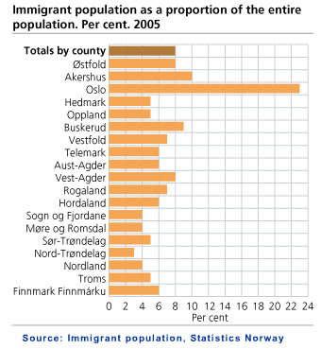
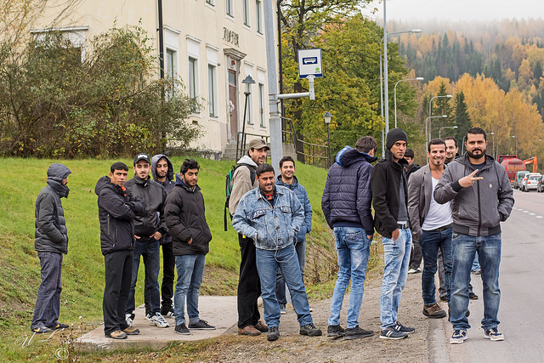
Immigration is Regionally Concentrated
Most immigrants have settled in Oslo and other urban areas in the south

Slide 13
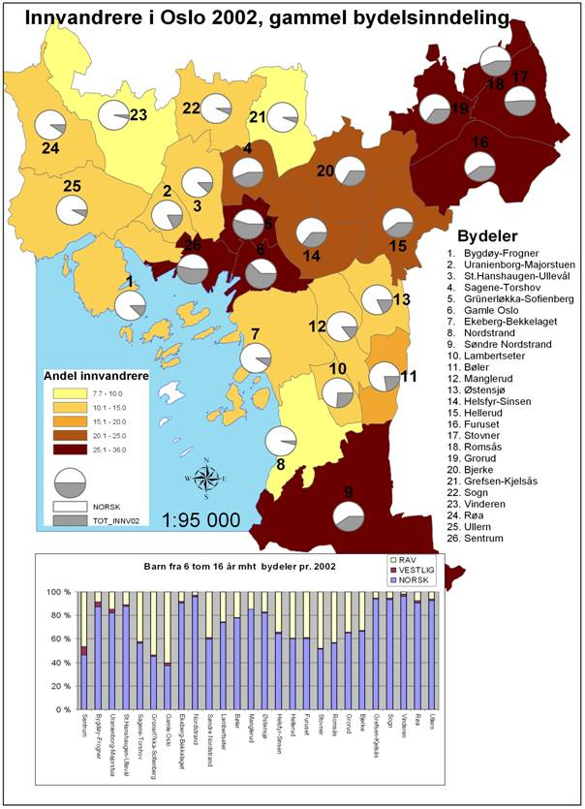
Ethnic Minorities in Oslo
30%+ immigrant background
Main ethnic minorities: Pakistanis, Poles, Somalis, Swedes
Most common boy’s name: Mohammed
50% of population Norwegian Lutherans, 9% Muslim
Substantial residential segregation, school districts vary between 97% ethnic minorities and < 5%
Immigrants are concentrated in inner city, eastern and southern suburbs

Slide 14
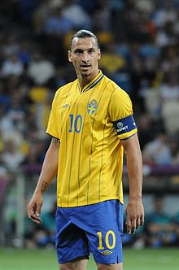
Two of Scandinavia’s greatest professional athletes, 2000s

Slide 15
Sweden’s Immigrant Athletes
Henrik Larsson
Zlatan Ibrahimovic
Born in 1971 in Helsingborg
African father, Swedish mother
Played for Feyenoord, Celtic, Barcelona, Manchester United
Played 106 matches for Sweden; scored 37 goals; captained the team
Played for Sweden in 3 World Cups and 3 European Championships
Winner of two Spanish League titles, 4 Scottish Premier League titles, and 2006 Champions League
Born 1981 in Malmö, grew up in Rosengård
Bosniak father and Croatian mother
Has played for Ajax, Juventus, Internazionale, Barcelona, AC Milan, Paris Saint-Germain, Manchester United, LA Galaxy, AC Milan
In aggregate transfer fees, the most expensive football (soccer) player in the world
The second most decorated active footballer in the world, having won 32 trophies in his career
Has played 116 matches for Sweden; scored 62 goals; captained the team
Has played for Sweden in 2 World Cups and 4 European Championships

Slide 16
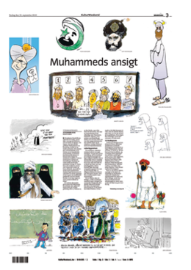
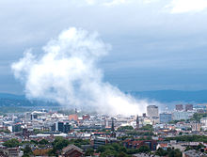
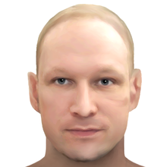
An Immigration Crisis? Scandinavian Flash Points
September 2005: Danish “Cartoon Crisis”: Danish newspaper Jyllands-Posten publishes satirical cartoons of the prophet Muhammad, leading to worldwide protests that escalate into violence resulting in more than 200 reported deaths, attacks on Danish and other European diplomatic missions, attacks on churches and Christians, and an assassination attempt on the newspaper editor.
December 2010: Suicide bomber explodes two bombs in central Stockholm during Christmas celebrations, killing himself and injuring two others.
July 2012: Norwegian Nazi sympathizer and anti-immigrant activist Anders Behring Breivik bombs government buildings and goes on shooting spree at a political youth camp, causing 77 deaths, mainly teenage camp attenders.
2016-17: Riots in immigrant areas of several Swedish cities, rocks thrown against police, several hundred cars set on fire

Slide 17
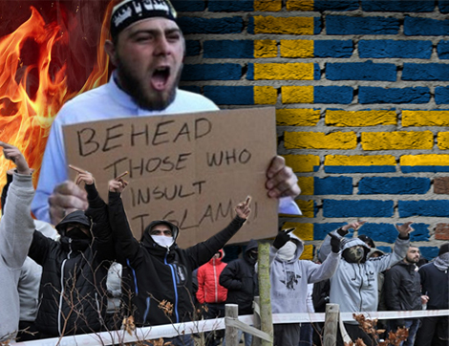
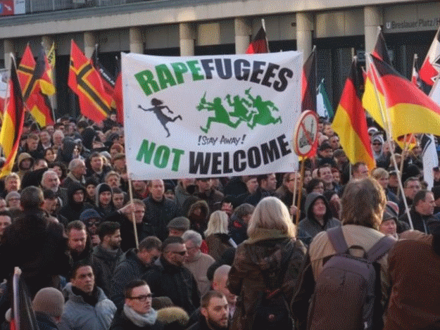
How is Scandinavia’s Immigration Situation Different from that of the United States?
Much shorter history of immigration
More culturally diverse immigrants
Immigrants are more different from natives
Immigrants are more different from one another
Fewer high-skill immigrants
Governments offer more extensive social benefits
Smaller, high-context societies
More fragile cultures?

Slide 18
Why Scandinavian Immigration Is Beneficial
Provides a better life for many immigrants (esp. refugees) that might otherwise experience deprivation and persecution
Provide skilled workers who will work hard for modest wages (Especially intra-European immigration)
Will do jobs native Scandinavians decline (e.g., elder care and manual labor)
Solving Europe’s demographic crisis, since native European populations are aging and have low birth rates
UK Study: EE immigrants paid more in taxes than they consumed in benefits

Slide 19
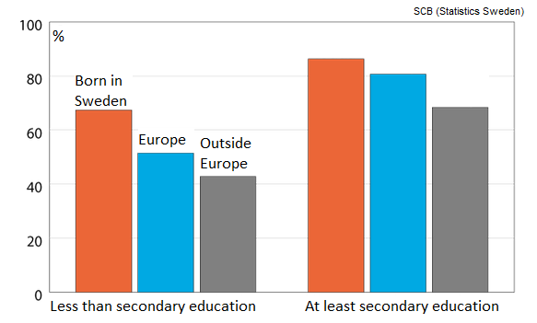
Why Scandinavian Immigration is Costly
Norwegian study: Immigrants a net economic liability
Europe “not getting the immigrants it needs” (Koopmans) – not suitable work skills for knowledge and service industries
Many immigrant groups poorly integrated into job market because of language skills, culture
But: Immigrants with job skills meet resentment, discrimination, and restrictive regulations
Increase in organized and violent crime, terrorism, human trafficking
Benefits of immigration may be short-lived when immigrants age and reduce family size

Slide 20
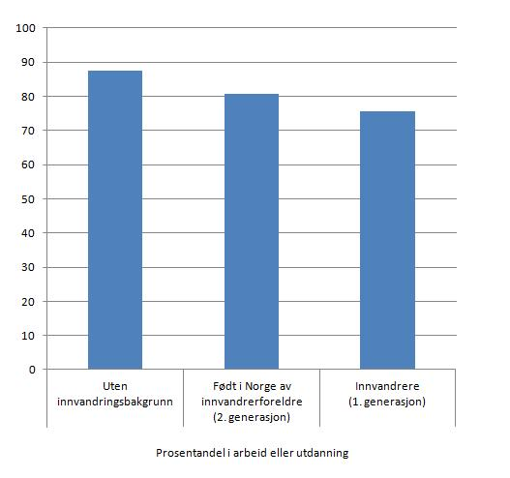
Employment among Norwegian immigrants

Slide 21
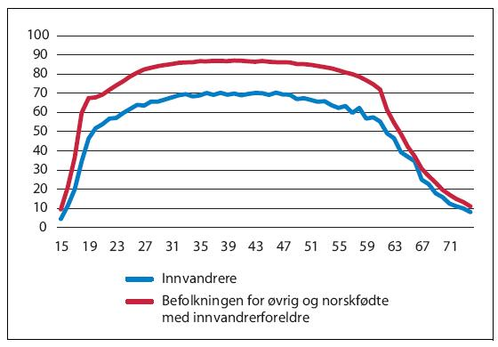
Employment by Age, Norway

Slide 22
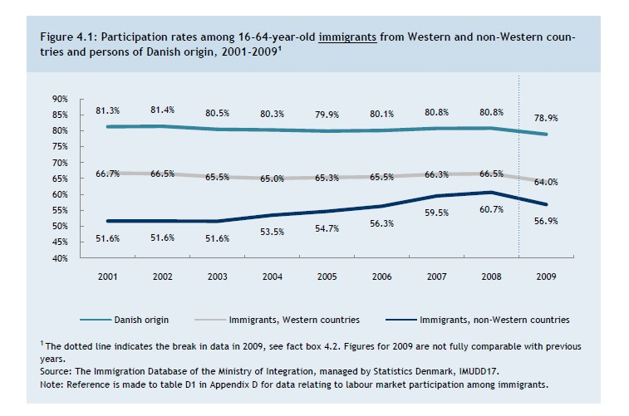
Immigrant Employment in Denmark

Slide 23
Immigration Raises Difficult Identity Questions
Should there be a preference for skills or family reunification?
Should criminals and asylum seekers without proper documentation be deported, even if it places them at risk?
Should there be a requirement to learn the language or national culture?
Should the state support one faith, all faiths, or none?
Should the state support individual rights or respect cultural autonomy?

Slide 24
Immigration Raises Difficult Policy Questions
Should the state support or permit private schools for all faiths?
Should the state actively attempt to promote social integration (through housing, education, etc.?)
Should immigrants enjoy the same welfare benefits as natives, even if they have not contributed financially?
Should immigrants enjoy special benefits (for relocation, education, job training, housing, etc.)?
Should the government regulate the display of religious (or anti-religious) symbols, or permit them freely, even if they conflict with local norms or job performance?

Slide 25
Attitudes Toward Non-European Immigration

Slide 26
Nordic Immigration Policies
Initially: Focus on immigrants, refugees as temporary residents, training in “native” languages
Universalistic welfare state policies
Income maintenance (anti-poverty) programs
Over time: Increasing emphasis on labor integration, gender issues, education, religious diversity
Denmark vs. Sweden: Restrictive vs. permissive immigration control
Little effort to combat job discrimination, little effective anti-discrimination legislation

Slide 27
Danish Immigration Laws
Affiliation requirement (stronger ties to DK than to other countries)
24-year requirement for all parties to any family reunification
Language test
50k DKK deposit for economic safety net
For citizenship, applicant must have been self-supporting 4.5 out of last 5 years
Previously: Application fee of DKK 8000 per person

Slide 28
Responses to Immigration: Populist Right Parties
No radical Islamist parties, though radical Islamist movements exist that have, for example, recruited soldiers for Islamic State
Ethnic minority politicians rising in most mainstream parties
Populist right parties by far the fastest-growing parties in Scandinavian in the 21st century
Most populist right parties draw support from immigration concerns, especially Sweden Democrats, but that is rarely their only issue
Some populist right parties in Europe have fascist or authoritarian pasts (Italy), but Nordic parties generally do not
Most Scandinavian populist right parties differ from the American right in that they are not religious conservatives or critics of big government
Most populist right parties across Europe have prominent and powerful leaders
Party leaders may have their personal beliefs and policy agendas, but many are electoral opportunists

Slide 29
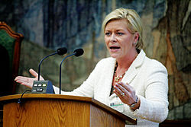
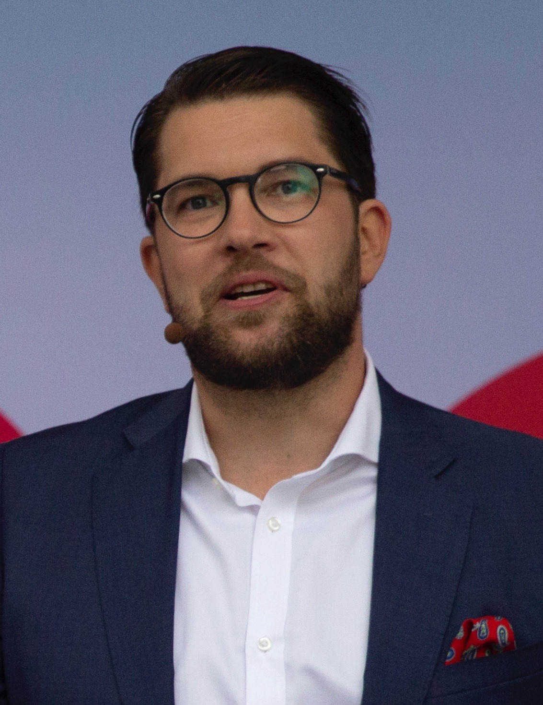
Nordic Populist Right Parties
Denmark: Danish People’s Party (DPP): 8.7%, 3rd
Finland: Finns: 17.5%, 2nd
Iceland: No significant party
Norway: Progress Party: 15.2%, 3rd
Sweden: Sweden Democrats: 17.5%, 3rd
Progress Party (N) the oldest and least explicitly immigration-critical (founded as a protest party against taxes and regulation)
Sweden Democrats the most radical
Finns: Successor to Rural Party
Sweden Democrats isolated by all other parties
DPP a support party for 2001-11 and 2015-19 Danish governments
Progress Party a member of the Norwegian government 2013-2020

