Slide 1
POLI 120E Scandinavian Politics Prof. Kaare W. Strøm
POLITICAL ECONOMY AND The Welfare State

Slide 2
Agenda for today
What is the Scandinavian welfare state?
What has the welfare state accomplished?
How has the welfare state changed?
What challenges does the welfare state face?

Slide 3
What is the Welfare State?
Functions
Insurance
Redistribution
Insurance Function
Forced savings for retirement
Pooling of savings for other calamities
Unemployment
Sickness
Disability

Slide 4
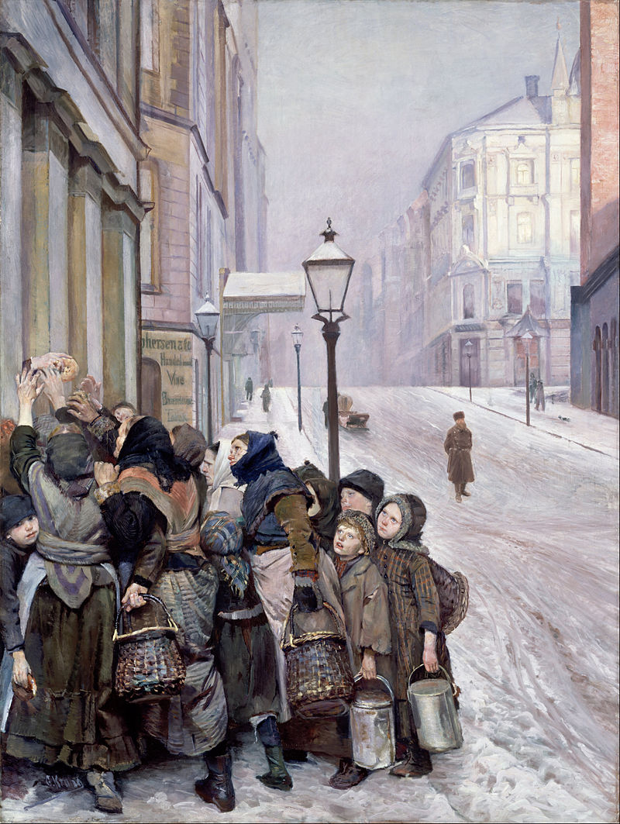
The Redistributive Function (Robin Hood) Illustration: “The Struggle for Survival” by Christian Krogh
Principles of distribution
Need
Contribution (taxes, years worked, voluntary contributions)
Entitlement (universalism)
Considerations
Universalism (entitlement): All citizens receive same benefits, regardless of need
Needs-based policies more redistributive, but determining needs can be controversial
Contribution-based policies more common for pensions, have better incentive effects
Universalistic policies remove stigma, less costly to implement
Nordic welfare states generally favor universalism, but not in pensions and less so than previously in other benefits

Slide 5
The Historical Evolution of the Nordic Welfare State
1890-1940: Industrial Model
Protection against hazards of industrial economy
1945-1970: Comprehensive Model
Family benefits, pensions, housing, education, universalism
1970-1990s: Gendered Model
Parental leave, child care, family benefits
1990s- present: Inclusive Model
Immigrants, refugees, disabled

Slide 6
The Nordic Welfare State
Basic Features
Stateness (Health care: 80-85% of expenses)
Universalism (Entitlement, Equal provision)
Social Goal of Equality
Comprehensiveness (“cradle to grave”)
Core Programs
Occupational Accident Insurance
Sickness Insurance
Old Age Pensions
Unemployment Compensation
Social Assistance (needs-based anti-poverty)
Post-World War II Expansion
Universal Social Security Systems
Disability Pensions
Maternity/Parental Benefits
Child benefits, Child care, Pre-school
Public Housing/Housing support
Secondary and Higher Education

Slide 7
Why Is the Nordic Welfare State So Generous (Large)?
Social Democratic Hegemony, strong unionization
The Welfare State as a consensual project
Transparent, high-trust societies means less fear of inefficiency, fraud
Few Alternatives to the State
Lack of Catholic tradition means state dominance
Weakness of guild tradition
Limited private wealth meant large majorities could benefit

Slide 8
Nordic Welfare Outcomes
Little dire poverty, especially among children and elderly
Low levels of joblessness, homelessness
Excellent public health outcomes
High educational attainment, though varying quality standards
Very high female labor force participation
Reasonable, but declining, birth rates

Slide 9
Population at Risk of Poverty, 2012

Slide 10
Percentage Very Poor in Europe, 2011
Sweden 1.2
Luxembourg 1.2
Iceland 2.1
Norway 2.3
Denmark 2.6
EU Average 9.0
Greece 15.2
Latvia 31.0
Bulgaria 44.0

Slide 11
Gini Index of Income Inequality, 1986 and 2010 Source: Arter (2016)

Slide 12
Challenges to the Nordic Welfare State
The cost of welfare growth
New distributional conflicts
Abuse and moral hazard
The Demographic Time Bomb

Slide 13
Government Spending and Taxes as Share of GDP

Slide 14
Social Expenditure as % of GDP, Norway

Slide 15
New Forms of Redistribution
From Rich to Poor
Traditional welfare state (pre-WWII)
From Men to Women
Newer (post-1970) benefits often favor (single) women
Child benefits, family leave, child care, housing subsidies
Old age pensions more redistributive over time, favoring women
From Natives to Immigrants
Immigration wave after 1970s
From those in the Labor Force to those outside
Growing share of pensions since 1960s
Declining share of population in labor force
Longer schooling
Lower retirement age
Growth of disability pensions

Slide 16
Effects of Immigration on the Welfare State
Immigrants underrepresented in labor force
Canada 78% employed, Norway 66%
Somali refugees: N 28%, MN 71%
Effects of immigration type, countries of origin, language skills
Many immigrants have health care needs
E.g., refugees
Many immigrants have few labor or language skills
Immigrants do not fit contribution model of financing

Slide 17
Other factors driving up welfare costs
Moral hazard: Easy access to benefits means less care is taken to avoid problems
Disability pensions: Approx. 13% of Norwegians age 18-65
Sickness benefits: Norwegians, Swedes sick more than twice as often as other Europeans
Extensive regulation makes many social services expensive
Norway has world’s most expensive schools per capita, middling results in international comparisons

Slide 18
How have policy choices contributed to Social Democratic decline?
Extensions of the welfare state have become more costly and less popular
Disability pensions (hard to reverse, exploitable)
Public housing (less popular)
Family benefits favoring large families (incr. immigrants)
Other policy positions favored by Social Democrats and unions have been unpopular
Resistance to more liberal shop hours
State monopolies in broadcasting
Wage earner funds (S)

Slide 19
The Demographic Time Bomb Estimated share of pensioners relative to labor force, 2050 (Source: U.N.)
Norway 45%
Finland 49%
Sweden 54%
A changing ratio of contributors to recipients means workers have to contribute more, especially when benefits are financed through payroll taxes
Example, if the ratio of contributors to recipients is 50% and each pensioner receives an average of $30,000 annually, then each taxpayer will have to pay an average of $15,000 in taxes just to support this pension scheme

