Slide 1
POLI 120E Scandinavian Politics Prof. Kaare W. Strøm
Scandinavian
Political Economy

Slide 2
What Is Social Democracy?
Party of the industrial working class
Working-class leadership
No Norwegian Labor Prime Minister 1928-81 had more than a primary education
Reformist change (not revolution)
Gov’t or collective ownership
Large Business, Housing, Stores
Universal welfare state
Moderate internationalism
Pacifism

Slide 3
Why has Social Democracy been so strong?
No significant ethnic or religious cleavages
No competing Catholic, linguistic, or ethnic parties (exc. FIN)
No history of revolutions, coups, civil war, or repression (exc. FIN)
Late, dispersed industrialization (N, S)
SD parties already existed, mobilized workers
Rural “company towns” with strong working-class consciousness
Social democrats made class alliances with agricultural labor, fishermen
No “labor aristocracy” supporting non-socialist parties
Esping-Andersen: Social Democrats introduced winning policies
Universal social security and health care system
Labor laws that favor unionization
Public housing policies (Sweden, not Denmark)

Slide 4
The Legacy of Social Democracy: The “Third Way” (Between capitalism and socialism)
Mixed economies
Predominantly private, but more public ownership than US
Natural resources, Transportation, Banks
Large public sector share of GDP, 45-55%
DK and S>ICE
Extensive government regulation
Welfare states
Large social safety net
Redistributive taxation
Wealth taxes, progressive income tax, inheritance taxes
Universalist principles of distribution
The Road to a “Third Way”
Historic Compromise of 1930s
Social Democratic Hegemony, 1930s-1970s
Consensual Societies
Goal: Social equality without “dictatorship of the proletariat”

Slide 5
Historic Compromise, 1930s
Fundamental economic change
Similar to New Deal but more radical and statist
But neither communist nor fascist
Compromise between industry and labor, non-socialists and social democrats
Social Democratic concessions
Limited nationalization of industry
Center-right concessions:
Extensive welfare states
Extensive government regulation
Corporatism

Slide 6
Implications of the Historic Compromise
Industrial peace; sharp reduction in strike levels
Mutual trust/social capital (Rothstein)
High levels of social participation
Social Equality: Among the highest in the world
Low Poverty Rates: Among the lowest in the world

Slide 7
The Decline of Social Democracy, 1970, 2005, and 2019

Slide 8
Why has Social Democracy declined since the 1970s?
Since the 1950s the working class has shrunk (and the rural population even more) in favor of the service class
Working-class communities have fragmented because of affluence, individualization, and immigration
Political preferences less determined by producer interests
New issues have split the working class:
Environmentalism, feminism
Competition from green, left socialist parties
Political campaigns have become more media-focused and capital-intensive, and activist labor has become less valuable

Slide 9
Class Voting 1960-2000 Alford Index: Pct of working-class voters voting left, minus pct of non-wc voters voting left

Slide 10
How have policy choices contributed to Social Democratic decline?
Extensions of the welfare state have become more costly and less popular
Disability pensions (hard to reverse, exploitable)
Public housing (less popular)
Family benefits favoring large families (incr. immigrants)
Other policy positions favored by Social Democrats and unions have been unpopular
Resistance to more liberal shop hours
State monopolies in broadcasting
Wage earner funds (S)

Slide 11
(Neo-)Corporatism
Integration of private interests (interest groups) in policy formulation, implementation, and adjudication
Representation on Commissions
Remiss Procedure generates comments on commission proposal
Government is obligated by law to consult affected interests
Representation in executive/administrative agencies
E.g., agency setting labor standards
Representation in judicial agencies
E.g., agency judging labor disputes
Applied first in primary sector, then in secondary sector and elsewhere
Applied to producer groups, over time also to consumer groups
Relies on strong concentration, centralization of interest groups

Slide 12
Rehn-Meidner Plan: Extending the Historic Compromise in Sweden
Goals:
Greater social equality
Industrial adaptation to technological change
Maintain economic stability and employment
Increase worker control over economy
Expanded welfare state, especially public pension system
Wage solidarity (gains for lower-skilled workers)
Increasing cost of lower-skilled labor shifts employment toward higher-skilled, capital-intensive sectors
Public retraining programs for redundant workers
Reliant on fiscal discipline and monetary restraint

Slide 13
Scandinavian Political Economy 1970-2010: One Miracle and Three Crises
The Miracle Nobody Foresaw or Worked For
Norway from the 1970s: Oil and Gas
Two Self-Inflicted Crises
Sweden: An Overgrown State
Iceland: Runaway Capitalism on Borrowed Funds
When the neighbor’s house burns
Finland 1991-93

Slide 14
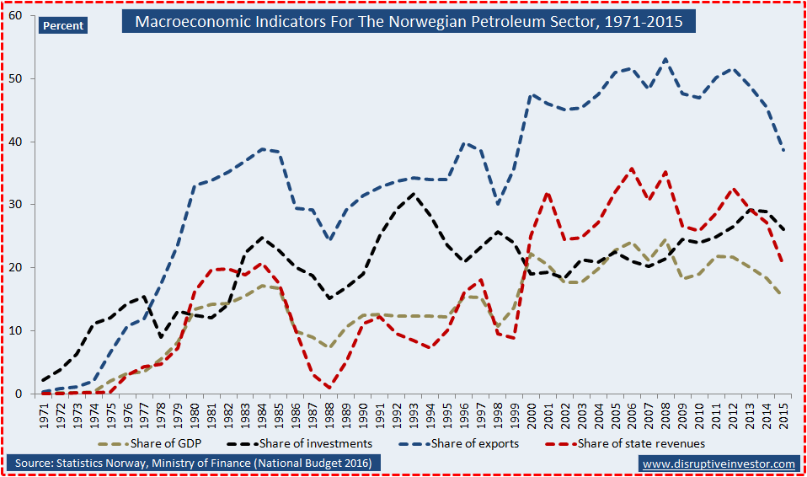
Norway: The Blessings(?) of Oil
Oil and gas discovered offshore in the North Sea 1970
Oil production begins shortly afterwards, under strong public regulation and dominated by largely state-owned Statoil (now: Equinor) corporation
Oil and gas become largest export products and account for 40-50% of GDP
Income from oil production grows to 30% of government revenue
Norway far surpasses Denmark and Sweden in GDP/Capita and becomes one of the richest countries in Europe (with Switzerland)
State Pension Fund becomes the world’s largest sovereign wealth fund, with more than $1 Trillion in assets, or 1.4% of all the world’s stocks
But: Oil economy drives up labor costs and drives out domestic manufacturing
Rising numbers of Norwegians on disability pensions, job-training schemes (hidden unemployment)
Declining working hours and actual retirement age

Slide 15
Sweden: The 1990s Crisis and the Problems of Wage Solidarity
Job loss
Industrial jobs outsourced to Asia, Eastern Europe/Baltic countries
Rapid rise in unemployment, 1990-94, to 8-9% (S)
New sectors did not compensate for job losses in traditional sectors
Job shift to public sector
Public sector in S, N > 30% of work force; US, UK 15%
S 1950s-1980s: almost all job growth in public sector
Economic rigidity
Politically not feasible to close down unprofitable enterprises
Large wage gains fuel inflation
Lindbeck et al.: Swedish inflation 2% higher than OECD
Large government budget deficits
Up to 14% of GDP in late 1970s, again in mid-1990s
Repeated devaluation in 1980s, 1990s; becomes the weakest currency in Scandinavia
Sweden slides from 3rd to 17th place globally in GDP/capita, 1975-95

Slide 16
How Did Sweden Adapt to the Economic Crisis of the 1990s?
“Trimming” of social welfare benefits (e.g., sick leave)
Less progressive taxation
Retreat from corporatism
Increased commitments to higher education, entrepreneurship
Joined European Union 1995

Slide 17
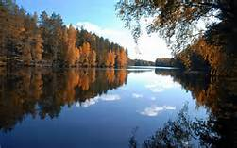
Finland’s Crisis, 1991-93
Finland’s economy in the early 1990s
Bubble economy, caused by easy access to foreign credit
High public and private debt, weak banks, overvalued housing
Sweden, Finland’s most important trading partner, experiences severe economic downturn in the 1990s
The USSR had accounted for 15-20% of Finnish foreign trade, collapses in 1991
The effects on Finland
Stock market and housing prices fall by 50%
GDP falls by 13% (worse than Great Depression)
Unemployment goes from near zero to 18.9%
10 Billion Euros spent to bail out failing banks

Slide 18
Finland after the Crisis
The economy begins growing again in late 1993
Joins the EU in 1995; only Nordic country to adopt the Euro
Unemployment declines but only to about 10%, similar to Ireland and EU average in 2015
Radical economic restructuring
Paper and pulp to technology
Nokia becomes world’s leading producer of cell phones in the 1990s, then falters
Yet the economy becomes the 4th largest knowledge economy in Europe
High economic growth rates since 2000, except during Financial Crisis; grew 1.9% in 2016
9th wealthiest country in the EU 2015, behind Ireland but ahead of all large countries except Germany

Slide 19
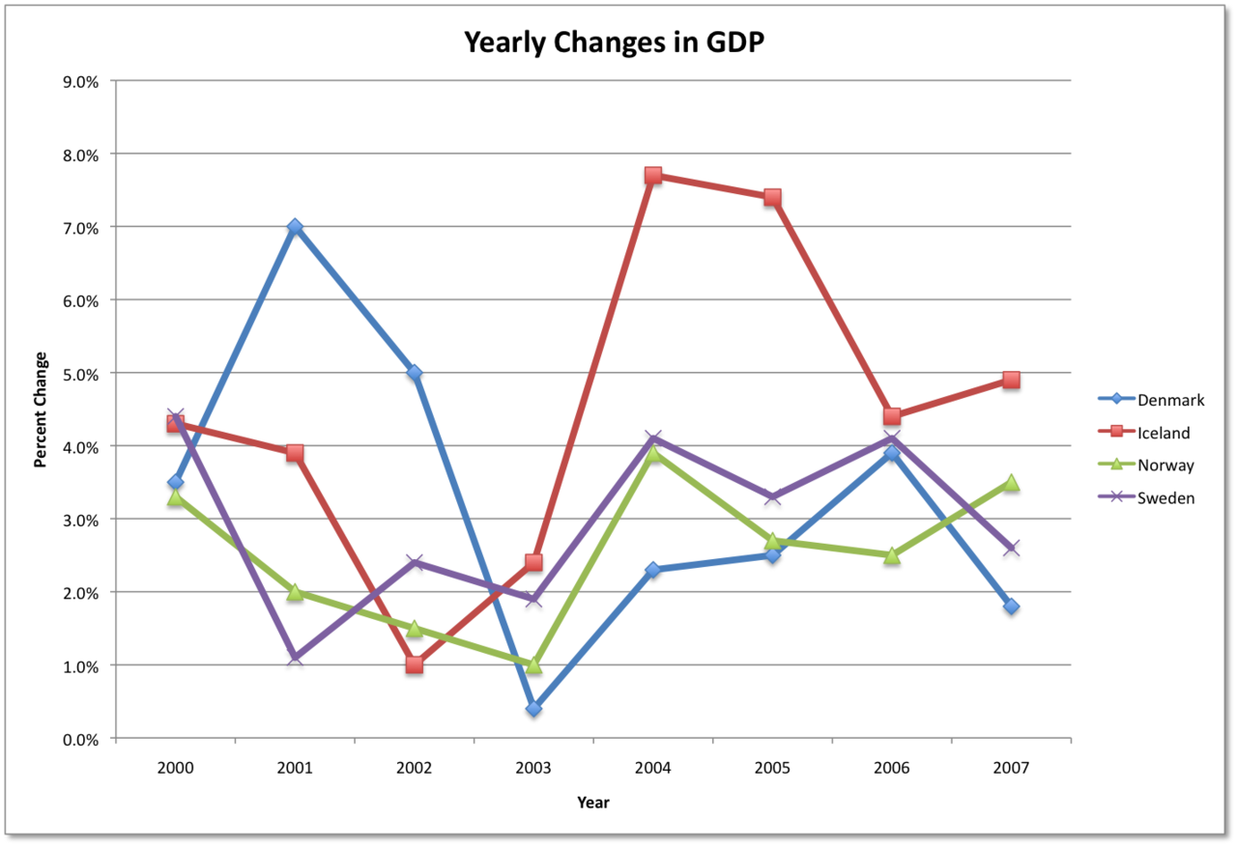
Iceland 2008-11: Living Large on Borrowed Funds and Lax Enforcement
Establishment of tradeable fishing quotas in 1990s enables widespread borrowing
Three major banks make invest heavily abroad with borrowed funds
Insider trading and lax oversight
International financial crisis of 2008 exposes risky investments and all three banks fail, causing losses for investors in the UK and Netherlands also
Iceland’s GDP falls by 10% 2007-09, stock market loses 90%+ of its value, krona devalued
Healthy recovery begins in 2011

Slide 20
Nordic Long-term Economic Performance: Positives
Mostly low unemployment
Few low-paying jobs
Rapid integration of women into labor force
Rapid adoption of information technology
Some very successful firms in emerging industries (IKEA, H&M, Pharmaceuticals; fish farming)
Decent economic growth 2000- (esp. S)
Social security reforms have been passed (S, N)
Improvements in economic freedom
Smaller public sector: Sweden 67% (1993) to 49% (2018)
Public debt: Sweden 84% of GDP (1996) to 41% (2018)

Slide 21
Long-term Economic Performance: Negatives
Rigidity: Difficult to close heavily unionized loss-making industries (shipyards, paper)
Large public sector (esp. DK, N) meant heavy job protection
Slow absorption of immigrants into work force
Sweden: 84% employment among natives;
51% among non-Europeans
Manufacturing industries have largely disappeared
High wages, heavy regulation mean difficult environment for service industries
Large share of working-age population on disability, sick leave, early retirement

Slide 22
Nordic Economies, 2018

