Slide 1
POLI 120E: Scandinavian Politics Prof. Kaare W. Strøm UC San Diego
Nordic Political Parties
And voters

Slide 2
Agenda for Today
How have critical historical junctures affected the Scandinavian party systems?
National variations on the five-party model
How have the party systems changed?
What coalitions do Nordic parties build?
How has the behavior of Nordic voters changed?

Slide 3
How Parliamentarians are Chosen
Direct popular election in one chamber of middling size: 63 ICE to 349 S
Multimember districts: Avg. District Magnitude: 6 (Ice) to 13 (Fin)
Proportional Representation
Modified St. Lague (N, S) vs D’Hondt (DK, FIN, ICE)
Thresholds: S 5%, N 4%, DK 2%
Adjustment (Supplementary) seats: DK (40), ICE (9), N (19), S (39)
Four-year term (S 1970-98: 3 yrs): Fixed (N, S) vs. Dissolution power (DK, FIN, ICE)
Candidate Selection
Norway: Closed List (Parties rank candidates, voters have no say)
Iceland: Closed List after primary elections
Denmark and Sweden: Open List with Weak Preferential Voting (voters may but need not vote for specific candidates on the party’s list)
Finland: Open List with Strong Preferential Voting (voters must vote for specific candidates on the party’s list)
Candidate (Preferential) voting
Has increased in recent decades
Weakens party loyalty, promotes name recognition as selection criterion

Slide 4
The Five-Party Model
Non-Socialist (“Bourgeois”) Bloc
Conservatives
Liberals
Agrarians
Socialist bloc
Left Socialists/
Communists
Social Democrats/Labor

Slide 5
The Historical Evolution of Party Systems (Lipset/Rokkan)
Political divisions arise at critical junctures
Rulers make alliances, parties arise in opposition
National Revolution (1500s-1800)
Church vs. State (Protestant Reformation, 30-year War)
Relationship between church and state, control over education
Scandinavia escaped divisive conflict because of rapid adoption of Protestantism
Center vs. Periphery (French Revolution)
National identity and independence movement, status of national and linguistic minorities, centralization of power
In three “peripheral” countries, this became a major division
Industrial Revolution (1800-1920s)
Workers vs. Owners (Industrial Revolution)
Redistribution, welfare state, public ownership
Bolshevik Revolution in Russia 1917 caused division between Social Democrats (national, constitutional) and Communists (international, revolutionary)
Urban vs Rural (“Urban Revolution”)
Tariffs, support for industry vs. agriculture
Rural populations often mixed agriculture, fisheries, forestry, and industrial work
Comparatively strong rural support for the left, weak for conservative parties

Slide 6
How Scandinavian History Has Affected the Party Systems
Protestant Reformation rapid and complete
No Continental-style Christian Democratic parties
Late national independence (FIN, ICE, N) fueled strong parties
Strong regional/linguistic cleavages
National independence parties strong in peripheral countries
Rapid industrialization not always urbanized (N, S)
Social democratic strength even in rural areas (exc. DK)
Rapid growth of radical socialism
Rural communities have remained strong (exc. S)
Resilient agrarian parties
Urban middle classes weak in “peripheral” countries (FIN, ICE, N)
Weak liberal parties

Slide 7
Party System Evolution
1870-1900: Two-party politics
Liberals vs Conservatives
Constitutional issues, monarchy, franchise, parliamentary government
1900-1920: Three-party politics
Enter Social Democrats
Economic issues, revolution
1920-1970: Five-party politics
Enter Agrarians and Communists
Urban-rural issues, great depression, capitalism, democracy, foreign policy
1970-: Fragmented politics
Enter Christian Democrats, Greens, and Populist Right parties,
Social issues, environmental issues, gender issues, tax burden, consumption issues, immigration

Slide 8
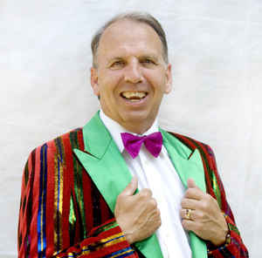
Making fun of parties: Jacob Haugaard
Danish comedian, born 1952 in Faroe Islands
Formed Association of Deliberate Work Avoiders
Slogan: If work is so healthy, give it to sick people
Ran for Parliament from 1979 until elected in 1994
Elected in 1994 as first independent member elected under 1953 Constitution; did not run for reelection in 1998
Spent public party subsidy on beer and hot dogs for supporters after election
Election platform
More whales in Danish waters
Bigger Christmas presents
Reopening of urinal in front of Århus city hall
More Renaissance furniture at IKEA
More tailwind on Danish bike paths

Slide 9
Sweden
The closest fit to the five-party model
The strongest social democrats
The most pronounced bloc politics
The least fragmented system
Frequent alternation in power between left and center-right
The most extreme populist party (Sweden Democrats)
Why?
Class politics has dominated
The highest electoral threshold (4%) for small parties

Slide 10
Denmark
1920s: Strongest social democrats
1970s-: Greatest decline for social democrats
Rural segment captures liberal party
Strongest liberal party
Biggest “earthquake election” with populist protest party (Glistrup)
Why?
Most affected by EU politics
Lowest barrier for small parties

Slide 11
Norway
Strongest Christian party, esp. 1970s-2005
Most spectacular decline of Liberals
Weakest far left (Socialist Left) and Greens in Scandinavia
Frequent alternation in government since 1960s
Populist party (Progress) in government coalition since 2013
First “bourgeois” (center-right) coalition (1963)
Why?
More traditional values than S, DK
Continuing importance of nationalism
Experience of World War II

Slide 12
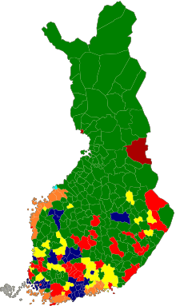
Finland
Greatest fragmentation
Weak social democrats
Strongest communists
Strongest agrarians
Significant linguistic minority party (Swedish People’s Party)
Least pronounced bloc politics
From unstable to stable governments
Why?
Most rural Nordic country
Late industrialization
Legacy of War of Independence and World War II

Slide 13
Iceland
Only country where liberals and conservatives have merged
Only country where the right bloc has tended to dominate the left
Independence party (center-right) dominant party
Weakest social democrats, strongest Green-Left
Strong volatility (vote fluctuations) in recent decades
Why?
Late independence, small size means national independence is important
No large-scale industrial economy
Important foreign powers are US, UK (not USSR)

Slide 14
Public Subsidies for Swedish Political Parties SEK per party member (Sweden), 1989-2008, in 2008 prices

Slide 15
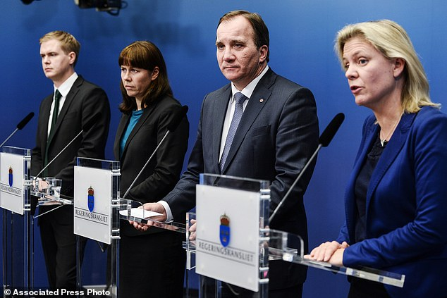
Party Coalitions
Non-socialist or Center-Right (N, S, DK)
Conservatives, Liberals, Agrarians, Christians
Popular Front/Left (S)
Social democrats, Communists
Red-Green
Social democrats, Agrarians
Social democrats, Greens
Lib-Lab (DK, S)
Social democrats, Liberals
Center (FIN)
Social democrats, agrarians, liberals +
Rainbow (FIN)
Conservatives through Social Democrats, Greens
Blue-Blue (N)
Conservatives and Populist Right

Slide 16
Nordic Parties and Executives, 2020
Country | Denmark | Finland | Iceland | Norway | Sweden
Election Year | 2019 | 2019 | 2017 | 2017 | 2018
Party 1 | Social Democrats 25.9% | Social Democrats 17.7% | Independence 25.2% | Labor (Social Democrats) 27.4% | Social Democrats 28.3%
Party 2 | Liberals 23.4% | Finns Party 17.5% | Left-Green Movement 16.9% | Conservatives 25.0% | Moderate Unity (Cons) 19.8%
Party 3 | Danish People’s Party 8.7% | National Coalition (Cons) 17.0% | Progressive Party 10.7% | Progress (Populist Right) 15.2% | Sweden Democrats 17.5%
Prime Minister | Mette Frederiksen | Sanna Marin | Katrin Jakobsdottir | Erna Solberg | Stefan Löfven
PM Party | Social Democrats | Social Democrats | Left-Green Movement | Conservatives | Social Democrats
President | Monarchy | Sauli Niniisto | Guðni Thorlacius Jóhannesson | Monarchy | Monarchy
Pres Party | NA | Conservative | Non-Partisan | NA | NA

Slide 17
Nordic Voters
High but declining turnout
High but declining levels of party membership and identification
Traditionally strong but declining class voting
Increasing gender, sectoral voting
Increasing volatility
Increasing candidate orientation, boosted by changes in electoral laws in Sweden

Slide 18
Voter Turnout in the Nordic Countries

Slide 19
Party Membership in the Nordic Countries

Slide 20
Party Identification in the Nordic Countries

Slide 21
Class Voting 1960-2000 Alford Index

Slide 22
Electoral Volatility (Vote-switching) in the Nordic Countries

Slide 23
Late Deciders (During Campaign) in Nordic Elections

