Slide 1
POLI 120E Scandinavian Politics Prof. Kaare W. Strøm
Nordic
Political Culture

Slide 2
What Is Political Culture?
Knowledge and Beliefs
Who is the prime minister?
How does a bill become a law?
Name a Member of Parliament in your district
Feelings
Are you proud of your nationality, flag, head of state, national holiday?
Do you trust politicians, ordinary people, members of other religious or ethnic groups, etc?
Evaluations
How satisfied are you with democracy?
Is the country run for the benefit of all citizens, or just a few?
How fair are elections in your country?
Does Political Culture Matter?

Slide 3
Scandinavian Culture
Informal, egalitarian (Jante Law)
Immediate reciprocity
Assumptions of shared knowledge;
High-context culture
Avoidance of conflict
Avoidance of potential embarrassment
Pride in Nation, especially in periphery

Slide 4
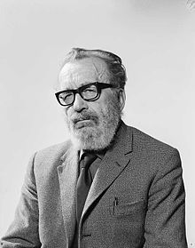
Egalitarianism and Envy: The Jante Law (Axel Sandemose)
You're not to think you are anything special.
You're not to think you are as good as us.
You're not to think you are smarter than us.
You're not to convince yourself that you are better than us.
You're not to think you know more than us.
You're not to think you are more important than us.
You're not to think you are good at anything.
You're not to laugh at us.
You're not to think anyone cares about you.
You're not to think you can teach us anything.

Slide 5
Political Trust and Values: Comparative Assessments
Satisfaction with government
Trust in government and people in national office
Trust in others
Political Values

Slide 6
Political Satisfaction Source: Bengtsson et al. 2014

Slide 7
Satisfaction with Parliament

Slide 8
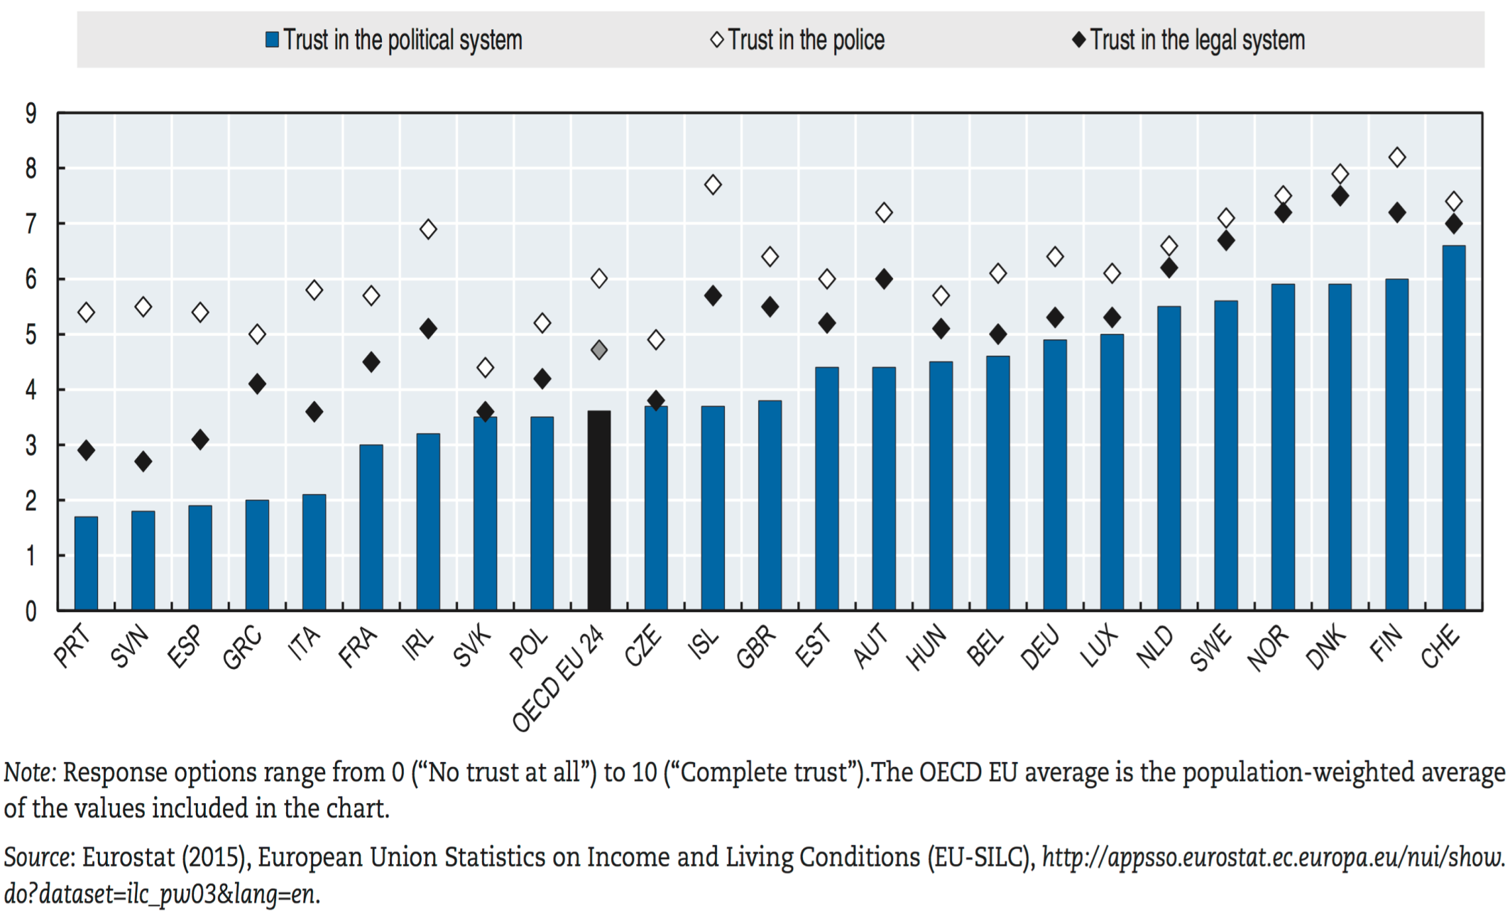
Political Trust in Scandinavia and Europe

Slide 10
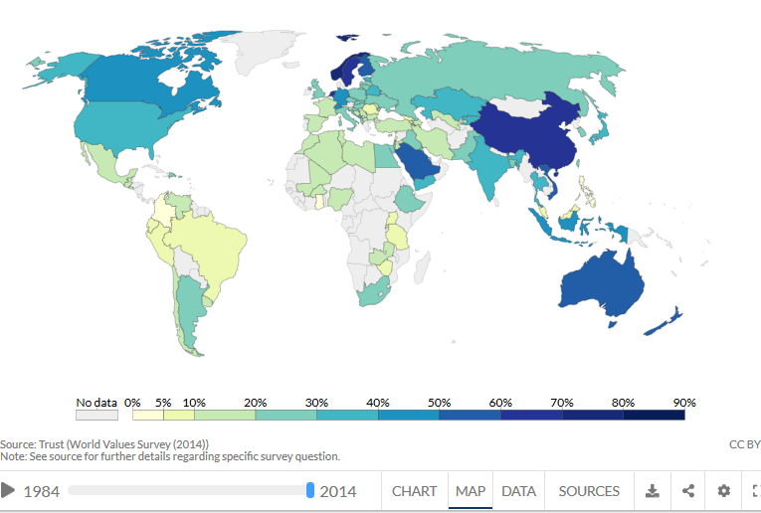
Trust in Others in the World

Slide 12
Nordic Values, Compared to the Rest of the World Source: World Values Survey
Very low on honor and respect for parents, tradition
Low on value of joy and friendship
High on punctuality and efficiency
High on gender equality
Very low on masculinity
Middling on national pride
Relatively high on individualism
Relatively low on belief in God
Relatively high on feeling of freedom
Low on value of hard work
Sweden generally the most extreme case; Finland and Iceland most similar to the United States

Slide 13
The Importance of Trust
How does trust matter?
High-trust societies tend to be more peaceful
High-trust societies tend to be more prosperous, partly because distrust is costly
Trust makes social life easier and more enjoyable
What causes trust?
Transparency
Equality
The welfare state
Prosperity
A shared culture
A strong legal and moral order

Slide 14
Eckstein’s Puzzle: Why is Norway so stable?
Second oldest living constitution (1814)
Adaptability: From civil servant state to liberal to social democratic rule
Stable and effective governments (except 1920s)
Cohesive, strong political parties
Strong popular legitimacy

Slide 15
Potential Explanations
Not formal institutions: Parliamentary democracy, no emergency powers
Not great wealth (as of 1960s)
Not a “small” society
Not lack of legalism
Not social deference (Bagehot)
Not dignified traditions
Not lack of divisions (social cleavages)
Officials vs. peasants
Cultural cleavages (language, alcohol, faith)
Class

Slide 16
Eckstein’s Explanation: Cohesion
Cohesion
Sense of community
Overarching common identity
Forces of Cohesion:
Early nationhood
Primordial community
Social interconnections
Congruent authority patterns

