Slide 1
POLI 120E Scandinavian Politics Prof. Kaare W. Strøm
DEMOCRATIZATION AND MODERNIZATION
1800-1950

Slide 2
Main Themes of Nordic Modernization, 1800-1945
Scandinavianism (mainly 1829-64)
Democratization, 1814-1921
Nationalism in Finland, Norway, Iceland, 1800-1945
Industrialization, 1850-1950
World Wars I and II

Slide 3
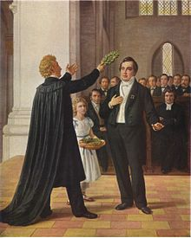
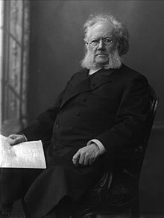
Peace and Scandinavianism
Scandinavianism, 1845-64
A solidarity movement among intellectuals
Influenced by romanticism
1829: Danish poet Adam Oehlenschläger crowned by Swedish Bishop Easias Tegnér in Lund
Nationalism in Finland, Norway, Iceland
Dano-Prussian wars of 1848, 1864 disillusioned many supporters, including Norwegian playwright Henrik Ibsen

Slide 4
The Process of Democratization, 1809-1921
Features of Democratization
Constitutional Order: 1809-1901
Universal Adult Suffrage: 1906-1921
Parliamentary supremacy: 1884-1917
Proportional Representation: 1906-1942
Gradual process in Denmark, Iceland, Norway
Rapid and late process in Sweden
Revolutionary process in Finland

Slide 5
Sovereignty and Constitutions, 1814-1945
1809: Swedish Constitution
1814: Norwegian Constitution
1849: Danish Constitution
1905: Norwegian Independence, end of dual monarchy
1917: Swedish Democratic Reforms
Parliamentary Government
Monarchy reduced to symbolic functions
1901-20: Danish Democratic Reforms
Universal suffrage
Monarchy constrained
Upper House (Landstinget) weakened

Slide 6
Nationalism in Peripheral Scandinavia
Finland: late 1700s on
Old Finns vs New Finns (resistance against Swedish vs. Russian rule)
Russian Revolution of 1905 leads temporarily to greater home rule, break with Russification policies
1917: Russian Revolution leads to war of independence/civil war (Reds vs. Whites); Whites win
Norway
Constitution of 1814; Dual monarchy and national parliament with broad franchise leads to growing tension between king and parliament
Parliamentarism 1884: Parliament (dominated by Liberal Party) removes the power of the King to appoint his cabinet
Dissolution of dual monarchy 1905: Norway unilaterally secedes from dual monarchy
Iceland
Restoration of Althingi 1844 as consultative body (originally active 930-1799)
Althingi given legislative powers 1874
Home Rule and Parliamentary government 1904
Independence declared and confirmed in referendum 1944

Slide 7
Industrialization, 1850-1950
Growing industrialization, especially in Sweden
Early industrialization often linked to natural resources
Denmark: Agriculture
Norway and Sweden: Hydroelectric power
Sweden: Engineering
Finland: Forestry
All of Scandinavia: Shipping, Shipbuilding
Industrial development not confined to urban areas (esp. Norway)
Rapid growth of industrial working class
Most strongly in Sweden, least in Iceland and Finland
Working class begins shrinking with rise of service economy from the 1950s
Growing social democratic strength

Slide 8
World War I, 1914-18
1912: Declaration of Neutrality
1914: Malmö meeting of kings
1916-18: “Hard war years,”
Merchant marine losses
1917: Swedish Parliamentary Democracy, Reforms
1917-18: Finnish Civil War, Independence

Slide 9
Interwar Years, 1918-39
1920s: Boom and bust economics
1930s: Great Depression
Growing social democratic strength
Industrial strife in early 1930s especially
DK, N, S: Red-Green coalitions come to power in 1930s
FIN: Political Right dominates, esp. after 1932
Communist, fascist movements have little success outside FIN

Slide 10
World War II, 1939-45
Neutrality policies maintained
Social democratic governments spend little on national security in the 1930s, leading to weak preparedness
Swedish Neutrality holds
1939-40, 1941-44: Finnish War Involvement, Attacked by USSR
April 1940: German Occupation of Denmark, Norway
Icelandic Occupation by Allies and 1944 Independence

Slide 11
Lessons of World War II
Sweden: Neutrality succeeded, requires strong national defense
Denmark, Norway: Neutrality failed, need for allies; positive experience with Western allies
Finland: Neutrality imposed by friendship treaty with USSR, 1948
Iceland: Alliance with Western Allies, dissent about base policies

Slide 12
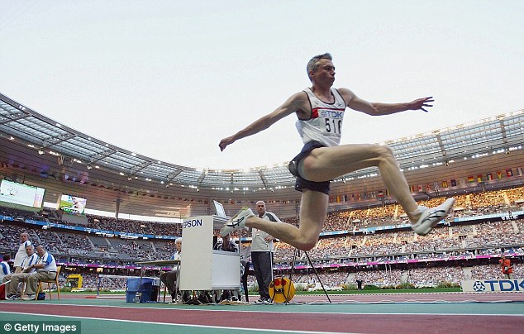
Lest we forget …

Slide 13
Triple Jump, Olympic Games, London 1948
 | Name | Country | Result
Gold | Arne Åhman | Sweden | 15.40 m
Silver | George Avery | Australia | 15.37 m
Bronze | Ruhi Sarialp | Turkey | 15.03 m
4. | Preben Larsen | Denmark | 14.83 m
5. | Geraldo de Oliveira | Brazil | 14.83 m
6. | Valle Rautio | Finland | 14.70 m
(Norwegian Record 1939-62: Kaare Strøm 15.49 m, set in Oslo 20.8.1939)

Slide 14
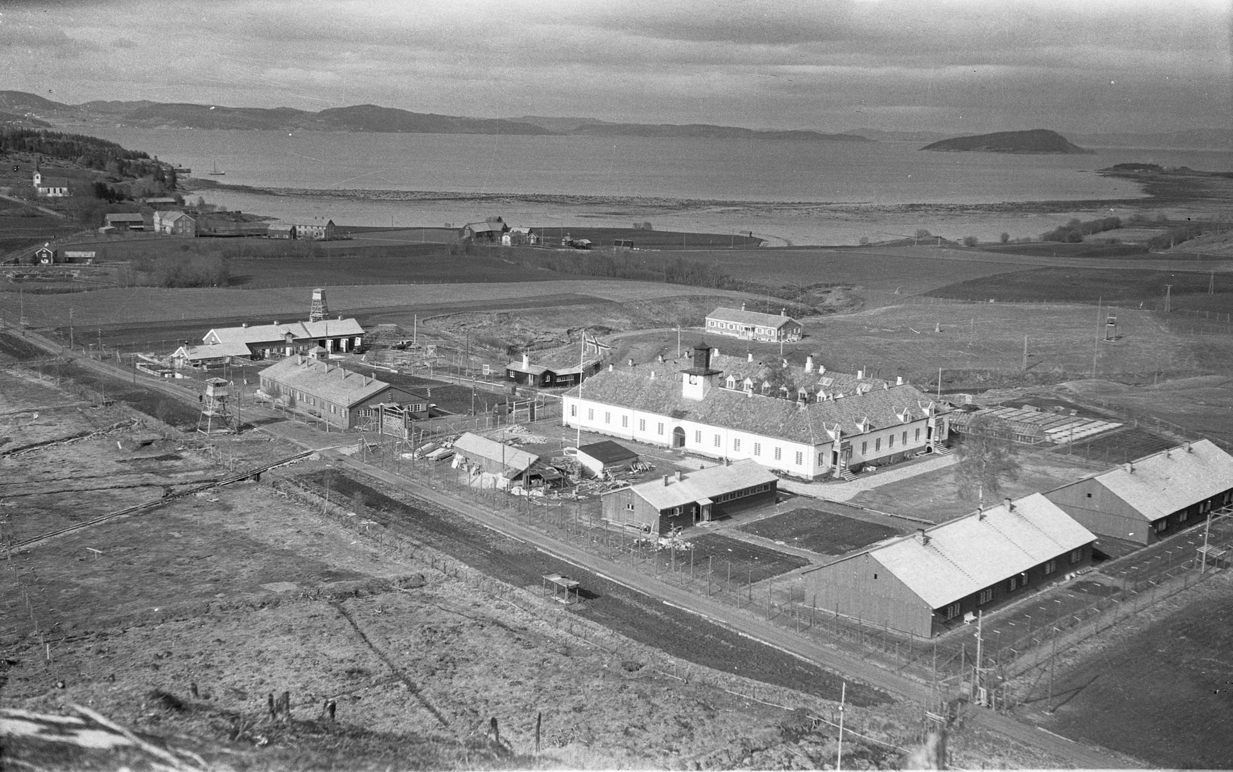
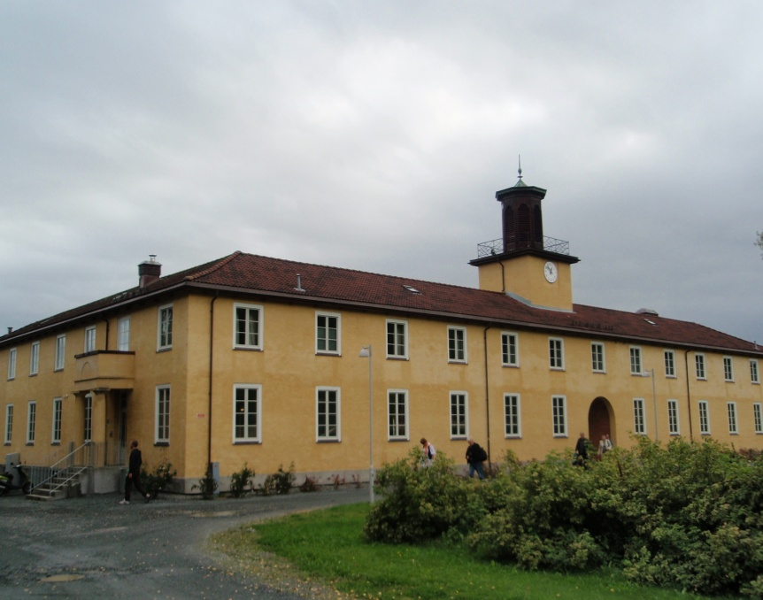
Falstad Concentration Camp
Founded 1895 in Levanger, North Central Norway, as a boarding school for “wayward” boys
April 1940: Nazi Germany attacks/occupies Norway (until May 1945), installs Quisling government
1940: Health care and education nazified; employees must swear allegiance to Quisling government
Sep 1941: Falstad becomes concentration camp for political prisoners
At least 4200 prisoners from 13 nationalities pass through, many POWs and some Jews
More than 200 executions in the forest around the camp; bodies buried or dumped in the fjord
Transit camp for prisoners (esp. Jews) to be transported to Auschwitz and other Germany camps
1942-43: The most brutal time. Prisoners subjected to a haphazard and extremely violent regime of slave labor on pointless projects. (Falstad Center)
1944: Local chairs of Norwegian Medical Association, incl. my maternal grandfather, imprisoned for resistance to nazification

