Slide 1
POLI 120E Scandinavian Politics Prof. Kaare W. Strøm
From Conflict TO PEACE AND DEMOCRATIZATION:
Nordic Political History,
1523-1900

Slide 2
Domestic Political Transformations, 1500-1680
Protestant Reformation of 1530s
Rapid and complete in DK, slower in S
Decline of Assembly Tradition
Trend toward Absolute Monarchy
DK absolutism 1660
S absolutism 1680
Centralization of Power
1536: Norway and Iceland lose their independence, incorporated into Denmark
Administrative Reform
More efficient tax system
Appointed administrative officials (sheriffs)

Slide 3
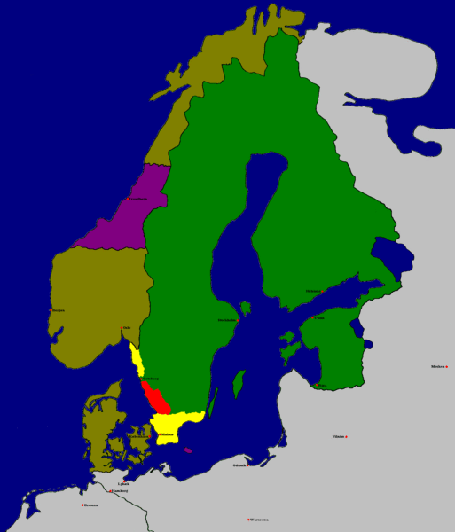
Sweden at its Territorial Peak: The Treaty of Roskilde, 1658
Repeated wars between Denmark and Sweden
Both countries pursue Great Power status in the 1600s
Denmark has the stronger navy; Sweden the stronger army
Sweden gradually emerges as the dominant power from 1620s
30-year War, 1618-48
30-year War and four additional wars lead to Danish defeats, loss of Skåne (Battle of Lund 1675)

Slide 4
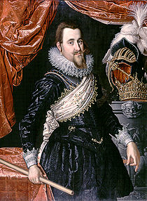
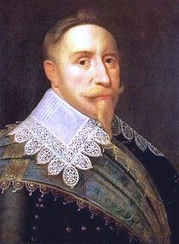
Rivalry and Prominence, 1520-1718
Two dominant and ambitious monarchs: Christian IV and Gustavus II Adolphus
Christian IV (1588-1648): Longest-serving Danish monarch; builder and warrior; founded and rebuilt various fortifications and cities, including Oslo (Christiania), travelled widely and launched colonial projects in North America and Sri Lanka; had at least 24 children (7 by his 1st wife, 12 by his 2nd, and at least 5 by various others)
Gustavus II Adolphus (1611-32): made Sweden a great power, one of the greatest military commanders in history, inherited a kingdom at war at the age of 16.
30-year War, 1618-48
Devastating, ruinous conflict, originally about rulers’ right to choose religious denomination (Catholics vs. Protestants)
1625: Intervention of Danish king Christian IV on the Protestant side proves disastrous, eventually bankrupts Denmark
1630: Gustavus II Adolphus intervenes and saves Protestant forces
1632: Gustavus II Adolphus killed in battle, war of attrition lingers on into stalemate
1648: Treaty of Westphalia ends war; Catholics gain territory at the expense of Protestants

Slide 5
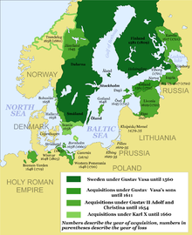
The Rise of Sweden, 1520-1718

Slide 6
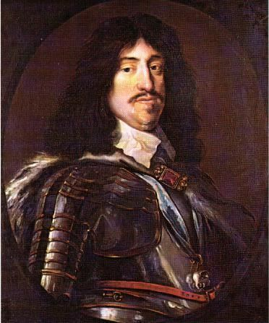
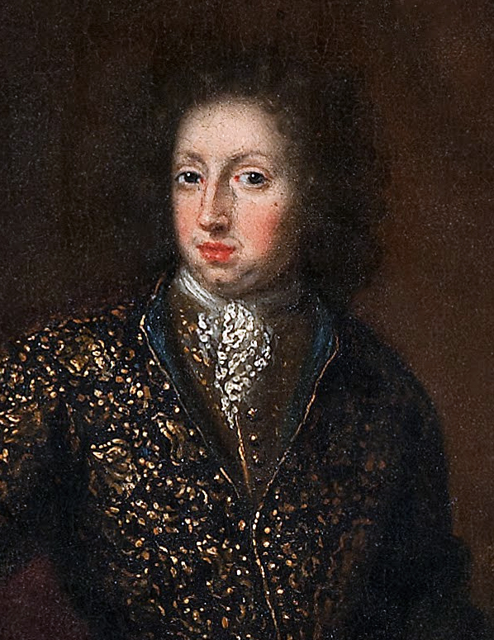
The Absolute Monarchy
Absolute Monarchy
From Elective to Hereditary Monarchy
Absolutism (after French model – Louis XIV)
Denmark, 1660-1849 under Frederik III
Sweden, 1680-1718 under Carl XI
Decline of Parliaments
Weaker constraints on kings
Royal charters lose their importance
Iceland, Norway: Parliaments cease to function
Sweden: Strong monarchs overreach (Carl XII 1697-1718)

Slide 7
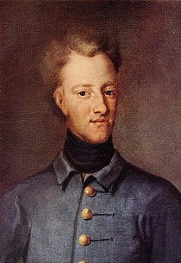
The Great Nordic War, 1700-1718
Continuous war between Denmark and Sweden, 1520-1718
Gradual emergence of Sweden as great power, with large Baltic possessions
30-year War brought conflict with Russia as well as Denmark
Carl XII – the (last Swedish) warrior king
1718: The Great Nordic War ends
Death of Carl XII
End of Swedish Great Power status
End of two centuries of constant conflict between Denmark and Sweden
Beginning of democratization in Sweden (“Age of Liberty” 1718-72)

Slide 8
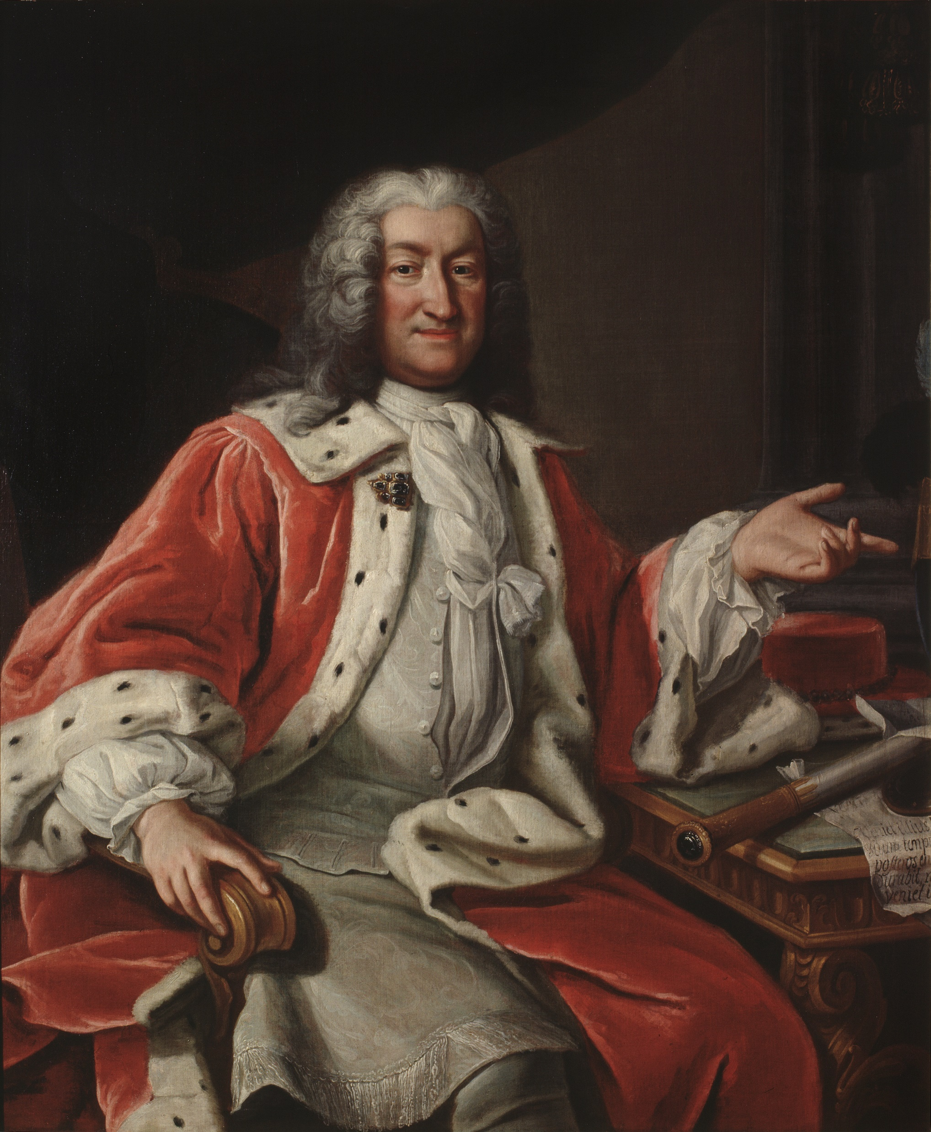
Nordic Political History 1718-1800: Diverging Paths: Sweden – The Age of Liberty
1718-72: The Age of Liberty
4-Chamber Parliament dominates the king
New constitution adopted 1719-23 favored nobility
Emergence of two-party politics: Hats (Nobility) vs. Caps (Farmers, Clergy)
Similar to Britain in gradual evolution of constitutional monarchy, parliamentary democracy
1772: Coup by King Gustav III, more autocratic constitution; king later assassinated (as portrayed in the opera “A Masked Ball” by Verdi)
Painting: Arvid Horn, Riksdag Speaker

Slide 9
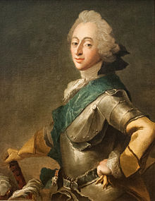
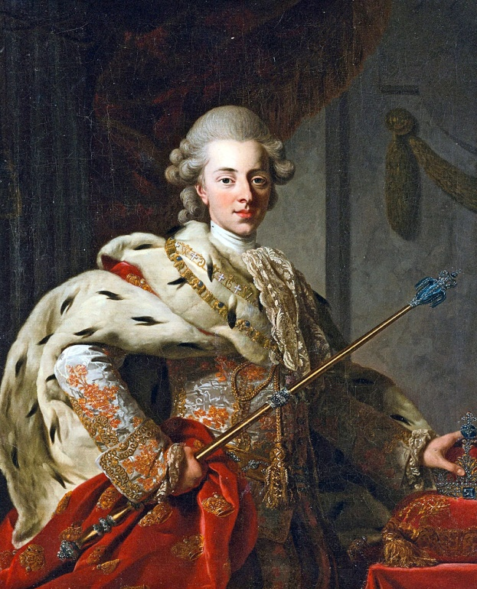
Diverging Paths 1718-1800: Denmark - Ineffective Autocrats
1660-1849: Absolute Monarchy
Danish Paradox: Strong monarchy, weak monarchs
Frederik V (1746-66): Unwilling to rule
Christian VII (1766-1808): Unable to rule
Late 1700s: Rule by royal advisors, bureaucrats
1784: Crown Prince Frederik assumes power through a coup
Napoleonic wars: Disastrous foreign policy mistakes by King Frederik VI
1800s: Monarchy increasingly criticized by liberalizers

Slide 10
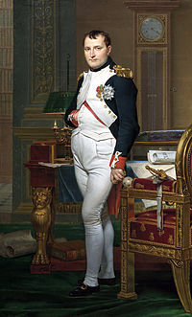
The Napoleonic Wars, 1792-1814: The Danish Tragedy
Denmark and Sweden try to protect their neutrality with important maritime interests
1800: “Free ports” alliance with Russia and Prussia
1801: British bombardment of Copenhagen (Admiral Nelson)
1807: Second British bombardment of Copenhagen; 160 ships seized; Denmark joins Napoleon’s side and leaves Sweden as Britain’s only ally in the north
1814: Napoleon’s defeat leads to Treaty of Kiel: Denmark cedes Norway (excl. ICE, GL, and the Faroe Islands) to Sweden

Slide 11
The Napoleonic Wars, 1792-1814: Changing Swedish Fortunes
1807: Sweden loses last possessions in Germany to France
1808: Russia attacks Sweden and captures Finland
1809: Mutiny against Swedish King Gustav IV Adolf, who abdicates, eventually leading to the emergence of King Carl XIV Johan (Bernadotte)
1809: In peace treaty Sweden cedes Finland to Russia, as Grand Duchy; adopts new liberal constitution; joins Napoleon’s enemies
1814: In Treaty of Kiel: Denmark cedes Norway (excl. ICE, GL, and the Faroe Islands) to Sweden
1814: Norway rebels, adopts liberal constitution, forced into dual monarchy with Sweden, but keeps constitution

Slide 12
The Legacies of the Napoleonic Wars
Political Downsizing
Denmark loser, Sweden wins some and loses some, but both Scandinavian powers reduced to small-power status
Democratization
1809 Swedish Constitution
1814 Norwegian Constitution
Until 1975 the oldest living constitutions in the world after the U.S.
Gradual rise of liberal forces in Denmark (Constitution in 1849)
Nationalism
Rise of nationalism in Norway, Finland, and later Iceland
End of Nordic Wars
No more wars between Nordic countries
No civil wars except Finland 1918
Strengthening of tradition of neutrality
Beginning of Scandinavianist movement

Slide 13
Main Themes of Nordic Modernization, 1814-1945
Scandinavianism (mainly 1829-64)
Nationalism in Finland, Norway, Iceland, 1800-1945
Democratization, 1814-1921
Industrialization, 1850-1950

Slide 14
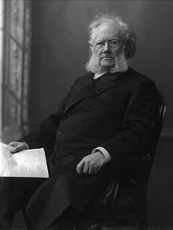
Peace and Scandinavianism
Scandinavianism, 1845-64
A solidarity movement among intellectuals
Influenced by romanticism
1829: Danish poet Adam Oehlenschläger crowned by Swedish Bishop Esaias Tegnér in Lund
Nationalism in Finland, Norway, Iceland
Dano-Prussian wars of 1848, 1864 disillusioned many supporters, including Norwegian playwright Henrik Ibsen
WWI: All countries adopt neutrality, supported by Malmö meeting of three kings
1945-: Nordic integration efforts, incl. Nordic Council (1952)

