Slide 1
POLI 120E Scandinavian Politics
Early History:
Vikings, Kings, and Queens

Slide 2
Early Scandinavian History: How Was the Region Distinctive?
Late Economic Development
Seafaring Traditions
Strong Farmer Societies
Early Statehood (1000 AD)
Early Nationhood
Late Middle Ages
Early Democratic Traditions
Viking Assemblies (Ting)
Late Christianization (1000 AD)

Slide 3
The Viking Period, 790-1066
Beginning: 793 Lindisfarne Raid
End: 1066 Battle of Hastings
Battle of Stamford Bridge
Christianization of Scandinavia
Savage raiders and pillagers, attacked monasteries and towns
Founded cities such as Dublin and York (Jørvik)
Reached North America (Vinland), North Africa, Constantinople (Myklagard), Jerusalem (Jorsal), Baghdad

Slide 4
What Drove/Attracted the Vikings?
Good maritime technology
Longboats were seaworthy and could also navigate shallow rivers, reach far inland
Shortage of food
Desire for slaves
Comparative richness of Western Europe
Weakness of Western Europe

Slide 5
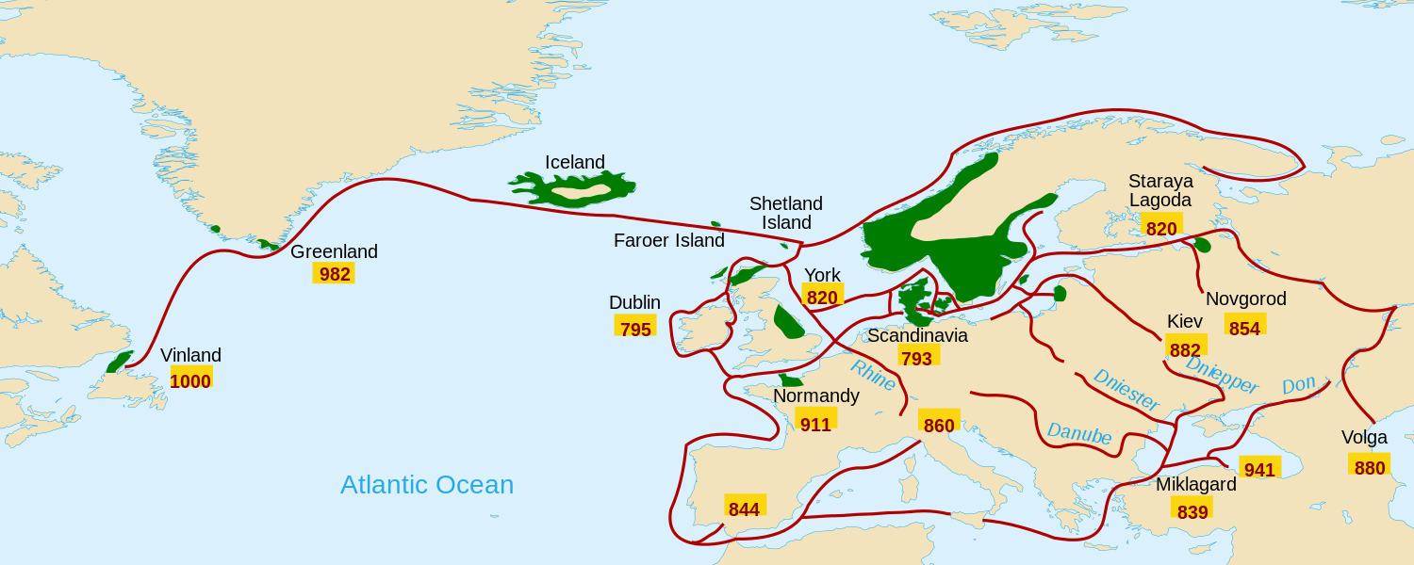
Viking Expansion, 790-1000 Source: By Pinpin - from Image:Vikings-Voyages.png and Image:Worldmap

Slide 6
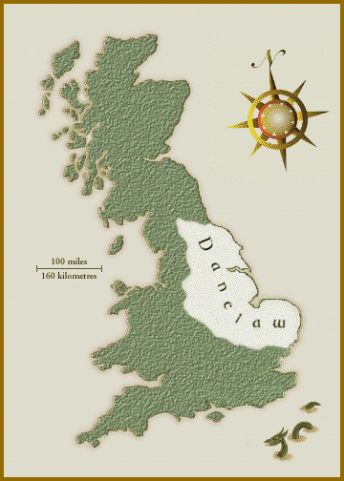
The Vikings in England, 880 AD

Slide 7
Scandinavia: Early Nation-States
872: Norway unified (Harald the Fairhaired)
874: Iceland settled by Norsemen
980: Harald Bluetooth unifies Denmark
1000: Sweden unified (Olof Skötkonung)
1150: Swedish settlement in Finland

Slide 8
Towards More Settled Societies: Christianization (Ca. 1000 AD)
Reduced violence, warfare
End of slavery (Christians should not enslave other Christians)
New (imported) crops and agricultural methods which improved yields
Literacy, education
Church becomes landowner, educational institution

Slide 9
Political Institutions of the Late Middle Ages
Ting (Assembly tradition)
Courts, Legislatures, and Town Hall meetings
Verbal and egalitarian tradition (all free men could participate)
National legal codes: NO King Magnus the Lawmender1274
Kingdoms
Formation of Nation-States
Elective monarchies
Charters

Slide 10
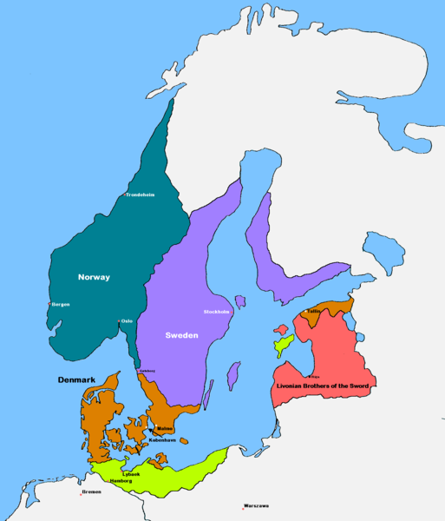
Scandinavia 1219

Slide 11
From Four to One: Nordic Integration, 1262-1397
1262: Iceland incorporated into Norway, Norway at its greatest territorial expanse
1349: Black Death
One of the worst pandemics in human history, originated in China
Killed 30-60% of European population
Killed approx. 50% of Swedish population; nobility weakened in all Nordic countries
Norwegian dynasty dies out 1370
1397: Kalmar Union
Queen Margrethe I of Denmark unifies the Nordic region

Slide 12
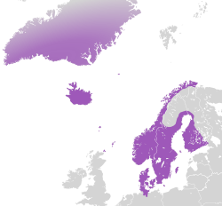
The Kalmar Union, 1397-1523

Slide 13
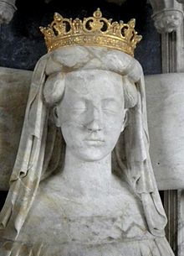
Margrethe I and the Kalmar Union: Precursor of Nordic Integration
Born 1353 as Princess of Denmark
Betrothed at age 6 to Norwegian prince Haakon, whom she later married
1375: Becomes regent of Denmark on behalf of her young son Olaf
1387: Becomes queen of Denmark and Norway when both Haakon and Olaf die
1397: Defeats Swedish king and forms the Kalmar Union of DK, N, and S (incl. also ICE and FIN)
1412: Margrethe dies; Kalmar Union experiences growing tension and resistance to Danish hegemony
1520: Stockholm Massacre: 82 Swedish noblemen killed by Danish King Christian II; Gustav I Vasa raises Swedish army to resist Danish rule
1523: End of Kalmar Union; Nordic area has never again been as unified

Slide 14
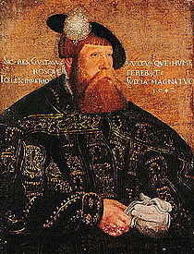
Gustav(us) I Vasa and Swedish Independence
1520: Stockholm Massacre, 82 Swedish nobles murdered on orders of Christian II
Gustav Vasa leads Swedish revolt against Danish rule
1523: Gustav Vasa crowned king of Sweden
Challenged Denmark and Hansa League
Strengthened the state, central control
Transformed Swedish nobility so as to serve the state
Protestant reformation
Careful to maintain peace with Denmark
Growing conflict with Denmark over former German territories in Baltic region following Gustav’s death in 1560

