Slide 1
POLI 120E Scandinavian Politics Prof. Kaare W. Strøm Summer Session II, 2020
WHAT IS SCANDINAVIA?

Slide 2
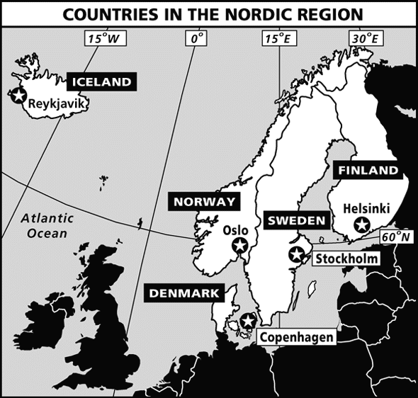
The Nordic Region

Slide 3
Scandinavia and the Nordic Region
Scandinavia refers to Scanian peninsula
Southern tip: Skåne
Scandinavian Countries
Denmark (DK)
Norway (N)
Sweden (S)
Nordic Countries
Finland (FIN)
Iceland (ICE)
Non-sovereign Territories (All islands)
Greenland (DK)
Faroe Islands (DK)
Åland (FIN)

Slide 4
The Nordic Countries
Country | Population (2020) | Similar to | Territory (Thousands of sq mls) | Similar to
Denmark | 5.8 M | Wisconsin | 16.6 | San Bernardino County (-)
Finland | 5.5 M | Colorado | 131 | Arizona
Iceland | 0.36 M | Anaheim | 40 | Tennessee
Norway | 5.4 M | Minnesota | 125 | Arizona
Sweden | 10.2 M | Los Angeles County | 174 | California (+)
Nordic Region | 27.3 M | Texas | 555 | Alaska (-)

Slide 5
Nordic Superlatives
Sweden: Most democratic country in the world (The Economist)
Denmark: Lowest income inequality in the world
Denmark: Happiest country in the world
Finland: Least corrupt country in the world (Transparency Int’l)
Finland: 2nd most stable country in the world
Norway: Most peaceful country in the world
Norway: Largest capital reserve fund in the world
Several Nordic countries: Highest Human Development Index in the World (U.N.)

Slide 6
But Also Some Reservations
Michael Booth: A skeptical, though sympathetic and humorous, look
Aksel Sandemose: The Jante Law – land of social envy, conformity, and repression
Roland Huntford (on Sweden): “The New Totalitarians”

Slide 7
Geography
Corner of Europe, bordering Atlantic, Russia, Arctic, German lowlands
Large territory
Small Population
Small Arable territory: S 5%, N 3%
Lots of water, forest; long coastlines
Only wilderness areas in Western Europe
Climate ranging from moderate to arctic

Slide 8
Is Geography Destiny? Consequences for Scandinavia
Scattered and small local communities
Difficult to impose central control, feudalism
Difficult to live by agriculture alone; supplemented by fisheries, hunting
Harsh climate meant a need for personal independence and interdependence
Travel mostly by sea
No enemy countries to the north and west
Long distance from centers of European culture
Similarities with British Isles, but much lower population density outside DK

Slide 9
Nordic Historical Peculiarities
Never under foreign rule
Never colonial powers of any significance
Never strongly feudal (exc. DK and southern Sweden)
Early nationhood
Historical independence and continuity

Slide 10
Foreign Rule and Colonialism
Nordic great power age 1500-1718
Limited threats from Great Powers
Russia (Finland 1809-1917)
Germany (DK 1848, 1864, WW II)
But Sweden, Iceland, and Norway have faced relatively few threats and occupations
Nordic countries had colonial possessions but lost them early on
Denmark outlawed the slave trade in 1792, first of all European countries
In sum, Scandinavia has been a remote and largely independent corner of Europe

Slide 11
Scandinavianism vs. Nationalism
Several efforts to unite Nordic countries historically
Kalmar Union 1397-1521
Scandinavianism as an intellectual movement, 19th century
Attempts to build Nordic Union after 1945
Nationalism
Swedish rejection of Kalmar Union 1521
Norwegian constitution 1814, independence 1905
Finnish independence 1917
Icelandic independence 1944
Greenland self-rule movement
Nationalism dominant force after Napoleonic Wars (1814-)

Slide 12
Features of Early Scandinavian History: How Was the Region Politically Distinctive?
Late Economic Development
Seafaring Traditions
Strong Farmer Societies
Early Statehood (1000 AD)
Early Nationhood
Late Middle Ages
Early Democratic Traditions
Viking Assemblies (Ting)
Late Christianization (1000 AD)

